Slide 1
Limiting Power Consumption on Home Appliances using Machine Learning
Sudhanva Narayana
Machine Learning Intern
Faststream Technologies
Vinay Bansal
Chief Executive Officer
Faststream Technologies
Vinod Agrawal
Chief Technology Officer
Faststream Technologies

Slide 2
Objective
Strategies to limit power consumption when there is a limited supply
The following is carried out with the help of Machine Learning
Notifies the user of excess power consumption and suggest measures to save power

Slide 3
Background
Power (electricity) optimization will be a crucial task in the coming years as there will be a limited supply
Factors like weather, time of the day and type of the device are considered
Devices are given priority (importance) before making the final decision

Slide 4
Methodologies
As there is no real data, we are using a random number generator and time series generator to generate a dataset
The dataset we generated consists of multiple attributes such as device, room, weather type, date, from time, to time, time of day, a number of people and time stayed
Column power is also generated along with it in terms of kilo watt hour.

Slide 5


Sample Dataset
Notes:
OpenCV: Open Source Computer Vision Library

Slide 6
Prediction
The model is trained on this dataset and is saved
Multiple Linear Regression, Random Forest Regression and Decision Tree Regression are used
A new dataset (unseen) is loaded, the saved model is used to predict the power consumption values

Slide 7
Implementation
A custom algorithm is used to give out a message and action to be performed
The message and action are given based on the priorities given
A new dataset is created with messages, actions and power saved

Slide 8
Sample Message and Action
“Moving 10 people from room 119 to room 105 saves 1188.0 of electricity, power consumption will reduce from 10507.0 to 9319.0”
“Turn off AC in room 119”

Slide 9
Results
We take the mean power consumption per day for that hour versus the mean power consumption that was previously specified and then plot the outcomes
We do this for all the three machine learning algorithms

Slide 10
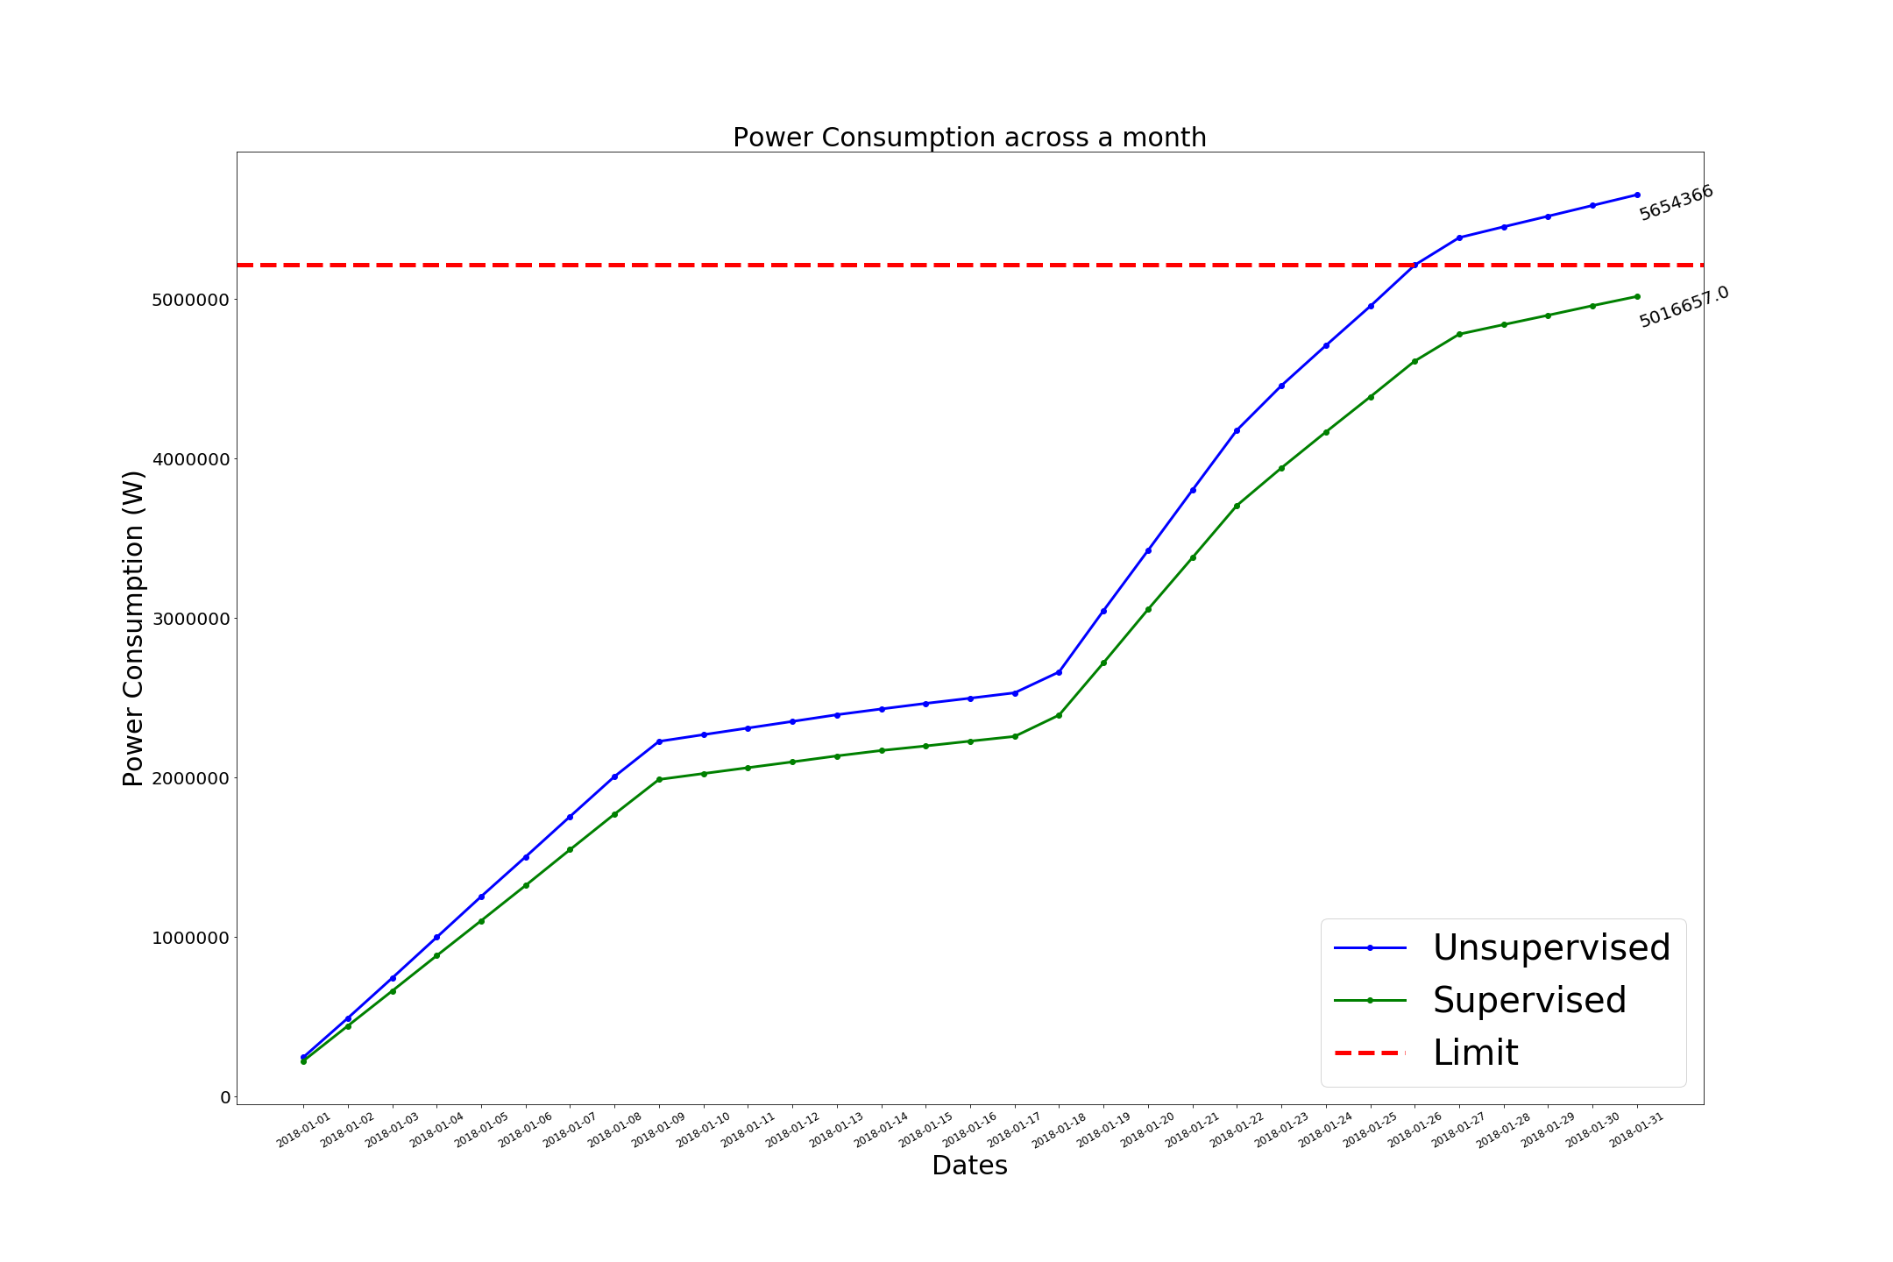
Results – Multiple Linear Regression

Slide 11

Results – Decision Tree Regression

Slide 12

Results – Random Forest Regression

Slide 13
Conclusion
The machine learning algorithms showed similar results and are proved to be useful
Power consumption can be limited in a given month
This method can be applied or experimented with real-world data as the simulated data is close to being real

Slide 14
Thank you

