Slide 1
FEEDYBACK
Guide Name: Dr. Veena S Vijaykumar R Pai – PES1201702013
Chairperson, Dept. of CA Ayush Pratyay – PES1201702164
PES University Subham Singh – PES1201801830

Slide 2
ABSTRACT
A Software as a service (SaaS) web application that is to provide a paid service to the end user, which will enable them to send bulk emails for collecting feedback of their own product. Our service will be provided on usage of assigned credit points to user. With the use of Google OAuth authentication, we will enhance the authentication flow in the app.

Slide 3
INTRODUCTION
The objective of the project is to build an application that can be used to send mass emails to a big list of users for the purpose of collecting feedback.
The application of ours will include the full gamut of features including everything from authentication to email handling.
Along with the ability to send bulk emails, our app will also be able to handle credit cards and receive payments from the users with Stripe. It can also engage the users with automated emails.
We will also be enhancing the authentication flows in our app with the use of Google Oauth authentication.

Slide 4
LITERATURE SURVEY
Product companies assign the task of collecting feedback to the surveyors.
If the surveyors try to send individual emails to collect feedback, it would be a tiresome job for them.
Therefore, with this system we are trying to send emails to collect feedback from the customers who had purchased products from their company much more efficiently and getting abstract of performance of the product in the market.

Slide 5
TOOLS AND TECHNOLOGIES
Frontend
React.js v16.x
Backend
Node.js 11.8.0
Database (NoSQL)
MongoDB v4.0.1
Cloud Deployment
Heroku Deployment
MongoDB Atlas - Storage

Slide 6
FUNCTIONAL REQUIREMENTS
CR Manager Signs Up via Google OAuth.
CR Manager Pays for email credits via Stripe.
CR Manager creates a new campaigns.
CR Manager enters list of emails to collect feedback.
Application send emails to list of customer.
Customers click on the link provided in the email to send feedback.
Application will tabulate feedback received.
CR Manager can see list of all feedback responses.
Logout

Slide 7
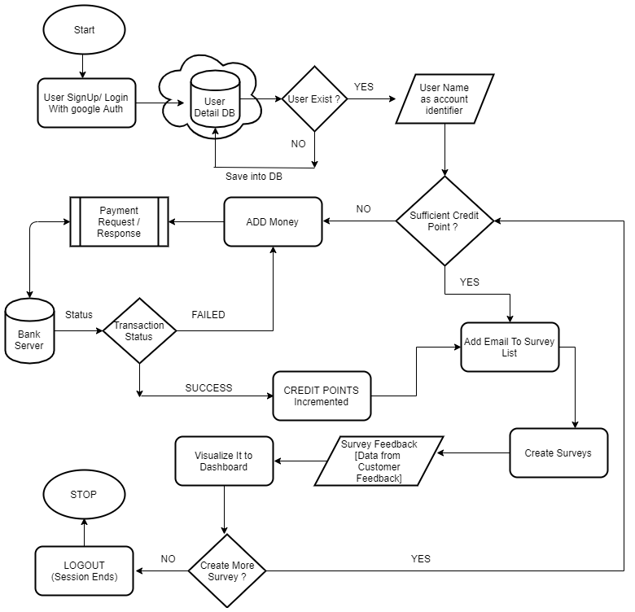
FLOW Diagram Of System

Slide 8
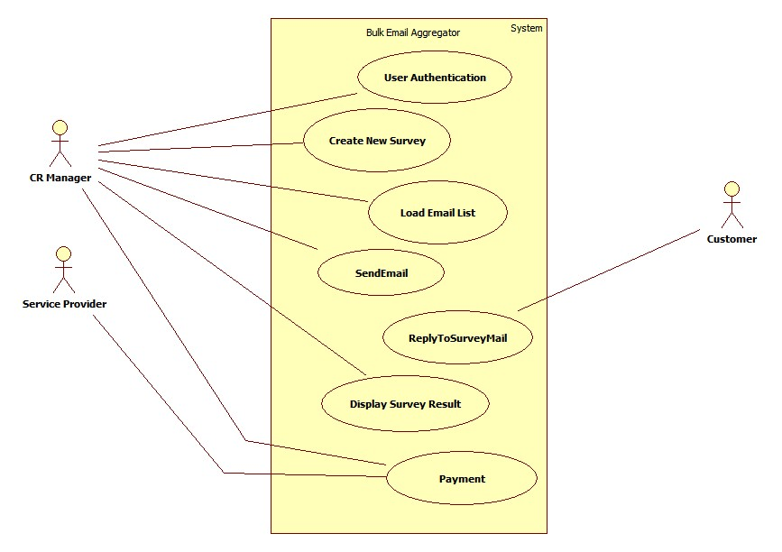
Use Case Diagram

Slide 9
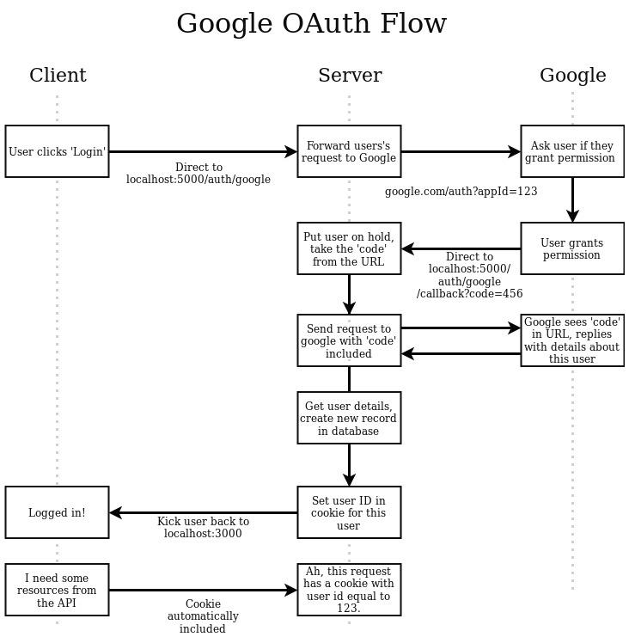
Google Oauth Flow Diagram

Slide 10
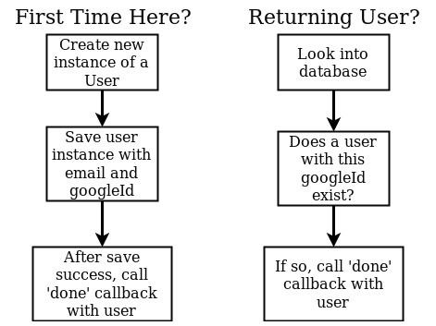
USER LOGIN PROCESS

Slide 11
NON – FUNCTIONAL REQUIREMENTS
Availability
Maintainability
Performance
Simplicity

Slide 12
HERE the live deployment of Web App
https://sheltered-reef-50053.herokuapp.com

Slide 13
USERS
Customer Relationship managers
Customers who buys products from different companies.

Slide 14
MODULES
Google Authentication
Credit Points
Payment Request/ Response
Creating Survey and Sending
Survey Collection
Visualization of Survey

Slide 15
THANK YOU

