Slide 1
Unit-5
Data Link layer

Slide 2
Link layer, LANs: outline
1 Introduction, services
2 Error detection, correction
3 LANs
  addressing, ARP
  Ethernet
  switches

Slide 3
Data-link Layer Introduction
Data link layer is responsible for converting data stream to signals bit by bit and to send that over the underlying hardware.
At the receiving end, Data link layer picks up data from hardware which are in the form of electrical signals, assembles them in a recognizable frame format, and hands over to upper layer.

Slide 4
Data link layer has two sub-layers:
Logical Link Control: It deals with protocols, flow-control, and error control
Media Access Control: It deals with actual control of media

Slide 5
Functionality of Data-link Layer
Framing
Data-link layer takes packets from Network Layer and encapsulates them into Frames. Then, it sends each frame bit-by-bit on the hardware. At receiver end, data link layer picks up signals from hardware and assembles them into frames.
Addressing
Data-link layer provides layer-2 hardware addressing mechanism. Hardware address is assumed to be unique on the link. It is encoded into hardware at the time of manufacturing.

Slide 6
Synchronization
When data frames are sent on the link, both machines must be synchronized in order to transfer to take place.
Error Control
Sometimes signals may have encountered problem in transition and the bits are flipped. These errors are detected and attempted to recover actual data bits. It also provides error reporting mechanism to the sender.
Flow Control
Stations on same link may have different speed or capacity. Data-link layer ensures flow control that enables both machine to exchange data on same speed.

Slide 7
Multi-Access
When host on the shared link tries to transfer the data, it has a high probability of collision. Data-link layer provides mechanism such as CSMA/CD to equip capability of accessing a shared media among multiple Systems.
Carrier Sense Multiple Access/Collision Detect (CSMA/CD) is the protocol for carrier transmission access in Ethernet networks. On Ethernet, any device can try to send a frame at any time. Each device senses whether the line is idle and therefore available to be used.

Slide 8
Error Detection & Correction
There are many reasons such as noise, cross-talk etc., which may help data to get corrupted during transmission.
Data-link layer uses some error control mechanism to ensure that frames (data bit streams) are transmitted with certain level of accuracy.

Slide 9

Types of Errors
1. Single bit error
In a frame, there is only one bit, anywhere though, which is corrupt.

Slide 10

2. Multiple bits error
Frame is received with more than one bits in corrupted state.

Slide 11

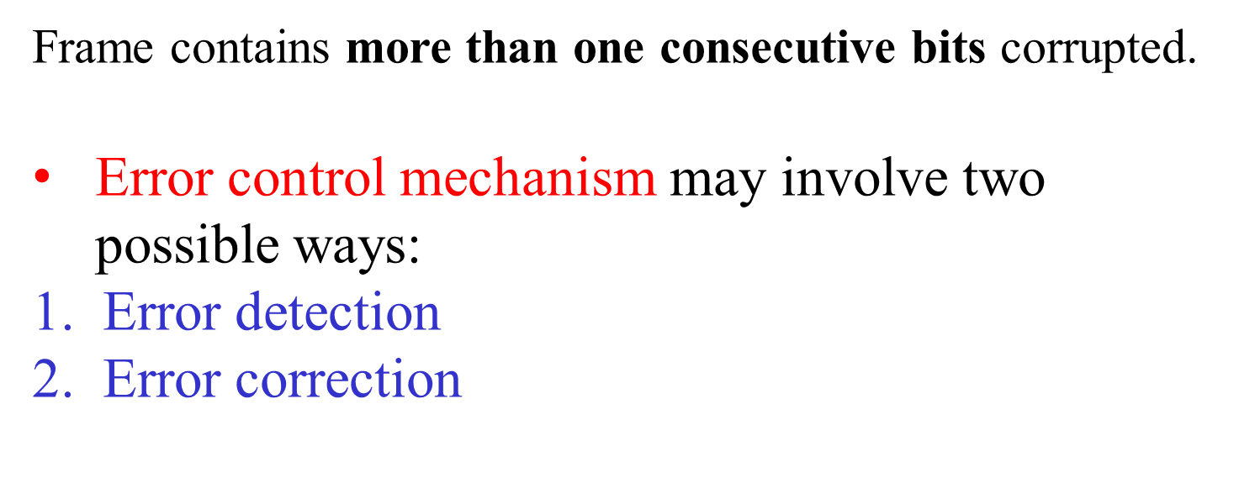
3. Burst error

Slide 12
Error Detection
Errors in the received frames are detected by
  Parity Check
  Cyclic Redundancy Check (CRC).
In both cases, few extra bits are sent along with actual data to confirm that bits received at other end are same as they were sent.
If the counter-check at receiver end fails, the bits are considered corrupted.

Slide 13
Parity Check
One extra bit is sent along with the original bits to make number of 1s either even in case of even parity, or odd in case of odd parity.
The sender while creating a frame counts the number of 1s in it.
For example, if even parity is used and number of 1s is even then one bit with value 0 is added. This way number of 1s remains even.
If the number of 1s is odd, to make it even a bit with value 1 is added.

Slide 14

The receiver simply counts the number of 1s in a frame. If the count of 1s is even and even parity is used, the frame is considered to be not-corrupted and is accepted. If the count of 1s is odd and odd parity is used, the frame is still not corrupted.
If a single bit flips in transit, the receiver can detect it by counting the number of 1s. But when more than one bits are erroneous, then it is very hard for the receiver to detect the error.

Slide 15
Cyclic Redundancy Check (CRC)
This technique involves binary division of the data bits being sent.
The divisor is generated using polynomials.
The sender performs a division operation on the bits being sent and calculates the remainder. Before sending the actual bits, the sender adds the remainder at the end of the actual bits.
Actual data bits plus the remainder is called a codeword. The sender transmits data bits as codewords.

Slide 16
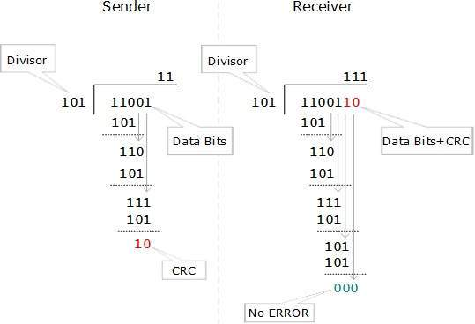
Cyclic Redundancy Check (CRC)

Slide 17
Cyclic Redundancy Check (CRC)
At the other end, the receiver performs division operation on codewords using the same CRC divisor.
If the remainder contains all zeros the data bits are accepted, otherwise it is considered as there some data corruption occurred in transit.

Slide 18
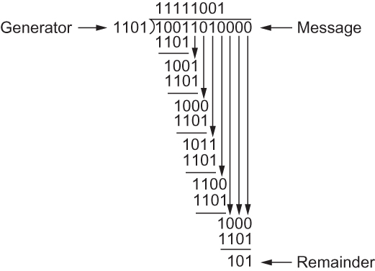
Cyclic Redundancy Check (CRC)
CRC Calculation using Polynomial Long Division

Slide 19

Error detection
EDC= Error Detection and Correction bits (redundancy)
Data protected by error checking, may include header fields
Error detection not 100% reliable!
  protocol may miss some errors, but rarely
  larger EDC field yields better detection and correction
otherwise

Slide 20
MAC address
A MAC address is given to a network adapter when it is manufactured. It is hardwired or hard-coded onto computer's network interface card (NIC) and is unique to it.
ARP (Address Resolution Protocol) translates an IP address into a MAC address.
The ARP is like a passport that takes data from an IP address through an actual piece of computer hardware.
Hardware and software working together, IP addresses and MAC addresses working together.

Slide 21
MAC address
The MAC address is sometimes referred to as a networking hardware address or the physical address.
Example of a MAC address for an Ethernet NIC: 00:0a:95:9d:68:16.
The MAC address is a string of usually six sets of two-digits or characters, separated by colons.
All devices on the same network subnet have different MAC addresses. MAC addresses are very useful in diagnosing network issues, such as problems with IP addresses.

Slide 22
MAC addresses and ARP
32-bit IP address:
  network-layer address for interface
  used for layer 3 (network layer) forwarding
MAC (or LAN or physical or Ethernet) address:
  function: used ‘locally” to get frame from one interface to another physically-connected interface (same network, in IP-addressing sense)
  48 bit MAC address (for most LANs) burned in NIC ROM, also sometimes software settable
  e.g.: 1A-2F-BB-76-09-AD (6 bytes, 12 Hexa numbers)

Slide 23

LAN addresses and ARP
each adapter on LAN has unique LAN address
1A-2F-BB-76-09-AD
LAN
(wired or
wireless)
adapter
71-65-F7-2B-08-53
58-23-D7-FA-20-B0
0C-C4-11-6F-E3-98

Slide 24
LAN addresses (more)
MAC address allocation administered by IEEE
manufacturer buys portion of MAC address space (to assure uniqueness)
analogy:
  MAC address: like Social Security Number
  IP address: like postal address

Slide 25


ARP: address resolution protocol
Question: how to determine
interface’s MAC address, knowing its IP address?
ARP table: each IP node (host, router) on LAN has table
  IP/MAC address mappings for some LAN nodes:
< IP address; MAC address; TTL>
  TTL (Time To Live): time after which address mapping will be forgotten (typically 20 min)
137.196.7.78
1A-2F-BB-76-09-AD
137.196.7.23
137.196.7.14
LAN
71-65-F7-2B-08-53
58-23-D7-FA-20-B0
0C-C4-11-6F-E3-98
137.196.7.88

Slide 26
ARP protocol: same LAN
A caches (saves) IP-to-MAC address pair in its ARP table until information becomes old (times out)
  soft state: information that times out (goes away) unless refreshed
ARP is called a “plug-and-play” protocol:
  nodes create their ARP tables without intervention from net administrator
A wants to send datagram to B
  B’s MAC address not in A’s ARP table.
A broadcasts ARP query packet, containing B's IP address
  Dest MAC address = FF-FF-FF-FF-FF-FF
  all nodes on LAN receive ARP query
B receives ARP packet, replies to A with its (B's) MAC address
  frame sent to A’s MAC address (unicast)

Slide 27

Figure ARP operation

Slide 28

Figure ARP packet

Slide 29
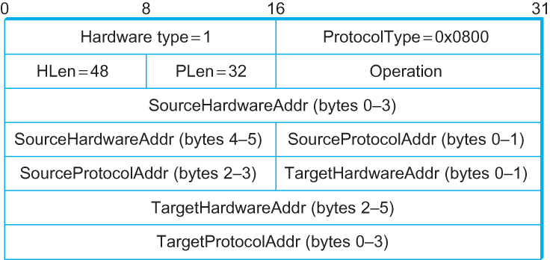
ARP Packet Format
  HardwareType: type of physical network (e.g., Ethernet)
  ProtocolType: type of higher layer protocol (e.g., IP)
  HLEN & PLEN: length of physical and protocol addresses
  Operation: request or response
  Source/Target Physical/Protocol addresses
Notes:
IFSC3315 – Applied Networking
Chapter 3 - Internetworking
Another feature is that since the original broadcast ARP request was received by all hosts they can look in their tables to see if they already have an entry for the requester’s address. If the entry is present it indicates the probable need to talk to that host again so this new ARP information will be used to update the table. To avoid the possibility that the table is stale ( for example a host is turned off) the table will age out entries after a configurable time interval, such as 10 minutes. Another possibility, rare but certainly possible, is that a NIC is replaced in one of the hosts. In this instance the IP could be the same but the MAC would be different. If the old table entry was used the packet would be sent to a MAC that was no longer active and would be ignored by everyone. The 10 minute interval is a compromise between reducing the broadcast traffic on the network and being confused by a stale ARP table. In the normal IP implementation, a bad ARP table would cause a higher layer protocol to fail. One of the steps taken, by the networking application in the operating system, after requests for re-transmission of lost packets is to resend the ARP for that address to see if that is the problem. Lost packets plus no response to ARP mean a lost connection for reasons ‘no response from host’ this is different to ‘host unreachable’ which indicates that no route to the host can be found.
Spring 2012

Slide 30
Example 1
A host with IP address 130.23.43.20 and physical address B2:34:55:10:22:10 has a packet to send to another host with IP address 130.23.43.25 and physical address A4:6E:F4:59:83:AB. The two hosts are on the same Ethernet network. Show the ARP request and reply packets encapsulated in Ethernet frames.
Solution
Figure 1 shows the ARP request and reply packets. Note that the ARP data field in this case is 28 bytes, and that the individual addresses do not fit in the 4-byte boundary. That is why we do not show the regular 4-byte boundaries for these addresses.
21.<number>

Slide 31

Figure 1, an ARP request and reply

Slide 32
Address Translation Protocol (ARP)
Map IP addresses into physical addresses
  destination host
  next hop router
Techniques
  encode physical address in host part of IP address
  table-based
ARP (Address Resolution Protocol)
  table of IP to physical address bindings
  broadcast request if IP address not in table
  target machine responds with its physical address
  table entries are discarded if not refreshed
Notes:
IFSC3315 – Applied Networking
Chapter 3 - Internetworking
The Address Resolution Protocol provides the interface between the Network Layer (3)address and the Data Link Layer (2) address. Your PC with its NIC card has the same Data Link Layer (MAC) address no matter where you plug it in. The IP (Layer 3 – network) address depends on what network your PC is plugged in to. A server on your subnet knowing your IP address has to know your MAC address to form the Layer 2 packet it will send on the Ethernet. ARP facilitates the assembly of the table in each host. When the IP layer wants to send a packet to another IP address, it looks in the table to see if it already knows the hardware address, if it does it can proceed to send the packet directly. If it does not it sends a broadcast packet(heard by all hosts on the local network segment) that effectively asks ‘if you have IP 1.2.3.4 tell me your MAC address. The ARP request has the broadcast IP destination, the sender’s IP source address, the Ethernet broadcast address ‘FF FF FF FF FF FF’ as the packet destination and the sender’s MAC as the packet source. The type field indicates ARP. This field is 0806_{hex} in Ethernet. Since every NIC will have to act on a broadcast packet all NIC’s will receive the packet and, hopefully, one host will have the matching IP requested. That host will format the response and, since it has the requester’s MAC address from the request packet it can unicast it directly back. Also, since it has the requester’s IP address it can put an entry in it’s ARP table that will avoid the target host from having to ARP to send back to the requester.
Spring 2012

Slide 33
Addressing: routing to another LAN
walkthrough: send datagram from A to B via R
  focus on addressing – at IP (datagram) and MAC layer (frame)
  assume A knows B’s IP address
  assume A knows IP address of first hop router, R (how?)
  assume A knows R’s MAC address (how?)
A
B
R
111.111.111.111
222.222.222.222
74-29-9C-E8-FF-55
49-BD-D2-C7-56-2A
222.222.222.220
1A-23-F9-CD-06-9B
111.111.111.112
111.111.111.110
222.222.222.221
CC-49-DE-D0-AB-7D
E6-E9-00-17-BB-4B
88-B2-2F-54-1A-0F
Link Layer
5-<number>

Slide 34
Addressing: routing to another LAN
A creates IP datagram with IP source A, destination B
A creates link-layer frame with R's MAC address as dest, frame contains A-to-B IP datagram
MAC src: 74-29-9C-E8-FF-55
MAC dest: E6-E9-00-17-BB-4B
IP
Eth
Phy
IP src: 111.111.111.111
IP dest: 222.222.222.222
A
B
R
111.111.111.111
222.222.222.222
74-29-9C-E8-FF-55
49-BD-D2-C7-56-2A
222.222.222.220
1A-23-F9-CD-06-9B
111.111.111.112
111.111.111.110
222.222.222.221
CC-49-DE-D0-AB-7D
E6-E9-00-17-BB-4B
88-B2-2F-54-1A-0F
Link Layer
5-<number>

Slide 35
Addressing: routing to another LAN
frame sent from A to R
frame received at R, datagram removed, passed up to IP
MAC src: 74-29-9C-E8-FF-55
MAC dest: E6-E9-00-17-BB-4B
IP src: 111.111.111.111
IP dest: 222.222.222.222
IP
Eth
Phy
IP src: 111.111.111.111
IP dest: 222.222.222.222
IP
Eth
Phy
A
B
R
111.111.111.111
222.222.222.222
74-29-9C-E8-FF-55
49-BD-D2-C7-56-2A
222.222.222.220
1A-23-F9-CD-06-9B
111.111.111.112
111.111.111.110
222.222.222.221
CC-49-DE-D0-AB-7D
E6-E9-00-17-BB-4B
88-B2-2F-54-1A-0F
Link Layer
5-<number>

Slide 36
Addressing: routing to another LAN
R forwards datagram with IP source A, destination B
R creates link-layer frame with B's MAC address as dest, frame contains A-to-B IP datagram
MAC src: 1A-23-F9-CD-06-9B
MAC dest: 49-BD-D2-C7-56-2A
IP
Eth
Phy
IP
Eth
Phy
IP src: 111.111.111.111
IP dest: 222.222.222.222
A
B
R
111.111.111.111
222.222.222.222
74-29-9C-E8-FF-55
49-BD-D2-C7-56-2A
222.222.222.220
1A-23-F9-CD-06-9B
111.111.111.112
111.111.111.110
222.222.222.221
CC-49-DE-D0-AB-7D
E6-E9-00-17-BB-4B
88-B2-2F-54-1A-0F
Link Layer
5-<number>

Slide 37
Addressing: routing to another LAN
R forwards datagram with IP source A, destination B
R creates link-layer frame with B's MAC address as dest, frame contains A-to-B IP datagram
MAC src: 1A-23-F9-CD-06-9B
MAC dest: 49-BD-D2-C7-56-2A
IP
Eth
Phy
IP
Eth
Phy
IP src: 111.111.111.111
IP dest: 222.222.222.222
A
B
R
111.111.111.111
222.222.222.222
74-29-9C-E8-FF-55
49-BD-D2-C7-56-2A
222.222.222.220
1A-23-F9-CD-06-9B
111.111.111.112
111.111.111.110
222.222.222.221
CC-49-DE-D0-AB-7D
E6-E9-00-17-BB-4B
88-B2-2F-54-1A-0F
Link Layer
5-<number>

Slide 38
Addressing: routing to another LAN
R forwards datagram with IP source A, destination B
R creates link-layer frame with B's MAC address as dest, frame contains A-to-B IP datagram
MAC src: 1A-23-F9-CD-06-9B
MAC dest: 49-BD-D2-C7-56-2A
IP src: 111.111.111.111
IP dest: 222.222.222.222
IP
Eth
Phy
A
B
R
111.111.111.111
222.222.222.222
74-29-9C-E8-FF-55
49-BD-D2-C7-56-2A
222.222.222.220
1A-23-F9-CD-06-9B
111.111.111.112
111.111.111.110
222.222.222.221
CC-49-DE-D0-AB-7D
E6-E9-00-17-BB-4B
88-B2-2F-54-1A-0F
Link Layer
5-<number>

Slide 39
POINT TO POINT PROTOCOL (PPP)
one of the most common protocols for point-to-point access is the Point-to-Point Protocol (PPP).
Today, millions of Internet users who need to connect their home computers to the server of an Internet service provider use PPP.
The majority of these users have a traditional modem; they are connected to the Internet through a telephone line, which provides the services of the physical layer.

Slide 40
PPP Services:
1. PPP defines the format of the frame to be exchanged between devices.
2. PPP defines how two devices can negotiate the establishment of the link and the exchange of data.
3. PPP defines how network layer data are encapsulated in the data link frame.
4. PPP defines how two devices can authenticate each other.
5. PPP provides multiple network layer services supporting a variety of network layer protocols.
6. PPP provides connections over multiple links.

Slide 41
Services not provided by PPP
PPP does not provide flow control. A sender can send several frames one after another with no concern about overwhelming the receiver.
PPP has a very simple mechanism for error control. A CRC field is used to detect errors. If the frame is corrupted, it is silently discarded; the upper-layer protocol needs to take care of the problem. Lack of error control and sequence numbering may cause a packet to be received out of order.
PPP does not provide a sophisticated addressing mechanism to handle frames in a multipoint configuration.

Slide 42
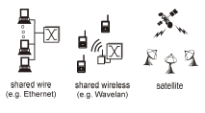
Multiple Access
Broadcast link used in LAN consists of multiple sending and receiving nodes connected to or use a single shared link
Broadcast links Examples

Slide 43

Figure Data link layer divided into two functionality-oriented sublayers
Responsible for error and flow control
Link Layer Control (LLC)
Control
MAC
Responsible framing and MAC address and Multiple Access Control

Slide 44
Multiple Access Control Protocols
Problem: When two or more nodes transmit at the same time, their frames will collide and the link bandwidth is wasted during collision
  How to coordinate the access of multiple sending/receiving nodes to the shared link???
Solution: We need a protocol to coordinate the transmission of the active nodes
These protocols are called Medium or Multiple Access Control (MAC) Protocols belong to a sublayer of the data link layer called MAC (Medium Access Control)
What is expected from Multiple Access Protocols:
  Main task is to minimize collisions in order to utilize the bandwidth by:
    Determining when a station can use the link (medium)
    what a station should do when the link is busy
    what the station should do when it is involved in collision

Slide 45

Figure Taxonomy of multiple-access protocols
Notes:
Random Access – Carrier Sense Multiple Access (CSMA)

Slide 46
Multiple access protocols
single shared broadcast channel
two or more simultaneous transmissions by nodes: interference
  collision if node receives two or more signals at the same time
multiple access protocol
distributed algorithm that determines how nodes share channel, i.e., determine when node can transmit

Slide 47
CSMA (carrier sense multiple access)
CSMA: listen before transmit:
if channel sensed idle: transmit entire frame
if channel sensed busy, defer transmission(random time)
human analogy: don’t interrupt others!
Listen before speaking – carrier sensing
If someone else is talking –backs off for random amount of time and then again sense the channel. (still collisions can occur)
If someone else begins talking at the same time, stop talking – collision detection

Slide 48


CSMA collisions
spatial layout of nodes
collisions can still occur: propagation delay means two nodes may not hear each other’s transmission
collision: entire packet transmission time wasted
  distance & propagation delay play role in determining collision probability

Slide 49
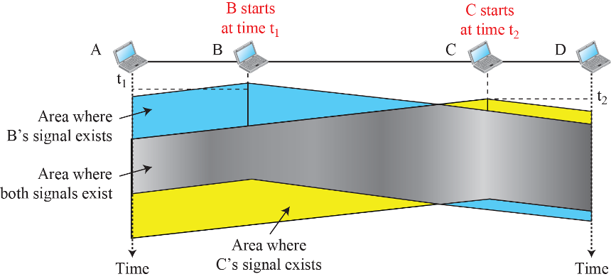
Figure 5.34: Space/time model of a collision in CSMA
(Part I: model)
Notes:
1.#

Slide 50
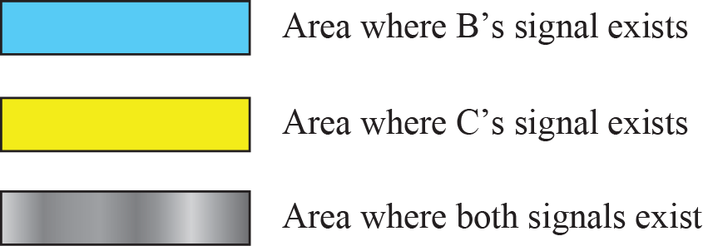
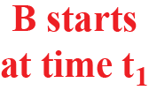
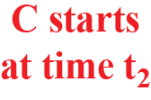


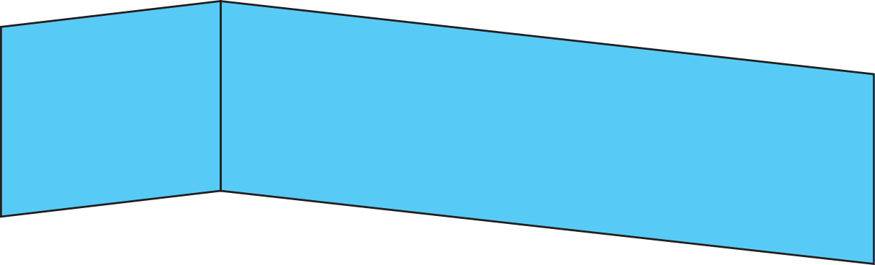

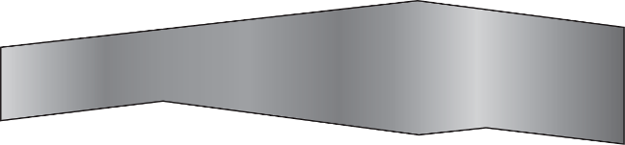
Figure 5.34: Space/time model of a collision in CSMA
Part II: timing)
Notes:
1.#

Slide 51
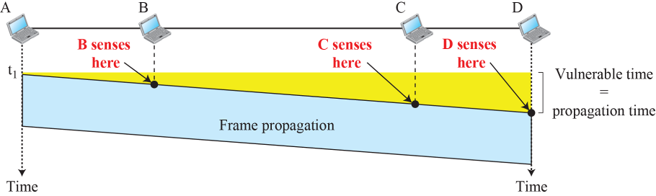
Figure 5.35: Vulnerable time in CSMA
Notes:
1.#

Slide 52
CSMA/CD (collision detection)
CSMA/CD: carrier sensing, deferral as in CSMA
  collisions detected within short time
  colliding transmissions aborted, reducing channel wastage
collision detection:
  easy in wired LANs: measure signal strengths, compare transmitted, received signals
  difficult in wireless LANs: received signal strength overwhelmed by local transmission strength
human analogy: the polite conversationalist

Slide 53

CSMA/CD (collision detection)
spatial layout of nodes

Slide 54
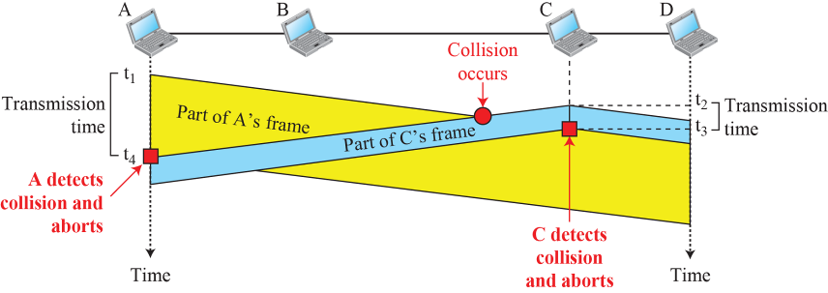
Figure 5.39: Collision and abortion in CSMA/CD
Notes:
1.#

Slide 55
CSMA/CA (Collision Avoidance)
CSMA/CA: carrier sensing, deferral as in CSMA
Carrier sense multiple access with collision avoidance (CSMA/CA) was invented for wireless networks.
Collisions are avoided through the use of CSMA/CA’s RTS and CTS Frames.
RTS – Request to send
CTS – Clear to send

Slide 56


Ethernet
“dominant” wired LAN technology:
cheap $20 for NIC
first widely used LAN technology
simpler, cheaper than token LANs and ATM
kept up with speed race: 10 Mbps – 10 Gbps
All nodes are in same Broadcast Domain
Metcalfe’s Ethernet sketch

Slide 57

Ethernet: physical topology
bus: popular through mid 90s
  all nodes in same collision domain (can collide with each other)
Star: late 90s hub based star topology
  all nodes in same collision domain (can collide with each other)
star: prevails today
  active switch in center
  each “spoke” runs a (separate) Ethernet protocol (nodes do not collide with each other)(Separate collision domain)
switch
star
bus: coaxial cable

Slide 58
Ethernet frame structure
sending adapter encapsulates IP datagram (or other network layer protocol packet) in Ethernet frame
preamble:
7 bytes with pattern 10101010 followed by one byte with pattern 10101011
used to synchronize receiver, sender clock rates
Data – 46 – 1500 bytes
type
preamble
dest.
address
source
address
data (payload)
CRC

Slide 59
Ethernet frame structure (more)
addresses: 6 byte source, destination MAC addresses
  if adapter receives frame with matching destination address, or with broadcast address (e.g. ARP packet), it passes data in frame to network layer protocol
  otherwise, adapter discards frame
type: indicates higher layer protocol (mostly IP but others possible, e.g., Novell IPX, AppleTalk)
CRC: cyclic redundancy check at receiver
  error detected: frame is dropped
type
preamble
dest.
address
source
address
data (payload)
CRC

Slide 60
Ethernet: unreliable, connectionless
connectionless: no handshaking between sending and receiving NICs
unreliable: receiving NIC doesnt send acks or nacks to sending NIC
  data in dropped frames recovered only if initial sender uses higher layer protocol like TCP, otherwise dropped data is lost
Ethernet’s MAC protocol: CSMA/CD with binary (exponential)backoff

Slide 61
Ethernet CSMA/CD algorithm
1. NIC receives datagram from network layer, creates frame
2. If NIC senses channel idle, starts frame transmission. If NIC senses channel busy, waits until channel idle, then transmits.
3. If NIC transmits entire frame without detecting another transmission, NIC is done with frame !
4. If NIC detects another transmission while transmitting(collision), it aborts and sends 48 bit jamming signal
5. After aborting, NIC enters binary (exponential) backoff:
  after mth collision, NIC chooses K at random from {0,1,2, …, 2^{m}-1}. NIC waits K*512 bit times, returns to Step 2
  longer backoff interval with more collisions
Note: One bit time = 0.1 microseconds for 10 Mbps Ethernet

Slide 62
CSMA/CD efficiency
better performance than ALOHA: and simple, cheap, decentralized!

Slide 63
802.3 Ethernet standards: link & physical layers
many different Ethernet standards
  common MAC protocol and frame format
  different speeds: 2 Mbps, 10 Mbps, 100 Mbps, 1Gbps, 10G bps
  different physical layer media: fiber, cable
application
transport
network
link
physical
MAC protocol
and frame format
100BASE-TX
100BASE-T2
100BASE-FX
100BASE-T4
100BASE-SX
100BASE-BX
copper (twister
pair) physical layer
fiber physical layer

Slide 64
Link Layer switches
link-layer device: takes an active role
  store, forward Ethernet frames
  examine incoming frame’s MAC address, selectively forward frame to one-or-more outgoing links.
transparent
  hosts are unaware of presence of switches and send their frames to other hosts
plug-and-play, self-learning
  switches do not need to be configured and they learn the topology information on their own

Slide 65
Switch: multiple simultaneous transmissions
hosts have dedicated, direct connection to switch
switches buffer packets
Each interface has buffers
Ethernet protocol used on each incoming link, but no collisions;
All links are full duplex in nature
each link is its own collision domain
switching: A-to-A’ and B-to-B’ can transmit simultaneously, without collisions
A
C’
B
6
1
2
5
4
3
B’
C
A’
switch with six interfaces
(1,2,3,4,5,6)

Slide 66
Switch forwarding table
Q: how does switch know A’ reachable via interface 4, B’ reachable via interface 5?
A
C’
B
A: each switch has a switch table, each entry:
  (MAC address of host, interface to reach host, time stamp)
6
1
2
5
4
3
B’
C
A’
Q: how are entries created, maintained in switch table?
  Self learning
switch with six interfaces
(1,2,3,4,5,6)

Slide 67
Switch: self-learning
Source: A
Dest: A’
switch learns which hosts can be reached through which interfaces
  when frame received, switch “learns” location of sender: incoming LAN segment
  records sender/location pair in switch table
  Eg: when A send a frame to A’
A
A A’
C’
B
6
1
2
5
4
3
B’
C
A’
MAC addr interface Time
A
1
Switch table
(initially empty)

Slide 68
Self-learning, forwarding: example
Source: A
Dest: A’
A
A A’
A to A’ communication frame destination, A’, locaton unknown:
C’
B
flood
6
1
2
A A’
A A’
A A’
A A’
A A’
A’ to A communication destination A location known:
5
4
3
B’
C
selectively send
on just one link
A’ A
A’
MAC addr interface Time
A
1
switch table
(initially empty)
A’
4

Slide 69
Forwarding and Filtering
Filtering is the switch function that determines whether a frame should be forwarded to some interface or just be dropped.
Forwarding is the switch function that determines the interfaces to which a frame should be directed, and then move the frame to those interfaces.
Switch filtering and forwarding are done with a switch table {MAC Table)

Slide 70
Switch: frame filtering/forwarding
when frame received at switch:
  1. record incoming link, MAC address of sending host
  2. Searches the switch table using MAC destination address
  3. if entry found for destination
  then {
  if destination present in the segment from which frame arrived
  then drop frame
  else forward frame on interface indicated by entry
  }
  else flood /* forward on all interfaces except arriving
  interface (Switch Broadcast)*/
Link Layer
5-<number>

Slide 71

Interconnecting switches
switches can be connected together
S₄
S₁
S₃
A
S₂
F
I
B
C
D
E
G
H
Q: sending from A to G - how does S₁ know to forward frame destined to F via S₄ and S₃?
A: self learning! (works exactly the same as in single-switch case!)

Slide 72
Properties of Link Layer Switches
Elimination of Collision: (performance improvement)
Heterogeneous links: (speeds of link ports may vary)
- switch is an ideal device for mixing legacy equipment with new equipment
Management of networks becomes easy (easily identify malfunctioning interface)

Slide 73
Switches vs. routers
application
transport
network
link
physical
both uses store-and-forward:
routers: network-layer devices (examine network-layer headers – additional overhead)
switches: link-layer devices (examine link-layer headers)
both have forwarding tables:
routers: compute tables using routing algorithms, uses IP addresses
switches: learn forwarding table using flooding and learning process.
Uses MAC addresses
datagram
frame
link
physical
frame
switch
network
link
physical
datagram
frame
application
transport
network
link
physical

