Slide 1
Instacart Analysis
Nicholas Susemiehl for Cascade Data Labs

Slide 2
Overall Product Sales

Slide 3
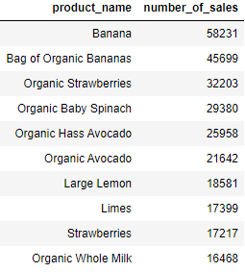
Top Selling Products

Slide 4
Bottom Selling Products
According to the data:
5501 products have only sold once
Ex: “Sardines In Mustard”, “Squid Ink Fettuccini”
20932 have sold less than 10% of the average number of sales per item (91)
Ex: “Rendered Duck Fat”, “Saline Nasal Mist”
6874 products seemingly have 0 sales

Slide 5
Product Sales Diversity
Large Portion of Products are Selling Poorly
80% of sales come from 10% of products
Some poorly-selling products are obscure, others are not
Ex: “Poppy Seed Bagels”, “2% Yellow American Cheese”
Promote Sale of Poorly Selling Products
Users likely do not know about these
Increase user awareness through advertisement campaign of specific products targeted at website users

Slide 6
Sales by Department and Aisle

Slide 7
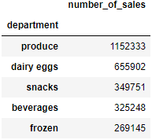
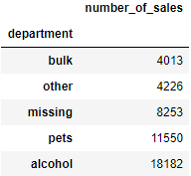
Departments
Top Selling Departments
Bottom Selling Departments

Slide 8
Underperforming Department
“Bulk” department is selling less than even “Other” and “Missing” departments
Potential customers may not be aware that bulk items can be purchased online
Increase awareness of “Bulk” department
Create advertisements to potential customers to inform them about this option

Slide 9
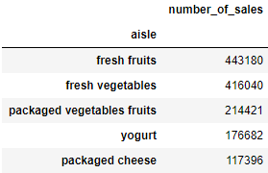
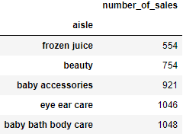
Aisles
Top Selling Aisle
Bottom Selling Aisle

Slide 10
Underperforming Aisles
“Frozen Juice” and “Beauty” aisles sell the least
Customers may have doubts about product integrity after shipping or finding the right specific product
Reassure Customers
Include shipping promise on product page
Negotiate trial period
Notes:
Fee to return, customers must facilitate return, store credit for returns, weekly return opportunities

Slide 11
Sales by User

Slide 12
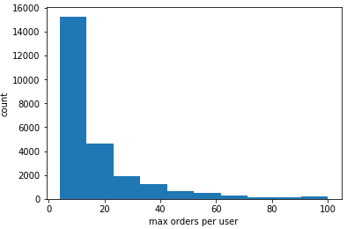
Max Number of Orders Per User

Slide 13
Observations
No users have made fewer than 4 orders or more than 100 orders
Data may not have been collected for new users or dedicated users
50% of users have less than 10 orders
Notes:
100 orders is a lot, no one has under 4 (irrelevant to business)

Slide 14
Users Reach an “Order Ceiling”
Provide incentive for reaching a certain number of orders
Discounts for orders past 4th (engage new users), 10th (engage regular users), or 100th (engage dedicated users)
Instate Loyalty Program
“10% off every 10th order”
Notes:
New user bonus instead of progressive bonus
Progressive discounts
“n% off of your nth order” (orders << 100)

Slide 15
Purchasing Habits

Slide 16
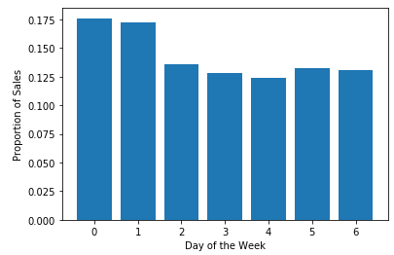
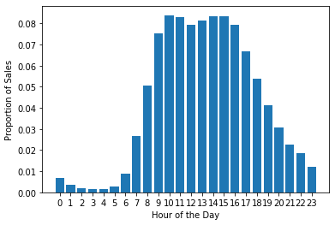
Orders per Time
Orders per Day of Week
Orders per Hour of Day

Slide 17
Fewer Sales at Certain Times
Largely to be expected
Fewer people shop in the middle of the week or late at night
Reach customers with non-traditional lifestyles
Provide incentives for shopping at different times
Early bird and weekday specials

Slide 18
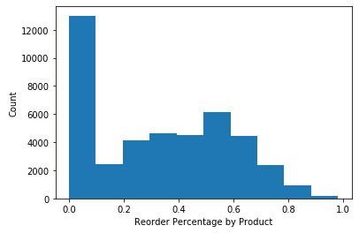
Product Reorders

Slide 19
Many Products are Not Reordered
30% of the products are reordered less than 10%
Some products that are rarely reordered makes sense (vitamins, seasonings)
Other product should reordered more frequently (candy, ice cream)
Offer discount for reoccurring orders through coupon/loyalty program
Give coupons primarily for products that aren’t reordered often
Notes:
How does this break down by aisle/department?
These products make sense
Talk about products that don’t make sense

Slide 20
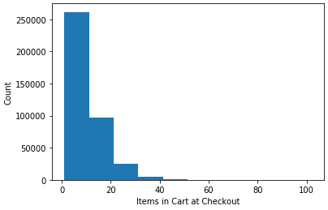
Number of Items at Checkout

Slide 21
Users Don’t Purchase Much Per Order
Median number of items in a completed order is 8
Encourage user to purchase more products per order
Negotiate discounts for items in cart past the 8th
Notes:
“order 10 this week you get % off”
Specific to online-delivery model?
High frequency buyers are not buying a lot
Issue with order process?
Stigma against ordering online (does shipping cost go up with cart size?)
Guarantee right item will delivered
Increasing reorder rate will increase number of items in cart

Slide 22
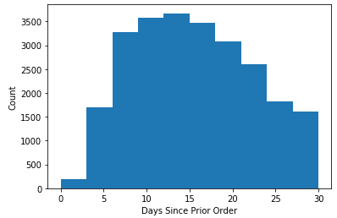
Days Since Prior Order

Slide 23
Time Between Orders is Long
Mean days since prior order is 15
Given median order size is 8, users likely need more than this per week
Users purchase groceries through other means throughout week
Provide weekly sale to encourage users to come back consistently
“Super Saturday”

Slide 24
Market Basket Analysis

Slide 25
Market Basket Analysis Overview
What items are frequently bought together?
Allows for prediction of purchasing behaviors
“Presence of product A in cart increases likelihood user will want to purchase B”

Slide 26
Market Basket Analysis Uses
Results
Obvious: Users who purchase garlic are 4x more likely to purchase onions
Non-obvious: Users who purchase barbeque baked potato chips are 3x more likely to purchase French-style cheese
Implications
Provide suggestions for users on what to buy next based on what is already in their cart
Allows for specific products to be advertised at most advantageous moments

Slide 27
Summary
Incentivize sales of underperforming items
Advertise bottom selling products
Inform users about specific aisles/departments
Target ads with results of Market Basket Analysis
Encourage increased user engagement
Use specials and discounts to boost sales in specific areas of opportunities
Notes:
The data show that there are numerous opportunities to..

