Slide 1


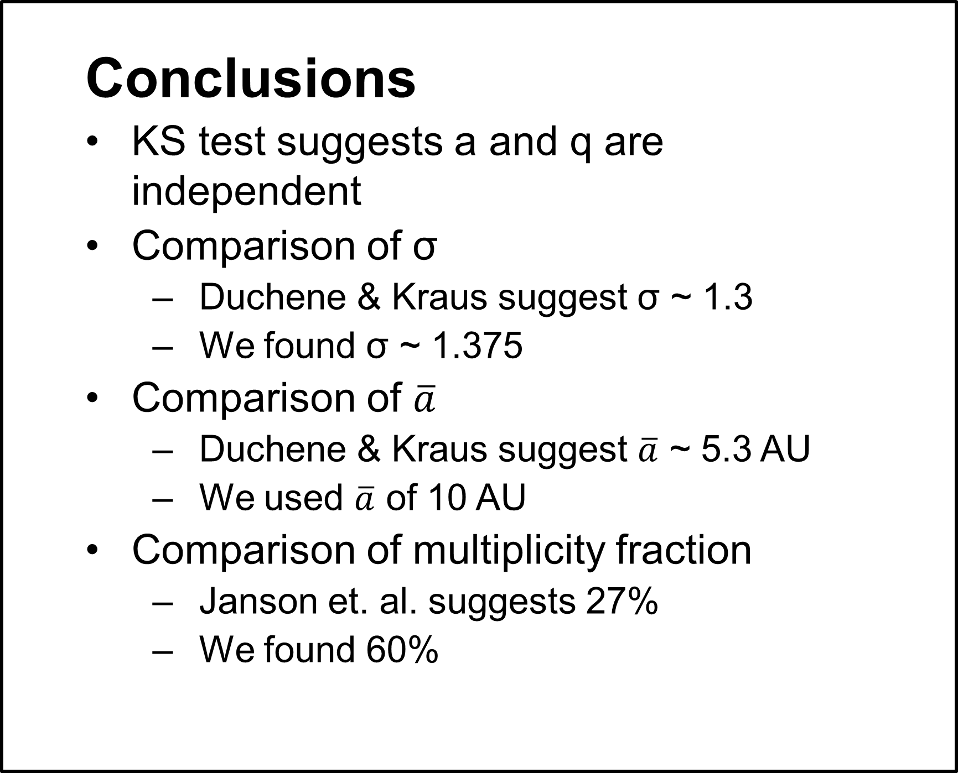
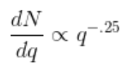


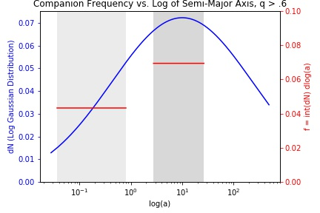
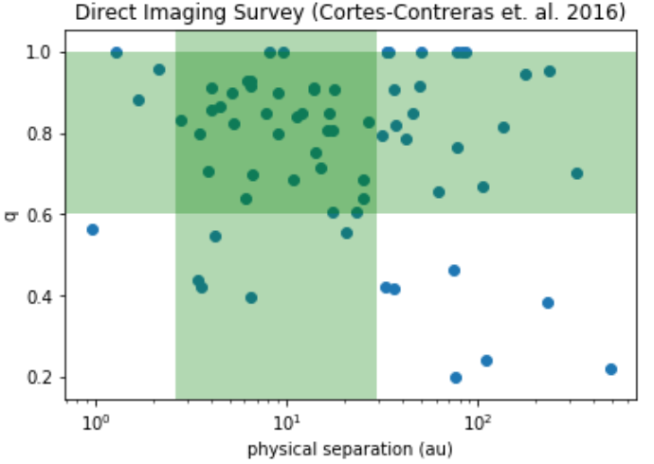
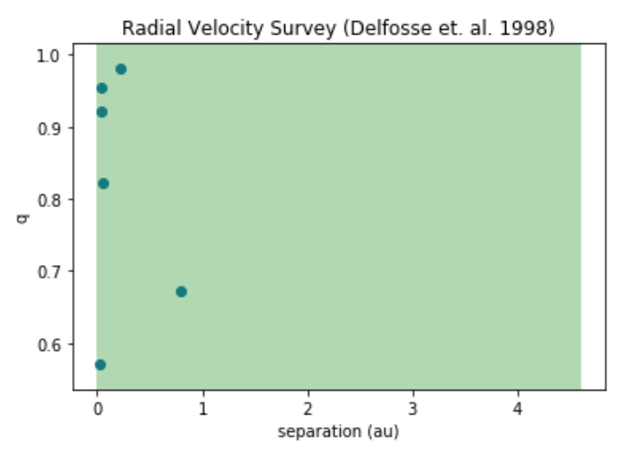
Nicholas Susemiehl¹, Prof. Michael Meyer¹
1 - University of Michigan
Introduction
Multiplicity fraction for M-dwarf stars is not well defined
Assumed form for companion mass ratio distribution of M-dwarfs (Reggiani & Meyer 2013) :
Assumed form for total stellar multiplicity:
Assume double integral is separable – q does not depend on a
Abstract
This research explores nature of M-dwarf binaries by comparing the companion frequency derived from two surveys which used different detection methods. This is done over a fixed mass ratio (q > .6) and the ranges of separations (semi-major axis, a) these surveys are complete for. We were able to fit a model to the point estimates of the frequencies and use this to extrapolate a total multiplicity fraction over all q [0,1] and a[0,∞] of .60.
Results
KS Test - statistical value of .48 and a p value of .19, which allows us to accept the null hypothesis that the two samples (and therefore a and q) are drawn from different distributions
Analysis – Log Gaussian distribution fit over point estimates of frequencies – f(radial velocity) = .043, f(direct imaging) = .069. Using known data points, found σ (standard deviation) of 1.375, and normalization constant (A) of .249.
Multiplicity – total multiplicity fraction of .60 from integration over all q and a
Survey Data
Data drawn from two surveys of M-dwarf binaries that use different detection methods: direct imaging (Cortes-Contreras et. al. 2016) and radial velocity (Delfosse et. al. 1998). Surveys are representative over different ranges of separation, and cut down to q > .6.
Next Steps
Refine process with more data
  Find microlensing and astrometry surveys with well-defined completion in q and a
  Fit new variables to log-normal model
  Recalculate total multiplicity fraction
Compare to multiplicity fraction of FGK stars as defined in other work
Search for further evidence that a does not depend on q
References
Cortes-Contreras et. al. 2016, Delfosse et. al. 1998, Reggiani & Meyer 2013, Janson et. al. 2012, Duchene & Kraus Review of Stellar Multiplicity 2013
Further information
nsusemiehl.com
sites.lsa.umich.edu/feps/
Notes:
Copyright Colin Purrington (http://colinpurrington.com/tips/academic/posterdesign).
f = \int dN = \int_{x_1}^{x_2}\frac{e^{\frac{(x - \overline{x})^2}{2\σ^2}}}{\sqrt{2\pi\σ^2}} dx = A \cdot N
f = \int dN = \int_{0}^{\infty }\int_{0}^{1 }\frac{dN}{x}\frac{dN}{dq} dx dq
f = \int dN=\int_{0}^{\infty }\int_{0}^{1 }\phi(x)q^{-\beta} dq dx = \int_{0}^{\infty}A \cdot\frac{e^{\frac{(x - \overline{x})^2}{2\σ^2}}}{\sqrt{2\pi\σ^2}} dx \cdot \frac{\int_{0}^{1}q^{-.25} dq}{\int_{.6}^{1}q^{-.25} dq}

