Slide 1
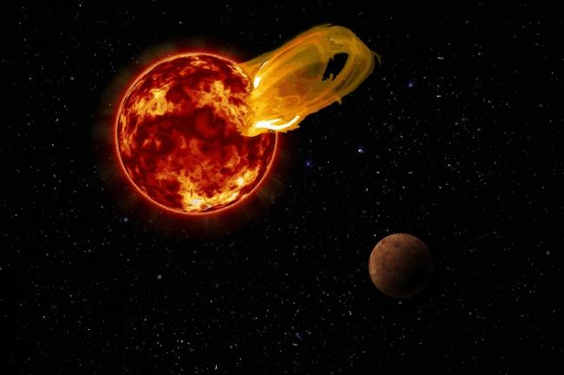


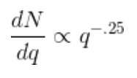
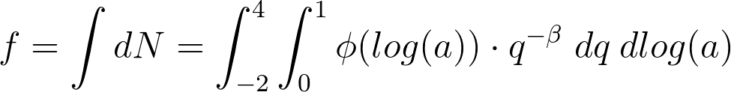
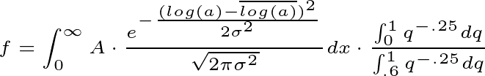
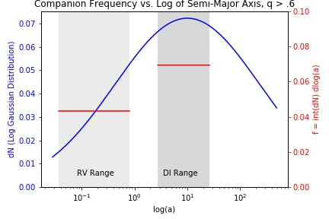
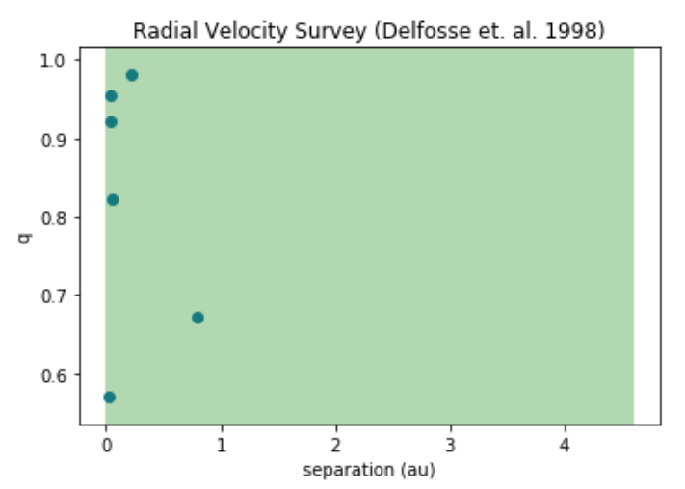
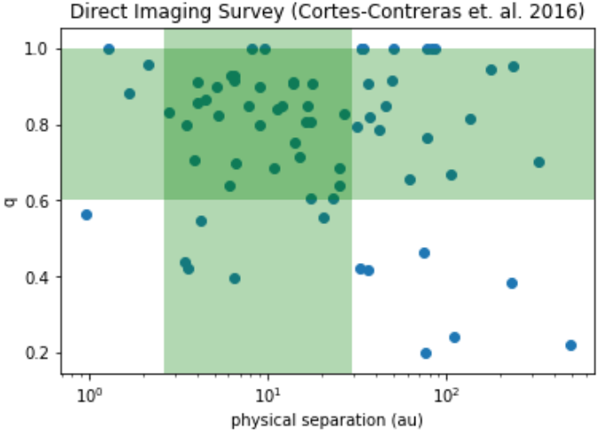
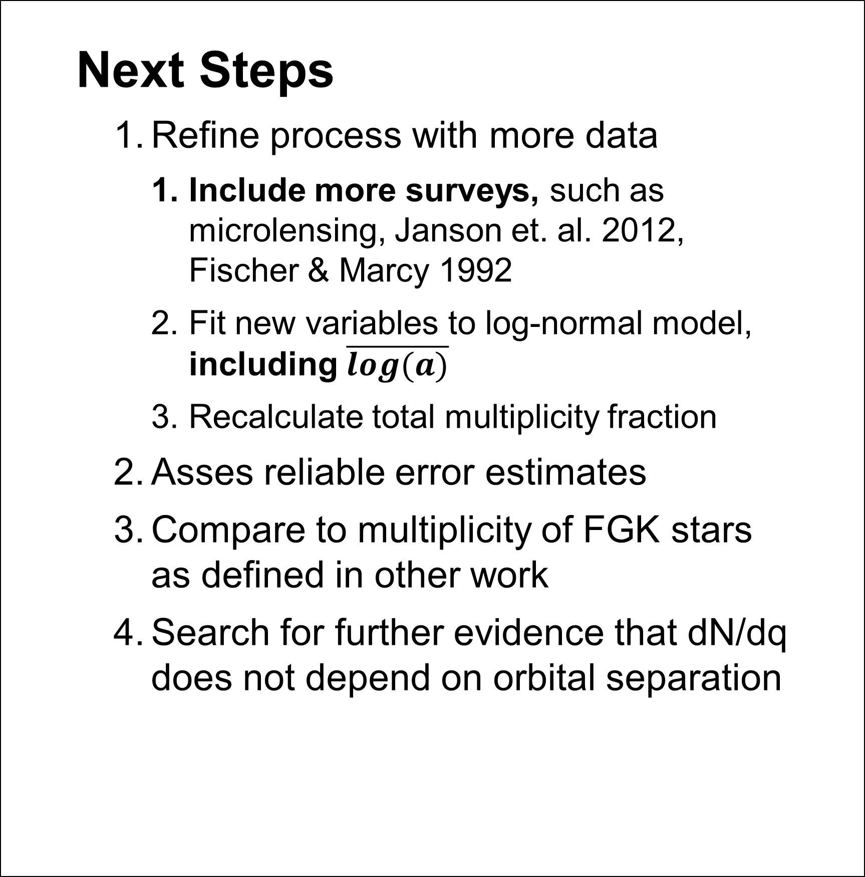

What Fraction of Small Stars Have Friends?
Companion Frequency and Orbital Distributions of M-Dwarfs
Nicholas Susemiehl¹, Prof. Michael Meyer¹ 1 - University of Michigan
Introduction
Understanding stellar multiplicity is key to understanding star and planet formation
Multiplicity fraction for M-dwarf stars is not well defined
Assumed form for companion mass ratio (q, secondary mass / primary mass) distribution (Reggiani & Meyer 2013):
Assumed form for total stellar multiplicity:
Assume double integral is separable – dN/dq does not depend on orbital separation
Abstract
This research explores nature of M-dwarf binaries by comparing the companion frequency derived from two surveys which used different detection methods. This is done over a fixed mass ratio (q > .6) and the ranges of separations (semi-major axis, a) these surveys are complete for. We were able to fit a model to the point estimates of the frequencies and use this to extrapolate a total multiplicity fraction over all q [0,1] and a[0,∞] of .60.
Conclusions
KS test suggests mass ratio and orbital separation distributions are independent
Comparison of σ
Duchene & Kraus 2013 suggest σ ~ 1.3
We found σ ~ 1.375
Comparison of multiplicity fraction
We found a total multiplicity fraction of .60 over all log(a) and q
Janson et. al. 2012 found multiplicity fraction of .27
Only for .4<q<1
When we constrain q to this range, we find fraction of .30
Results
KS Test – statistical value of .48 and p value of .19 allow us to accept the null hypothesis that both mass ratio distributions (q>.6) were drawn from same parent population regardless of orbital separation
Analysis – Log-normal distribution fit over point estimates of frequencies (q>.6), f (radial velocity) = .043, f (direct imaging) = .069. Using known data points, found σ (standard deviation) of 1.375 and normalization constant (A) of .249, while holding $\overline{log⁡(a)}$ to 1 (10 AU)
Multiplicity – total multiplicity fraction of .60 from integration over all q[0,1] and a(0,∞)
Survey Data
Sources
Radial Velocity (RV) - Delfosse et. al. 1998
Direct Imaging (DI) - Cortes-Contreras et. al. 2016
Completeness Limit
Mass Ratio (q)
RV: q > 0
DI: q > .6
Separation (semi-major axis, a)
RV: .01 < a < 4.612 AU
DI: 2.6 < a < 29.5 AU
Next Steps
Refine process with more data
Include more surveys, such as microlensing, Janson et. al. 2012, Fischer & Marcy 1992
Fit new variables to log-normal model, including $\overline{log⁡(a)}$
Recalculate total multiplicity fraction
Asses reliable error estimates
Compare to multiplicity of FGK stars as defined in other work
Search for further evidence that dN/dq does not depend on orbital separation
References
Cortes-Contreras et. al. 2016, Astro. & Astrophys., FC23
Delfosse et. al. 1998, Astro. & Astrophys., 344, 897–910
Reggiani & Meyer 2013, Astro. & Astrophys., 553, A124
Janson et. al. 2012, The Astrophys. Journal, 754, 44
Duchene & Kraus 2013, Annu. Rev. Astron. Astrophys., 51
Further Information
nsusemiehl.com
sites.lsa.umich.edu/feps/
Notes:
Copyright Colin Purrington (http://colinpurrington.com/tips/academic/posterdesign).
f = \int dN = \int_{x_1}^{x_2}\frac{e^{\frac{(x - \overline{x})^2}{2\σ^2}}}{\sqrt{2\pi\σ^2}} dx = A \cdot N
f = \int dN = \int_{0}^{\infty }\int_{0}^{1 }\frac{dN}{x}\frac{dN}{dq} dx dq
f = \int_{0}^{\infty}A \cdot\frac{e^{-\frac{(log(a) - \overline{log(a)})^2}{2\sigma^2}}}{\sqrt{2\pi\sigma^2}} dx \cdot \frac{\int_{0}^{1}q^{-.25} dq}{\int_{.6}^{1}q^{-.25} dq}
f = \int dN=\int_{0}^{\infty }\int_{0}^{1 }\phi(log(a))\cdot q^{-\beta} \; dq\: dlog(a)

