Slide 1
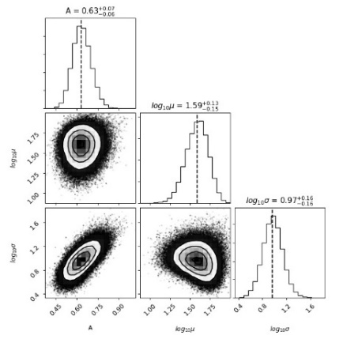
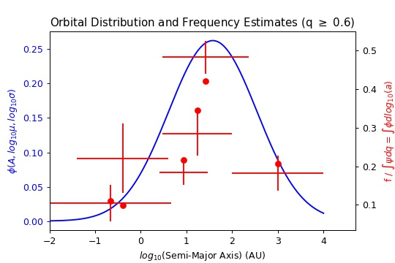
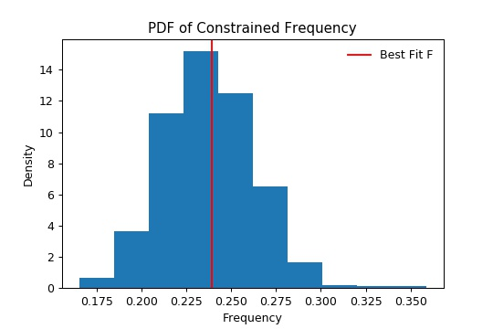
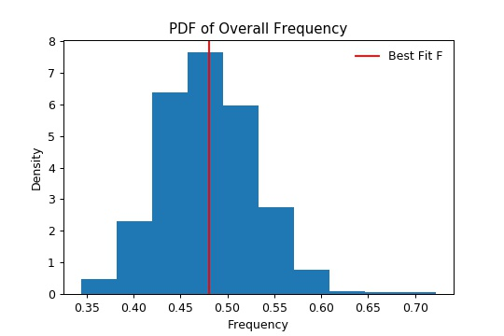


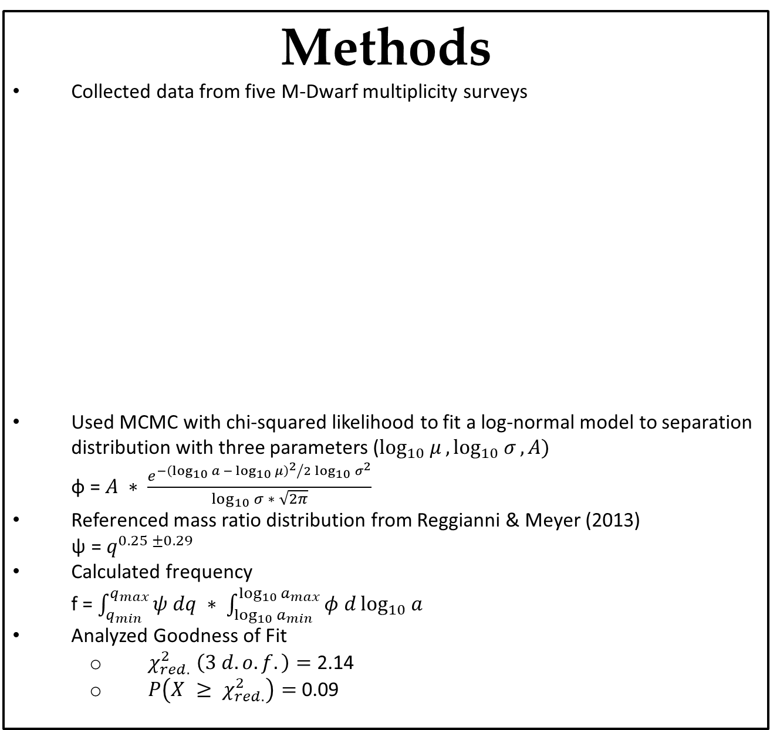
The Companion Frequency and Orbital Distribution of M-Dwarf Binaries
Nicholas Susemiehl¹, Michael Meyer¹
1 – Department of Astronomy, University of Michigan, Ann Arbor
Motivation & Goals
M-Dwarf multiplicity is not well constrained
We seek to fit a model to the surface density distribution of M-Dwarfs using point estimates from surveys over a range of orbital separations
Calculate a constrained frequency
Specific ranges of mass ratio (q) and semi-major axis (a) from sensitivity of data
Assume companion mass ratio distribution does not depend on orbital separation
Only account for binary systems (no triples, quadruples, etc.)
Extrapolate constrained frequency to find new value covering broad ranges of mass ratio and semi-major axis
Compare to other stellar multiplicity estimates
Results
Constrained Frequency (0.60 ≤ q ≤ 1.00, 0.00 ≤ a ≤ 10,000): 0.239 ± 0.04
Overall Frequency (0.10 ≤ q ≤ 1.00, 0.00 ≤ a ≤ ∞): 0.481 ± 0.08
Analysis of Fit
Methods
Collected data from five M-Dwarf multiplicity surveys
Used MCMC with chi-squared likelihood to fit a log-normal model to separation distribution with three parameters ($\log_{10}{μ}, \log_{10}{σ}, A)$ φ = $A ∗ \frac{e^{{{−\left(\log_{10}{a} − \log_{10}{μ}\right)}^{2}}/{2\log_{10}{σ^{2}}}}}{\log_{10}{σ ∗ \sqrt{2π}}}$
Referenced mass ratio distribution from Reggianni & Meyer (2013) ψ = $q^{0.25 ±0.29}$
Calculated frequency f = $\int_{q_{min}}^{q_{max}}{ψ dq ∗ \int_{\log_{10}{a_{min}}}^{\log_{10}{a_{max}}}{φ d\log_{10}{a}}}$
Analyzed Goodness of Fit
$χ_{red.}^{2} \left(3 d.o.f.\right)=$2.14
$P\left(X ≥ χ_{red.}^{2}\right)=$0.09
Conclusions
Peak in orbital surface density distribution of M-Dwarf binaries occurs at about 40 AU (larger than the estimate from Winters et al. 2018 and slightly smaller than Raghavan et al. 2010 for FGK stars)
About half of all M-Dwarfs have a low mass companion, many of which may be brown dwarfs after extrapolating down to this regime
Comparisons
Extrapolated results from surveys of other spectral type over constrained regions of mass ratio and separation
Overall, multiplicity fraction does not vary significantly across spectral types over q = [0.6, 1] and a = [0.00, 10000 AU]
Reference | Semi-Major Axis Sensitivity Range (AU) | Multiplicity Estimate (q ≥ 0.6)
Delfosse et. al. (1998) | 0.00 - 4.63 | 0.04 ± 0.018
Fischer & Marcy (1992) | 0.04 - 4.00 | 0.08 ± 0.034
Cortes-Contreras et. al. (2016) | 2.60 - 29.5 | 0.07 ± 0.012
Janson et. al. (2012) | 3.00 - 227 | 0.18 ± 0.016
Ward-Duong et. al. (2015) A | 3.00 - 100 | 0.11 ± 0.022
Ward-Duong et. al. (2015) B | 100 – 10,000 | 0.07 ± 0.017
Survey | Raghavan et. al. (2010) - FGK Stars | De Rosa et. al. (2013) – A Stars
Multiplicity Fraction q = [0.6, 1], a = [0.00, 10000 AU] | f = 0.230 +/- 0.032 | f = 0.238 +/- 0.026
Despite this low probability, we do not reject the null hypothesis that the data came from this model
Literature Cited
Cortes-Contreras et. al. 2016, Astro. & Astrophys., FC23
De Rosa et. al. 2013, Mon. Not. R. Astro. Soc. 437, 1216-1240
Delfosse et. al. 1998, Astro. & Astrophys., 344, 897–910
Fischer and Marcy 1992, The Astrophys. Journal, 396, 178-194
Acknowledgements
We thank the Formation and Evolution of Planetary Systems group (https://sites.lsa.umich.edu/feps/) for their consistent support. We would also like to thank Dr. Max Moe and Dr. Kimberly Ward-Duong for their insightful advice.
Janson et. al. 2012, The Astrophys. Journal, 754, 44-70
Raghavan et. al. 2010, The Astrophys. Journal, 190, 1-42
Reggiani and Meyer 2013, Astro. & Astrophys., 553, A124
Ward-Duong et. al. 2015, Mon. Not. R. Astro. Soc. 000, 1–34
Winters et. al. 2019, The Astron. Journal, 157, 6, 216

