Slide 1
Online quiz app
CSE 299.2
Group 4

Slide 2
Hello!
I’m Sohel Rahman, and my groupmate is Afif Bari.
Our project involves a web-based quiz app.

Slide 3
What does it do?
Its core purpose is to let educators take quizzes online.
Educators upload questions onto the website
Each student gets an access code.
Students log in using the code and take the quiz.
Their scores are recorded in the database.

Slide 4
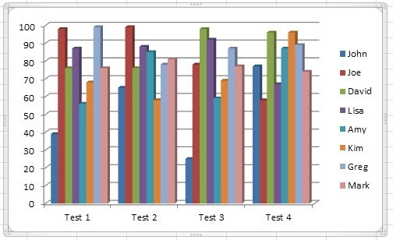
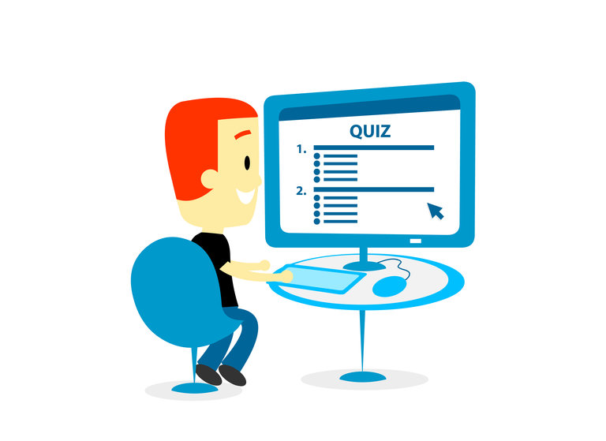
features
Lets educators take quizzes with multiple choice questions, short questions and others.
Produces graphs to track a student’s performance.
Generates practice questions for students.

Slide 5
Why use this? Why not take the quiz in a classroom as usual?
Taking quizzes online has several advantages over the traditional method.

Slide 6
1.
Saves time
No one likes checking copies

Slide 7
2.
Eliminates human error
When you are checking hundreds of copies, a mistake can easily happen

Slide 8
So, what’s the catch? It can’t possibly be flawless?
Unfortunately, like every other system, it does have some inherent downsides.

Slide 9
1.
No supervision
Students can look up answers online

Slide 10
2.
Auto-grading limitations
Broad and short questions cannot be auto-graded reliably, so human input is required

Slide 11
Despite these inherent flaws, it can become a powerful tool in a teacher’s arsenal

Slide 12
THANK you!
Any questions?

