Slide 1
CSE 299.2
Group 4

Slide 2
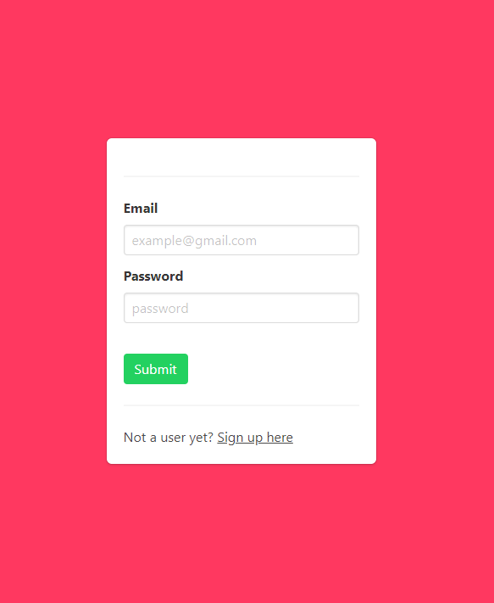
Login screen

Slide 3
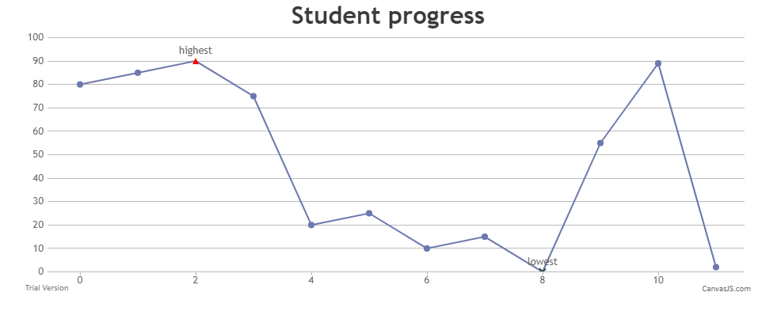
Sample graph

Slide 4
THANKS!
Any questions?

