Slide 1
“KHUJO” System Design
Presenting by Group-3
Mithi Shams ID: 1211041042
Ariful Hasan Kawshiq ID: 1510313042
Shafika Islam ID: 1610239042

Slide 2
Basic mechanism
The basic mechanism that goes behind the scene is when the user writes includes an item in his list the system finds the category it falls in. For example if a user writes or includes sugar in his list. This item falls under the category grocery store, Departmental store, super Store and mega store. Now the system searches with the key words Grocery Store, Departmental store, Super Store, Mega Store in Google map in a distance of 3km radius around him, the user. Listing up the name of the store the system notices the user. Then the user can select anyone of the store of his choice from the given list and it will direct him to Google Map with the map direction of the store. The system searches for store in according to the list created or modified by the user periodically at a regular interval of time.

Slide 3
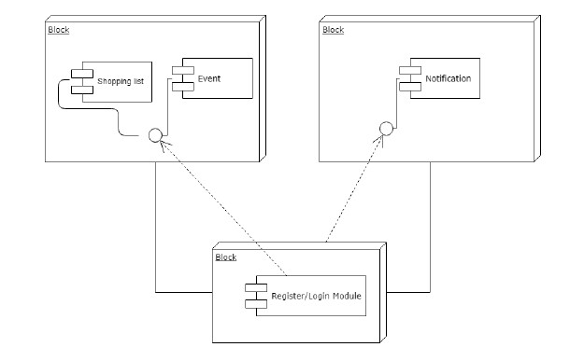
Design Architecture

Slide 4
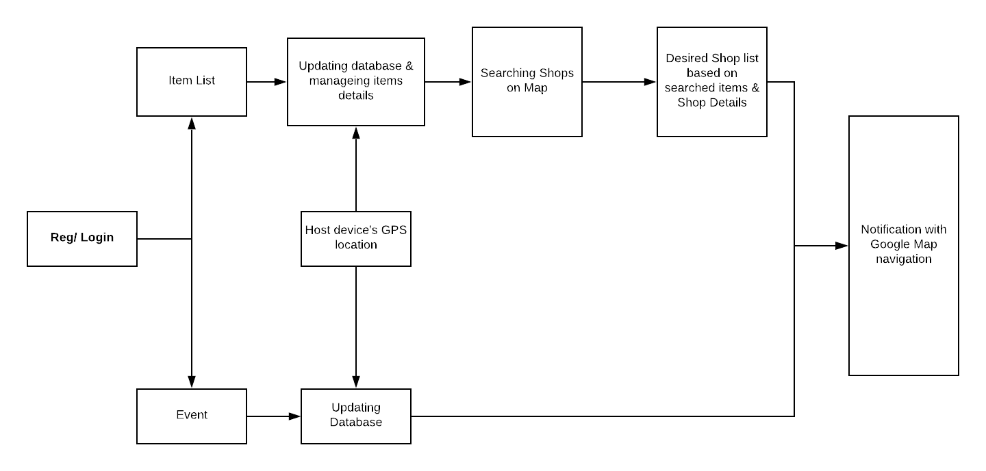
System Diagram

Slide 5
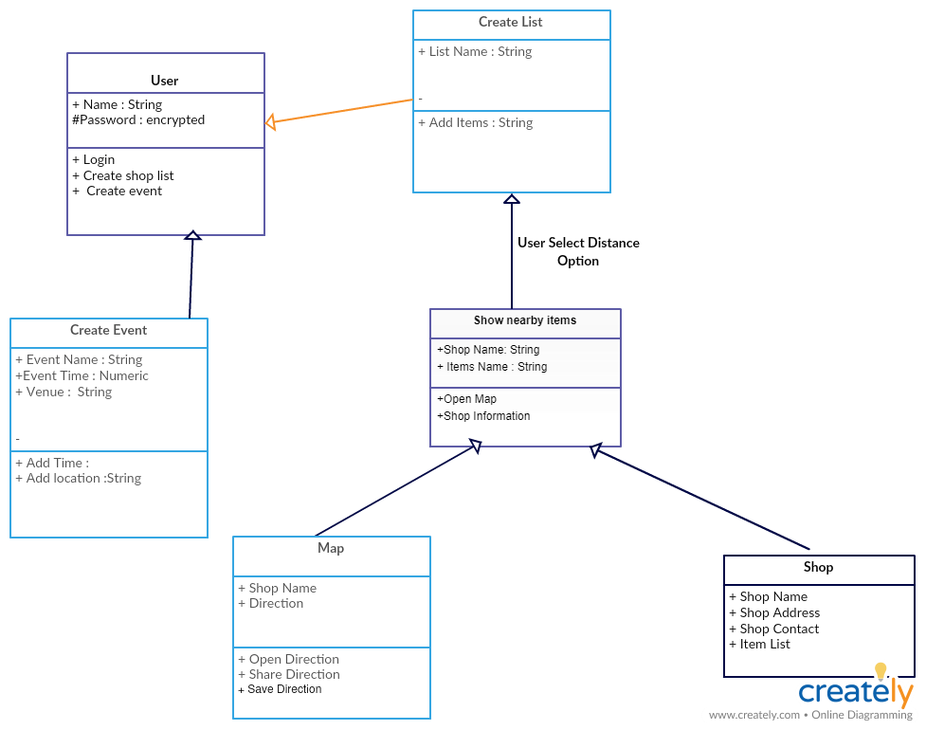
UML (Class) Diagram

