Slide 1
Project Proposal on “Pizza Ordering App”
Limon Motin – 1620902042
Md. Golam Rabby Shuvo - 1620044042

Slide 2
Introduction
Pizza Ordering App is based on a concept of making pizza orders and payments. Here, the user can login, select pizza sets, quantity and proceed towards payment. Other features include viewing full payment receipt which includes each and every detail. Prices will be displayed in BDT currency. This mini project contains limited features, but the essential ones.

Slide 3
Objectives
Build Your Own Pizza
Online Payment
Know Delivery Time
Better Knowledge
Improves Efficiency

Slide 4
Scope
The scope of the proposed system will be based on the features and functionalities proposed for pizza restaurant which is located in Bashundhara R/a. Online pizza ordering system will be an android based application whose main language of programming will be Java. Its main aim is to simplify and improve the efficiency of the ordering process for both customer and restaurant, minimize manual data entry and ensure data accuracy and security during order placement process.

Slide 5
Limitation
Requires internet connection.
The set back of the system is that the customers targeted are adults with access to android phone.
The other limitation is that the system will only be convenient to people with a small geographical region.

Slide 6
How it works

Slide 7
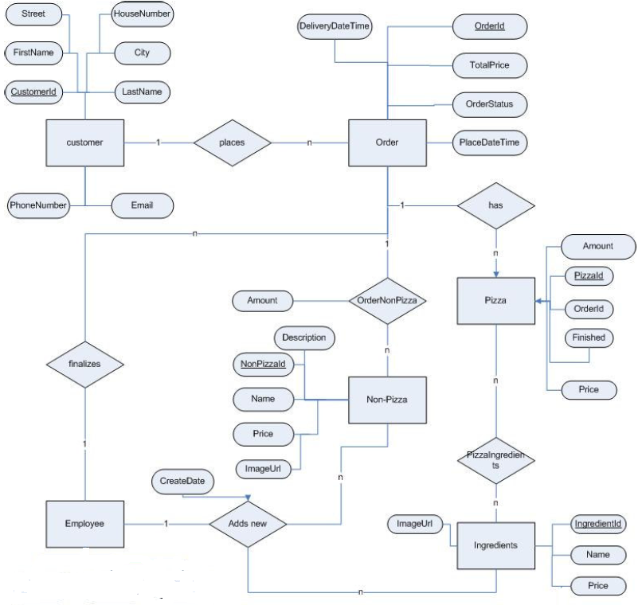
ER Diagram

