Slide 1
Project Proposal on “Pizza Ordering App”
Limon Motin – 1620902042
Md. Golam Rabby Shuvo - 1620044042

Slide 2
Introduction
Pizza Ordering App is based on a concept of making pizza orders and payments. Here, the user can login, select pizza sets, quantity and proceed towards payment. Other features include viewing full payment receipt which includes each and every detail. Prices will be displayed in BDT currency. This mini project contains limited features, but the essential ones.

Slide 3
Objectives
Build Your Own Pizza
Online Payment
Know Delivery Time
Better Knowledge
Improves Efficiency

Slide 4
Scope
The scope of the proposed system will be based on the features and functionalities proposed for pizza restaurant which is located in Bashundhara R/a. Online pizza ordering system will be an android based application whose main language of programming will be Java. Its main aim is to simplify and improve the efficiency of the ordering process for both customer and restaurant, minimize manual data entry and ensure data accuracy and security during order placement process.

Slide 5
Limitation
Requires internet connection.
The set back of the system is that the customers targeted are adults with access to android phone.
The other limitation is that the system will only be convenient to people with a small geographical region.

Slide 6
How it works
Firstly, the customer has to provide his/her details like name, phone number, address, email id into the registration field.
After successfully logging in, the menu will be visible to the customer with the pizza customizations and other non-pizza products on offers along with the prices.
Next, after adding the items to be ordered, the customer will select the type of drop-off process whether it will be a home delivery or a pick up.
Lastly, the payment option will be shown to the customer. He/she will choose from the various online payment methods or cash on delivery option.

Slide 7
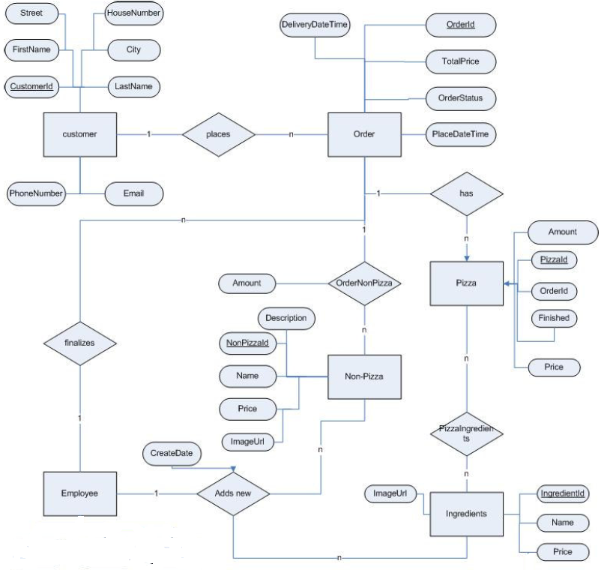
ER Diagram

Slide 8
Requirements
Hardware Requirements:
Processor: Intel dual core or above
Processor Speed: 1.0GHZ or above
RAM: 1 GB RAM or above
Hard Disk: 20 GB hard disk or above
Mobile: Android phone
USB flash disk (At least 2GB)

Slide 9
Software Requirements:
Operating system: Windows XP / windows 7 and Android
Technology: Java language
Database: Firebase
Java sdk
Android studio
Github
Slack
Trello

Slide 10
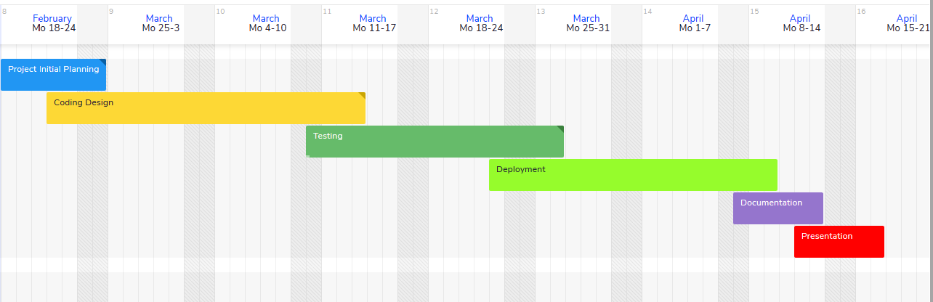
Planning
Gantt Chart:

Slide 11
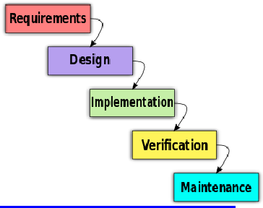
Process Model:

Slide 12
Conclusion
This project is not difficult to use, operate and understand by the users. Design of this project is pretty responsive so that user won’t find it difficult to understand, use and navigate. This project provides the simplest system for managing pizza orders.

