Slide 1

E-Commerce (Online Shopping Store)
COURSE INSTRUCTOR: | Shaikh Shawon Arefin Shimon
CORSE TITLE: | cse299
SECTION: | 08
NAME | ID
MD ANIKUL ISLAM | 1520086042
Mitu Rani Das | 1512383642
Asiful Alam Fahim | 1521551042

Slide 2

E-Commerce
E-commerce is the buying and selling of goods and services, or the transmitting of funds or data, over an electronic network, primarily the internet. These business transactions occur either as business-to-business, business-to-consumer, consumer-to-consumer or consumer-to-business.

Slide 3
E-Commerce in Bangladesh
E-Commerce website development in Bangladesh nowadays is a moneymaking or profitable business. This project is organized for an e-Commerce site for any small to medium shopping store. This project has been designed for solving current problems of many e-Commerce sites in Bangladesh. These websites are not updated regularly, and there are also SPAM and MARKETING STRATEGY issues which give negative impression to the user and the customers.

Slide 4
Technical approach
Our goal is to avoid those possible problems that we mentioned earlier and also create more error free, updated, reliable and licensed web applications to the users and the customers. We are going to make an e-Commerce site which contains User and Admin Interfaces. The information of admins and users will be arranged in a database. The database can be only accessed by the admins.

Slide 5
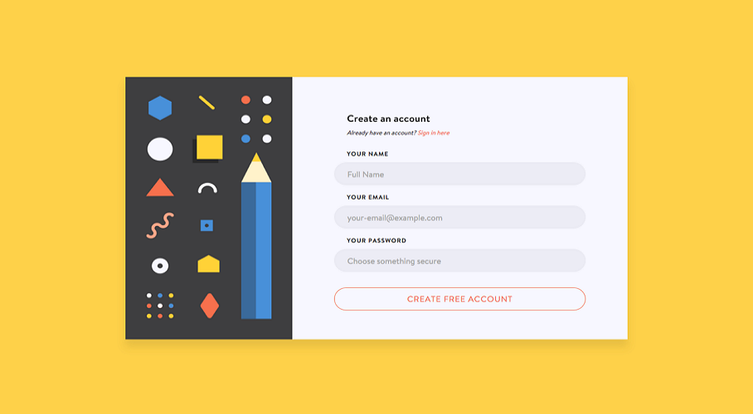
web interface
a) Registration.
b) Log in -
● User Name.
● Password.
c) Search Key.

Slide 6


Payment method -

Slide 7
Software requirements
PHP
MySQL
JS (Java Script)
HTML
CSS
Text Editor ( GIT or Visual Studio Code )
GITHUB
Bootstrap

Slide 8
Week | Task
1 | Project proposal, presentation slide.
2 3 | Study on project topic, making plan about process and distribute the parts of this project among the members.
4 5 6 7 8 | Completing the coding part of the project.
9 10 11 | Testing and modifying.
12 | Project report, presentation and submitting the complete project.

Slide 9
