Slide 1
Surprise Celebration Nazmus Sakib Siraji Akila Rahman Akib Rahman Saleheen

Slide 2
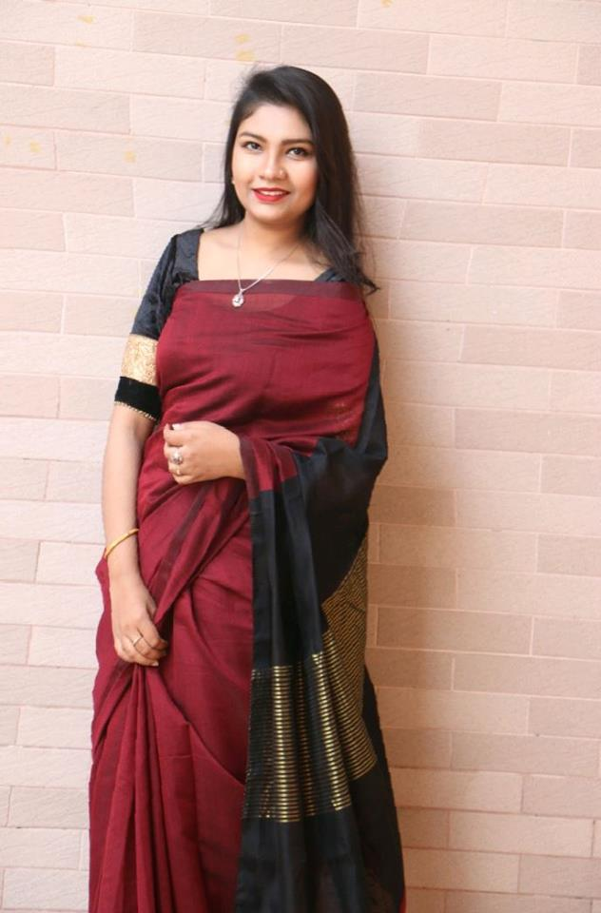
HELLO!
My name is Akila Rahman
<number>

Slide 3
1
Project Briefing
Surprise Celebration
<number>

Slide 4
In 21st century, it takes time to do something, to plan something for family and friends.
We will arrange any surprise program on behalf of our clients as per their choice for their loved ones.
We will offer decorations, gifts and cakes primarily.
<number>
<number>

