Slide 1
Challenges in the current supply chain process
Lack of single source of truth for reliable decision making
Inconsistent business intelligence due to non standardized reporting
Inefficient and irregular communication, collaboration & vendor management
Lack of tooling for Self-Service MI/BI and Decision Science Predictive Analytics capability
Notes:
https://www.forbes.com/sites/forbestechcouncil/2022/06/21/how-digital-twins-can-help-supply-chains-survive-disruption/?sh=116dc3056800

Slide 2
How Digital Twins Help Achieve Excellence In Supply Chain
Demand Planning
Increased E2E Visibility
DT provides a dynamic simulation model of the real-time customer behaviors, macroeconomic & microeconomic events to draw insights into the current, and future demand levels
DT enables greater transparency between different tiers of the supply chain operations. Enhancing the ability to track, monitor & easily report on all freight movements from the point of origin to the destination, & everything in-between
Identify Bottlenecks & Increase Visibility
Plan Transportation & Facilities
Provides a Transparent, Perpetual, E2E view of processes and bottlenecks across the supply chain, facilitating more agile problem resolution with minor human intervention
By leveraging real-time data, DTs enable supply chain management to better plan transportation resources by effectively being able to monitor how changes in demand and supply affect the supply chain’s physical locations and supporting system
Optimize Overall Supply chain Processes
Risk Assessments & Mitigation
DT improves design tests of supply chain process & optimization across critical areas ꟷ procurement synergies, logistics and network optimization, and sales and operations planning
In supply chain, earlier a business can identify potential issues, DT allows for better risk assessment, devise effective mitigation strategies and proactive management with contingency plans
Notes:
https://www.forbes.com/sites/forbestechcouncil/2022/06/21/how-digital-twins-can-help-supply-chains-survive-disruption/?sh=116dc3056800

Slide 3




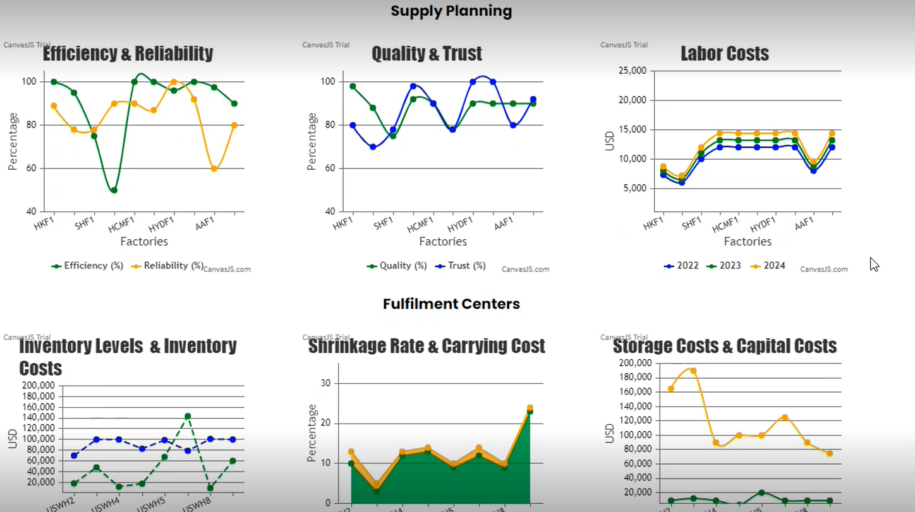
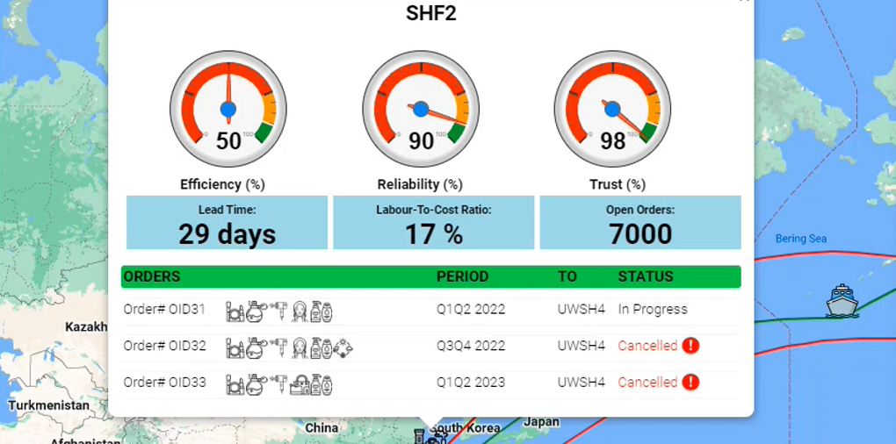
User Journey – Supply Chain Operations Manager
He leads and executes supply/ demand planning, logistic optimization, and capacity planning
He is facing issues in fulfilling demands due to issues faced in sourcing various raw material required for optimal production
Product brands are grappling with shortages of key ingredients and packaging materials alongside soaring costs and shipping delays, resulting in a significant impact on the bottom line and launch of new product lines
A new innovative digital twin-based supply chain management & financial planning solution that continuously monitors raw materials inventory status, freight charges & in real-time monitors supply chain dynamics, will help to optimize Financial planning process along with improved resilience & sustainability. Aggregation of real-time data from different sources (ERPs, financial & planning systems), KPIs, demand, inventory levels, supplier, and freight charges, facilitates achieving enhanced operational visibility and enabling shorter lead time. Using DT, we can continuously experiment with ‘what-if’ scenarios by facilitating enhancement of variables without impacting real-world productivity & operations to gain insights & visibility on impact on bottom line
User Persona - Matthew
Sales & Operational Planning (S&OP) Manager
User Journey
Matthew centrally monitors & manages entire supply chain, factory operations & demand planning via DT solution. Data is aggregated in real-time information from different factories, logistics, procurements etc. (ERP, sourcing, financial and planning system)
Matthew logs into his system and views dashboard which provides info of different KPIs tracked across:
Supply Planning – Efficiency & Reliability, Quality, ESG Ratings
Demand Planning – Inventory level, Order Management, Capital Cost
He can zoom into any supply chain touchpoints like factories & fulfillment centers to get more details like efficiency, reliability & trust along with granular details like order details
To be better prepared for black swan effect, he wants to simulate these 2 scenarios:
Increase in freight cost due to change of transportation mode
Order volume decrease due to cancellation
that leads to change in inventory level & resulting to decrease in margin and revenue
He accesses the situation and views the recommendations provided for Smart Planning
DT solution facilitates enhancement of variable & enables Matthew to performs ad-hoc analysis and observe changes in costs, order & inventory level based.
Equipped with insights he develops strategies, and he can take data-driven decisions to ensures that there is no impact on demand and supply, plan operations effectively while ensuring cost competitiveness
Using Digital Twin solution, Matthew can monitor constantly, simulate scenarios continuously and react instantly to develop demand and supply strategies that ensure high productivity & demand fulfillment without any significant impact to revenue and margins. With insights gained, he optimizes future costing process and improves production efficiency
Notes:
Scenario – Experiment with impacting real-world – What if – not affecting prodcutiity changes
-- scenarios and
-- No impact on demand and supply – preparing for future scenario
-- Experiment continuously

Slide 4









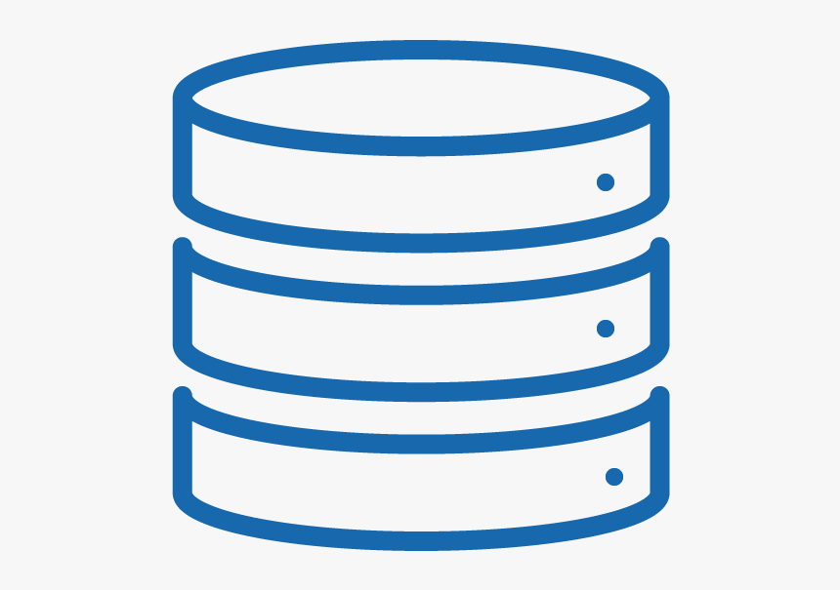

Azure Static App
Data Sources
Azure Data Explorer
Azure Event Hub
Azure Data Lake Storage
Azure IOTHub
Azure Functions
Azure Digital Twins
Azure Logic Apps

