Slide 1

Implement MLOps with Github Action and AML V2

Slide 2
Agenda
Day 1: 8 AM- 12 PM PST
Introduction to EZ-MLOps workshop (20 mins)
Part 0: Environment setup (30 mins)
Part 1: Structure code for fast iterative development (50 mins)
Break: 10 mins
Part 2: Use cloud scale compute to run, deploy and manage ML experiment with Azure ML (60 mins)
Part 3: Use GitHub for Version Control and Automation (30 mins)
Day 2: 8 AM – 12 PM PST
Part 3: Use GitHub for Version Control and Automation cont. ( 50 mins)
Part 4: Continuous integration (CI) (60 mins)
Break: 10 mins
Part 5: Continuous Deployment (CD) (60 mins
Part 6: Observability (30 mins)
Wrap-up (20 mins)

Slide 3

Introduction to EZ-MLOps workshop

Slide 4
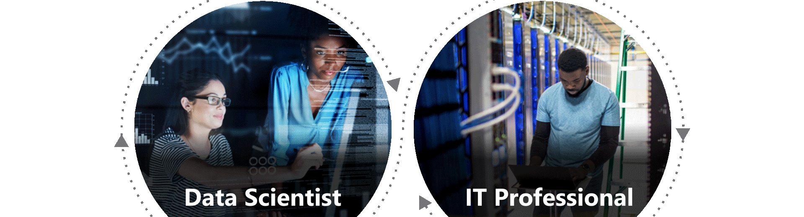
MLOps at a glance
Deliver innovation rapidly
MLOps—machine learning operations, or DevOps for machine learning—enables data science and IT teams to collaborate and increase the pace of model development and deployment via monitoring, validation, and governance of machine learning models.

Slide 5
Motivations
There are multiple guidelines for MLOPs implementations, but most are complex and difficult to follow
1
Recent improvements in technologies makes MLOps easier to implement (new AML, Github, MLFlow…)
2
Sharing good design patterns and best practices from real world implementations
3

Slide 6
Key features
Simplicity: adoption of AML vNext CLI, Github and MLFlow
Reusability: reusable Github actions for common activities and Monitoring library
Streamlined workflows: new workflow design to make CI/CD efficient
New scalable model & data drift monitoring library

Slide 7
Workshop format
Workshop is in a scenario format, featuring a journey in which a company going step by step to advance in MLOps journey
Background knowledge about tools & technologies are explained by instructors
Attendees will create and run hands-on MLOps tasks from reference solution
1. Structuring code for fast iterative development
2. Cloud scale ML and Management
3. Github for Automation
4. Continuous Integration
5. Continuous Deployment
6. Observability

Slide 8
Part 0: Environment Setup

Slide 9
Environment setup tasks
Local development setup
Python Conda environment 3.8 with pandas and sckit-learn
Azure CLI, Azure ML V2 CLI
GitHub account and repo
Clone MLOpsTemplate/src/workshop at main · microsoft/MLOpsTemplate (github.com) and push to your repo
Azure environment setup
Azure ML workspace with contributor access
Compute cluster and datastore
Detail guide: MLOpsTemplate/part_0.md at main · microsoft/MLOpsTemplate (github.com)

Slide 10
Part 1: Structure code for fast iterative development

Slide 11



From monolithic to modular and collaborative
In data scientist centric development, collaboration is limited, work is done most commonly via notebook. This is not scalable for enterprise level ML
Monolithic structure
Parallel development & testing
Feature engineering module
Jupyter notebook
Jupyter notebook
ML training module
Model validation module

Slide 12
Tasks
Review the jupyter notebook that represents the work of a data scientist up to this point
Modularization: monolithic notebook is refactored into python modules that can be developed and tested independently and in parallel by multiple members
Parameterization: The modules are parameterized so that they be rerun with different parameter values.

Slide 13
Part 2: Use cloud scale compute to run, deploy and manage ML experiment with Azure ML

Slide 14
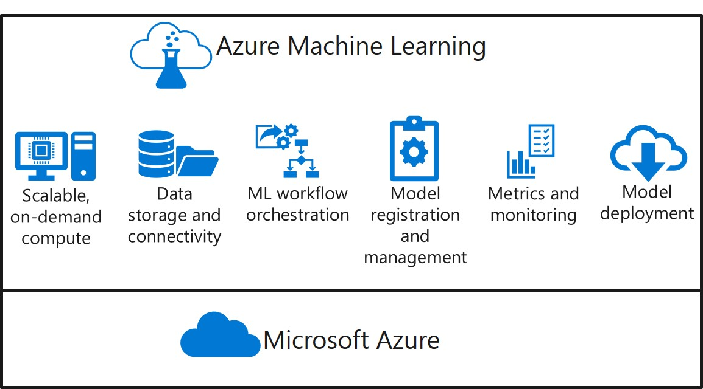
Introduction to Azure ML CLI v2

Slide 15
Introduction to Azure ML CLI v2
The Azure Machine Learning CLI (v2) is an Azure CLI extension enabling you to accelerate the model training process while scaling up and out on Azure compute, with the model lifecycle tracked and auditable.
The CLI v2 greatly simplify running ML in Azure by decoupling ML logic from operationalization
Core logic
Run time definition
Python file
YML job definition
Conda environment

Slide 16
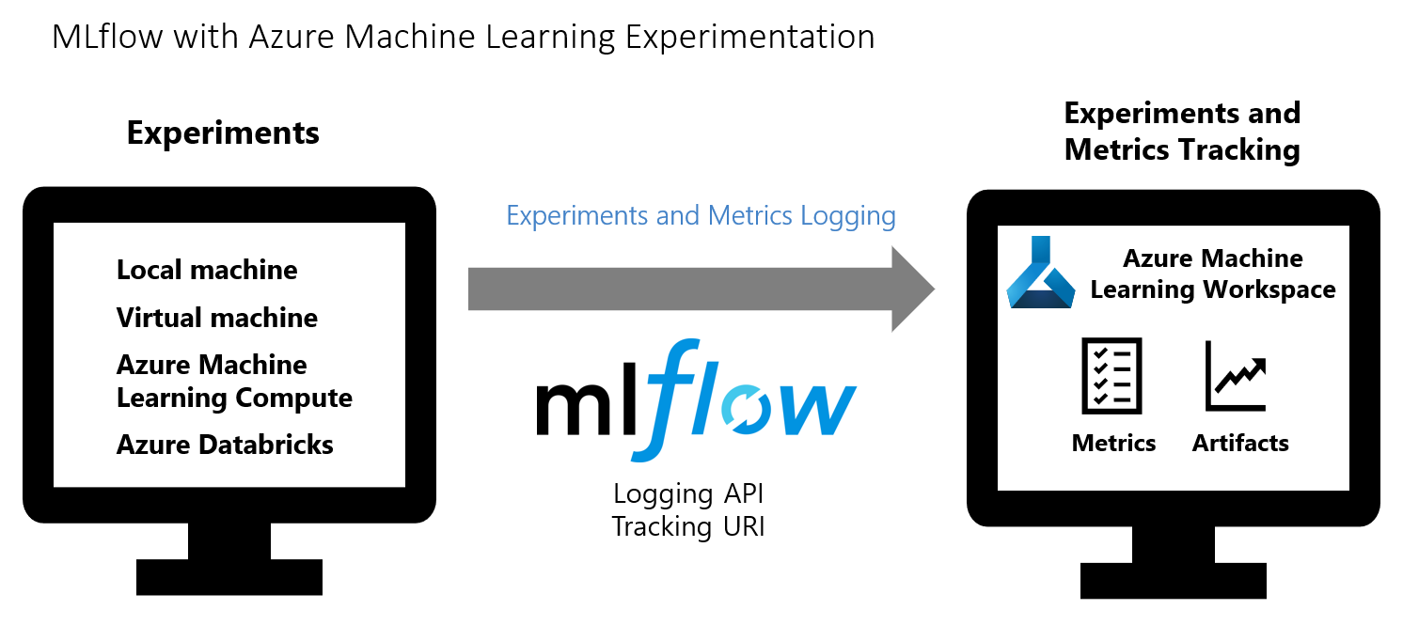
Azure ML & MLFlow Experiment Tracking

Slide 17
Part 3: Use GitHub for Version Control and Automation

Slide 18















Architecture
Close & Merge to int.
Close & Merge to main
Run CI Workflow
Run CD Workflow
IDE, Notebook
Int.
Prod.
CI/CD
Pull Req.
Pull Req.
Int. branch
Train Model
Evaluate Model
Register Model
main
Test Scoring Pipeline
Test Scoring Pipeline
Data Drift, New Dataset, Model Drift
Log
ML Life Cycle Management
Metrics
Model
Scoring Output
Training Data
Scoring Output
Scoring Results
Incoming Data
Data Drift Trigger
Data Monitoring
AML Pipeline
Batch Scoring Pipeline
Model Monitoring
Model Drift Trigger
Data Monitoring
Model Monitoring
Preprocessing
Score
Save to ADLS
Consume
Consume

Slide 19
Branch Strategy
Feature Branch – Data Scientists and ML Engineers work in their own branches and open pull requests to the integration branch
Integration Branch – When a PR is opened to this branch, the CI pipeline will begin. If the run is successful, the merge will complete. If a higher performing model is produced, a PR to the main branch is open
Main Branch – When a PR is opened to this branch, the CD pipeline will begin. Once the CD pipeline is successfully run, the merge will complete

Slide 20
Use of AML V2 and GitHub Actions
AML V2:
- no boiler plate SDK to learn, easier story around 'bring your code as is + YML descriptors
- focus on dev local + scale/automate/operationalize in cloud with same code
GitHub Actions:
- integrate OPS where code lives
- almost instant provisioning of compute to run MLOps Workflows
- leverage az ml CLIv2 commands, very small learning curve to automate workflows
- get customers w/o MLOps practice to learn/start on Ops platform of the future

Slide 21
Part 4: Continuous Integration

Slide 22
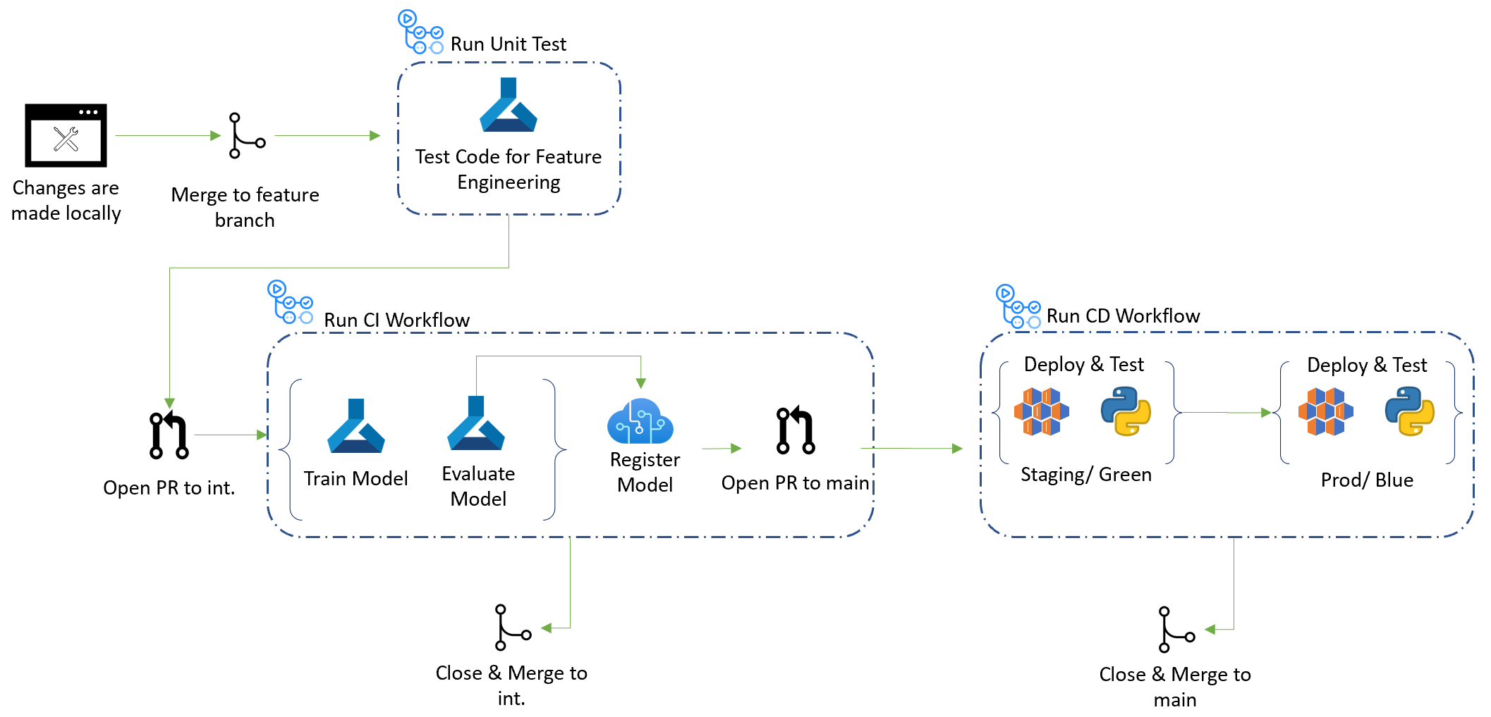
CI flow

Slide 23
CI flow
Use Azure ML CLI v2 for pipeline creation using .yml files
Plug in .py files in the .yml file which includes all pipeline steps and settings
GitHub CI workflow is triggered when changes are committed to the integration branch and Pull Request is made
If the new model passes evaluation step (based on performance etc.), CI workflow opens a Pull Request to main
CD workflow continues the next steps

Slide 24
Part 5: Continuous Deployment

Slide 25
CD flow
CD flow highlights
- leverages new AML Managed Endpoints
- automatically creates blue/green deployments for safe, no downtime rollouts
- identifies staging based on traffic allocation of existing Endpoint
- tests endpoint before swapping deployment slots (staging / prod)
- runs on PR to main

Slide 26
Part 6: Observability

Slide 27
Wrap-up

