Slide 1
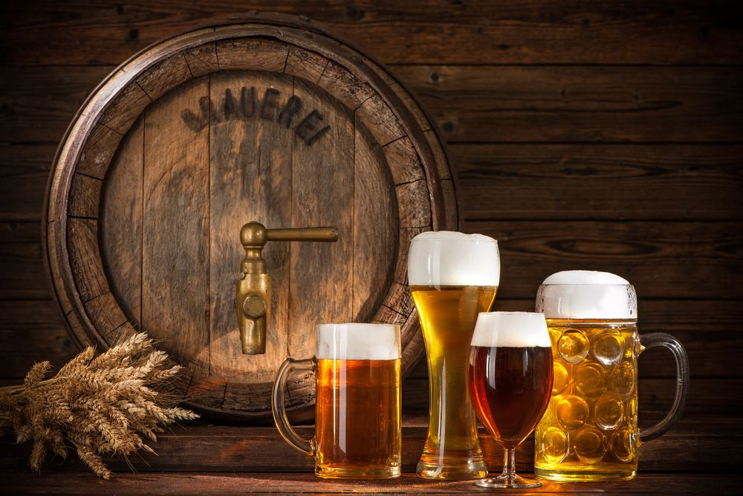
CRAFT BEER INDUSTRY
STATISTICAL ANALYSIS OF STRATEGIC OPPORTUNITIES
Prepared by: Nina Sysoeva

Slide 2

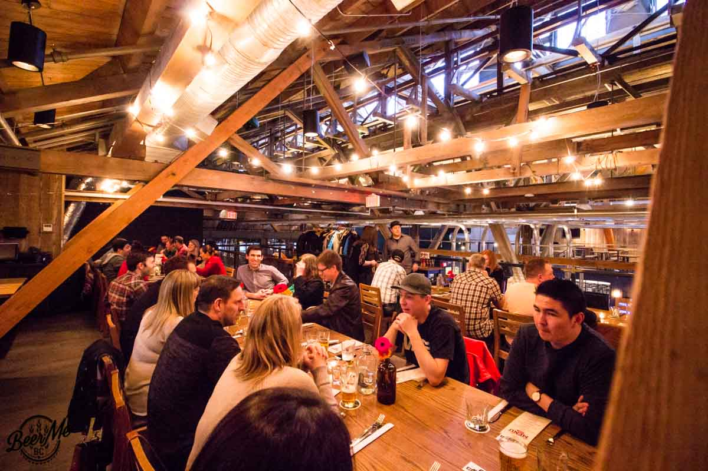
Small Business Focus: Craft Breweries
Small Businesses
Craft Breweries Industry
Micro-, small and medium-sized enterprises - responsible for more than 2/3 of all jobs worldwide
SMEs also account for the majority of new job creation
SMEs typically have fewer than 250 employees
Small businesses focus on customer experience, stimulate local economy, often reduce environmental impact, create jobs, and facilitate community building
Craft beer industry has gained popularity globally and it is continuing to expand
Only in the U.S. there were 1,813 craft breweries in operation in 2010. In 2021, that number rose to well over 9,000
Globally, customers are demanding more unique tastes and the breweries continuing to reinvent themselves to fit to the tastes if the new demographics
Localized industry, which needs to be analyzed on a location-by-location basis
https://www.ilo.org/infostories/en-GB/Stories/Employment/SMEs#engines
https://www.linkedin.com/pulse/where-micro-small-businesses-around-world-visualizing-/
https://mailchimp.com/resources/why-you-should-support-small-business/
Notes:
In many countries across the globe, small businesses act as a backbone of the economy, providing jobs, goods, and services. In order to open a small business, a careful research into potential product and market characteristics needs to be performed, to ensure the endeavor is successful.
Micro-, small and medium-sized enterprises (commonly abbreviated as SMEs) are responsible for more than two thirds of all jobs worldwide. SMEs also account for the majority of new job creation. Small businesses focus on customer experience, stimulate local economy, often have lower environmental impact (through shorter transportation distances), create jobs, and facilitate local community building (through paying local and state taxes and engaging in local charities and nonprofits).
Craft beer industry has gained popularity globally in recent years and is continuing to expand. It is a localized industry, which needs to be analyzed on a location-by-location basis due to its niche nature.

Slide 3


Small Business Focus: Craft Breweries
Tackling the Problem
Estimating the Impact
Key to assess the economics before opening a brewery because of the competitive nature of the market, post-pandemic challenges, and because many start-ups fail in their first years
Determining product pricing is one of the crucial components towards calculating its profitability
We will help up incoming entrepreneurs in their journey by helping to competitively price their beer offering on the market
Craft breweries are a local experience, and we need to estimate their impacts locally
With over 60 various craft brewery outlets, it is believed that Bangalore is still nowhere near to the peak of reaching its saturation point
The solution will impact entrepreneurs in Bangalore, who are looking to open a brewery and compete with the existing ones. This solution can be also be scaled
https://www.linkedin.com/pulse/future-beer-bangalo-nagraj-paripati/
https://www.statista.com/statistics/270269/leading-10-countries-in-worldwide-beer-production/
Notes:
https://globalnews.ca/news/10156194/rising-costs-bc-craft-breweries/

Slide 4
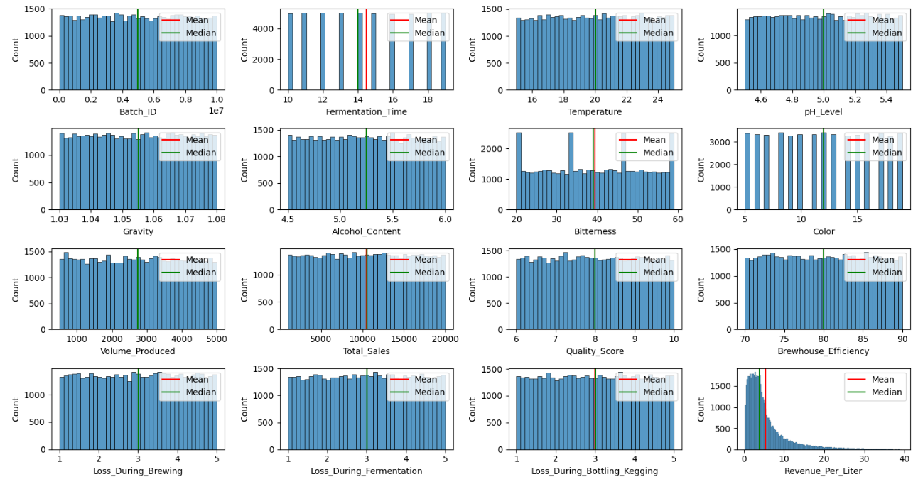
Most Numerical Data Is Uniformly Distributed (Sample)
Target variable for estimation
Notes:
Data looks uniformly distributed. Presumably because it is synthetically generated – likely created to capture all different scenarios / beer classes.
Revenue/liter (also price/liter) is a calculated field. It is distributed around the mean of US$5.4

Slide 5
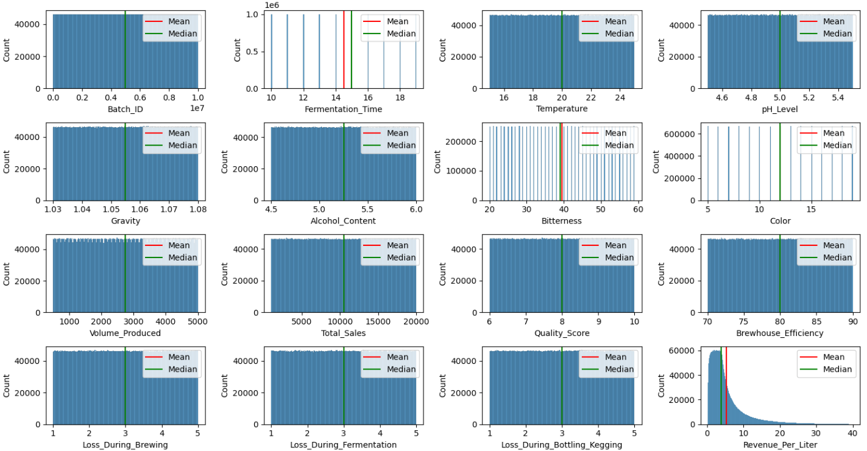
Most Numerical Data Is Uniformly Distributed (Population)
Target variable for estimation

Slide 6
Population Mean Grouped by Beer Style

Slide 7
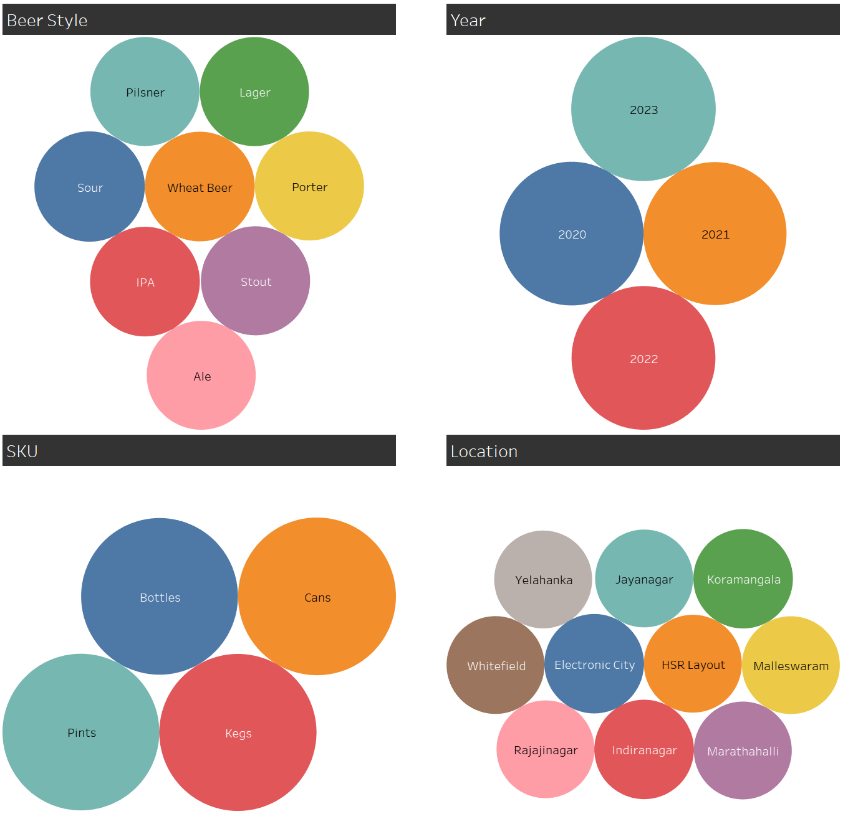
Similarly, Categorical Data Is Uniformly Distributed
Dataset summarizes craft brewery beer data, spanning from January 2020 to December 2023
This is a synthetic database for educational purposes
The database is focused on Bangalore, India
The database has 20 features and 10M rows (scaled down to 50k sample)⁽¹⁾
Most features in the database are uniformly distributed
(1) Ingredient ratio (water:grains:hops) is not included in the charts

Slide 8
Next Steps
We have performed an Exploratory Data Analysis and concluded:
The database is very clean – no N/A or missing values identified
HOWEVER, IT APPEARS TO NOT PRODUCE ANY MEANINGFUL INSIGHTS DUE TO UNIFORM DESTRIBUTIONS FOR ALL PROVIDED FEATURES
It looks like we would need to perform feature scaling as part of our feature engineering process. Specifically, it appears that Volume Produced, Total Sales and Brewhouse Efficiency (to a lesser extent) should be scaled, provided that we use those variables in our modeling
We would also need to change categorical variables (Beer Style, SKU, and Location) to dummy variables
Data science solution for this problem is to build a few statistical models that would be trained to determine per liter price of beer
Plan to use linear regression, decision tree, random forest, and XGBoost. Plan to train the model on training data (80% of the total data) and will test it on testing data (the remaining 20%)
Identified very low correlation between independent variables and the dependent variable
Signals the model may have low predictive power
Additionally, identified low correlation between various independent variables and several instances of multicollinearity

