Slide 1
Protein Tertiary Structure Prediction
Presenter: Jing-Liang Hsin
Date: April 26, 2006

Slide 2
Common Methods
Comparative modeling
  Homology modeling is based on the theory of the property of reservation for homology protein tertiary structure
Fold recognition
  Testing a sequence for compatibility against a library of folds.
Ab initio structure prediction
  Deriving structures, approximate or otherwise, from sequence.

Slide 3
Comparative Modeling
Presuppoition:
  Little changes on protein sequence would also alter little changes on structure.
General Processes:
  Datebase search and template select
  Multiple sequence alignment
  Framework construction, loop structure and side-chains simulation
  Energy minimization
  Reasonableness evaluation

Slide 4
Fold Recognition
General Processes:
  Minimize the total free energy
  Folding model
    HP model
    Lattice model

Slide 5
Ab Initio Method
Two Main Components:
  The potential function.
    Mostly, electrostatics, van der Waals and H-bonds are considered.
    hydrophobic and hydrophilic
  The conformational search method
    Genetic Algorithm
    Ant Colony Optimization
    Molecular Dynamics

Slide 6
A Prediction Method Based on
Curve Alignment
Proposed by Yi-Ying Chen, 2002.
Overview of this method
  Sequence alignment
  Folding algorithm
  B-spline curve fitting

Slide 7
A Prediction Method Based on
Curve Alignment (Cont.)
Input : S1=SSKCSRLKTFPQNACVYHK
S2=SVYCSSLACSDHN
Ouput : The backbone conformation model of S1.
Step 1: Sequence Alignment.
S1=SSKCSRLKTFPQNACVYHK
S2=SVYCSSL------ ACSDHN

Slide 8
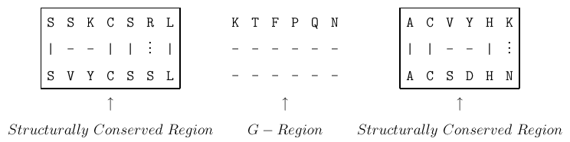
Step 2 : Find the structurally conversed regions. Copy the coordinators of structurally conversed regions from S2 to S1.

Slide 9
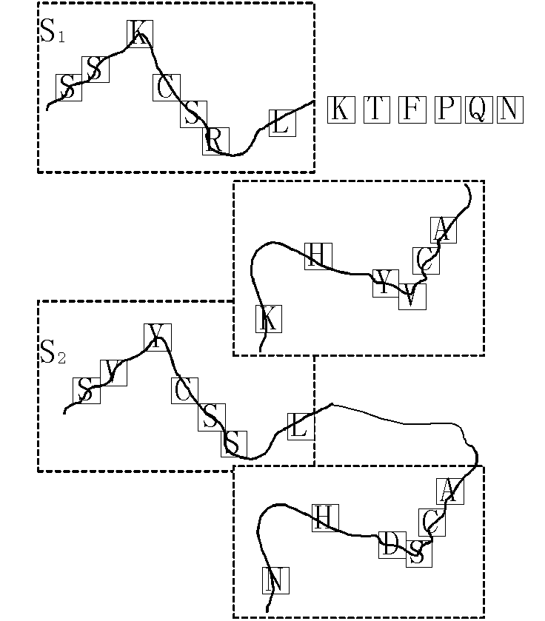

Slide 10
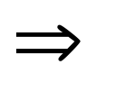
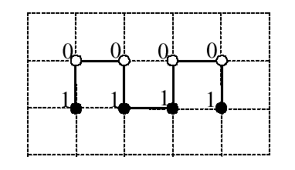
Step 3 : Apply the folding algorithm to position the residues that lose of sequence similarity.
LKTFPQNA 10011001

Slide 11
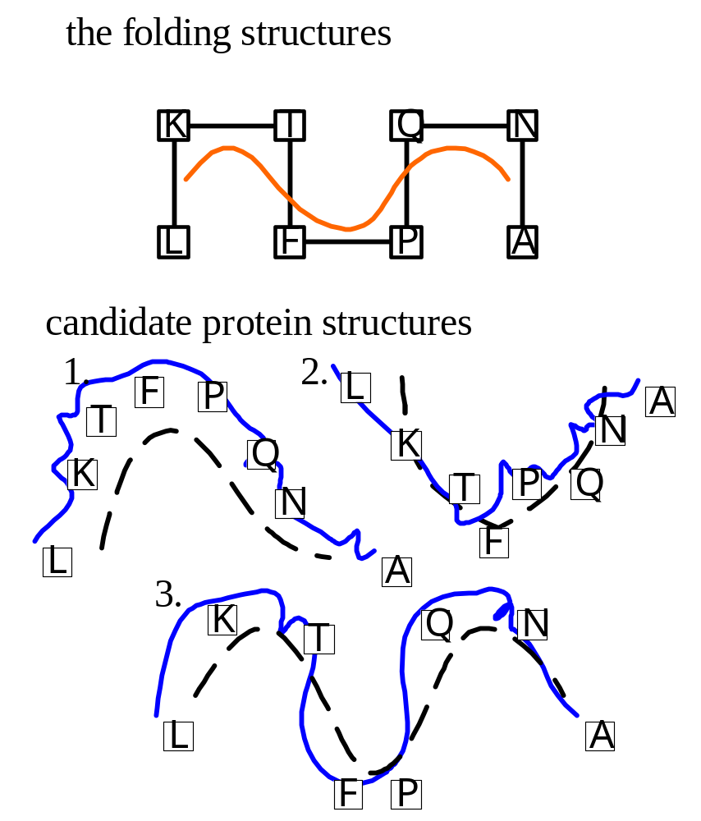
Step 4 :
- Find the the structure-known proteins with 70% or higher sequence similarity.
- Construct a segment of B-spline curve for every four points.

Slide 12
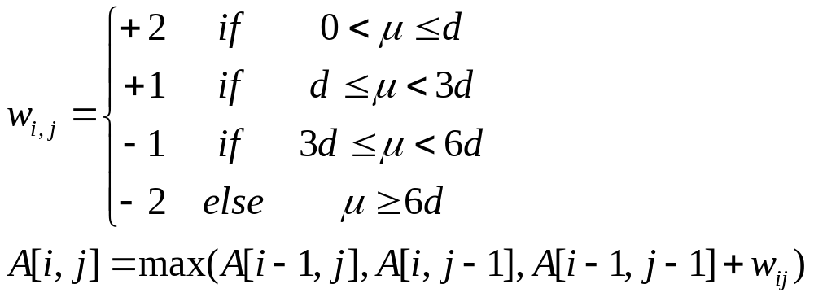
- Apply the curve alignment.
Our score function of the curve alignment.

Slide 13
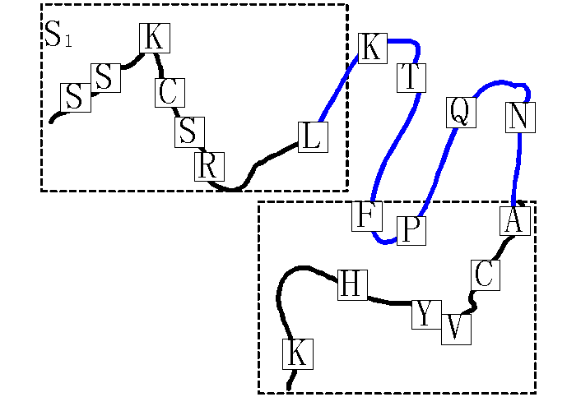
Final conformation

Slide 14
SWISS-MODEL
Search for suitable templates
  BLASTP2
  Will find all similarities of target sequence with sequences of known structure.
Check sequence identity with target
  Will select all templates with sequence identities above 25% and projected model size larger than 20 residues.
  Furthermore, this step will detect domains which can be modelled based on unrelated templates.

Slide 15
SWISS-MODEL (Cont.)
Generate models with ProModII
  Dynamic sequence alignment algorithm.
  Regions with sequence similarity are selected and the corresponding residues matched in three-space.
  The primary match is further refined using expanding context possible.
Energy minimisation with Gromos96

Slide 16
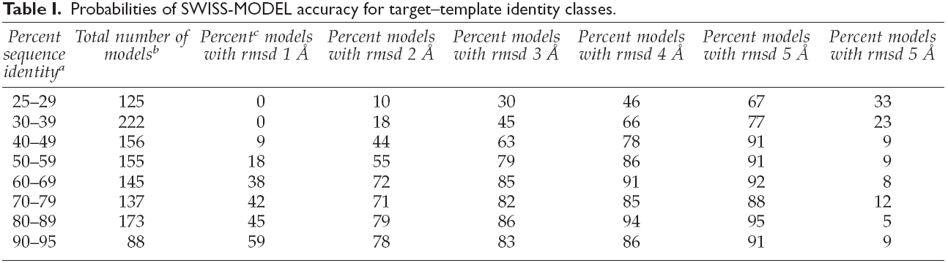
SWISS-MODEL (Cont.)
Torsten Schwede and Alexander Diemand, 2000

Slide 17
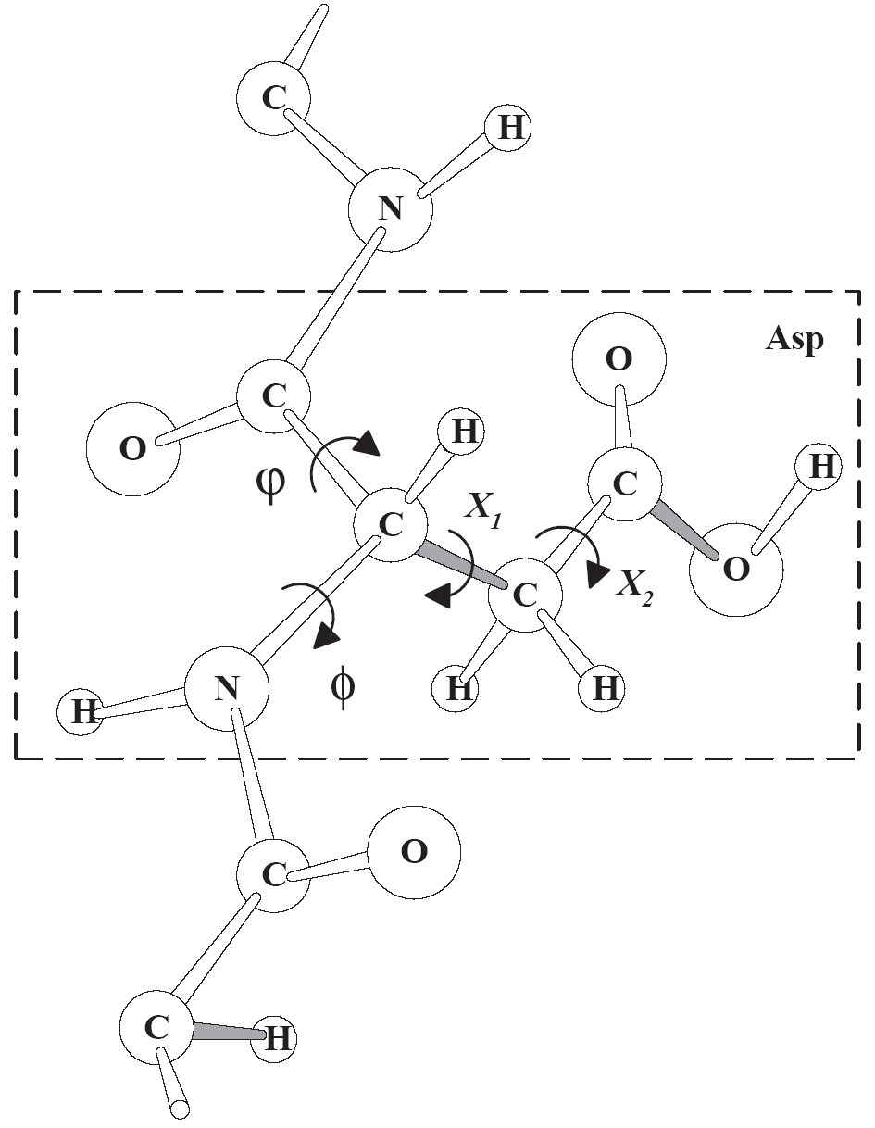
Side-chain Prediction
Polypeptide Chain

Slide 18
Side-chain Prediction (Cont.)
The Protein Side-chain Packing Problem assume a fixed backbone.
Search Space
  All possible rotamers
  Rotamer library
Search Method
  Gene algorithm
  Linear programming
  Maximal clique

Slide 19
7th Community Wide Experiment on the
Critical Assessment of Techniques for Protein Structure Prediction
CASP7 will particularly address the following questions:
  Are the models produced similar to the corresponding experimental structure?
  Is the mapping of the target sequence onto the proposed structure (i.e. the alignment) correct?
  Have similar structures that a model can be based on been identified?
  Are comparative models more accurate than can be obtained by simply copying the best template?
  Has there been progress from the earlier CASPs?
  What methods are most effective?
  Where can future effort be most productively focused?

Slide 20
7th Community Wide Experiment on the
Critical Assessment of Techniques for Protein Structure Prediction
Scope
  Tertiary structure predictions
    Template based modeling
    Template free modeling
  High resolution models
    This new category will include a subset of tertiary structure models where the backbone is sufficiently accurate that the details of side chains, loops, and active sites can be meaningfully assessed.
  Other predictions
    Function prediction

Slide 21
7th Community Wide Experiment on the
Critical Assessment of Techniques for Protein Structure Prediction
Protein Structure Prediction Center
  Genome Center University of California
  http://predictioncenter.org/

Slide 22
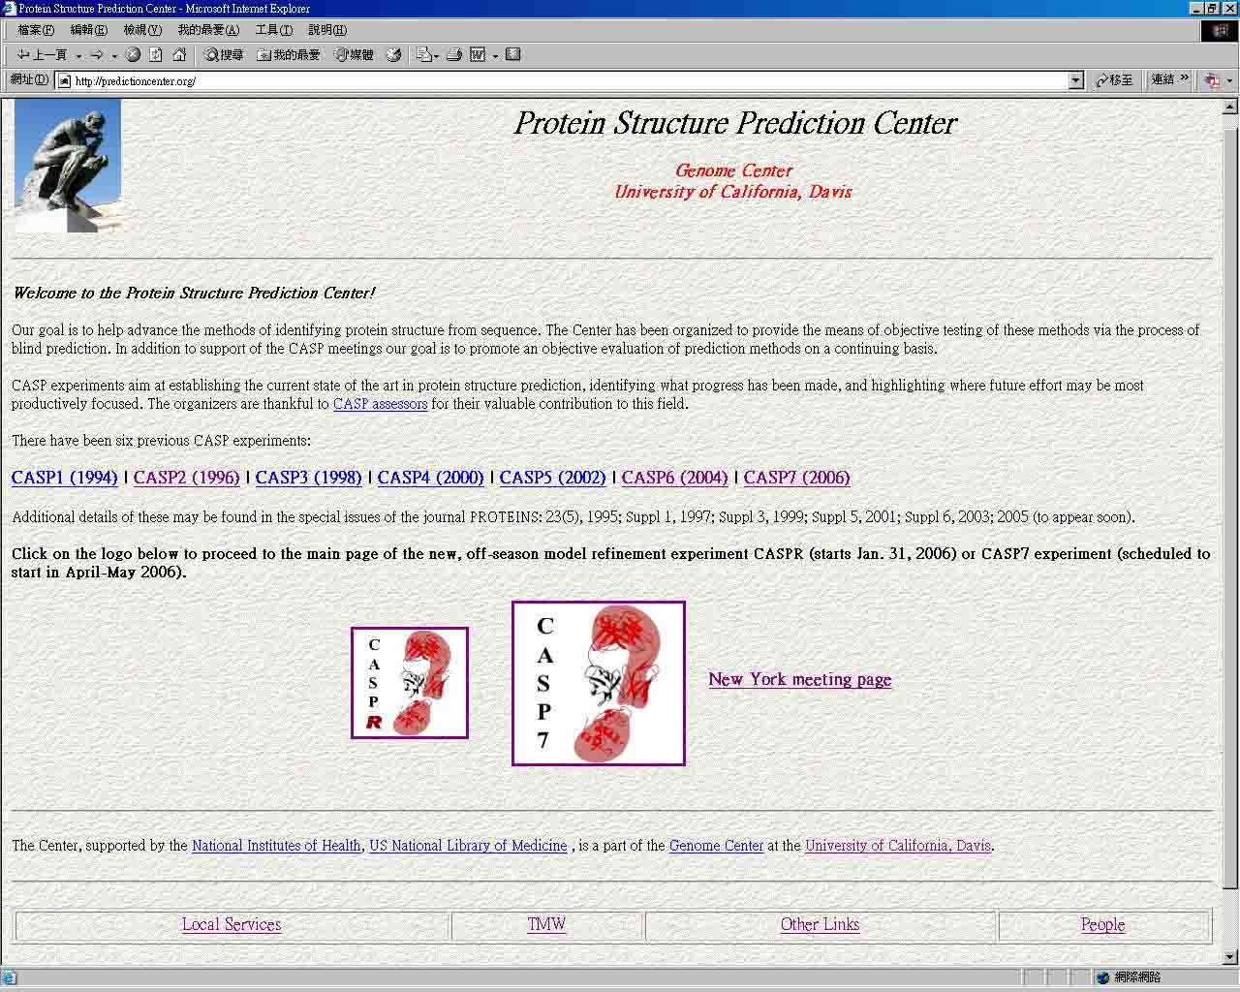

Slide 23
