Slide 1
Comparing Sequences with Segment Rearrangements
F. Ergun, S. Muthukrishnan and S. C. Sahinalp
FST TCS 2003: Foundations of software technology and theoretical computer science, Vol. 2914 of Lecture Notes in Computer Science, pp. 183-194, 2003
Date: May 18, 2006
Introducer: Hsing-Yen Ann

Slide 2
Abstract
Computational genomics involves comparing sequences based on "similarity" for detecting evolutionary and functional relationships. Until very recently, available portions of the human genome sequence (and that of other species) were fairly short and sparse. Most sequencing effort was focused on genes and other short units; similarity between such sequences was measured based on character level differences. However with the advent of whole genome sequencing technology there is emerging consensus that the measure of similarity between long genome sequences must capture the rearrangements of large segments found in abundance in the human genome.

Slide 3
Abstract (cont’d)
In this paper, we abstract the general problem of computing sequence similarity in the presence of segment rearrangements. This problem is closely related to computing the smallest grammar for a string or the block edit distance between two strings. Our problem, like these other problems, is NP hard. Our main result here is a simple O(1) factor approximation algorithm for this problem. In contrast, best known approximations for the related problems are factor Ω(n) off from the optimal. Our algorithm works in linear time, and in one pass. In proving our result, we relate sequence similarity measures based on different segment rearrangements, to each other, tight up to constant factors.

Slide 4
Problem Definition
Edit operations:
-- character edits: character insertions, deletions, replacements
-- segment edits: substring relocations, deletions, duplications
Properties:
-- edit operations may overlap arbitrarily.
-- asymmetric distance
d(abc →φ) = 1, d(φ→ abc) = 3.
Example: d(φ→ acaabaaca) = 6
φ → b → ba → aba → abaaba → acaaba → acaabaaca

Slide 5
Approximation Models (1)
d(R→S): Transformation from R to S with working string S'.
  Block moves, copies and deletions.
  external model: only substrings of R can be copied to new S'.
  internal model: substrings of R / S' can be copied to new S'.
  The two models are both NP-hard.
Example 1:
  d_{ext}(φ→ acaabaaca) = 9 (9 character insertions)
  d_{int}(φ→ acaabaaca) = 6
  φ → a → ac → aca → acaab → acaaba → acaabaaca
Example 2:
  d_{ext}(abc→ cbacbacbacba) = 12 (12 character insertions)
  d_{int}(abc→ cbacbacbacba) = 5
  φ → c → ba → cba → cbacba → cbacbacbacba

Slide 6
Approximation Models (2)
External: (no relocations)
  d_{ext}(R→S): arbitrary copies and deletions.
  e_{ext}(R→S): arbitrary copies from R to S'.
  g_{ext}(R→S): copies from R to left / right boundary of S'.
  c_{ext}(R→S): copies from R to right boundary of S'.
Internal:
  d_{int}(R→S): arbitrary moves, copies and deletions.
  e_{int}(R→S): arbitrary moves and copies from R / S' to S'.
  c_{int}(R→S): copies from R / S' to right boundary of S'.

Slide 7
Approximation Models (3)
External: (no relocations)
  d_{ext}(R→S): arbitrary copies and deletions.
  e_{ext}(R→S): arbitrary copies from R to S'.
  g_{ext}(R→S): copies from R to left / right boundary of S'.
  c_{ext}(R→S): copies from R to right boundary of S'.
Claims:
  d_{ext}(R→S) ≦ e_{ext}(R→S) ≦ 2．d_{ext}(R→S)
  e_{ext}(R→S) ≦ g_{ext}(R→S) ≦ 2．e_{ext}(R→S)
  g_{ext}(R→S) = c_{ext}(R→S)
  c_{ext}(R→S) can be computed in linear time
Theorem 1:
c_{ext}(R→S) provides a 4-approximation to d_{ext}(R→S) in linear time.

Slide 8
Approximation Models (4)
Internal:
  d_{int}(R→S): arbitrary moves, copies and deletions.
  e_{int}(R→S): arbitrary moves and copies from R / S' to S'.
  c_{int}(R→S): copies from R / S' to right boundary of S'.
Claims:
  d_{int}(R→S) ≦ e_{int}(R→S) ≦ 4．d_{int}(R→S)
  e_{int}(R→S) ≦ c_{int}(R→S) ≦ 3． e_{int}(R→S)
  c_{int}(R→S) can be computed from Lempel-Ziv-77 phrases in linear time.
Theorem 2:
c_{int}(R→S) provides a 12-approximation to d_{int}(R→S) in linear time.

Slide 9
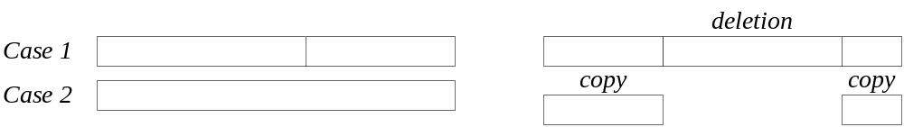
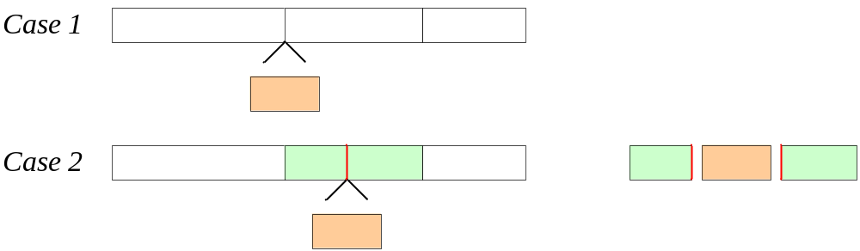
Notes
d_{ext}(R→S) ≦ e_{ext}(R→S) ≦ 2．d_{ext}(R→S)
e_{ext}(R→S) ≦ g_{ext}(R→S) ≦ 2．e_{ext}(R→S)

