Slide 1
Prediction of protein structural classes by support vector machines
Computers and Chemistry 26 (2002) 293–296
Yu-Dong Cai, Xiao-Jun Liu, Xue-biao Xu, Kuo-Chen Chou
Presenter: Jen-Hui Wang
Date: June 15, 2006

Slide 2
Abstract
In this paper, we apply a new machine learning method which is called support vector machine to approach the prediction of protein structural class. The support vector machine method is performed based on the database derived from SCOP which is based upon domains of known structure and the evolutionary relationships and the principles that govern their 3D structure. As a result, high rates of both self-consistency and jackknife test are obtained. This indicates that the structural class of a protein inconsiderably correlated with its amino acid composition, and the support vector machine can be referred as a powerful computational tool for predicting the structural classes of proteins.

Slide 3
Introduction
Protein structure:
all-α
all-β
α/β
α+β
ζ: high irregular
Protein structural class can be predicted according to amino acid composition alone to some extent (chou,1980,1989;…)

Slide 4


Support vector machine
a set of samples:
a series of input vectors (training vector)
corresponding labels
a hyperplane which separates all data

Slide 5



The linear separable case
Hyperplane:
Decision Function:

Slide 6
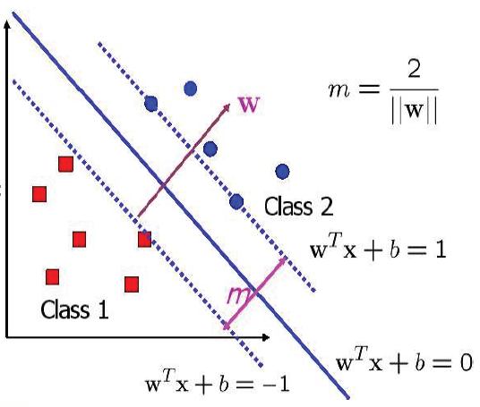
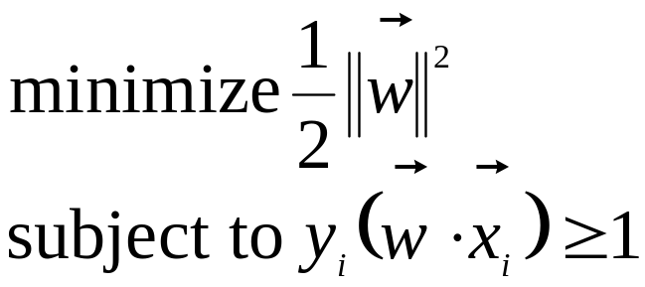
The linear separable case
This is a QP(Quadratic Programming) problem
- Lagrange multipliers α_{i}

Slide 7

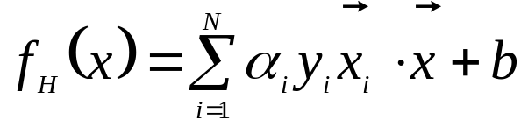

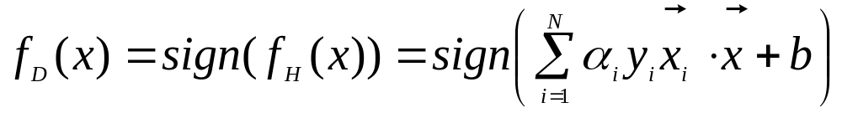
The linear separable case
Optimal separating hyperplane(OSH):
Decision function:

Slide 8
The linear non-separable case
Soft margin
Kernel function

Slide 9
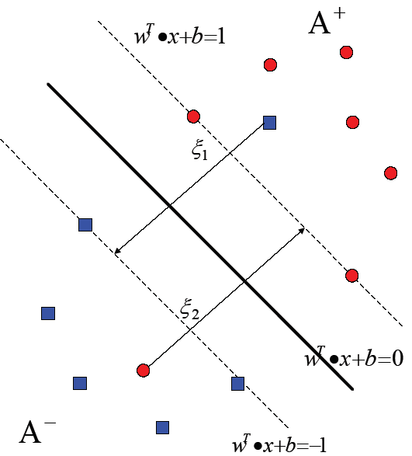


Soft margin
Slack variable:
ξ_{i}≧0, i=1…N

Slide 10
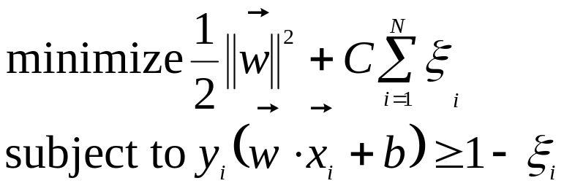
Soft margin
The OSH can be found by
C: A regularization parameter used to decide a trade-off between the training error and the margin.

Slide 11
Kernel function
SVM performs a non-linear mapping of the input vector x from the input space R^{d} to a higher dimensional Hilbert space, where the mapping is determined by the kernel function.

Slide 12
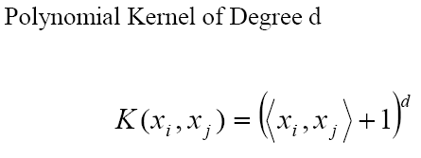
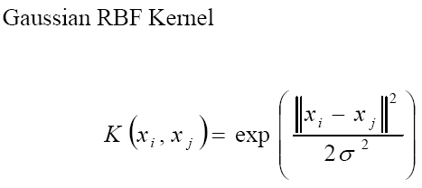
Kernel function
Two typical kernel function:

Slide 13

Kernel function
Decision function:

Slide 14
The training and prediction of protein structural class
According to its amino acid composition, a protein can be represented by a point or a vector in a 20-D space.
The amino acid composition is taken as the input of the SVM.
For the four-class problems, we use a simple and effective method: “one-against-others”
For the SVM, the width of the Gaussian RBFs is selected as that which minimized an estimate of the VC-dimension
After being trained, the hyperplane output by the SVM was obtained. (trained model)

Slide 15
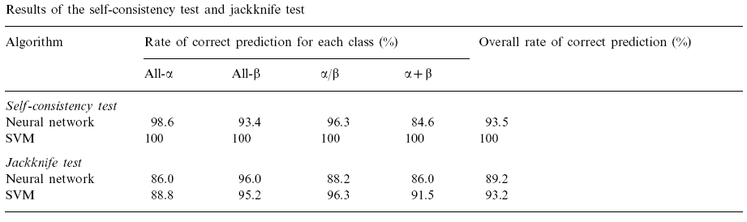
Results

Slide 16
Conclusions
The above results, together with those obtained by
the other prediction algorithms, indicate that the structural class of a protein is considerably correlated with its amino acid composition. It is anticipated that the SVM method and the elegant covariant discriminant algorithm , if complemented with them, will become a very useful tool for predicting the structural classes of proteins.

