Slide 1
GIB: Steps Toward an Expert-Level Bridge-Playing Program
Matthew L. Ginsberg
IJCAI. 1999. p. 584-593.
Presenter: Yun-An Chen
Date: Sept. 6, 2022

Slide 2
Abstract
This paper describes GIB, the first bridge-playing program to approach the level of a human expert. (GIB finished twelfth in a hand-picked field of thirty-four experts at an invitational event at the 1998 World Bridge Championships.) We give a basic overview of the algorithms used, describe their strengths and weaknesses, and present the results of experiments comparing GIB to both human opponents and other programs.

Slide 3
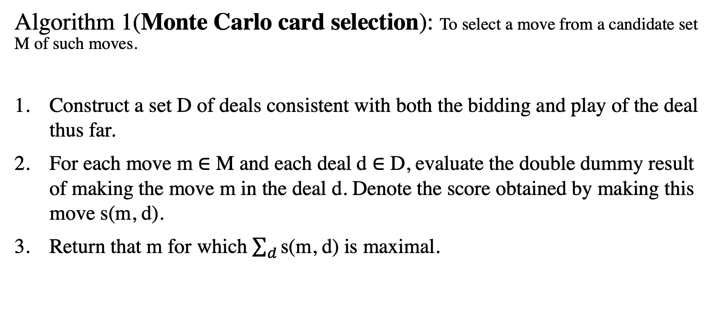
Card play
Algorithm 1(Monte Carlo card selection): To select a move from a candidate set M of such moves.
Construct a set D of deals consistent with both the bidding and play of the deal thus far.
For each move m ∈ M and each deal d ∈ D, evaluate the double dummy result of making the move m in the deal d. Denote the score obtained by making this move s(m, d).
Return that m for which $\sum_{d}{\text{s}\text{(}\text{m}\text{, }\text{d}\text{)}}$ is maximal.

Slide 4



Card play
GIB uses its existing analyses to identify mistakes that the opponents might make.
$\sum_{d}{\text{s}\text{(}\text{m}\text{, }\text{d}\text{)}}$
$\sum_{d}{w_{d}\text{s}\text{(}\text{m}\text{, }\text{d}\text{)}}$
K
$w_{d}$: the weight assigned to deal d.
80% that west holds the SK
5
(GIB)

Slide 5
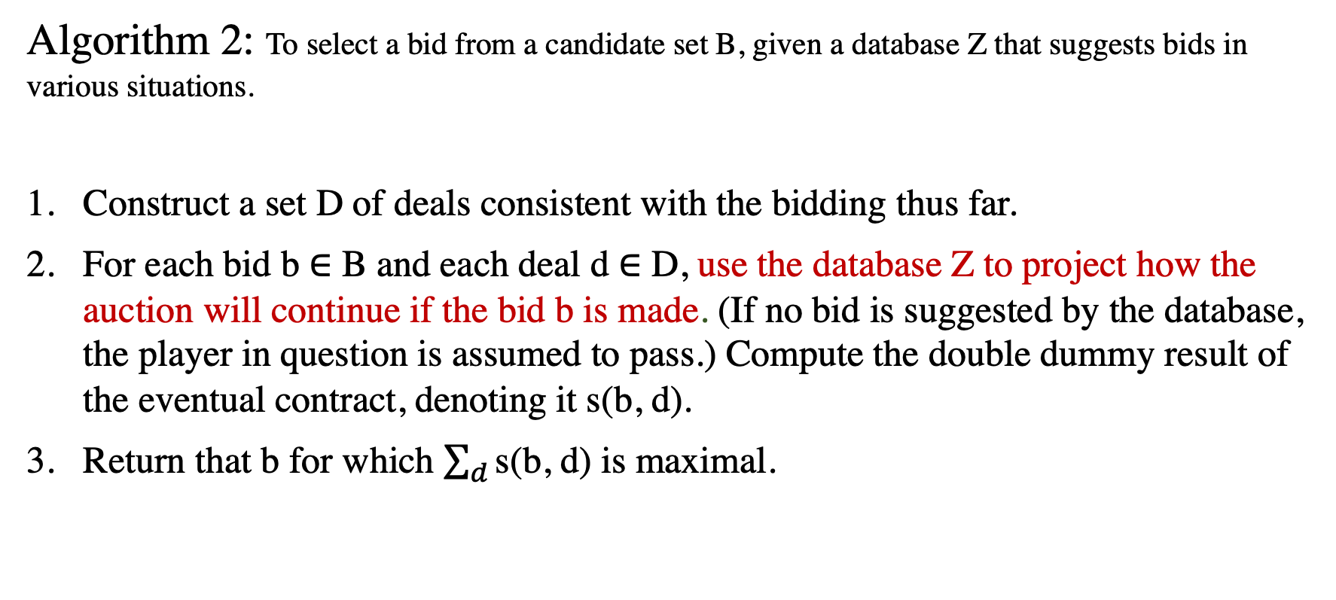
Bidding
Algorithm 2: To select a bid from a candidate set B, given a database Z that suggests bids in various situations.
Construct a set D of deals consistent with the bidding thus far.
For each bid b ∈ B and each deal d ∈ D, use the database Z to project how the auction will continue if the bid b is made. (If no bid is suggested by the database, the player in question is assumed to pass.) Compute the double dummy result of the eventual contract, denoting it s(b, d).
Return that b for which $\sum_{d}{\text{s}\text{(}\text{b}\text{, }\text{d}\text{)}}$ is maximal.

Slide 6
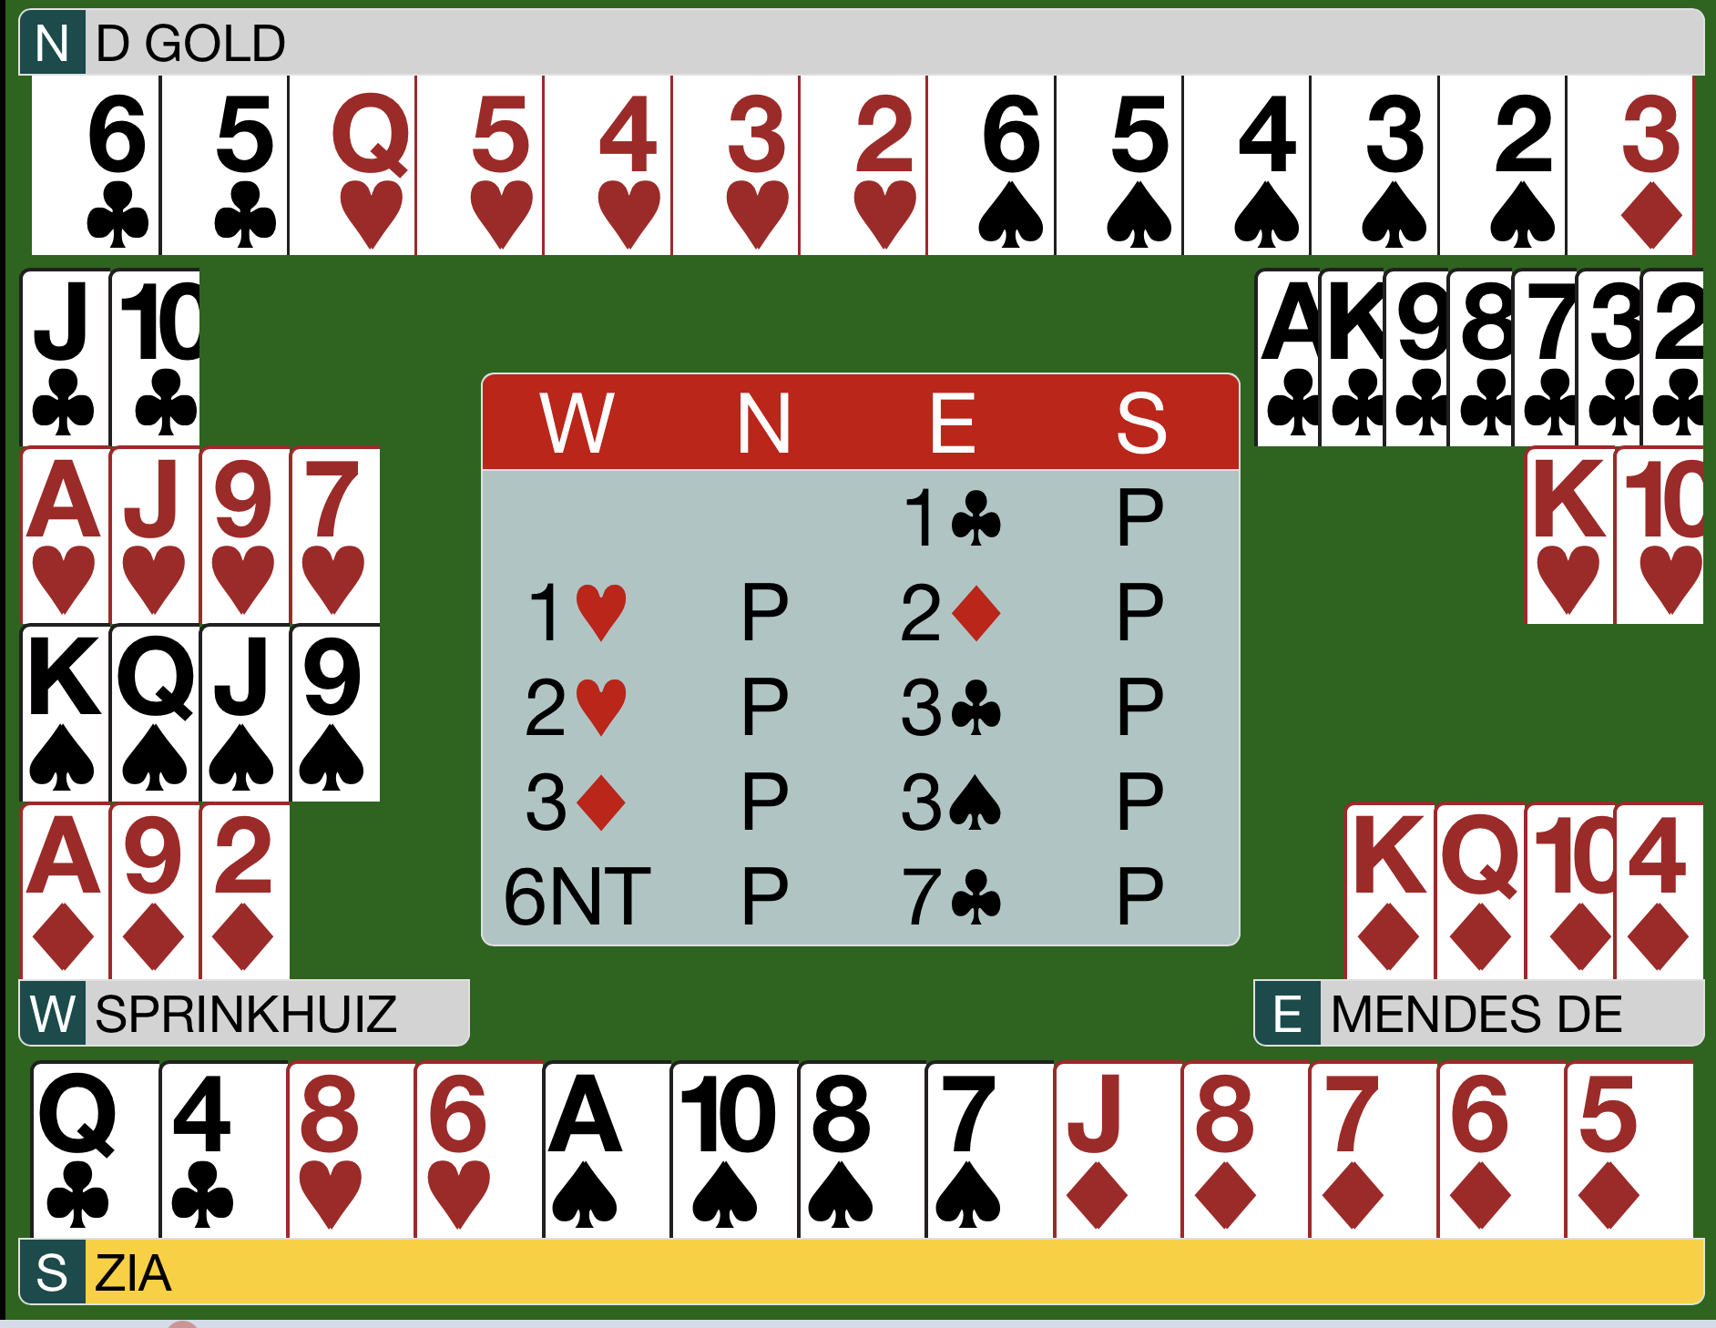
Dataset of deals
Dataset of deals: the bidding and play of the deal.
Simplify the auction as observed, building constraints describing each of the hands.
Deal hands consistent with the constraints using a deal generator.
Test this set of deals to remove elements that do not satisfy the remaining constraints.

Slide 7
Bidding database Z
GIB’s database is built using a derivative of the Meadowlark language, and includes about 3000 rules.
Meadowlark has two main systems: SAYC and 2/1.
Ginsberg, M. L. (2001). GIB: Imperfect information in a computationally challenging game. Journal of Artificial Intelligence Research, 14, 303-358.

Slide 8
Meadowlark language
1. The next bid is selected from a prioritized list of available bids that match the description of the hand.
1H-4C would be a higher priority bid than 1NT forcing.
2. Use a hand evaluator for all four hands, then generate hands matching the bidding, get the scores based on what the evaluator says can be made for the bid being considered, and use the accumulated best bid.
Ginsberg, M. L. (2001). GIB: Imperfect information in a computationally challenging game. Journal of Artificial Intelligence Research, 14, 303-358.

Slide 9
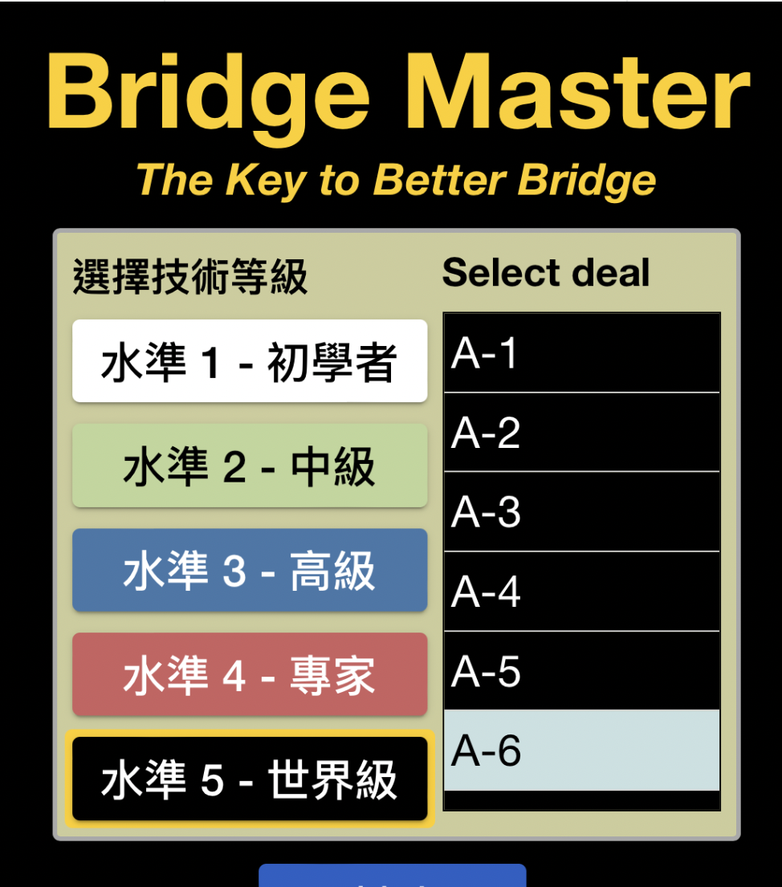
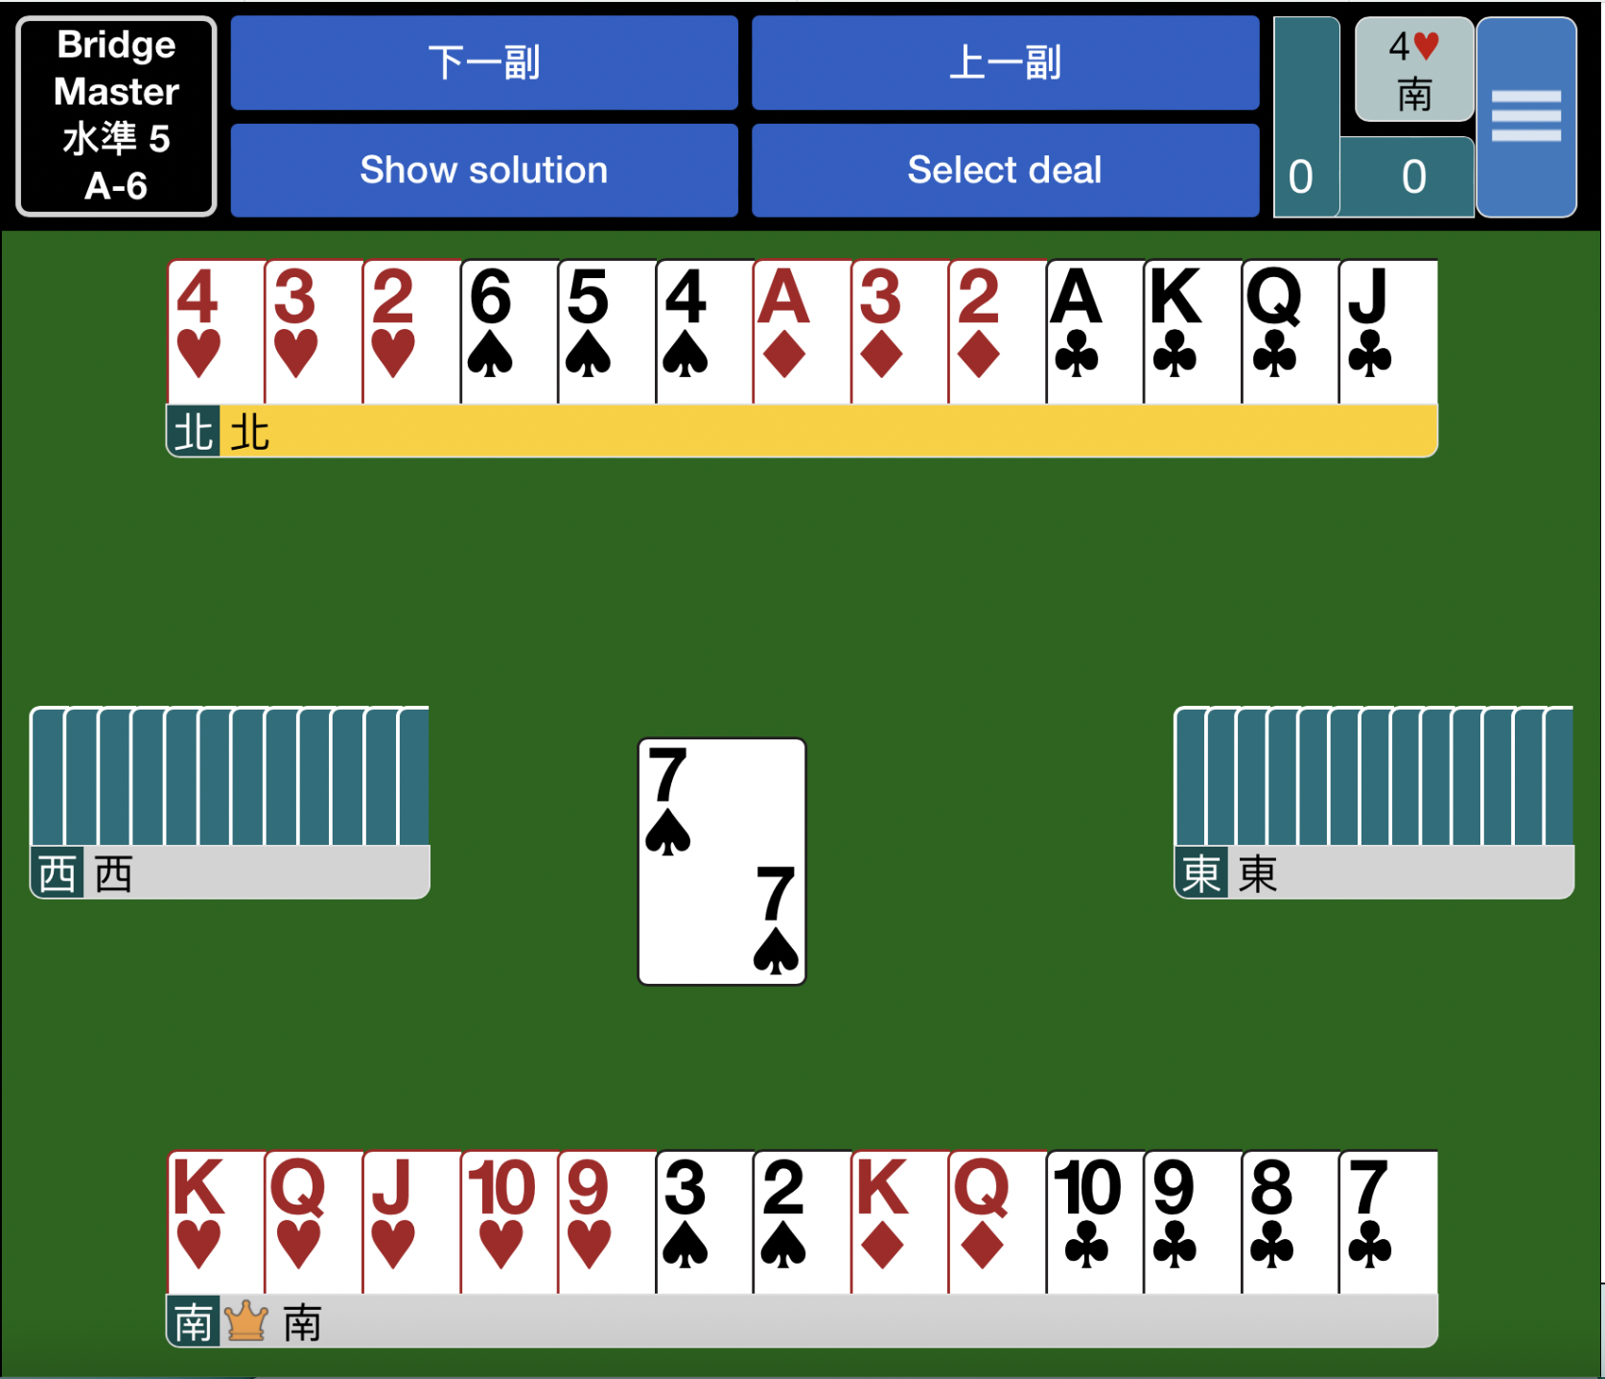
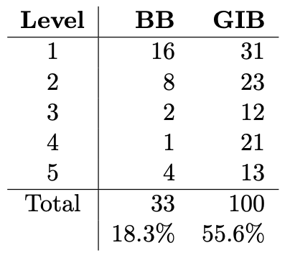
GIB’s performance
Use Bridge Master (BM) to evaluate the strength of GIB’s play.

Slide 10
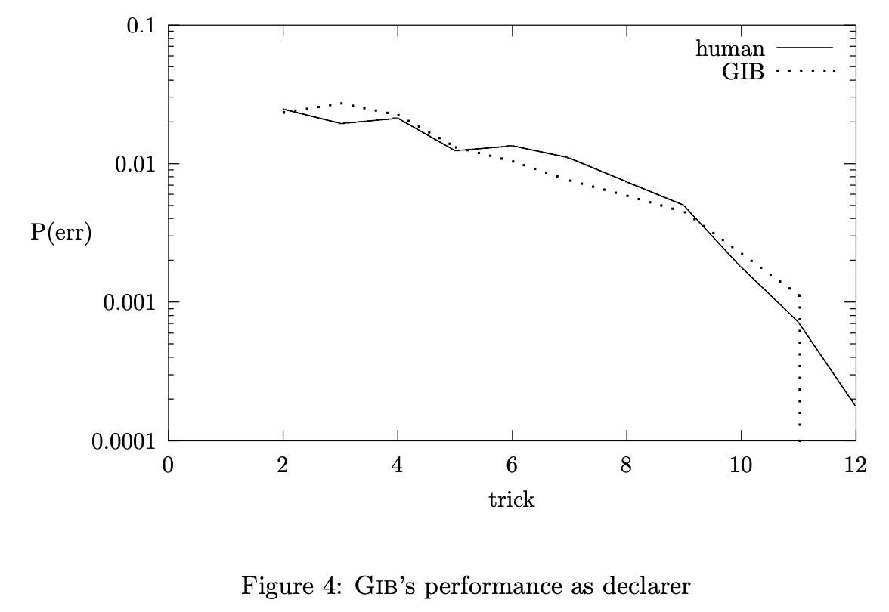
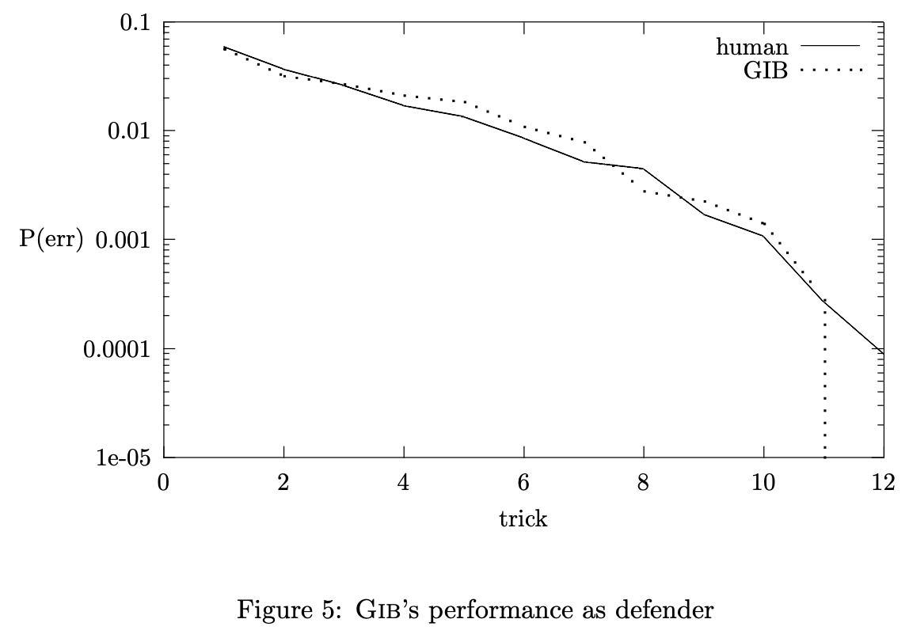
GIB’s performance
Ginsberg, M. L. (2001). GIB: Imperfect information in a computationally challenging game. Journal of Artificial Intelligence Research, 14, 303-358.

Slide 11
GIB compared
Other programs:
GIB participated in the 1998 World Computer Bridge Championships, along with six other computer programs, including Bridge Baron.
GIB won every match it played in the round robin, accumulating 95 out of a possible 120 victory points.
In the knockout phase, it beat Bridge Baron by 84 IMPS over 48 deals.
In the finals, it beat Q-Plus Bridge by 63 IMPS over 64 deals.

Slide 12
GIB compared
Human:
GIB played 14 deal against human world champions Zia Mahmood and Michael Rosenberg, losing by a total of 6.4 IMPS.
GIB played thousands of deals against human opponents of various levels on OKBridge, it was losing at the rate of 0.2 IMPs/deal.

