Slide 1
A Hybrid Heuristic-Genetic Algorithm with Adaptive Parameters for Static Task Scheduling in Heterogeneous Computing System
Shan Ding, Jinhui Wu, Guoqi Xie and Gang Zeng
2017 IEEE Trustcom/BigDataSE/ICESS
Presenter: Chih-Hsuan Chien​
Date: Sept. 6, 2022

Slide 2
Abstract (1/2)
Task scheduling is critical for obtaining a high performance schedule in heterogeneous computing systems (HCS) and searching an optimal scheduling solution has been shown to be NP-complete. In this paper, a hybrid heuristicgenetic algorithm with adaptive parameter (HGAAP) is proposed by combining a heuristic scheduling algorithm and a genetic algorithm. An existing common heuristic scheduling algorithm is utilized for generating the initial generation to speed up the convergence rate of HGAAP. The parameters of crossover probability and mutation probability are adaptive according to the current evolution status to promote the evolution and find better solution.
Notes:
Paradigm 示範
Viable 可行的
Orchestration 編排

Slide 3
Abstract (2/2)
Moreover, the redundant individuals in each generation are removed to keep the diversity of population during the iteration. The experimental results on randomly generated task sets validated that our algorithm can obtain better scheduling results than existing algorithms.

Slide 4
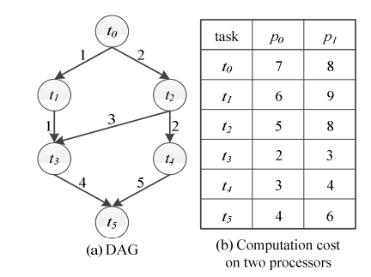
Heterogeneous Computing

Slide 5
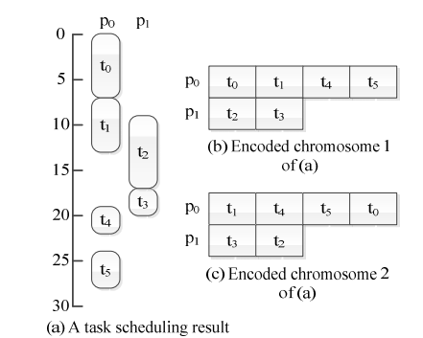
Encode

Slide 6
Initialiazation
Random-generated and HEFT

Slide 7
fitness
1/makespan

Slide 8
Selection
10% chromosomes with the highest fitness values are selected as the elitism set.

Slide 9
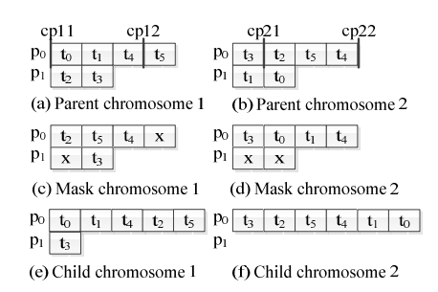
Crossover

Slide 10
Mutation
Exchange the position of two task

Slide 11
Deleting the Redundant Chromosomes
重複的解，只保留一個，其他做mutation產生新的解

Slide 12
Parameters Adaptation
Initial:crossover rate=5% mutation rate=10%
If cannot envolve in next n iteration => mutation rate +10%.
If mutation rate =100% => mutation rate =10%, crossover rate +5%
Termination:crossover rate and mutation rate are both 100%

Slide 13
Experiment
100 DAGs are randomly selected from the generated DAG set and are used to tune HGAAP and find out the best parameters
Best n=7,population=17

Slide 14


Experiment
Notes:
把所有task放在computation sum最小的processor上

Slide 15
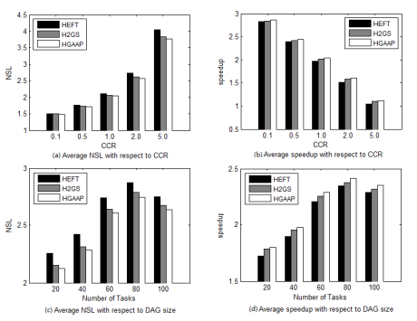
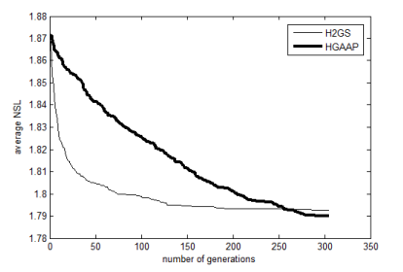
Experiment

