Slide 1
Modified Genetic Algorithm
for Solving n-Queens Problem
Jalal eddin Aghazadeh heris, Mohammadreza Asgari Oskoei
Iranian Conference on Intelligent Systems (ICIS), 2014
Presenter: Chen Guan-Jie
Date: Sept, 13, 2022

Slide 2
Abstract (1 / 2)
Genetic algorithm is applicable to a wide range of constraint satisfaction problems such as n-queens problem. In the absence of specialized solution for a particular problem, genetic algorithm would be efficient. But holism and random choices cause problem for genetic algorithm in searching large state spaces. So, the efficiency of this algorithm would be demoted when the size of state space of the problem grows exponentially. In this paper, we attempt to cover this weakness by using local search algorithm like minimal conflicts algorithm.

Slide 3
Abstract (2 / 2)
Minimal conflicts algorithm is trying to provide partial view for genetic algorithm by locally searching the state space. This may cause genetic algorithm to take longer steps toward the solution. Modified genetic algorithm, is the result of collaboration between genetic algorithm and minimal conflicts algorithm. Comparing the results of applying standard genetic algorithm and modified genetic algorithm on n-queens problem in section VI, indicates the amount of performance improvement.

Slide 4
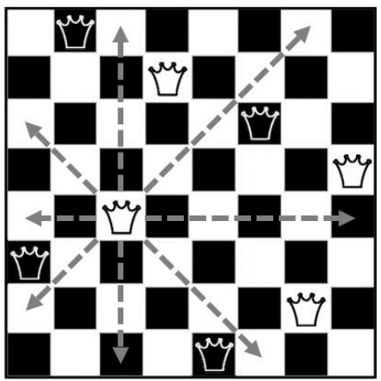
N-queens Problem
Rules
．1: no two queens can share a same row
．2: no two queens can share a same column
．3: no two queens can share a same diameter

Slide 5



N-queens Problem
Constraints
(rule2)
(rule1)
(rule3)
A={(3, 8, 4, 7, 1, 6, 2, 5)}

Slide 6
Modified Genetic Algorithm vs Standard Genetic Algorithm
．Minimal conflicts algorithm
．Crossover with best break-point
．Greedy initialization instead of random initialization

Slide 7
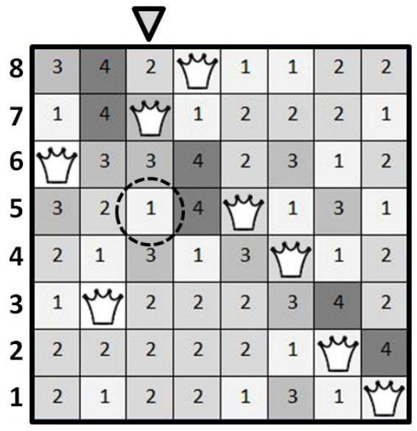
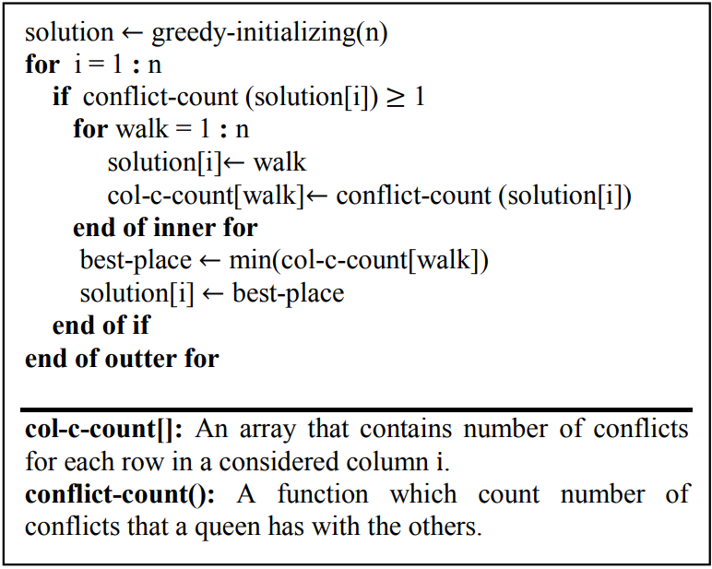
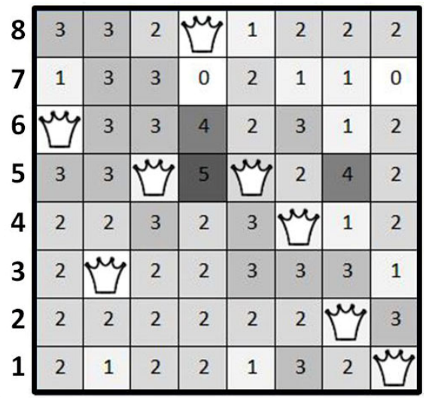
Minimal Conflicts Algorithm

Slide 8
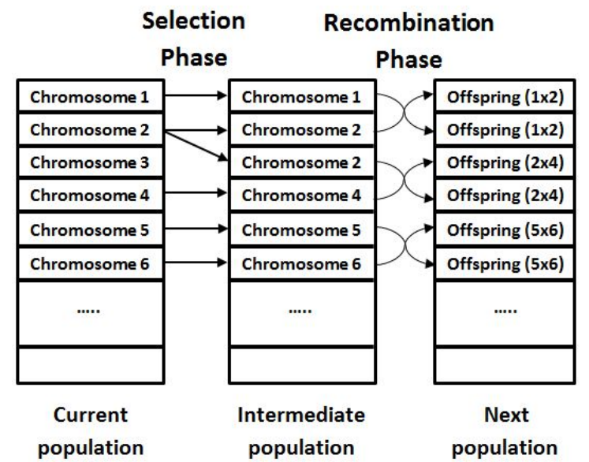

Genetic Algorithm
Roulette Wheel Fomula
(Selection Phase)
fi: the fitness function
(is measure of distance or proximity of a candidate for problem’s solution)
k: size of population

Slide 9
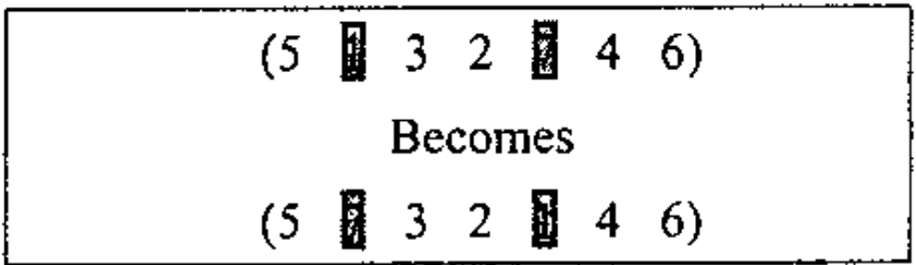
Standard Genetic Algorithm (Recombination Phase)
Mutation

Slide 10
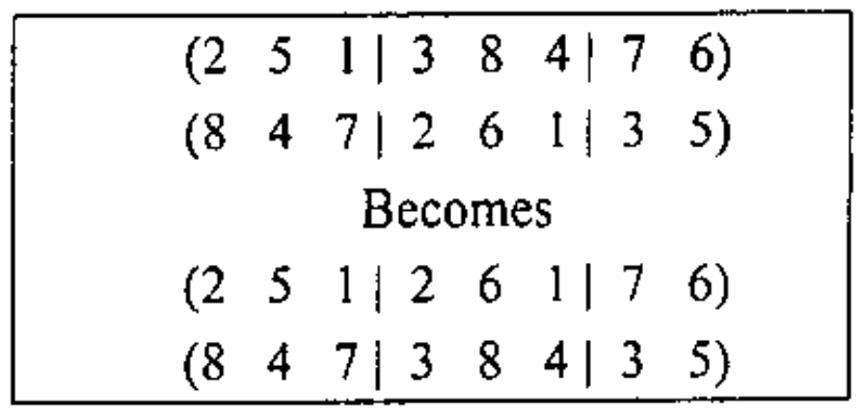
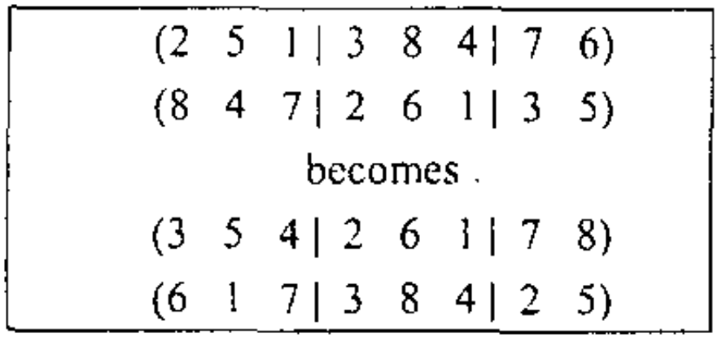
Standard Genetic Algorithm (Recombination Phase)
PMX Crossover
Invalid
Fixed

Slide 11
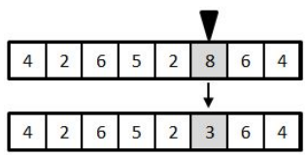
Modified Genetic Algorithm (Recombination Phase)
Mutation

Slide 12
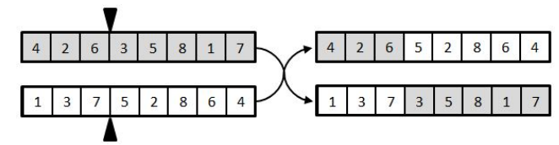
Modified Genetic Algorithm (Recombination Phase)
Crossover

Slide 13
Greedy Initialization
♛ | 1 | 1 | 1
1 | 1 | 0 | 0
1 | 0 | 1 | 0
1 | 0 | 0 | 1
♛ | 2 | 1 | 2
2 | 2 | 1 | 0
2 | ♛ | 2 | 1
2 | 1 | 1 | 1

Slide 14
Greedy Initialization
♛ | 3 | 2 | 3
3 | 3 | ♛ | 1
2 | ♛ | 3 | 2
3 | 1 | 2 | 1
♛ | 3 | 2 | 4
3 | 4 | ♛ | 2
2 | ♛ | 4 | 3
4 | 2 | 3 | ♛
(not a solution)

Slide 15
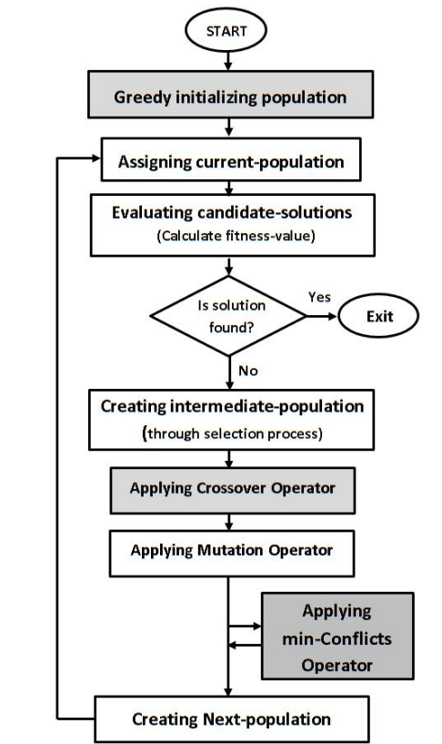
Flowchart
Gray areas: modified section of standard genetic algorithm

Slide 16
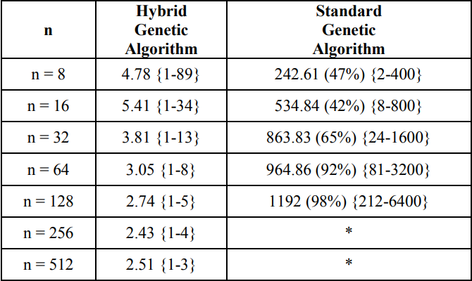
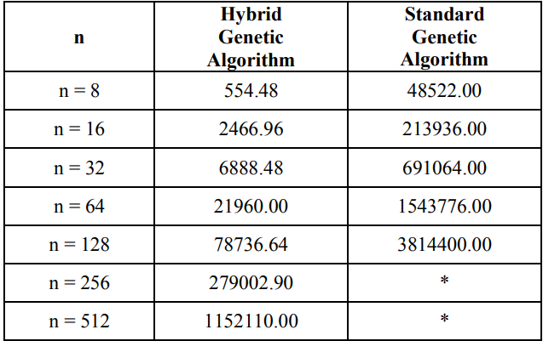
Result
Average Times of Evaluating Fitness Function
Average Number of Iterations

Slide 17
Thanks for your patience

