Slide 1
Efficient String Matching an Aid to Bibliographic Search
A. V. Aho, M. J. Corasick,
Communications of the ACM, Vol. 18, 1975, pp. 333~340
Presenter: Guan-Ting Chen
Date: Sept. 13, 2022

Slide 2
Abstract
This paper describes a simple, efficient algorithm to locate all occurrences of any of a finite number of keywords in a string of text. The algorithm consists of constructing a finite state pattern matching machine from the keywords and then using the pattern matching machine to process the text string in a single pass. Construction of the pattern matching machine takes time proportional to the sum of the lengths of the keywords. The number of state transitions made by the pattern matching machine in processing the text string is independent of the number of keywords. The algorithm has been used to improve the speed of a library bibliographic search program by a factor of 5 to 10.

Slide 3
String Matching
Goto Function
Failure Function
Output Function

Slide 4
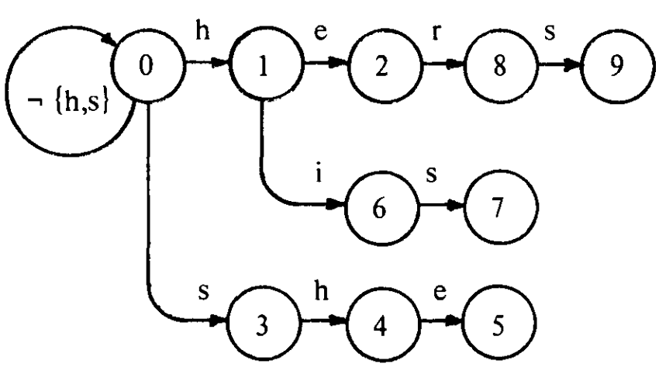
Goto Function

Slide 5
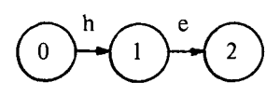
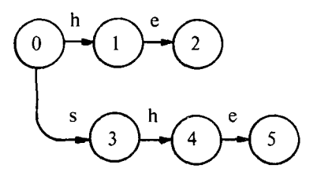
Goto Function (cont.)
index | Pattern
1 | he
2 | she
3 | his
4 | hers

Slide 6
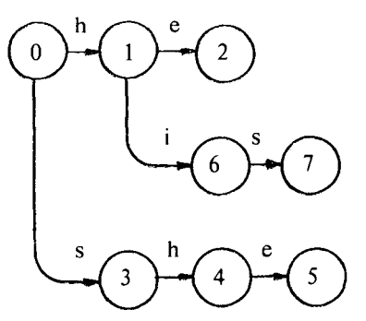
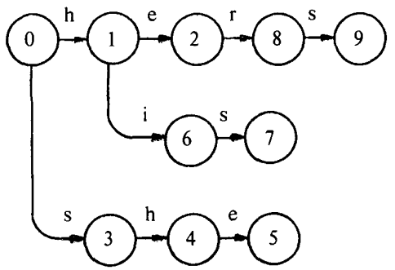
Goto Function (cont.)
index | Pattern
1 | he
2 | she
3 | his
4 | hers

Slide 7
Output Function
index | Pattern
1 | he
2 | she
3 | his
4 | hers

Slide 8
Failure Function
Depth: 1

Slide 9
Failure Function (cont.)
i | 1 | 2 | 3 | 4 | 5 | 6 | 7 | 8 | 9
f(i) | 0 |  | 0
Depth: 1

Slide 10
Failure Function (cont.)
Depth: 2

Slide 11
Failure Function (cont.)
i | 1 | 2 | 3 | 4 | 5 | 6 | 7 | 8 | 9
f(i) | 0 | 0 | 0

Slide 12
Failure Function (cont.)
i | 1 | 2 | 3 | 4 | 5 | 6 | 7 | 8 | 9
f(i) | 0 | 0 | 0 | 1

Slide 13
Failure Function (cont.)
i | 1 | 2 | 3 | 4 | 5 | 6 | 7 | 8 | 9
f(i) | 0 | 0 | 0 | 1 | 2 | 0

Slide 14
Failure Function (cont.)
i | 1 | 2 | 3 | 4 | 5 | 6 | 7 | 8 | 9
f(i) | 0 | 0 | 0 | 1 | 2 | 0 | 3

Slide 15
Failure Function (cont.)
i | 1 | 2 | 3 | 4 | 5 | 6 | 7 | 8 | 9
f(i) | 0 | 0 | 0 | 1 | 2 | 0 | 3 | 0 | 3

Slide 16
Time Complexity
O(m * length(k))
m
The number of the keywords

