Slide 1
Build and Conquer: Solving N Queens Problem using Iterative Compression
Ahmed Alhassan
2019 International Conference on Computer, Control, Electrical, and Electronics Engineering (ICCCEEE)
Presenter: Chen Guan-Jie
Date: Nov, 8, 2022

Slide 2
Abstract (1 / 2)
The N queens problem is a very hot topic for research use. Nonetheless all previous algorithms that solved the N queens problem treat each order of it as if they are separate problems with no connection among them. The main idea of this paper is to connect the dots among various orders of the N queens problem and demonstrate that all orders of the N-queens problem are connected with each other.

Slide 3
Abstract (2 / 2)
And then we propose an algorithm using iterative compression to solve the problem i.e. beginning from the solution of the least order of the problem and then by using the relation among different orders we add a queen in every iteration until we have the N queens residing in the NxN board.

Slide 4
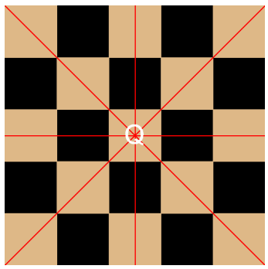
Rules
(How queen attacks)
(1) There are no queen sharing the same row with any other queen.
(2) There are no queen sharing the same column with any other queen.
(3) There are no queen sharing the same diagonal with any other queen.

Slide 5
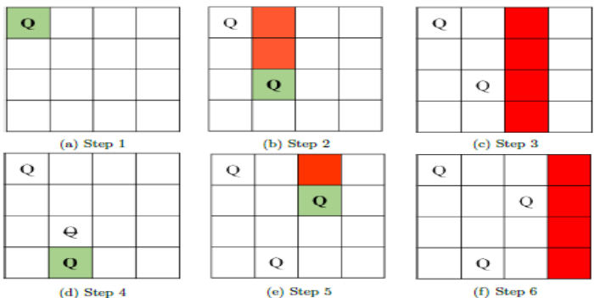
Backtrack Algorithm (1 / 2)

Slide 6
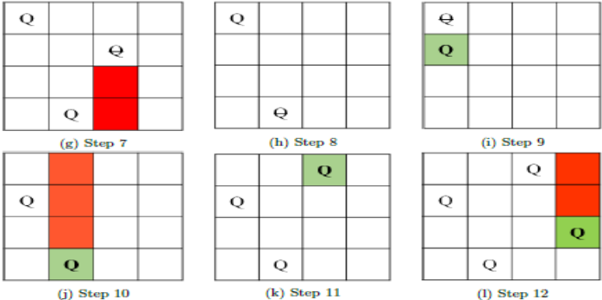
Backtrack Algorithm (2 / 2)

Slide 7
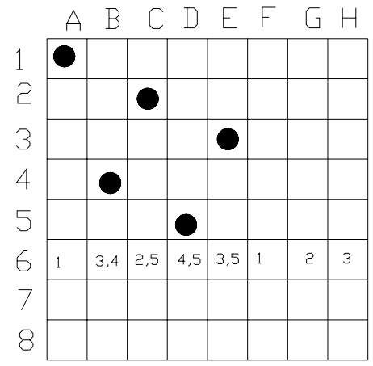
Backjump Algorithm
6 to 4 (B.J.)
instead of
6 to 5 (B.T.)
Conflict set: (1, 3, 2, 4, 3, 1, 2, 3)
(Row-major)

Slide 8
Backtrack & Backjump
Time Complexity: O(N!)

Slide 9
Build and Conquer
Nonattacked Corners
Solution
Pseudo-solution

Slide 10
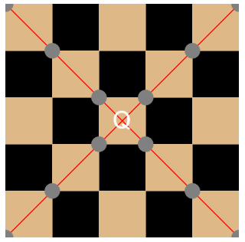
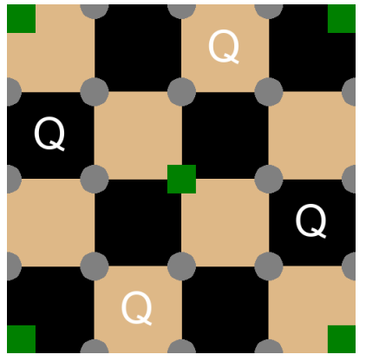
Nonattacked Corners

Slide 11
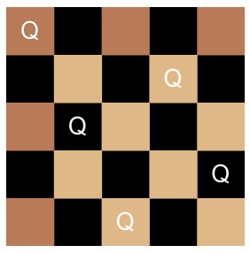
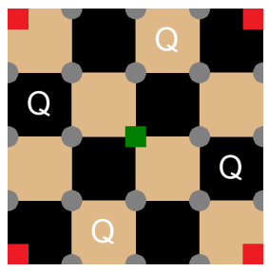
Solution (can be generated using lower orders solution)

Slide 12
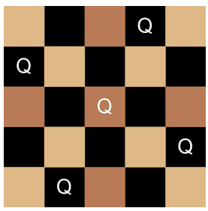
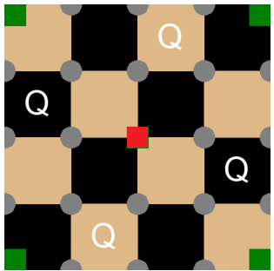
Pseudo-solution (1 / 2)

Slide 13
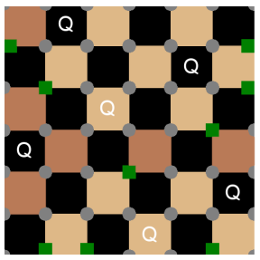
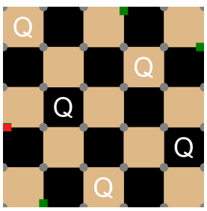
Pseudo-solution (2 / 2)

Slide 14
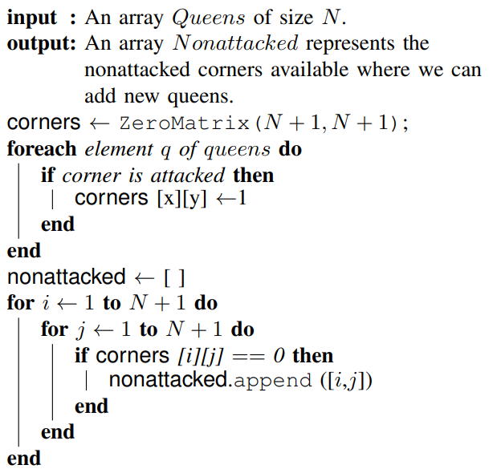
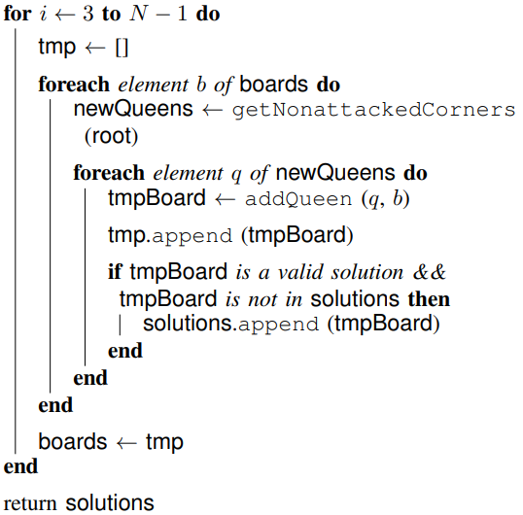
Nonattacked Corner
BFS

Slide 15
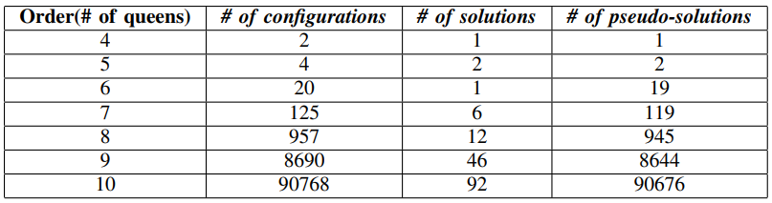
Result
?
using DFS / BFS

Slide 16
Build and Conquer
Time Complexity: O(C * (N²))
C: the number of configurations we search in order to generate the solutions

Slide 17
Reference
Vishal Kesri, Vaibhav Kesri, and Prasant Ku. Pattnaik. An Unique Solution for N queen Problem International Journal of Computer Applications (0975 – 8887) Volume 43– No.12, April 2012
ECE 566 Constraint Satisfaction Problems and Techniques
https://iq.opengenus.org/backjumping/

Slide 18
Thanks for your patience

