Slide 1
An Algorithm For Solving the Longest Increasing Circular Subsequence Problem
S. Deorowicz,
Information Processing Letters, Vol. 109, 2009, pp. 630~634
Presenter: Guan-Ting Chen
Date: Nov. 8, 2022

Slide 2
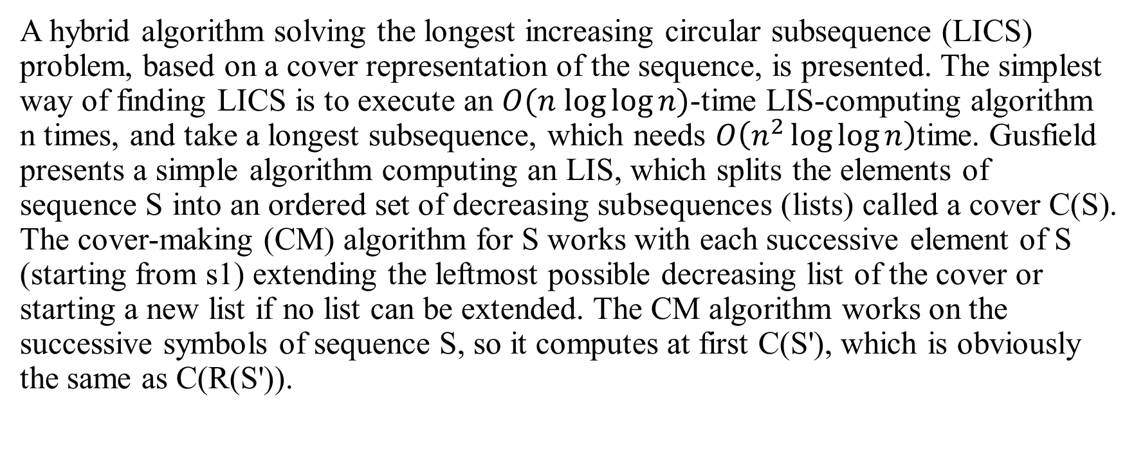
Abstract
A hybrid algorithm solving the longest increasing circular subsequence (LICS) problem, based on a cover representation of the sequence, is presented. The simplest way of finding LICS is to execute an $O(n log⁡log⁡n)$-time LIS-computing algorithm n times, and take a longest subsequence, which needs $O\left(n^{2}\log{\log{n}}\right)$time. Gusfield presents a simple algorithm computing an LIS, which splits the elements of sequence S into an ordered set of decreasing subsequences (lists) called a cover C(S). The cover-making (CM) algorithm for S works with each successive element of S (starting from s1) extending the leftmost possible decreasing list of the cover or starting a new list if no list can be extended. The CM algorithm works on the successive symbols of sequence S, so it computes at first C(S'), which is obviously the same as C(R(S')).

Slide 3
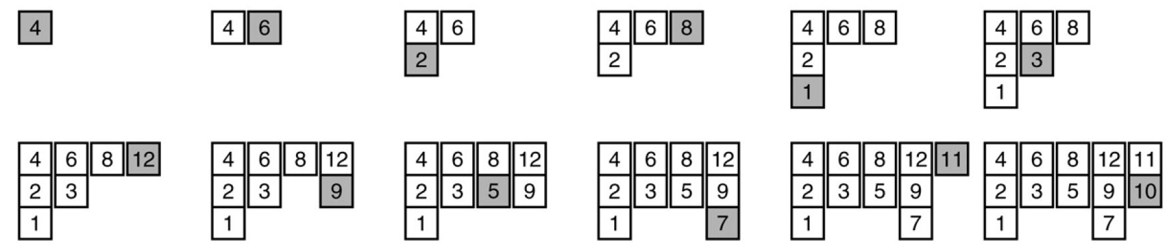
Longest Increasing Subsequence
S
4 6 2 8 1 3 12 9 5 7 11 10

Slide 4
Greedy Cover
C[1] | C[2] | C[3] | C[4] | C[5]
4 | 6 | 8 | 12 | 11
2 | 3 | 5 | 9 | 10
1 |  |  | 7

Slide 5
Longest Increasing Circular Subsequence
S
4 6 2 8 1 3 12 9 5 7 11 10 4 6 2 8 1 3 12 9 5 7 11 10
4 6 8 12
Increasing Circular Subsequence

Slide 6
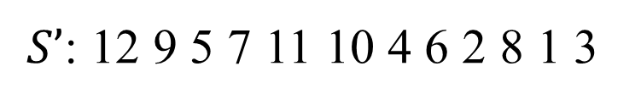

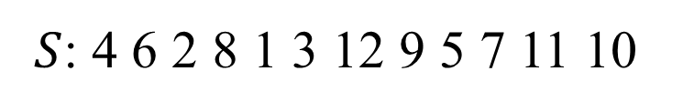
Algorithm
Rotate to make the first element $S_{1}$ be the maximal value.
$S$: 4 6 2 8 1 3 12 9 5 7 11 10
$S’$: 12 9 5 7 11 10 4 6 2 8 1 3

Slide 7

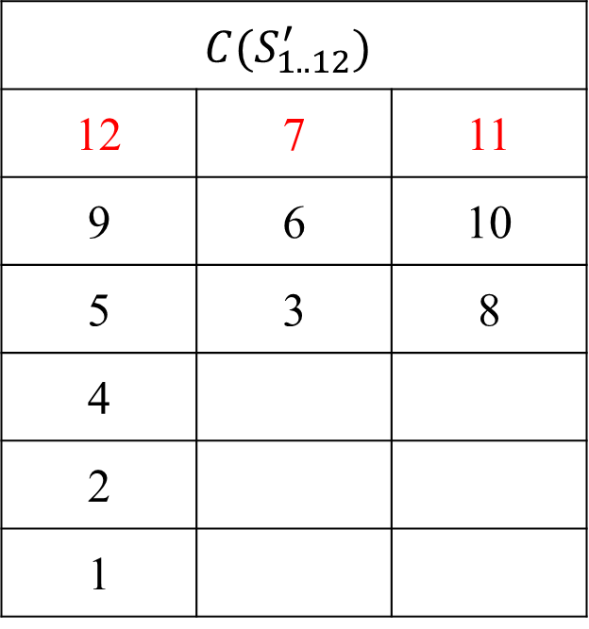
Algorithm (cont.)
Create Cover
$S’$: 12 9 5 7 11 10 4 6 2 8 1 3
$$C(S_{1..12}^{′})$$
12 | 7 | 11
9 | 6 | 10
5 | 3 | 8
4
2
1
Stop Points

Slide 8
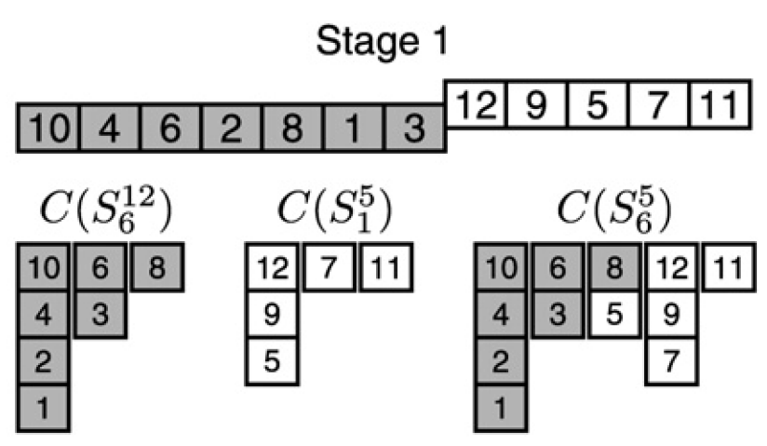
Algorithm (cont.)

Slide 9
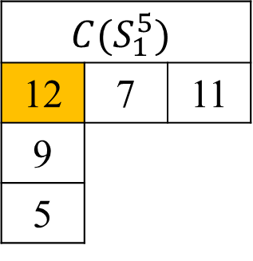
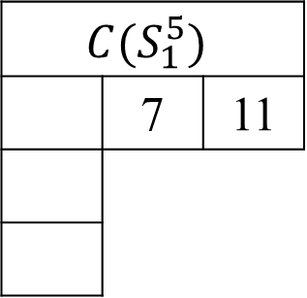
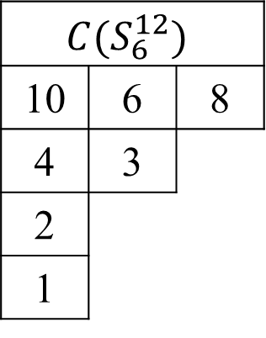
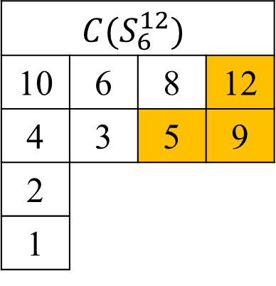
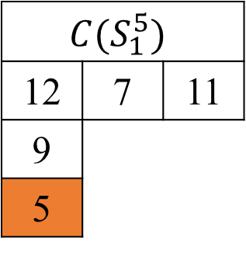
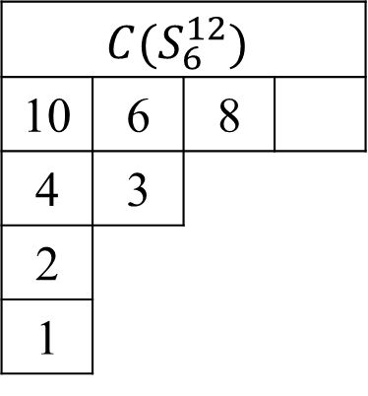
Merge
$$C(S_{6}^{12})$$
10 | 6 | 8
4 | 3
2
1
$$C(S_{1}^{5})$$
12 | 7 | 11
9
5
$$C(S_{6}^{12})$$
10 | 6 | 8
4 | 3
2
1
$$C(S_{1}^{5})$$
12 | 7 | 11
9
5
$$C(S_{6}^{12})$$
10 | 6 | 8 | 12
4 | 3 | 5 | 9
2
1
$$C(S_{1}^{5})$$
 | 7 | 11

Slide 10
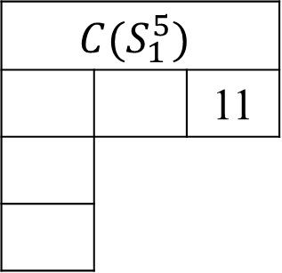
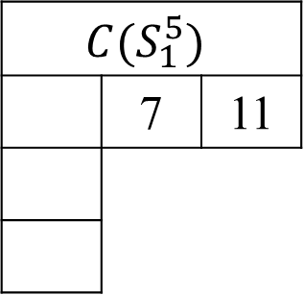
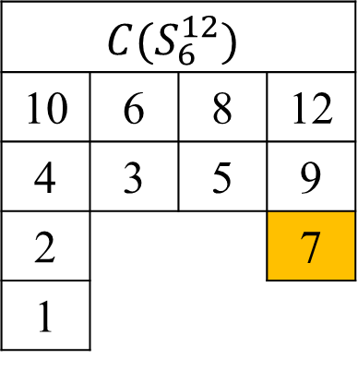
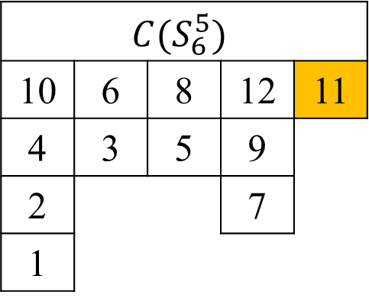
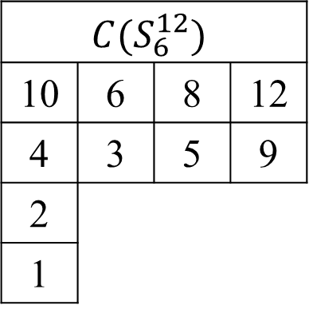
Merge (cont.)
$$C(S_{6}^{12})$$
10 | 6 | 8 | 12
4 | 3 | 5 | 9
2
1
$$C(S_{1}^{5})$$
 | 7 | 11
$$C(S_{6}^{12})$$
10 | 6 | 8 | 12
4 | 3 | 5 | 9
2 |  |  | 7
1
$$C(S_{1}^{5})$$
 |  | 11
$$C(S_{6}^{5})$$
10 | 6 | 8 | 12 | 11
4 | 3 | 5 | 9
2 |  |  | 7
1

Slide 11
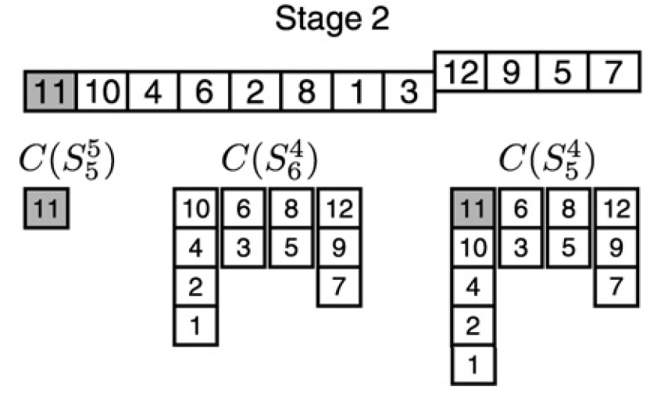
Algorithm (cont.)

Slide 12
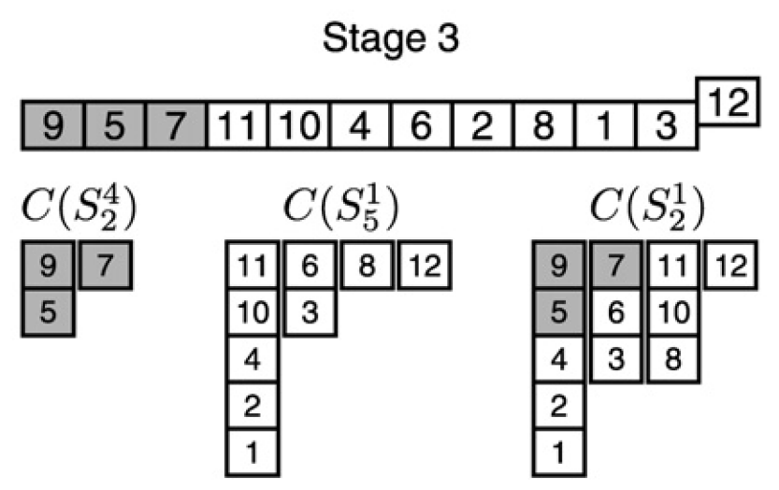
Algorithm (cont.)

Slide 13
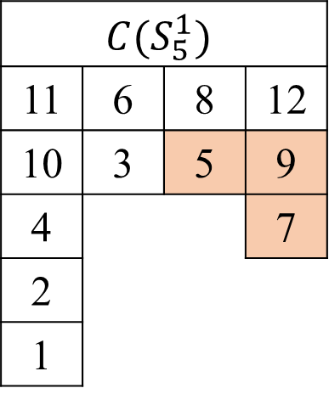
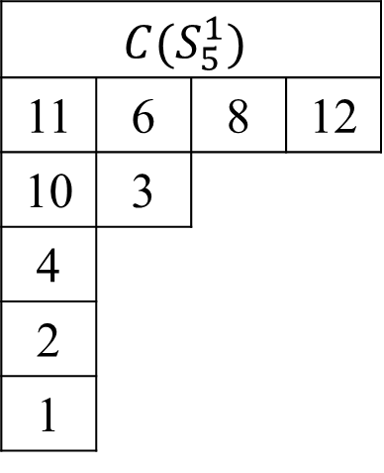
Remove
$$C(S_{5}^{1})$$
11 | 6 | 8 | 12
10 | 3 | 5 | 9
4 |  |  | 7
2
1
$$C(S_{5}^{1})$$
11 | 6 | 8 | 12
10 | 3
4
2
1

Slide 14


Time Complexity
Cover-Making
$O(m_{i}\log{l})$
Merge
$O\left(m_{i}l+n\right)$
Total Time Complexity
$O(nl)$
$$m_{i}$$
12 | 9 | 5 | 7 | 11 | 10 | 4 | 6 | 2 | 8 | 1 | 3

