Slide 1
Image Completion Using Efficient Belief Propagation via Priority Scheduling and Dynamic Pruning
Nikos Komodakis and Georgios Tziritas
IEEE TRANSACTIONS ON IMAGE PROCESSING,
Vol. 16, No. 11, Nov. 2007
Reporter: Chiou-Yi Hor
Date: Jan. 16, 2007

Slide 2
Abstract-1
In this paper, a new exemplar-based framework is presented, which treats image completion, texture synthesis, and image in-painting in a unified manner. In order to be able to avoid the occurrence of visually inconsistent results, we pose all of the above image-editing tasks in the form of a discrete global optimization problem. The objective function of this problem is always well-defined, and corresponds to the energy of a discrete Markov random field (MRF).

Slide 3
Abstract-2
For efficiently optimizing this MRF, a novel optimization scheme, called priority belief propagation (BP), is then proposed, which carries two very important extensions over the standard BP algorithm: “priority-based message scheduling” and “dynamic label pruning.” These two extensions work in cooperation to deal with the intolerable computational cost of BP, which is caused by the huge number of labels associated with our MRF. Moreover, both of our extensions are generic, since they do not rely on the use of domain-specific prior knowledge.

Slide 4
Abstract-3
They can, therefore, be applied to any MRF, i.e., to a very wide class of problems in image processing and computer vision, thus managing to resolve what is currently considered as one major limitation of the BP algorithm: its inefficiency in handling MRFs with very large discrete state spaces. Experimental results on a wide variety of input images are presented, which demonstrate the effectiveness of our image-completion framework for tasks such as object removal, texture synthesis, text removal, and image in-painting.

Slide 5
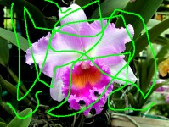

Image in-painting
It requires a number of iterations before it converges to an acceptable answer.
It is valuable since it performs quite well for small scratches and runs relatively fast.

Slide 6
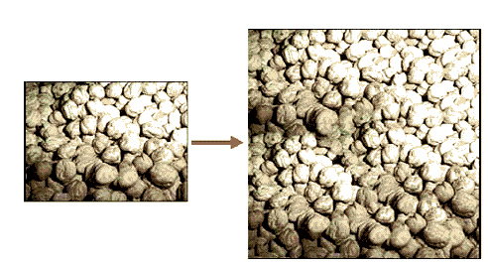
Texture Synthesis
It comes to help restore these larger regions of damage or to extend an repeated image.

Slide 7
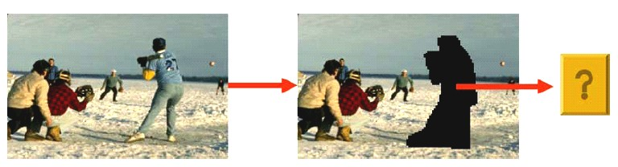
Image Completion
The user wants to remove a region from the input image. He, therefore, simply marks a region around and that region must then be filled automatically so that a visually plausible outcome is obtained.

Slide 8
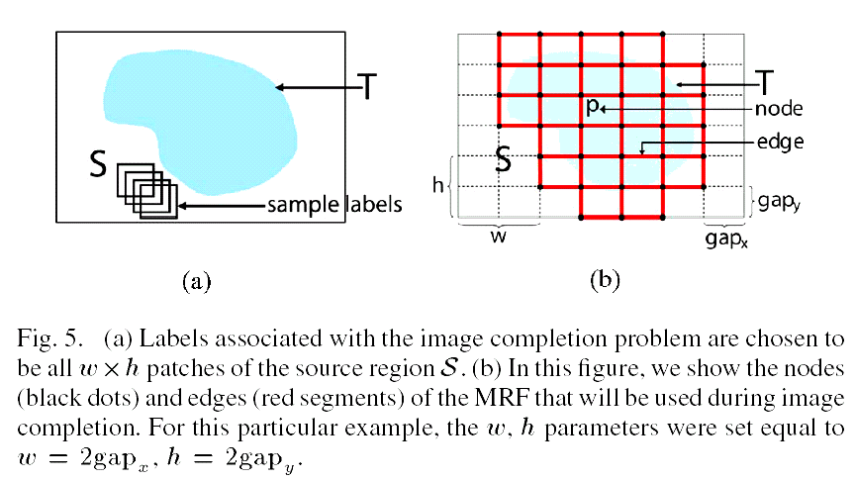
Image Completion
Given an input image , as well as a target region T and a source region S (where is always a subset of ), the goal of image completion is to fill in a visually plausible way simply by copying patches from S.

Slide 9
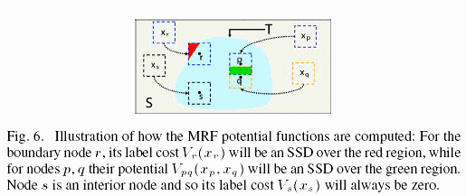
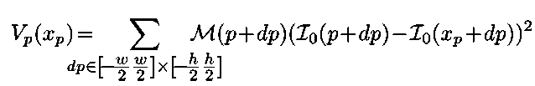

Image Completion=>
A Global Optimization Problem

Slide 10
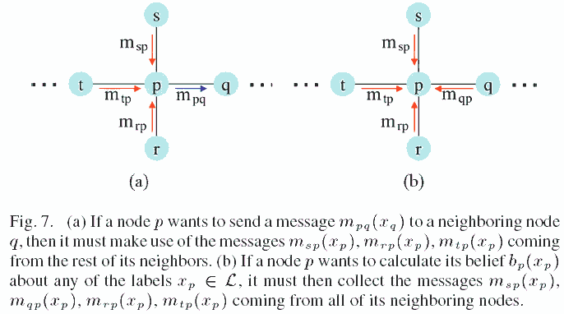
Conventional Belief Propagation

Slide 11
Conventional Belief Propagation
BP does nothing more than continuously propagating & accepting local messages between the neighboring nodes.
This process repeats until all the messages have stabilized, i.e., they do not change any more.

Slide 12

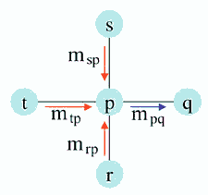
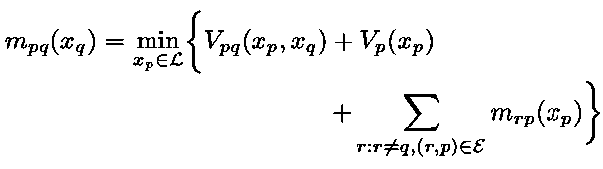
Conventional Belief Propagation
The set of messages sent from a node p to a neighboring node q will be denoted by
The number of such messages is always |L| (i.e., there exists one message per label in L).
A message m_{pq}(x_{q}) expresses the opinion of node p about assigning label x_{q} to node q.

Slide 13


Conventional Belief Propagation
Making connection between the potential & belief. It means how likely label x_{p} is for node p.
Once all beliefs have been computed, each node is then assigned the label having the maximum belief
The computational cost is intolerable due to the huge number of existing labels.

Slide 14
Belief Propagation
Complexity for Conventional BP
  If is the total number of labels |L| (which, in our case, can be many many thousands) then just the basic operation of updating the messages from one node to another node takes O(|L|²) ?? time.
If we had a node whose labels could be pruned (and assuming that the maximum number of labels after pruning is L_{max} with L_{max}<<|L| then any message from that node would take only O(L_{max}) time. => Label pruning in this paper

Slide 15
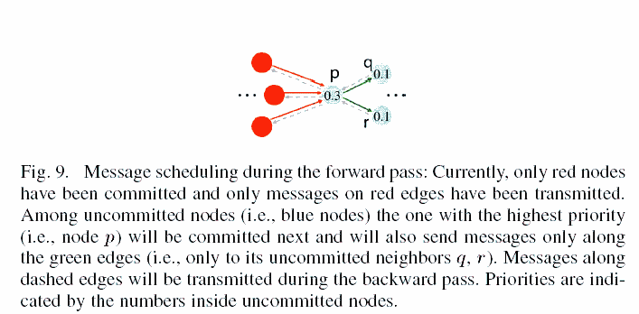
Message-Scheduling

Slide 16
Message-Scheduling
Belief->Confidence->Priority
The node most confident about its labels should be the first one (i.e., it has the highest priority) to transmit outgoing messages to its neighbors.
Why?

Slide 17
Why Message-Scheduling?
The more label pruning it can tolerate (before sending its outgoing messages) and, therefore, the cheaper these messages will be.
The more confident a node is, the more informative its messages are going to be. These messages can help its neighbors to increase their own confidence, and, thus, these nodes will become ore tolerable to pruning .
By first propagating the most informative messages around the graphical model, we also help BP to converge much faster.

Slide 18
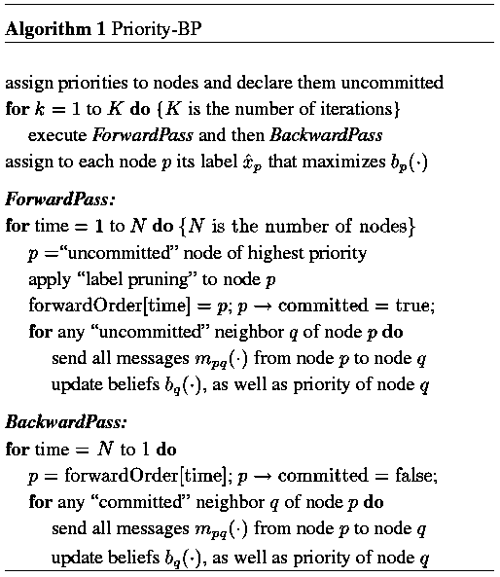
Message-Scheduling Algorithm
Belief->Confidence->Priority

Slide 19


Assigning Priorities to Nodes
The definition of relative belief
The definition of confusion set
The b_{conf} is a threshold confidence
The priority of is inversely related to the cardinality of that set

Slide 20
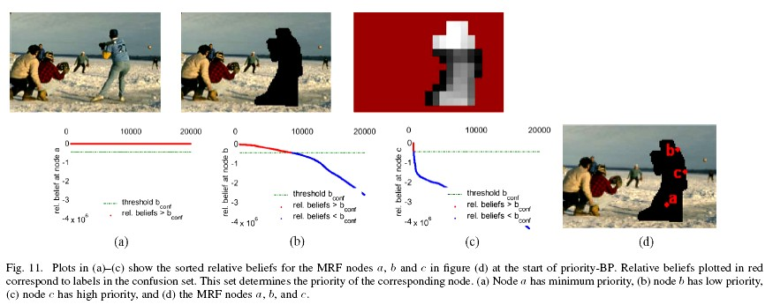
Assigning Priorities to Nodes
For the visiting order of the nodes during the first forward pass (based on our definition of priority). The darker a patch is in these images, the earlier the corresponding node was visited. The algorithm learns by itself how to propagate first the messages of the nodes containing salient structure, where the notion of saliency depends on each specific case.
Higher priority

Slide 21
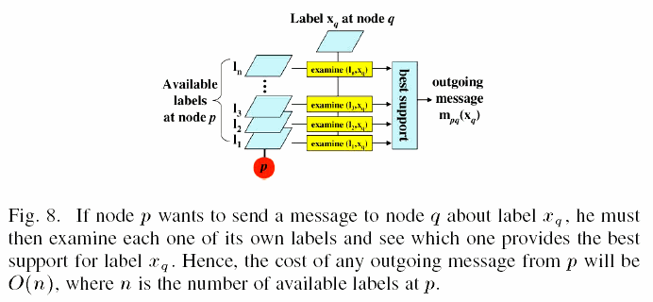
Label Pruning
During the forward pass, we dynamically reduce the number of
possible labels for each node by discarding labels that are unlikely
to be assigned to that node.

Slide 22
Label Pruning
Only to nodes whose number of active labels exceeds a user specified number L_{max}.
Each such label is declared active until either no more labels with relative belief greater than b_{prune} exist or the maximum number of active labels L_{max} has been reached.
A minimum number of active labels L_{min} is always kept.
The net result of label pruning is, thus, to obtain a compact and diverse set of active labels for each node.

Slide 23
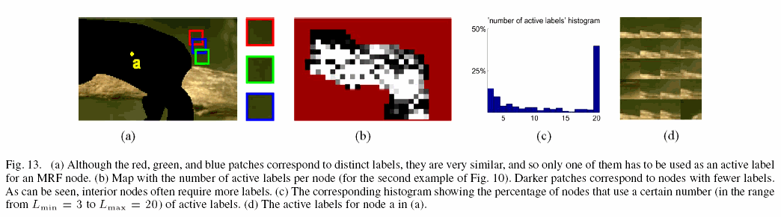
Label Pruning

Slide 24
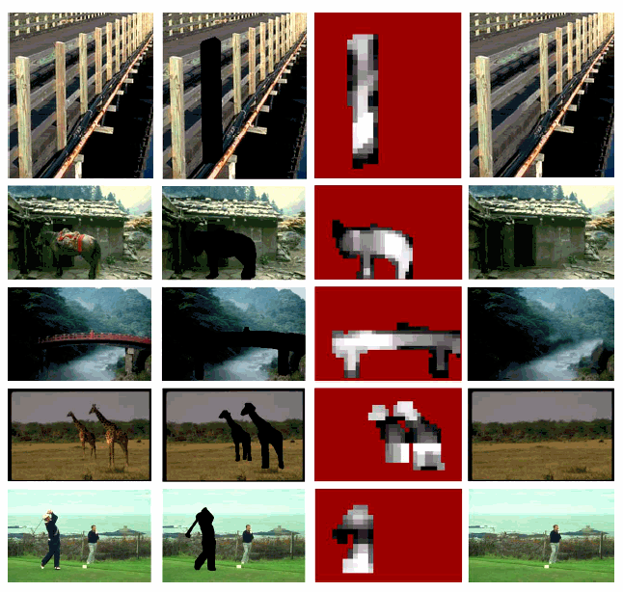
Results

Slide 25
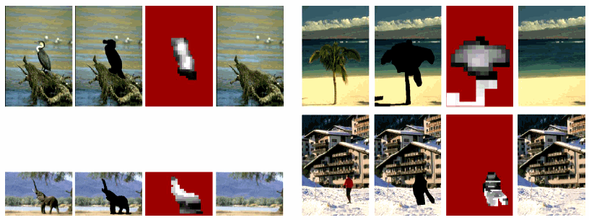
Results

Slide 26
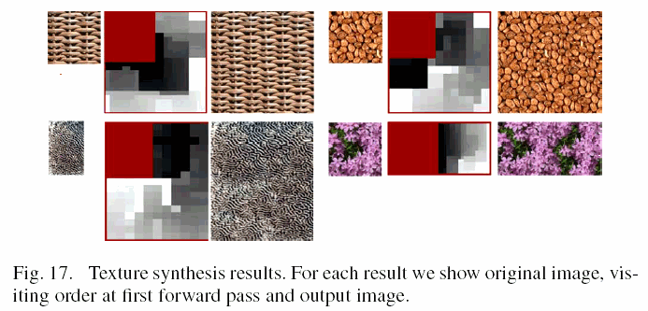
Results

Slide 27
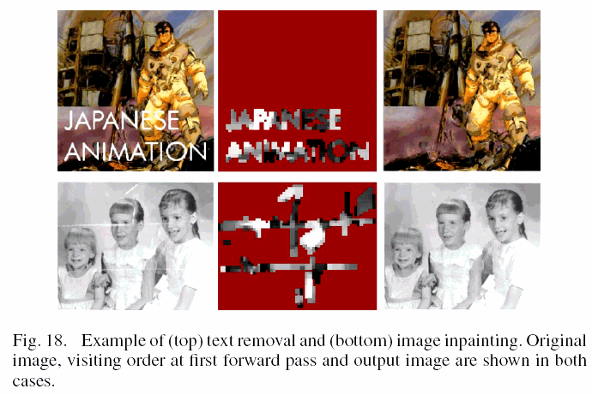
Results

