Slide 1
Block Edit Models for Approximate String Matching
Daniel Lopresti and Andrew Tomkins
Theoretical Computer Science,
Vol. 181, pp. 159-179, 1997.
Date: Feb. 20, 2008
Introducer: Hsing-Yen Ann

Slide 2
Abstract
In this paper we examine string block edit distance, in which two strings A and B are compared by extracting collections of substrings and placing them into correspondence. This model accounts for certain phenomena encountered in important real-world applications, including pen computing and molecular biology. The basic problem admits a family of variations depending on whether the strings must be matched in their entireties, and whether overlap is permitted. We show that several variants are NP-complete, and give polynomial-time algorithms for solving the remainder.

Slide 3
Input & Output
Input
  Two strings A and B
  Scoring functions for character insertions, deletions and substitutions
  Per-block cost c_{block}
Output
  Block edit distance between A and B

Slide 4
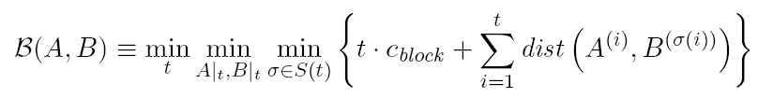
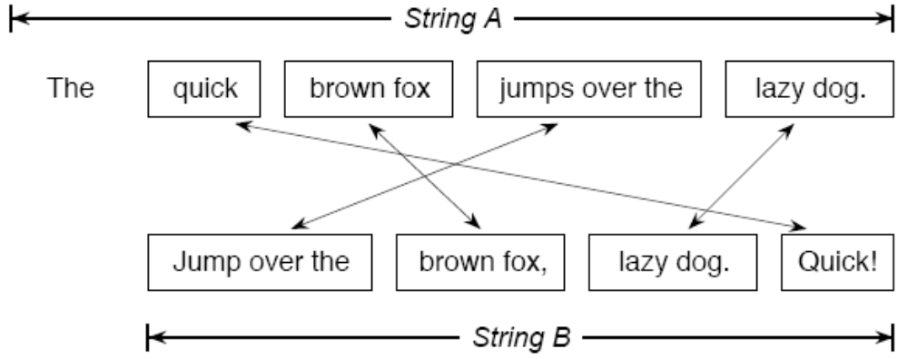
Block Edit Distance
Finding the best way to choose t-block substring alignments of A and B
dist: traditional edit distance

Slide 5
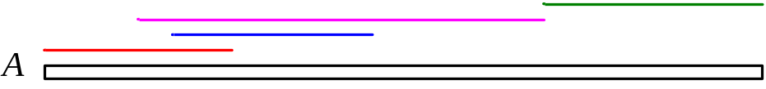
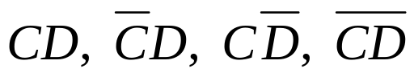
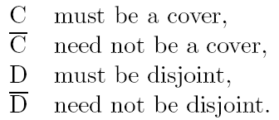
Properties of Block Edit Models
Cover: The union of all blocks (substrings) covers the original string.
Disjoint: The intersection of every two blocks (substrings) is an empty set.
Four block families of a string:

Slide 6
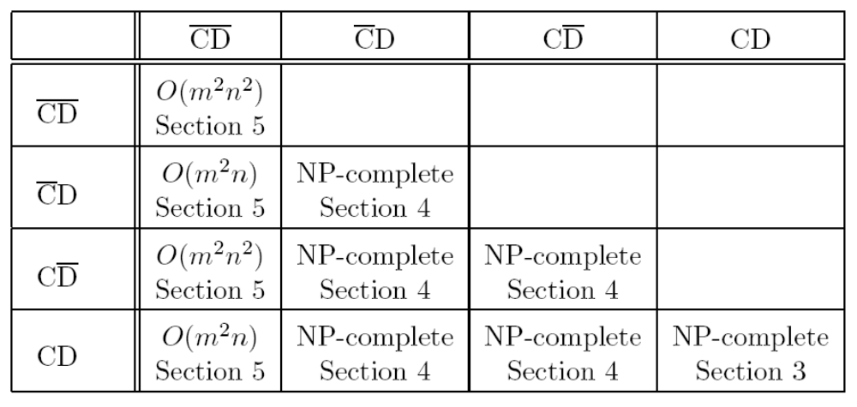
Results in This Paper
NP-completeness is skipped in this presentation.
(8-page proof)

Slide 7
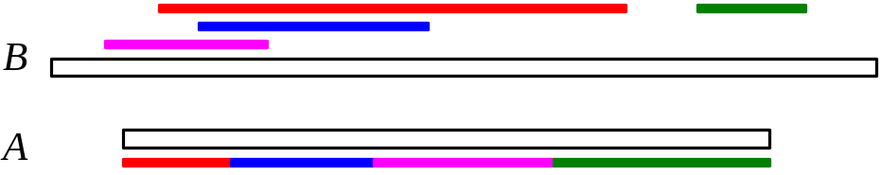
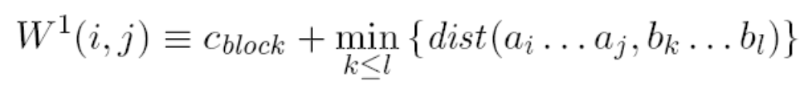



CD-CD Block Edit Distance
Substring edit distance:
: the best matching between A_{1…i} and B
Block edit distance:
Time:

Slide 8
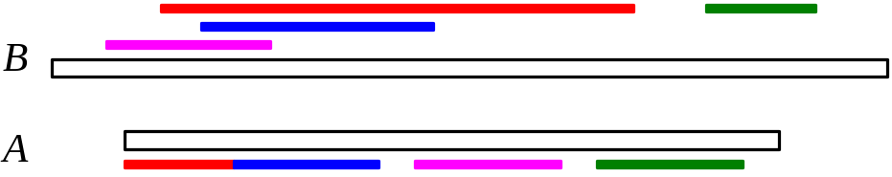


CD-CD Block Edit Distance
Some sections of A can be “skipped”.
Block edit distance:
Time:
Note that, in general, there are negative costs.
If there is no negative cost, no blocks will be selected and the solution is always 0.

Slide 9
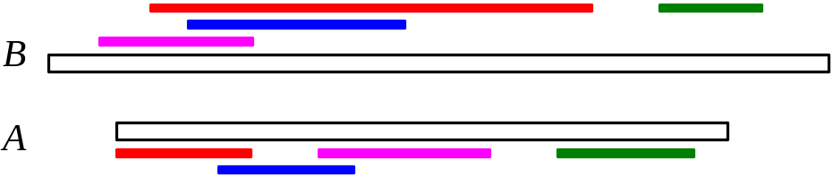



CD-CD Block Edit Distance
Note that the same block pairing (A_{i…j} , B_{k…l}) can be used at most once. It prevents the solutions of -∞.
There are O(m²n²) independent block pairs. Only the negative cost pairs are selected.
Time:

Slide 10
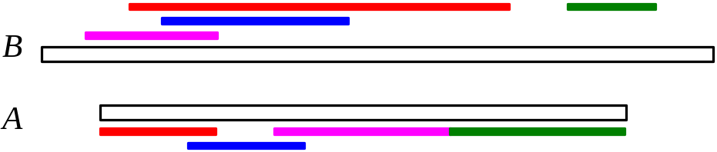
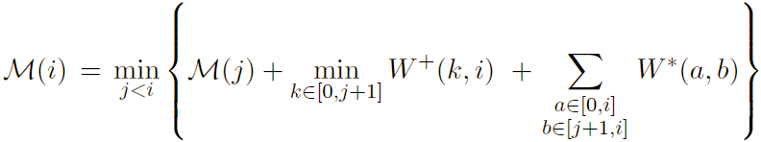
CD-CD Block Edit Distance
We cover the string A and reduce the overall cost by adding the negative cost pairs.
Time:
A_{1..j}
covered
To cover A_{j+1..i}
Adding negative cost pairs

