Slide 1
An improved incremental training algorithm for support vector machines using active query
Shouxian Cheng, FrankY. Shih
Pattern Recognition 40, 2007, pp.964 – 971
Reporter: Chiou-Yi Hor
Date: Mar. 5, 2008

Slide 2
Abstract-1
In this paper, we present an improved incremental training algorithm for support vector machines (SVMs). Instead of selecting training samples randomly, we divide them into groups and apply the k-means clustering algorithm to collect the initial set of training samples. In active query, we assign a weight to each sample according to its confidence factor and its distance to the separating hyper-plane.

Slide 3
Abstract-2
The confidence factor is calculated from the error upper bound of the SVM to indicate the closeness of the current hyper-plane to the optimal hyper-plane. A criterion is developed to eliminate non-informative training samples incrementally. Experimental results show our algorithm works successfully on artificial and real data, and is superior to the existing methods.

Slide 4
K-Means
Initial set of clusters randomly chosen.
Iteratively, items are moved among sets of clusters until the desired set is reached.
High degree of similarity among elements in a cluster is obtained.
Given a cluster K_{i}={t_{i1},t_{i2},…,t_{im}}, the cluster mean is m_{i} = (1/m)(t_{i1} + … + t_{im})
Taken from the textbook: Data Mining Introductory and Advanced Topics

Slide 5
K-Means Example
Given: {2,4,10,12,3,20,30,11,25}, k=2
Randomly assign means: m₁=3,m₂=4
K₁={2,3}, K₂={4,10,12,20,30,11,25}, m₁=2.5,m₂=16
K₁={2,3,4},K₂={10,12,20,30,11,25}, m₁=3,m₂=18
K₁={2,3,4,10},K₂={12,20,30,11,25}, m₁=4.75,m₂=19.6
K₁={2,3,4,10,11,12},K₂={20,30,25}, m₁=7,m₂=25
Stop as the clusters with these means are the same.
Taken from the textbook: Data Mining Introductory and Advanced Topics

Slide 6
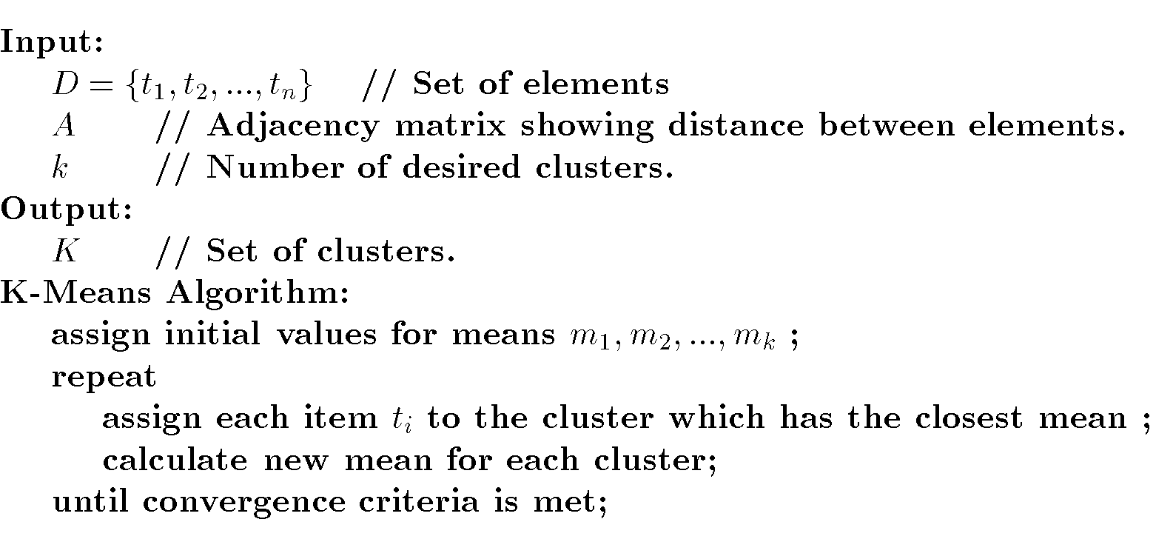
K-Means Algorithm
Taken from the textbook: Data Mining Introductory and Advanced Topics

Slide 7
K-means Clustering properties
Time complexity
  O(n*cluster#*iteration#)
Sensitive to clusters’ sizes, shapes and outliers
Using centroids for final labeling may cause some problems

Slide 8
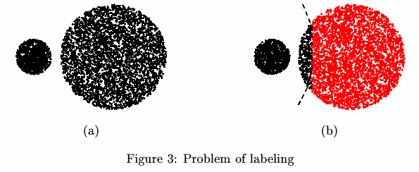
Using centroids for final labeling
o
o

Slide 9
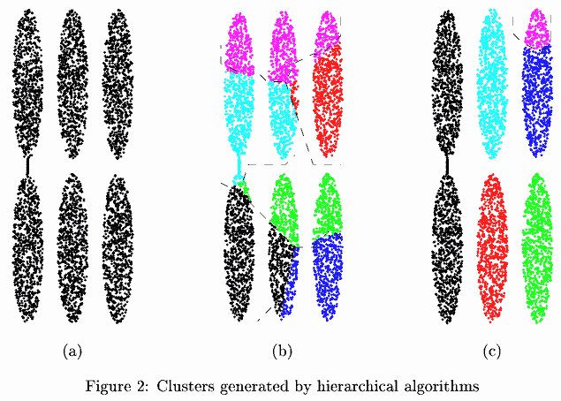
Hierarchical Clustering
Clustering with distance_{mean} (b) & distance_{min} (c)

Slide 10
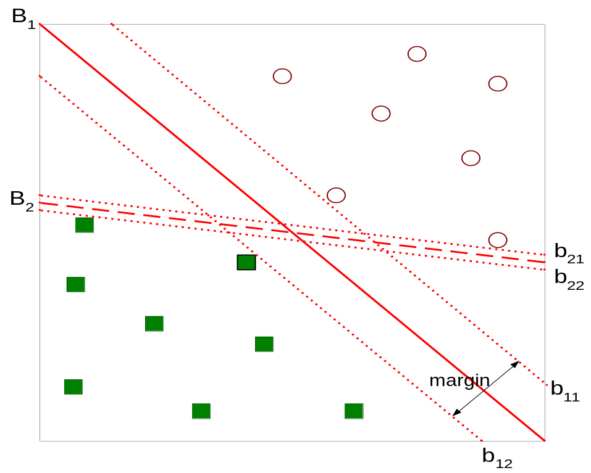
Support Vector Machines
The problem is linearly separable.
Find hyper-plane maximizes the margin => b1 is better than b2
Taken from the textbook: Introduction to Data Mining

Slide 11
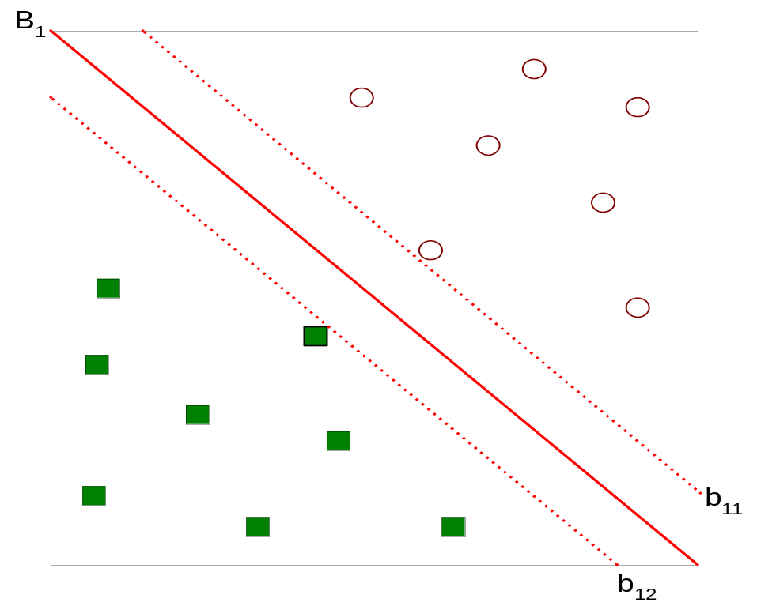



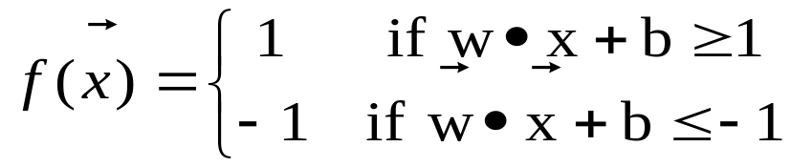
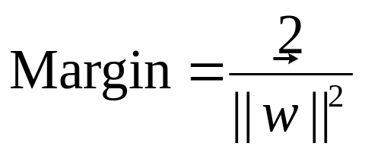
Support Vector Machines
The problem is linearly separable.
Taken from the textbook: Introduction to Data Mining

Slide 12
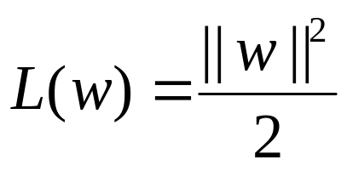
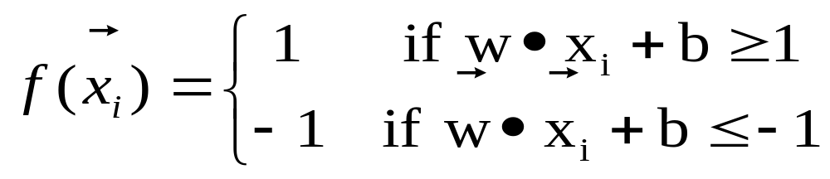
Support Vector Machines
The linearly separable problem.
We want to maximize:
  Which is equivalent to minimizing:
  But subjected to the following constraints:
    This is a constrained optimization problem
      Numerical approaches to solve it (e.g., quadratic programming)
Taken from the textbook: Introduction to Data Mining

Slide 13
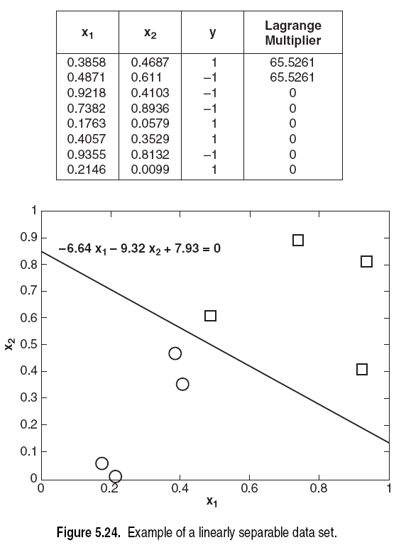
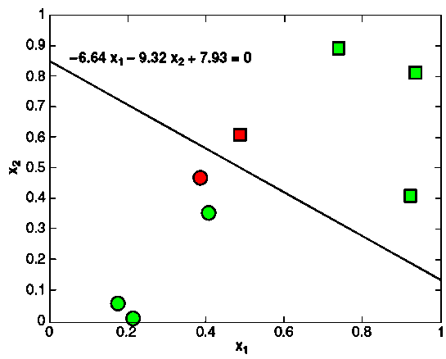
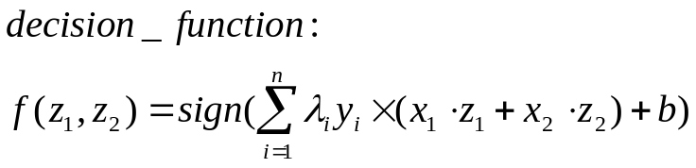
λ_{i}
Informative samples
Non-informative samples
Taken from the textbook: Introduction to Data Mining

Slide 14
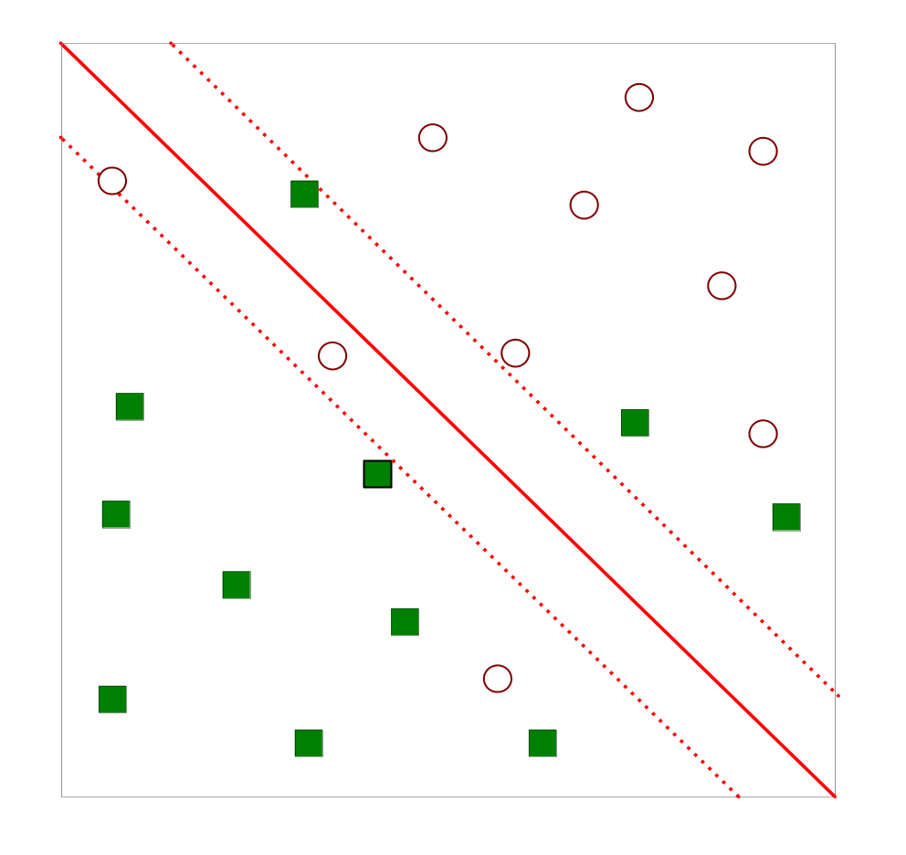
Support Vector Machines
What if the problem is not linearly separable?
Taken from the textbook: Introduction to Data Mining

Slide 15
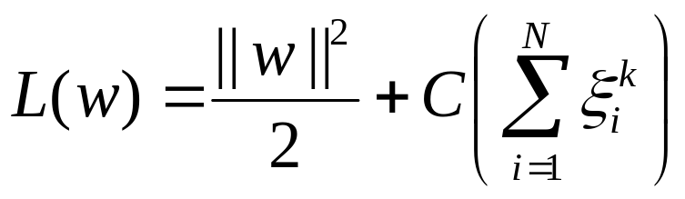
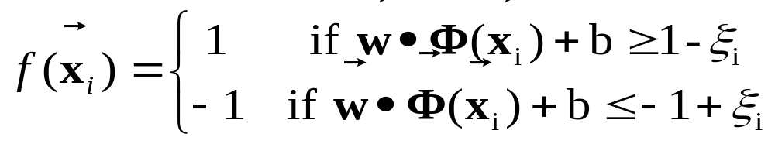
Nonlinear Support Vector Machines
What if the problem is not linearly separable?
  Introduce slack variables
    Need to minimize:
    Subject to:
    w & Φ [唸phi] are higher dimensional then x.
Taken from the textbook: Introduction to Data Mining

Slide 16
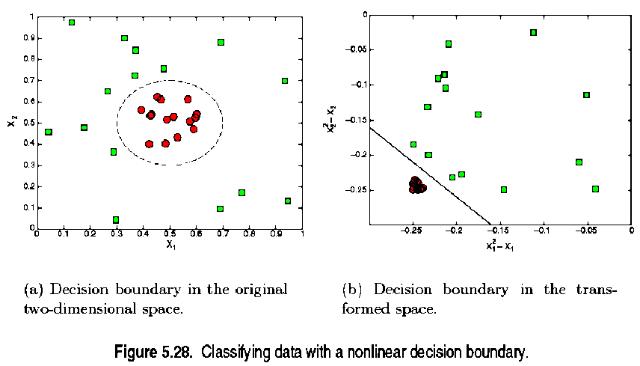
Nonlinear SVM Example 1
(x₁-0.5)² +(x₂-0.5)² =0.04 ⇒(x₁²-x₁)+(x₂² -x₂)+0.46=0
Taken from the textbook: Introduction to Data Mining

Slide 17
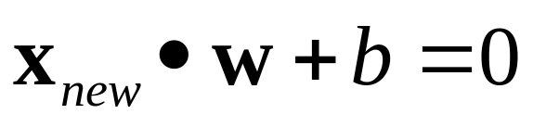
Nonlinear SVM Example 1
Original decision boundary is:
  (x₁-0.5)²+(x₂-0.5)²=0.02 ⇒
  x₁²-x₁+x₂ ²-x₂+0.46=0 ⇒
  (x₁²,x₂²,x₁,x₂)• (1,1,-1,-1)+0.46=0
The transformation is:
  Class1: (x₁²,x₂², x₁, x₂)•(1,1,-1,-1)+0.46>0
  Class2: (x₁²,x₂², x₁, x₂)•(1,1,-1,-1)+0.46<0
  Φ:(x₁, x₂)_{2D}→(x₁²,x₂², x₁, x₂)_{4D}
  w: (1,1,-1,-1), b = 0.46
  Φ(x) •w+b=0
The transformed decision boundary has the following form. It is linear in the higher dimension.
Taken from the textbook: Introduction to Data Mining

Slide 18
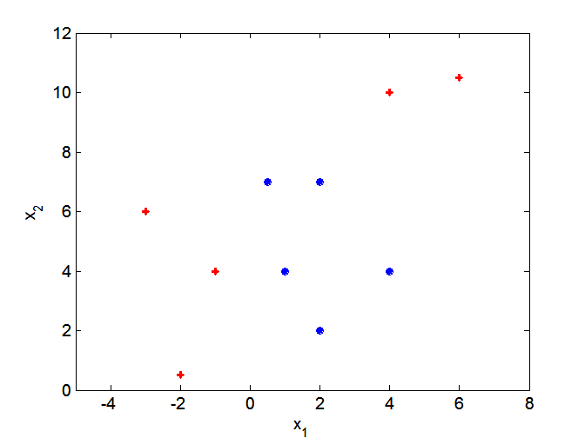
Nonlinear SVM Example 2
What if decision boundary is not linear?
Taken from the textbook: Introduction to Data Mining

Slide 19
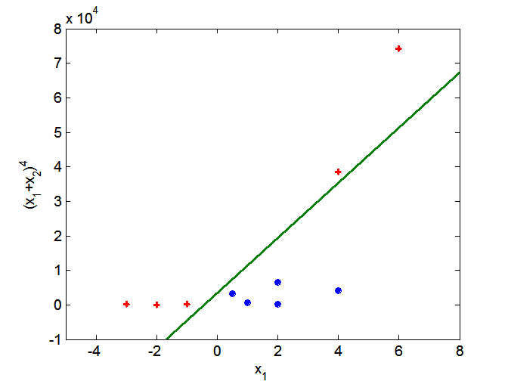
Nonlinear SVM Example 2
Transform data into higher dimensional space
Taken from the textbook: Introduction to Data Mining

Slide 20
Support Vector Machines
SVM learning problem can be formulated as a convex optimization problem, in which efficient algorithm are available to find the global minimization. (eg. The neural network is not.)
SVM can be applied to categorical data (eg. Modeling marital (婚姻的) status∈{single, married, divorced} as [0/1,0/1,0/1])
It is possible to extend SVM to multi-class problems.
Taken from the textbook: Introduction to Data Mining

Slide 21
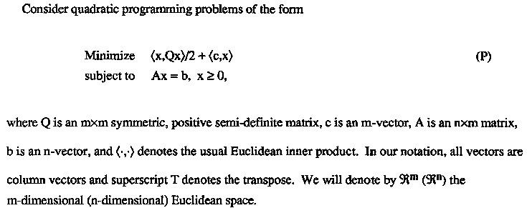
Quadratic Programming
In SVM, m is O(n), where n is # of training samples. Because matrix Q is of size n*n.

Slide 22
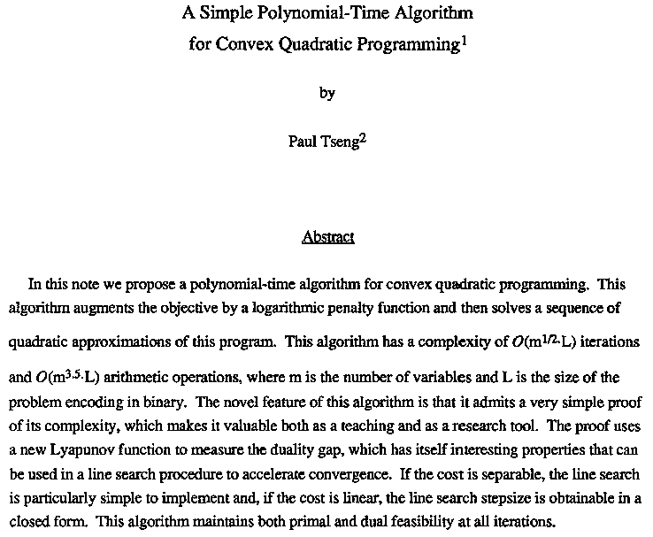
Quadratic Programming

Slide 23
VC (Vapnik Chernovenkis) Dimension
The VC dimension of the class {f(x, a)} is defined to be the largest number of points (in some configuration) that can be shattered by members of {f(x, a)}.
The Vapnik Chernovenkis dimension is a way of measuring the complexity of a class of functions by assessing how wiggly its members can be.
One can use the VC dimension in constructing an estimate of in-sample prediction error.
Taken from the textbook: The elements of statistical learning

Slide 24
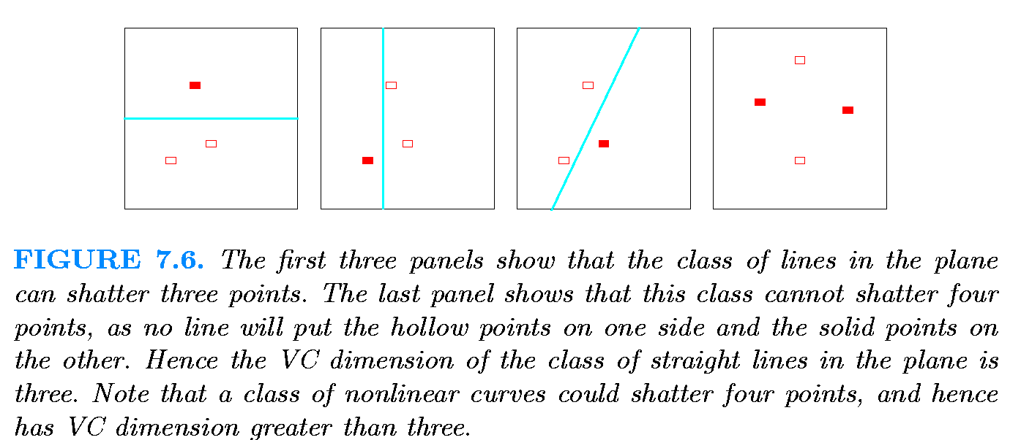
VC Dimension
In general, a linear indicator function in p dimensions has VC dimension p + 1, which is also the number of free parameters.
Taken from the textbook: The elements of statistical learning

Slide 25

VC Dimension for SVM kernels
Assuming the dimension of the feature space is n, then the VC dimension is as follows
  Linear SVMs: n+1
  2nd degree polynomial SVMs: n(n+3)/2
  Gaussian RBF(radial basis function): no explicit VC dimension

Slide 26


VC Dimension
VC Dimension for error bound calculation
  α: selected parameters of a trained machine
  R(α): the expectation of the test error for a trained machine
  l : training sample #
  R_{emp}(α): The empirical(觀察或實驗的) test error
  h: VC Dimension
  (1-η): the probability for the following bound to hold (η [唸eta ])

Slide 27
The incremental SVM training
Input:
  Training samples
Output:
  Support vector machine classifier
  Informative samples & their weights
Algorithm
  Next slide

Slide 28
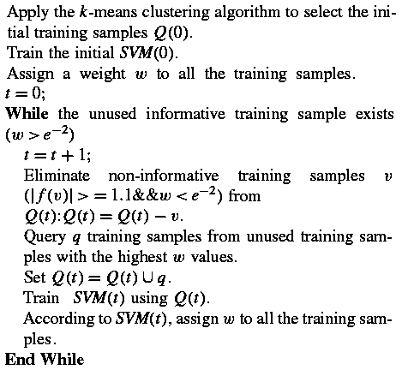
The incremental SVM training

Slide 29
Step 1
Select initial training samples & train a initial SVM
  Partitioning all samples into K groups
    Time issue
  Using k-means algorithm to cluster each group
  Choosing the samples closest to the cluster mean
  Avoiding unbalanced & random data to bias the initial decision boundary

Slide 30
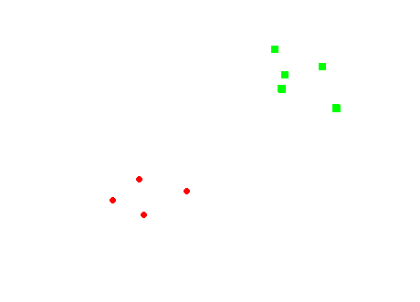
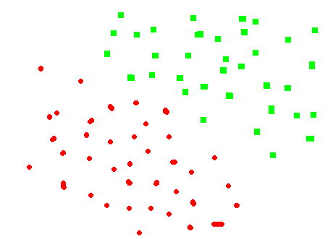
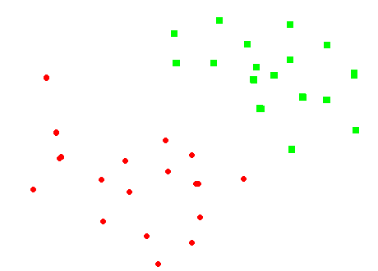
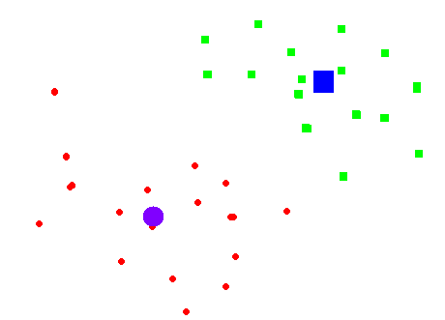
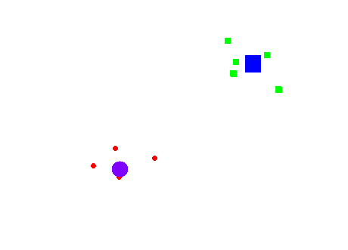
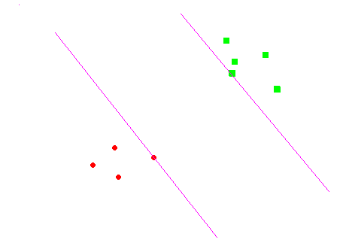
Step 1

Slide 31
Step 2
Active query of new samples
  Assigning each sample a weight (related to confidence & information content)

Slide 32


Error calculation
SVM margin: M=2/||w||
l: training sample #
s: support vector #
D: the diameter of the minimum sphere enclosing all the training samples in the feature space
e_{t}: the error calculated on the entire training set
In this paper, m is # of test samples, the error e_{opt} is
In this paper, the error is

Slide 33



Weight calculation
Calculate the confidence factor C:
Calculate the ratio α (error↓, C↑, α also ↑):
Calculate the weight for each sample:
其中f(x)=0表示決策邊界，f(x_{i})表距x_{i}之距離。上式表示，如果x_{i}距決策邊界越遠，其權重一定越小。若x_{i}分類正確，且誤差小，其權重往上修正。若x_{i}分類正確，且誤差大，其權重往下修正，因為對未來訓練無幫助。若x_{i}分類錯誤，但誤差小，其權重往上修正，因為其距決策邊界近。若x_{i}分類錯誤，且誤差大，其權重往下修正，因為可能是outlier (錯誤資料點)。

Slide 34
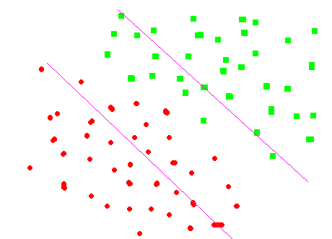
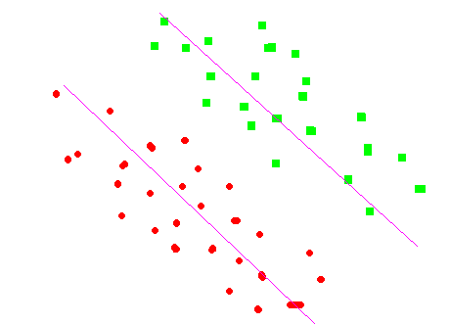
The incremental SVM training
Eliminate non-informative training samples

Slide 35
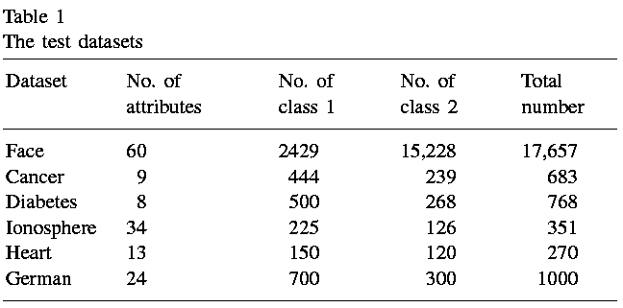
Experiment
Data source
  Face: Center for Biological and Computational Learning (CBCL) at Massachusetts Institute of Technology (MIT)
  Others: the Repository of Machine Learning Databases of the University of California, Irvine (UCI)

Slide 36
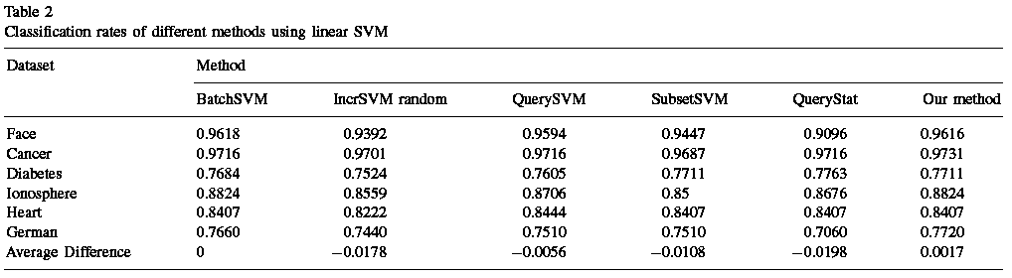
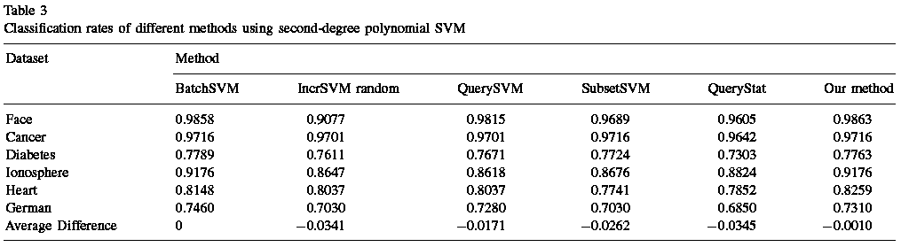
Experiment

Slide 37
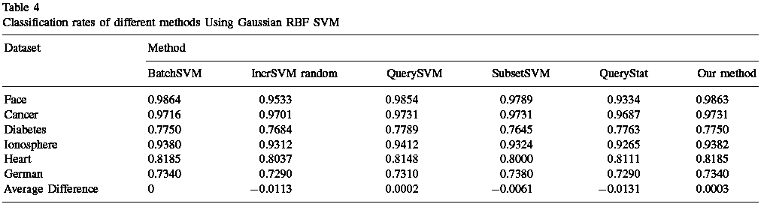
Experiment

Slide 38
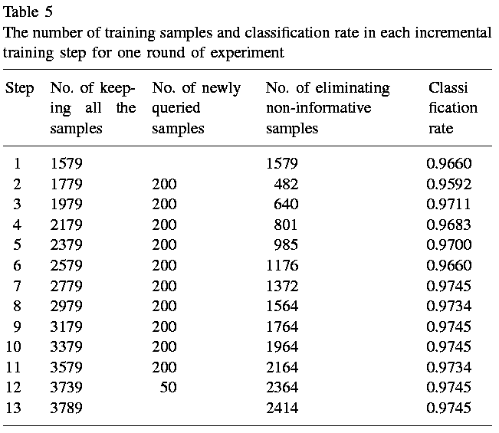
Experiment - face

