Slide 1
Bit-Parallel Algorithms for the Merged Longest Common Subsequence Problem
SEBASTIAN DEOROWICZ and AGNIESZKA DANEK†
International Journal of Foundations of Computer Science
Vol. 24, No. 8 (2013) 1281–1298
Presenter:De-Sheng Jhan
2014/08/26

Slide 2
Abstract
It is often a necessity to compare some sequences to find out how similar they are.
There are many similarity measures that can be used, e.g., longest common subsequence, edit distance, sequence alignment. Recently a merged longest common subsequence (MergedLCS) problem was formulated with applications in bioinformatics. We propose the bit-parallel algorithms for the MergedLCS problem and evaluate them in practice showing that they are usually tens times faster than the already published methods.

Slide 3
MergedLCS(1/5)
T = ABA, A = DDA, B = BAC
LCS(T, E₁(A, B)) = LCS (ABA, DDBAAC) = AA
LCS(T, E₂(A, B)) = LCS (ABA, BACDDA) = AA
LCS(T, E₃(A, B)) = LCS (ABA, DDABAC) = ABA
LCS(T, E (A, B)) = LCS (T, E₃(A, B))
|LCS (T, E (A, B))| = 3

Slide 4
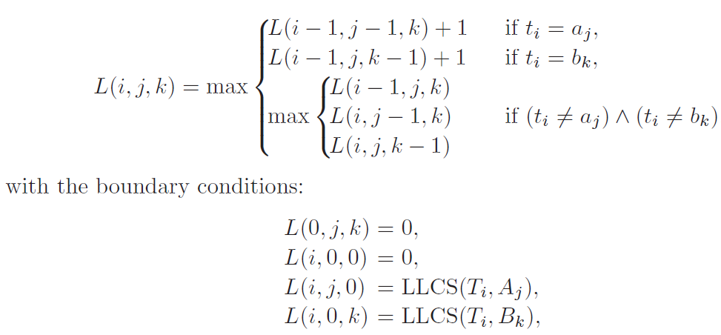
MergedLCS(2/5)
|T| = r, |A| = n, |B| = m, 0≦i≦r, 0≦j≦n, 0≦k≦m
O(mnr)

Slide 5
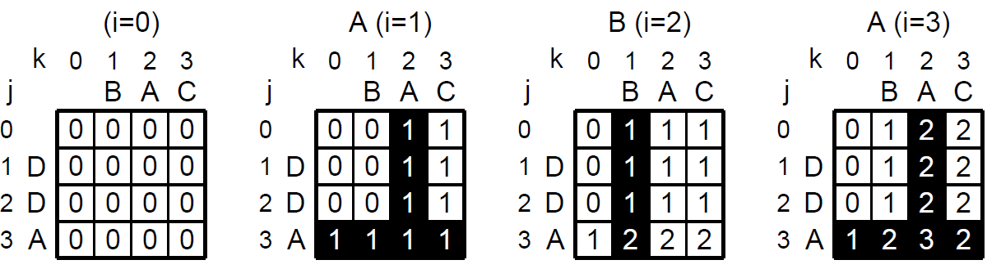
MergedLCS(3/5)
T = ABA, A = DDA, B = BAC
L(3, 3, 3) = 2

Slide 6
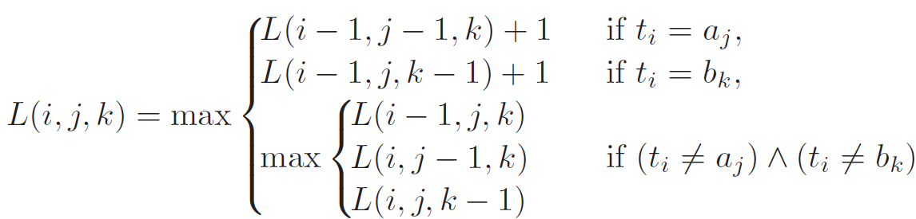
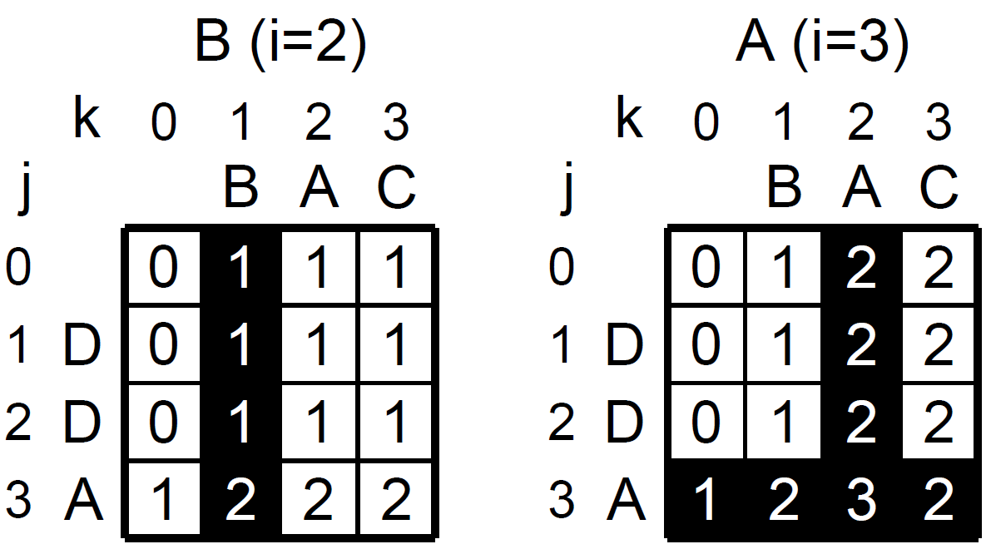
MergedLCS(4/5)
T = ABA, A = DDA, B = BAC
L(3, 3, 3) = max(L(2, 2, 3) + 1) = 2

Slide 7
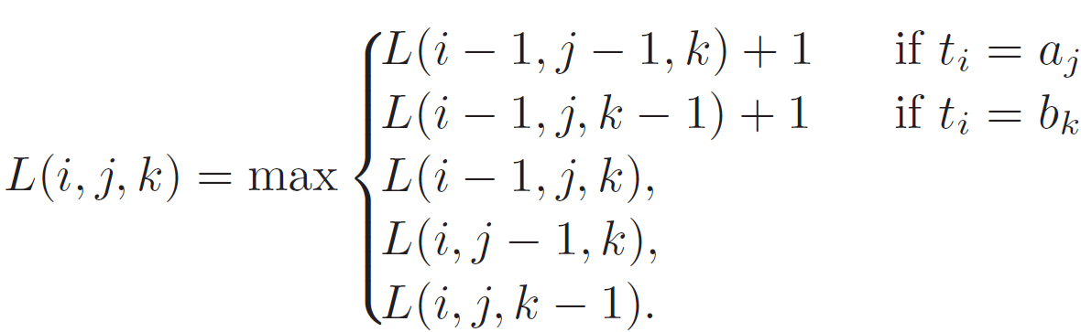
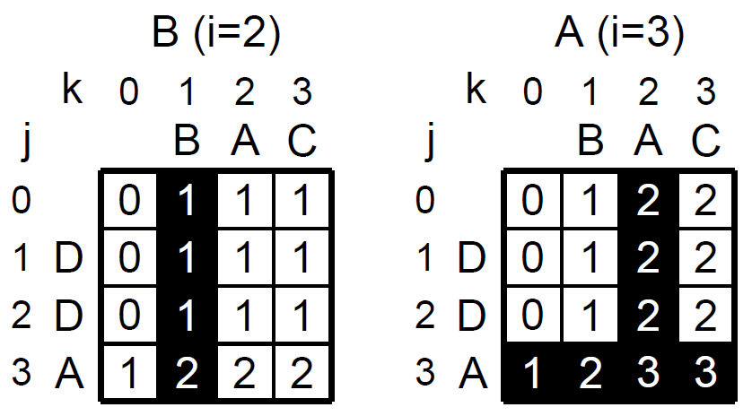
MergedLCS(5/5)
L(3, 3, 3) = max((L(2, 2, 3) + 1), L(2, 3, 3),
L(3, 2, 3) , L(3, 3, 2))
= L(3, 3, 3) = max(2, 2, 2, 3) = 3

Slide 8
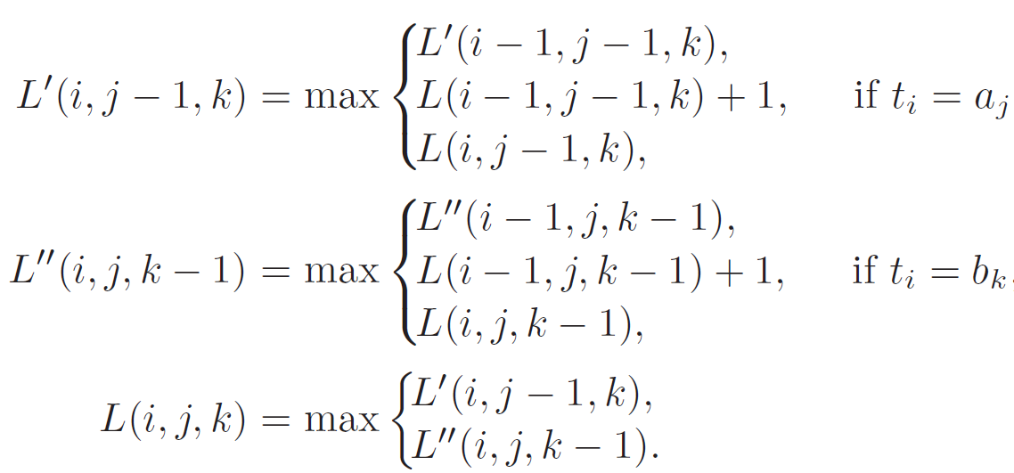
Bit-Parallel Algorithm

Slide 9
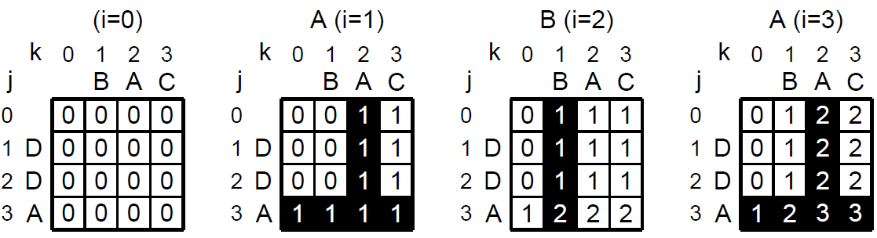
M( j, k)
M(3, 3) = {1, 2, 3}, M(2, 3) = {1, 3}, M(3, 2) = {1, 2, 3}

Slide 10
M’( j, k) and M’’( j, k)
M ’( j, k)
i ∈ M ’( j, k) if and only if L’ (i, j, k) - L’ (i - 1, j, k) = 1 for 1 ≦i ≦ r
M’’( j, k)
i ∈ M’’( j, k)if and only if L’’(i, j, k) - L’’(i - 1, j, k) = 1 for 1 ≦i ≦ r

Slide 11
W( j, k)
M(3, 3) = {1, 2, 3} M(2, 3) = {1, 3}
W(3, 3) = W(2, 3) =
index | value
0 | 1
1 | 0
2 | 0
3 | 0
index | value
0 | 1
1 | 0
2 | 1
3 | 0
In a similar way W ’( j, k), W’’( j, k) can be computed.

Slide 12
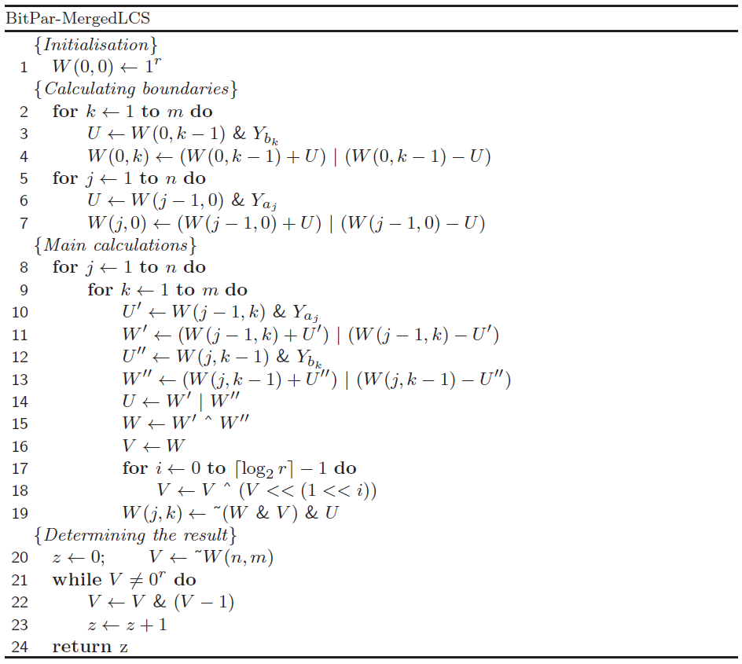
Algorithm

Slide 13
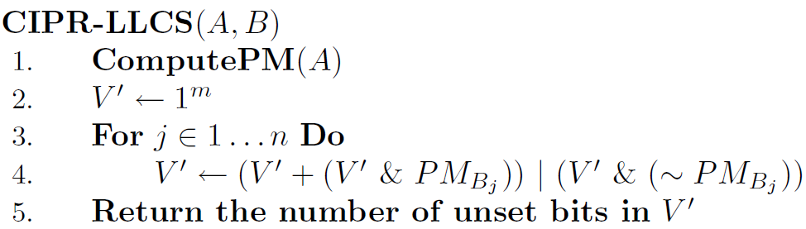
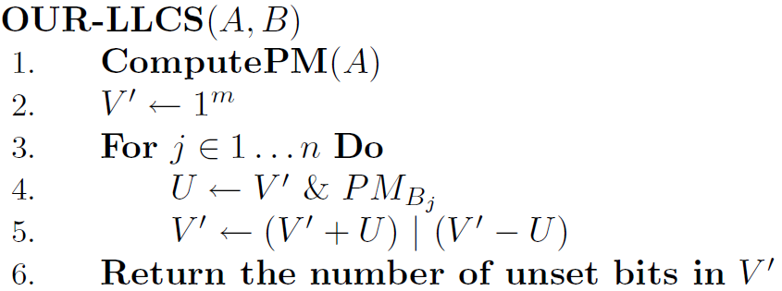
Improved Formula

Slide 14
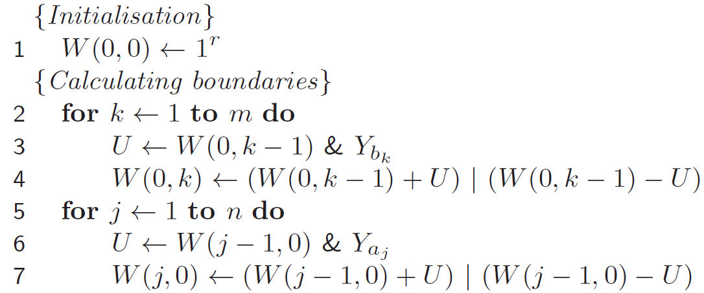
Initialisation
LCS(T, A), LCS(T, B)

Slide 15
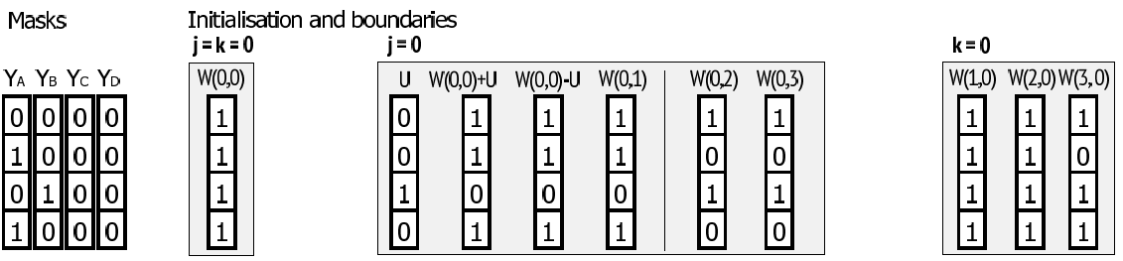

Slide 16
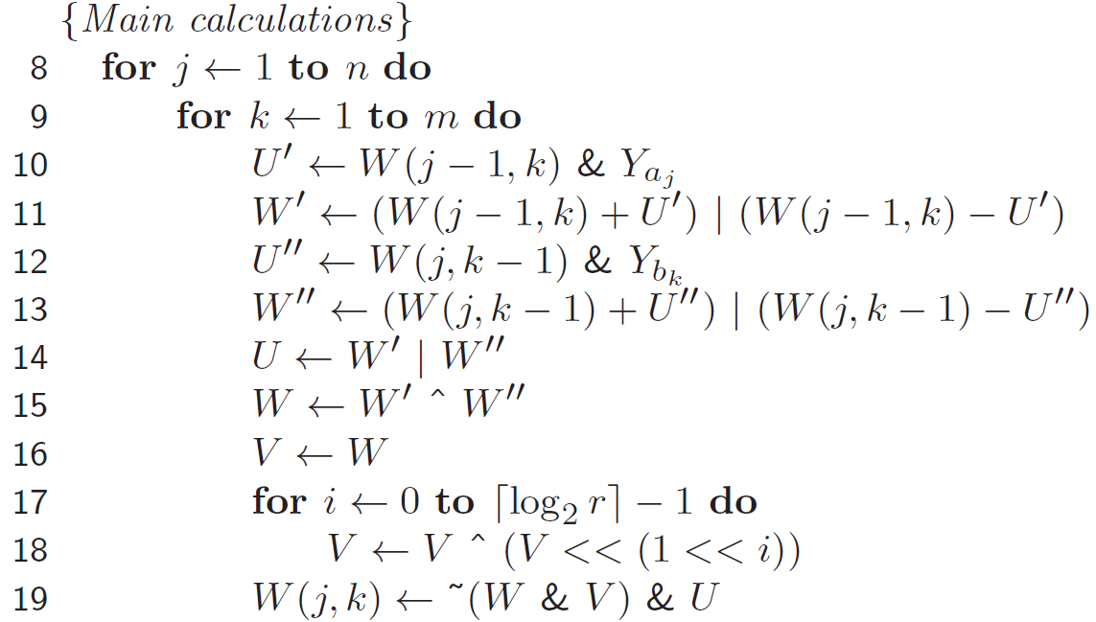
W’(j – 1, k) and W’’(j, k - 1)

Slide 17
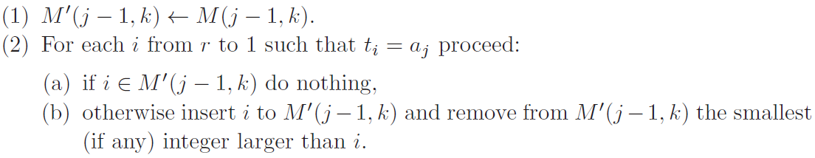
W’(j – 1, k) and W’’(j, k - 1)
ex: T = ABA, A = DDA, M(2, 1) = {2}
M’(2, 1) = M(2, 1) = {2}
M’(2, 1) = {2, 3} t₃ = a₃ , A = A
M’(2, 1) = {1, 2, 3} t₁ = a₃ , A = A

Slide 18
W’(j – 1, k) and W’’(j, k - 1)
3 | 2 | 1 | 0
1 | 0 | 1 | 1
M(2, 1) = {2}, W(2, 1) =
Y_{A} = 1010
W’(2, 1) = W(2, 1) & Y_{A} = 1010
W’(2, 1) = (W(2, 1) + W’(2, 1)) | (W(2, 1) - W’(2, 1))
= 0101

Slide 19
W(j, k)

Slide 20
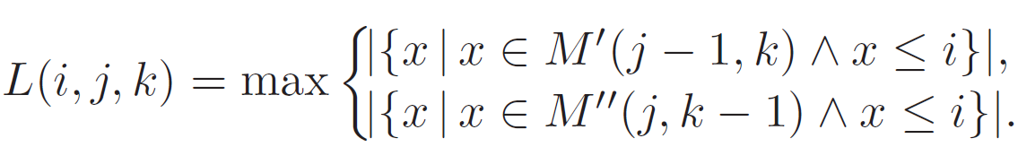
W(j, k)
M ’(2, 3) = {1, 3}
M ’’(3, 2) = {1, 2, 3}
L(3, 3, 3) = max{|M ’( 2, 3)|,|M ’’(3, 2)|}
= max{2,3} = 3

Slide 21
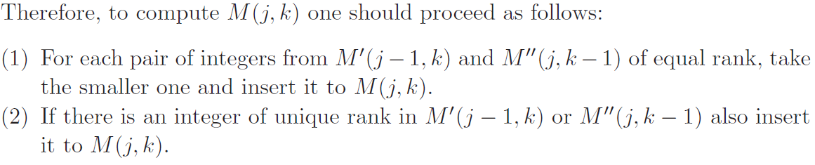
W(j, k)
M ’(2, 3) = {1, 3}
M ’’(3, 2) ={1, 2, 3}
M (3, 3) ={1, 2, 3}
ex: M(3, 3)

Slide 22
W(j, k)
M ’(7, 8) = {1, 3, 4, 5, 6}
M ’’(8, 7) ={1, 2, 3, 5, 8}
M (8, 8) ={1, 2, 3, 5, 6}
ex: M(8, 8)
M ’ (7, 8) = {1, 3, 4, 5, 6}
M ’’(8, 7) ={1, 2, 3, 5, 8}
1, 3, 5∈ M (8, 8)
M ’ (7, 8) = {4, 6}
M ’’(8, 7) = {2, 8}
2, 4, 6, 8 ∈ M (8, 8)
∴ 1, 2, 3, 5, 6 ∈ M (8, 8)

Slide 23
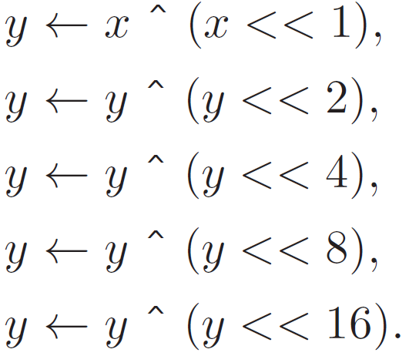
in a 32-bit computer
M ’ (7, 8) = {4, 6}
M ’’(8, 7) = {2, 8}
2, 4, 6, 8 ∈ M (8, 8)
x =
y = x ^ (x << 1) = 111111100
y = x ^ (x << 2) = 000001100
y = x ^ (x << 4) = 011001100
y & x =
8 | 7 | 6 | 5 | 4 | 3 | 2 | 1 | 0
1 | 0 | 1 | 0 | 1 | 0 | 1 | 0 | 0
8 | 7 | 6 | 5 | 4 | 3 | 2 | 1 | 0
0 | 0 | 1 | 0 | 0 | 0 | 1 | 0 | 0
The ith bit of y is 1 if and only if the number of 1s in
positions from 0 to i in x is odd

Slide 24
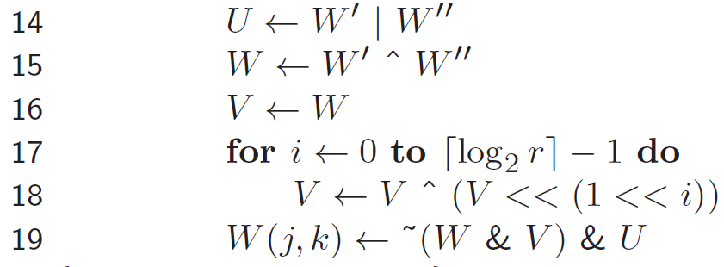
8 | 7 | 6 | 5 | 4 | 3 | 2 | 1
1 | 1 | 0 | 0 | 0 | 0 | 1 | 0
0 | 1 | 1 | 0 | 1 | 0 | 0 | 0
1 | 1 | 0 | 0 | 1 | 0 | 0 | 0
M ’(7, 8) = {1, 3, 4, 5, 6}=>W’ =
M ’’(8, 7) ={1, 2, 3, 5, 8}=>W’’ =
M (8, 8) ={1, 2, 3, 5, 6}=>W(8, 8)=
U = W’|W’’ = 11101010
W= W’^W’’ = 10101010 (2, 4, 6, 8)
V = W = 10101010
V = V^(V<<1)=11111110
V = V^(V<<2)=00000110
V = V^(V<<4)=01100110
W(8, 8) = ~(W & V) & U = 11001000

Slide 25
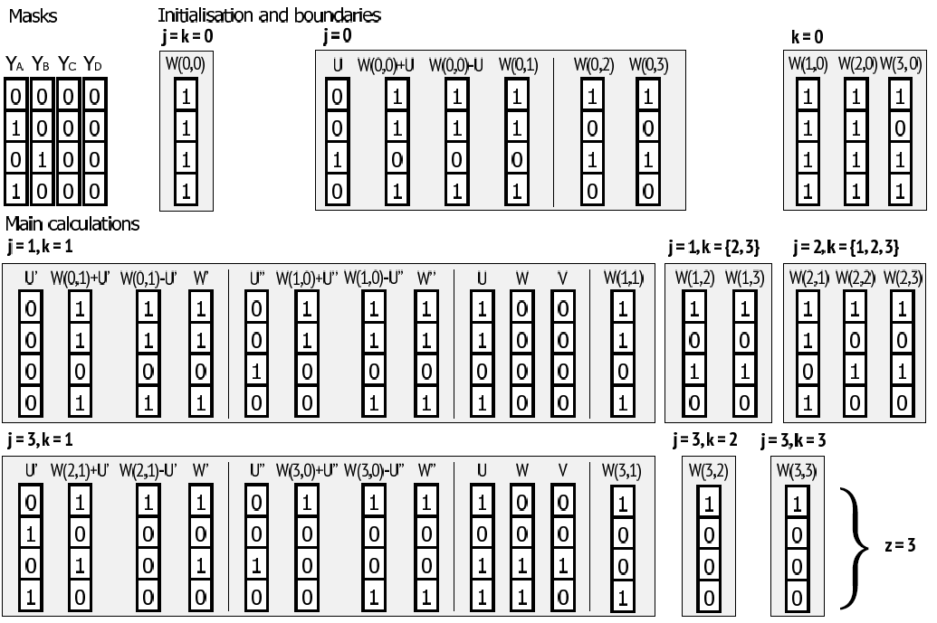
T = ABA, A = DDA, B = BAC

Slide 26
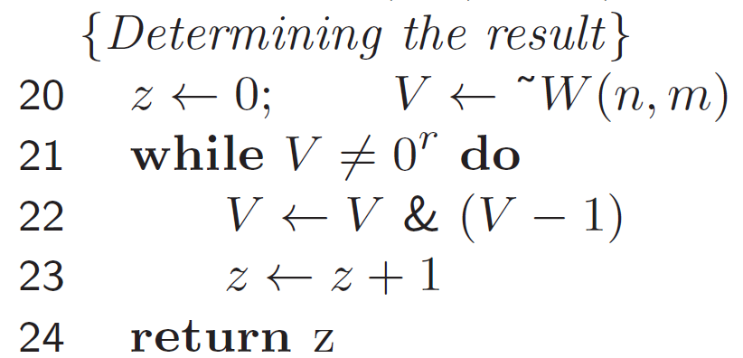
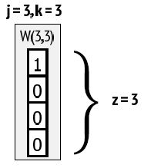
Determining the result

Slide 27
Analysis of algorithm
Θ(⌈r/w⌉mn logw)
|T| = r, |A| = n, |B| = m
w : word size

Slide 28
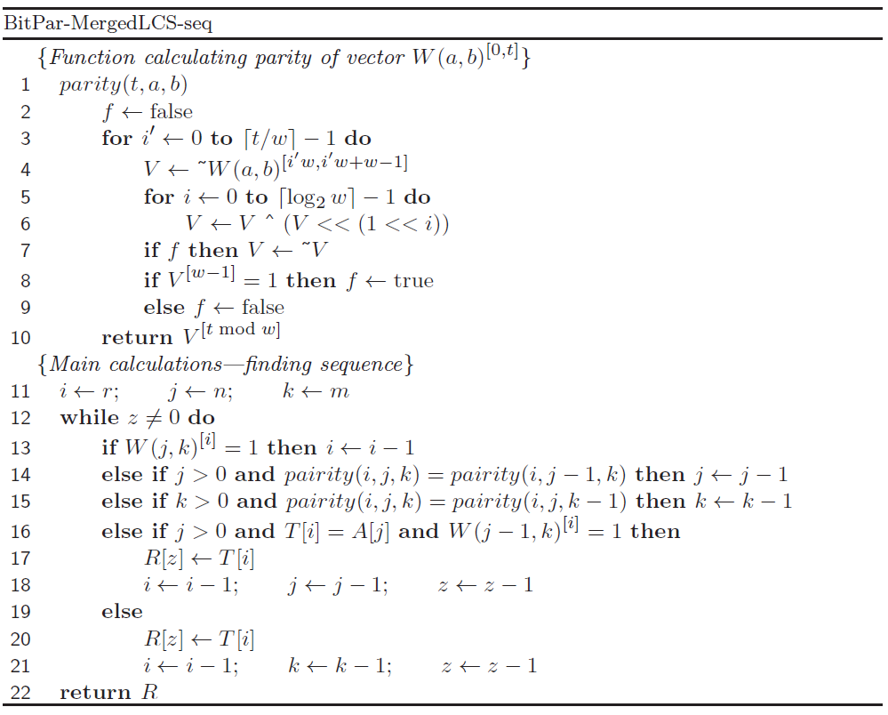
BitPar-MergedLCS-seq(1/5)

Slide 29
BitPar-MergedLCS-seq(2/5)
A = DDA
T = ABA
B = BAC
3 | 2 | 1 | 0
1 | 1 | 1 | 0
~w(3, 3) =
~w(2, 3) =
3 | 2 | 1 | 0
1 | 0 | 1 | 0

Slide 30
BitPar-MergedLCS-seq(3/5)
A = DDA
T = ABA
B = BAC
3 | 2 | 1 | 0
1 | 1 | 1 | 0
~w(3, 3) =
~w(3, 2) =
3 | 2 | 1 | 0
1 | 1 | 1 | 0

Slide 31
BitPar-MergedLCS-seq(4/5)
A = DDA
T = ABA
B = BA
3 | 2 | 1 | 0
1 | 1 | 1 | 0
~w(3, 2) =
~w(2, 2) =
3 | 2 | 1 | 0
1 | 0 | 1 | 0

Slide 32
BitPar-MergedLCS-seq(5/5)
A = DDA
T = ABA
B = BA
A = DD
T = AB
B = BA
output:A
3 | 2 | 1 | 0
1 | 1 | 1 | 0
~w(3, 2) =
~w(3, 1) =
3 | 2 | 1 | 0
0 | 1 | 1 | 0

Slide 33
Experimental Results(1/7)
Θ(⌈r/w⌉mn logw)
|T| = r, |A| = n, |B| = m
w : word size

Slide 34
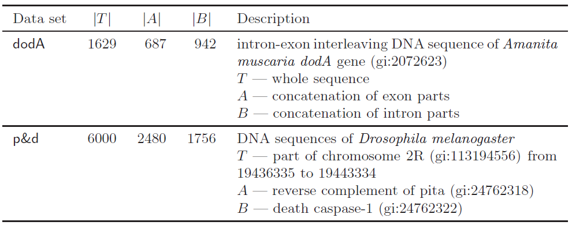
Experimental Results(2/7)

Slide 35
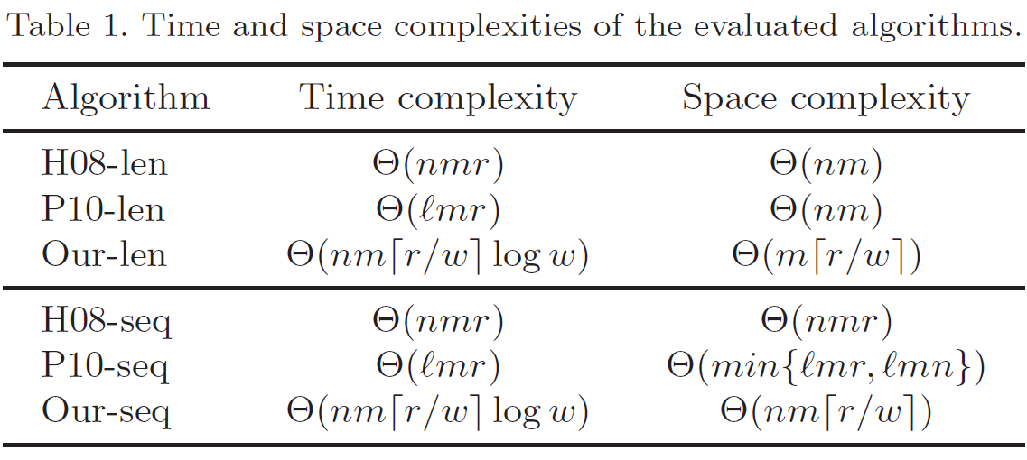
Experimental Results(3/7)
H08: K.-S. Huang, C.-B. Yang, K.-T. Tseng, H.-Y. Ann, and Y.-H. Peng. Efficient algorithm
for finding interleaving relationship between sequences. Information Processing
Letters, 105(5):188–193, 2008.
P10 : Y.-H. Peng, C.-B. Yang, K.-S. Huang, C.-T. Tseng, and C.-Y. Hor. Efficient sparse
dynamic programming for the merged lcs problem with block constraints. Interna-
tional Journal of Innovative Computing, Information and Control, 6(4):1935–1947,
2010.

Slide 36
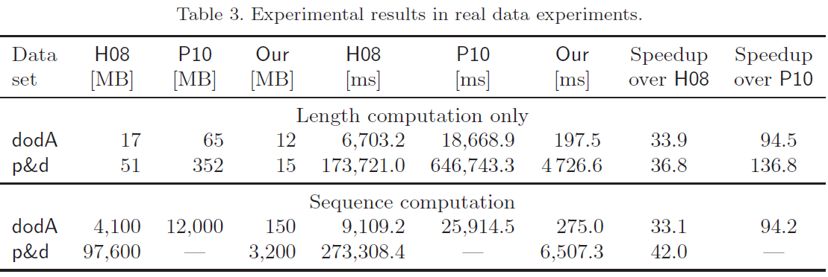
Experimental Results(4/7)
Each experiment was repeated 201 times to get median values.

Slide 37
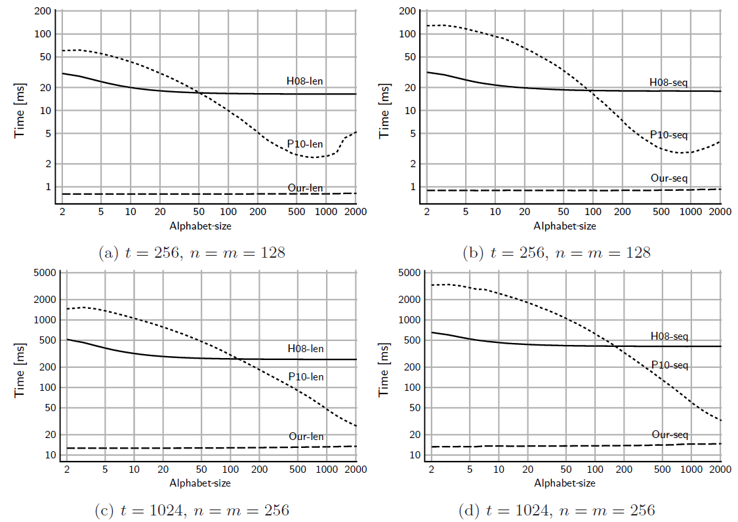

Slide 38
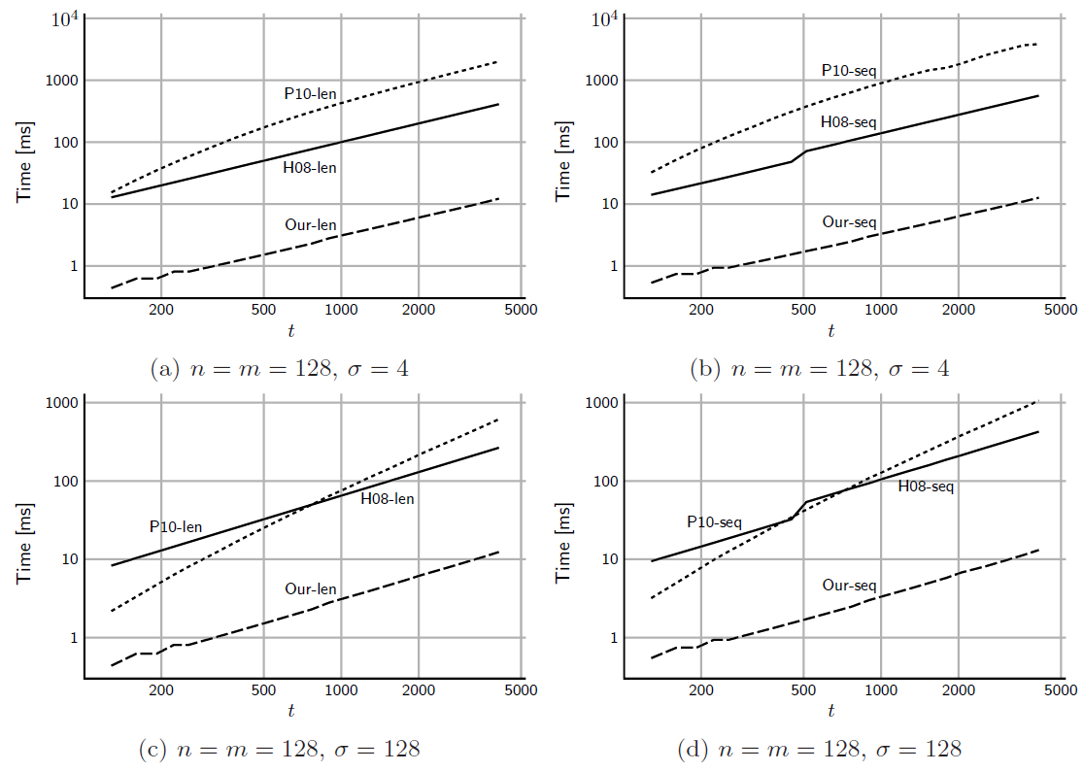

Slide 39
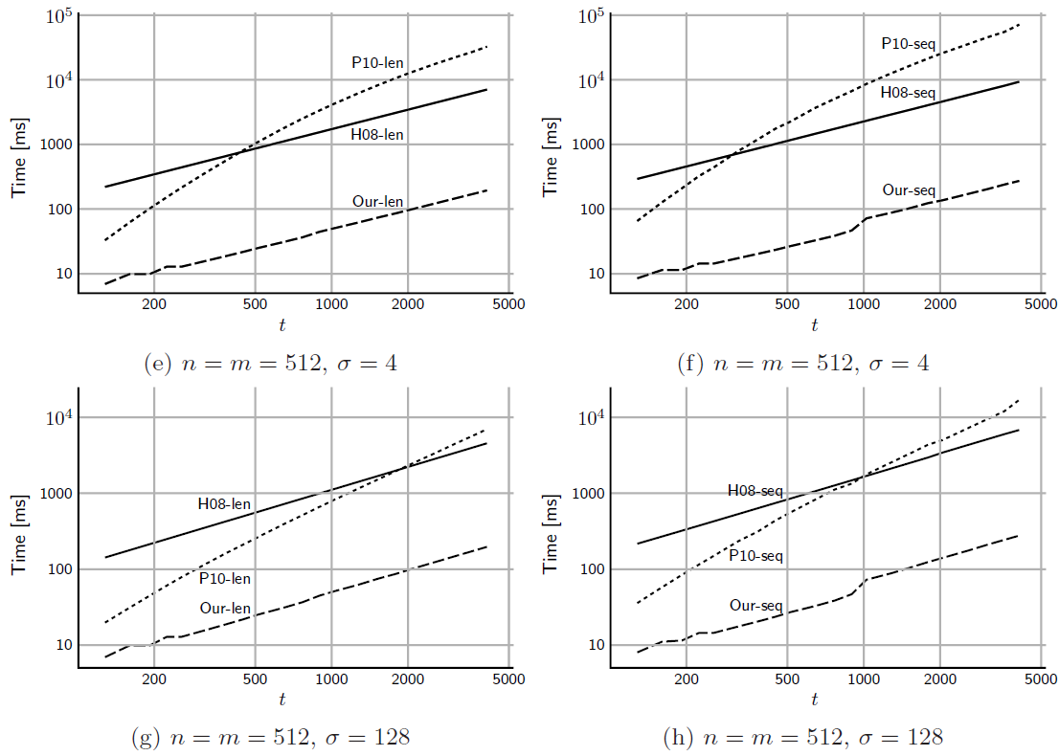

Slide 40
Thanks for listening

