Slide 1
Clickstream Clustering using Weighted Longest Common Subsequences
Arindam Banerjee and Joydeep Ghosh
In Proceedings of the Web Mining Workshop at the 1st SIAM Conference on Data Mining
Presenter: Ding-Yao Huang
Date:2014/08/26

Slide 2
Abstract
Categorizing visitors based on their interactions with a website is a key problem in web usage mining. The clickstreams generated by various users often follow distinct patterns, the knowledge of which may help in providing customized content.
In this paper, we propose a novel and effective algorithm for clustering web users based on a function of the longest common subsequence of their clickstreams that takes into account both the trajectory taken through a website and the time spent at each page.
Results are presented on weblogs of www.sulekha.com to illustrate the techniques.
Notes:
簡單說就是想對於使用者在網頁上的行為選擇
進行分析 分群
就可以進一步得知 個人嗜好
例如 夫妻喜歡便宜要大碗 情侶喜歡華麗一點

Slide 3
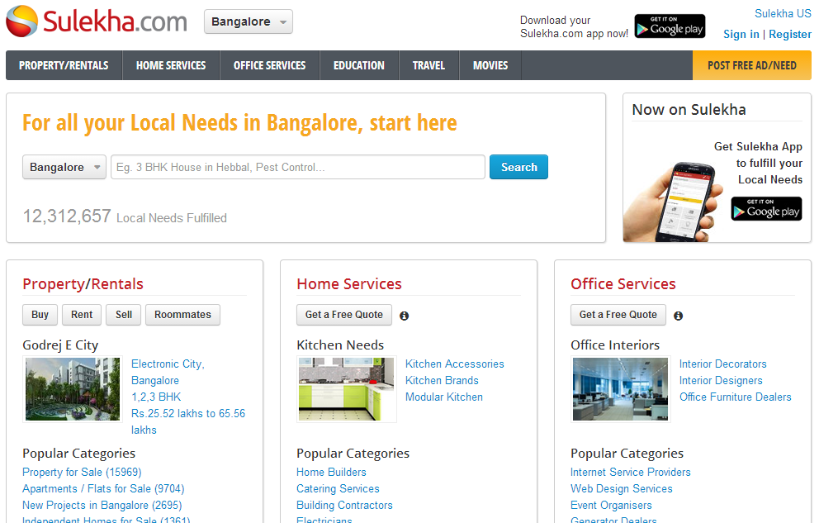
Introduction
Clickstream
就是使用者的在網頁間來來去去的點選記錄。
Timestamp, sessionID, userID, cookieID, web page
2014/04/01:1323,x,user1,cookie1,http://abc.com/index
2014/04/01:1324,x,user1,cookie1,http://abc.com/item?itemid=1234
2014/04/01:1327,z,null,cookie3,http://abc.com/item?itemid=2345
2014/04/01:1340,x,user1,cookie1,http://abc.com/item?itemid=2837
2014/04/01:1341,x,user1,cookie1,http://abc.com/category?cid=23
2014/04/01:1341,z,null,cookie3,http://abc.com/search?kw=big data
2014/04/01:1344,y,user2,cookie2,http://abc.com/top?by=lastweek
2014/04/01:1344,x,user1,cookie1,http://abc.com/item?itemid=8899
2014/04/01:1348,x,user1,cookie1,http://abc.com/item?itemid=297
2014/04/01:1348,x,user1,cookie1,http://abc.com/category?cid=18
2014/04/01:1349,xx,user1,cookie1,http://abc.com/category?cid=24
...

Slide 4
Clustering
分群 (Clustering) 是將一組資料依據某種距離的量度將其分割成若干群。

Slide 5

LCS algorithm
 |  | B | D | C | A | B | A
 | 0 | 0 | 0 | 0 | 0 | 0 | 0
A | 0 | 0 | 0 | 0 | 1 | 1 | 1
B | 0 | 1 | 1 | 1 | 1 | 2 | 2
C | 0 | 1 | 1 | 2 | 2 | 2 | 2
B | 0 | 1 | 2 | 2 | 2 | 3 | 3
D | 0 | 1 | 2 | 2 | 2 | 3 | 3
A | 0 | 1 | 2 | 2 | 3 | 3 | 4
B | 0 | 1 | 2 | 2 | 3 | 4 | 4
 |  | B | D | C | A | B | A
 | 0 | 0 | 0 | 0 | 0 | 0 | 0
A | 0 | 0 | 0 | 0 | 1 | 1 | 1
B | 0 | 1 | 1 | 1 | 1 | 2 | 2
C | 0 | 1 | 1
B | 0 | 1 | 2
D | 0 | 1 | 2
A | 0 | 1 | 2
B | 0 | 1 | 2
2

Slide 6
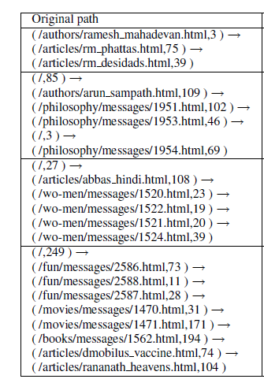
Path Information

Slide 7
Method
Path Intersection
Path Similarity Measure
The Similarity Graph and Clustering
Concept-based Clustering
Notes:
Session 的機制就像是你去飲料店下了單以後，得到號碼牌，然後你走開幾步，店員就忘了你是誰。所以，如果你想去取飲料，你就得靠這張號碼牌，去跟店員領，店員會跟據這號碼牌，認定你是顧客、是否點過餐、知道你點了什麼東西，然後可以接著給你屬於你的飲料。

Slide 8
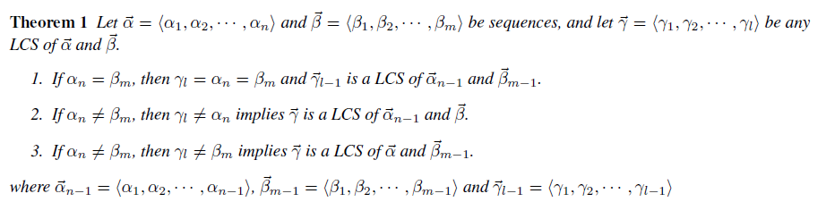
Path Intersection
Ex:
α=<A,B,C,B,D,A>
β=<B,D,C,A,B,A>
γ=<B,C,B,A>
α=<A,B,C,B,D,A,B>
β=<B,D,C,A,B,A>
γ=<B,C,B,A>
α=<A,B,C,B,D,A,B>
β=<B,D,C,A,B,A>
γ=<B,D,A,B>
<2,3,4,6> < 2,3,4,6 > <2,5,6,7>
<1,3,5,6> < 1,3,5,6> <1,2,4,5>
l^{α}(1)=2 , l^{α}(2)=3 , l^{α}(3)=4 , l^{α}(4)=6
l^{β}(1)=1, l^{β}(2)=3, l^{β}(3)=5, l^{β}(4)=6
Notes:
目的:應該是要分析這個使用者個另一個使用者他們Session中是不是有流覽相同的網站

Slide 9









Path Similarity Measure
The Similarity Component
Ex:
32 33 vs 1 20
The Importance Component
Notes:
有可能點錯，所以說要用時間當作判斷的依據
這頁要在說明

Slide 10

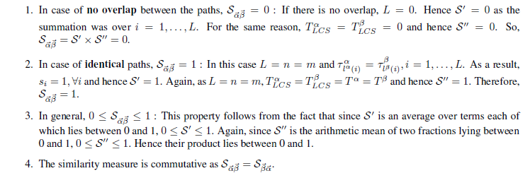
Path Similarity Measure

Slide 11


Path Similarity Measure
α=<A,B,C,B,D,A,B>
β=<B,D,C,A,B,A>
γ=<B,D,A,B>
103
70
120
95
0.86
0.74
73
70
120
95
0.61
0.74
α=<4,33,10,3,27,28,15>
β=<14,3,18,20,33,7>

Slide 12

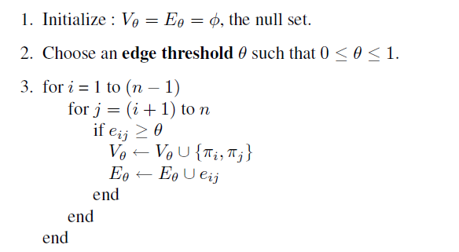
The Similarity Graph and Clustering

Slide 13
V={}
E={}
1
0.66
5
0.65
0.43
0.46
0.63
0.64
4
0.53
0.27
0.74
2
0.33
3
Threshold =0.47

Slide 14
V={π₁, π ₃, π ₄}
E={e₁₃,e₁₄}
V={π₁, π ₃}
E={e₁₃}
V={}
E={}
V={π₁, π ₂, π ₃, π _{4 ,}π ₅}
E={e₁₃,e₁₄,e_{25,}e_{34,}e₃₅}
V={π₁, π ₂, π ₃, π ₅}
E={e₁₃,e₁₄,e₂₅}
V={π₁, π ₂, π ₃, π _{4 ,}π ₅}
E={e₁₃,e₁₄,e_{25,}e₃₄}
1
0.66
5
0.65
0.43
0.46
0.63
0.64
4
0.53
0.27
0.74
2
0.33
3
Threshold =0.47

Slide 15

The Similarity Graph and Clustering
1
0.66
5
0.65
0.63
4
0.64
0.53
0.74
2
3
Notes:
xxx

Slide 16
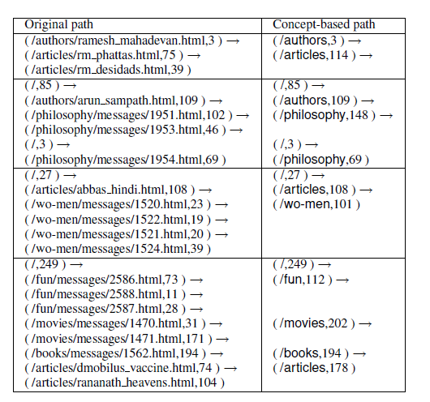
Concept-based Clustering
Notes:
單純看path的話 往往關聯性就會降低，所以說

Slide 17
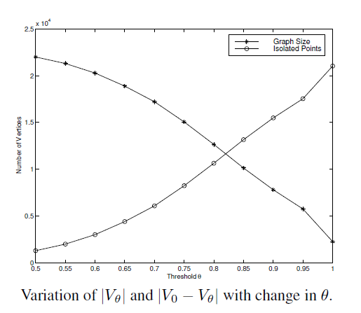

Slide 18
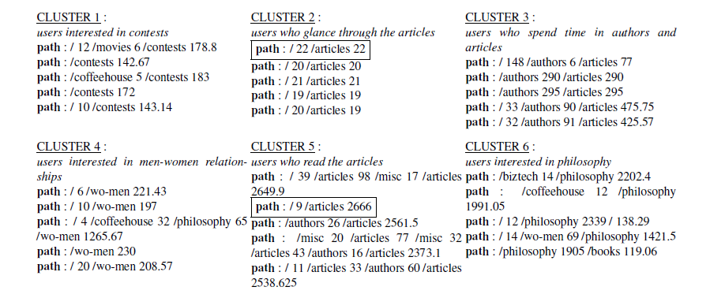
Sample Results

Slide 19
Concluding Remarks
In the paper, by defining a suitable similarity measure between any pair of paths, we map the paths into a similarity space. This technique enables one to naturally incorporate both path and time information. The idea of thresholding the similarity graph is particularly useful for data-mining applications since it is a good way of reducing the size of the data to be handled in the clustering stage, and being more robust against outliers.
A fast, scalable and efficient graph-partitioning algorithm has been used to do the clustering. It avoids curse-of-dimensionality problems encountered in traditional clustering methods (K-means etc.) applied to high dimensional spaces. The superiority of graph-partitioning methods for clustering has also been demonstrated in other web analytics domains such as clustering of web documents .

Slide 20
Another contribution of this paper is the use of metadata such as pre-existing category labels. This captures the notion of content at a more abstract level. It is possible that extracting textual and meta-tag information from the contents of the pages being viewed can further enhance the quality of user clustering, provided the additional information complexity can be managed properly.

