Slide 1
Constrained LCS: Hardness and Approximation
Zvi Gotthilf, Danny Hermelin and Moshe Lewenstein
Combinatorial Pattern Matching Lecture Notes in Computer Science Volume 5029, 2008, pp. 255-262
Presenter：Guan-Cheng Guo Date：2014/10/14

Slide 2
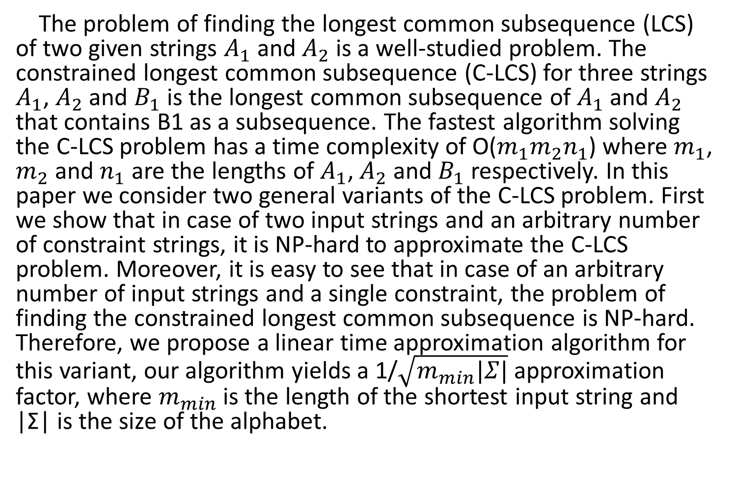
Abstract
The problem of finding the longest common subsequence (LCS) of two given strings $A_{1}$ and $A_{2}$ is a well-studied problem. The constrained longest common subsequence (C-LCS) for three strings $A_{1}$, $A_{2}$ and $B_{1}$ is the longest common subsequence of $A_{1}$ and $A_{2}$ that contains B1 as a subsequence. The fastest algorithm solving the C-LCS problem has a time complexity of O($m_{1}m_{2}n_{1}$) where $m_{1}$, $m_{2}$ and $n_{1}$ are the lengths of $A_{1}$, $A_{2}$ and $B_{1}$ respectively. In this paper we consider two general variants of the C-LCS problem. First we show that in case of two input strings and an arbitrary number of constraint strings, it is NP-hard to approximate the C-LCS problem. Moreover, it is easy to see that in case of an arbitrary number of input strings and a single constraint, the problem of finding the constrained longest common subsequence is NP-hard. Therefore, we propose a linear time approximation algorithm for this variant, our algorithm yields a 1/$\sqrt{m_{min}|Σ|}$ approximation factor, where $m_{min}$ is the length of the shortest input string and |Σ| is the size of the alphabet.

Slide 3
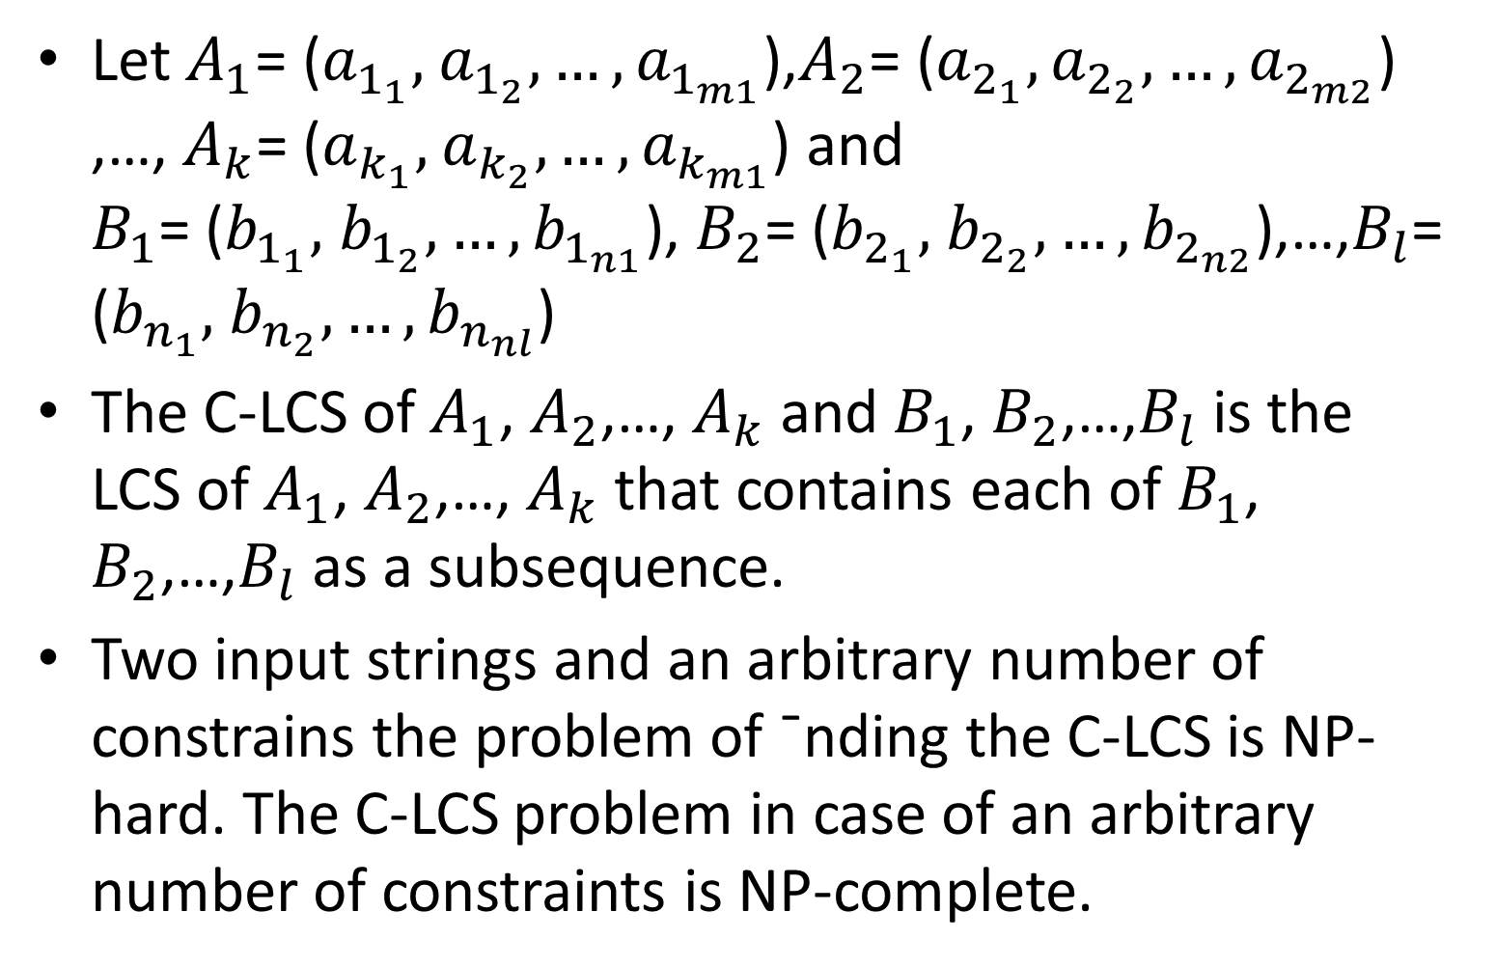
Constrained LCS
Let $A_{1}$= ($a_{1_{1}},$ $a_{1_{2}},…,a_{1_{m1}}$),$A_{2}$= ($a_{2_{1}},a_{2_{2}},…,a_{2_{m2}}$) ,…, $A_{k}$= ($a_{k_{1}},$ $a_{k_{2}},…,a_{k_{m1}}$) and $B_{1}$= ($b_{1_{1}},$ $b_{1_{2}},…,b_{1_{n1}}$), $B_{2}$= ($b_{2_{1}},$ $b_{2_{2}},…,b_{2_{n2}}$),…,$B_{l}$= ($b_{n_{1}},$ $b_{n_{2}},…,b_{n_{nl}}$)
The C-LCS of $A_{1}$, $A_{2}$,…, $A_{k}$ and $B_{1}$, $B_{2}$,…,$B_{l}$ is the LCS of $A_{1}$, $A_{2}$,…, $A_{k}$ that contains each of $B_{1}$, $B_{2}$,…,$B_{l}$ as a subsequence.
Two input strings and an arbitrary number of constrains the problem of ¯nding the C-LCS is NP-hard. The C-LCS problem in case of an arbitrary number of constraints is NP-complete.

Slide 4
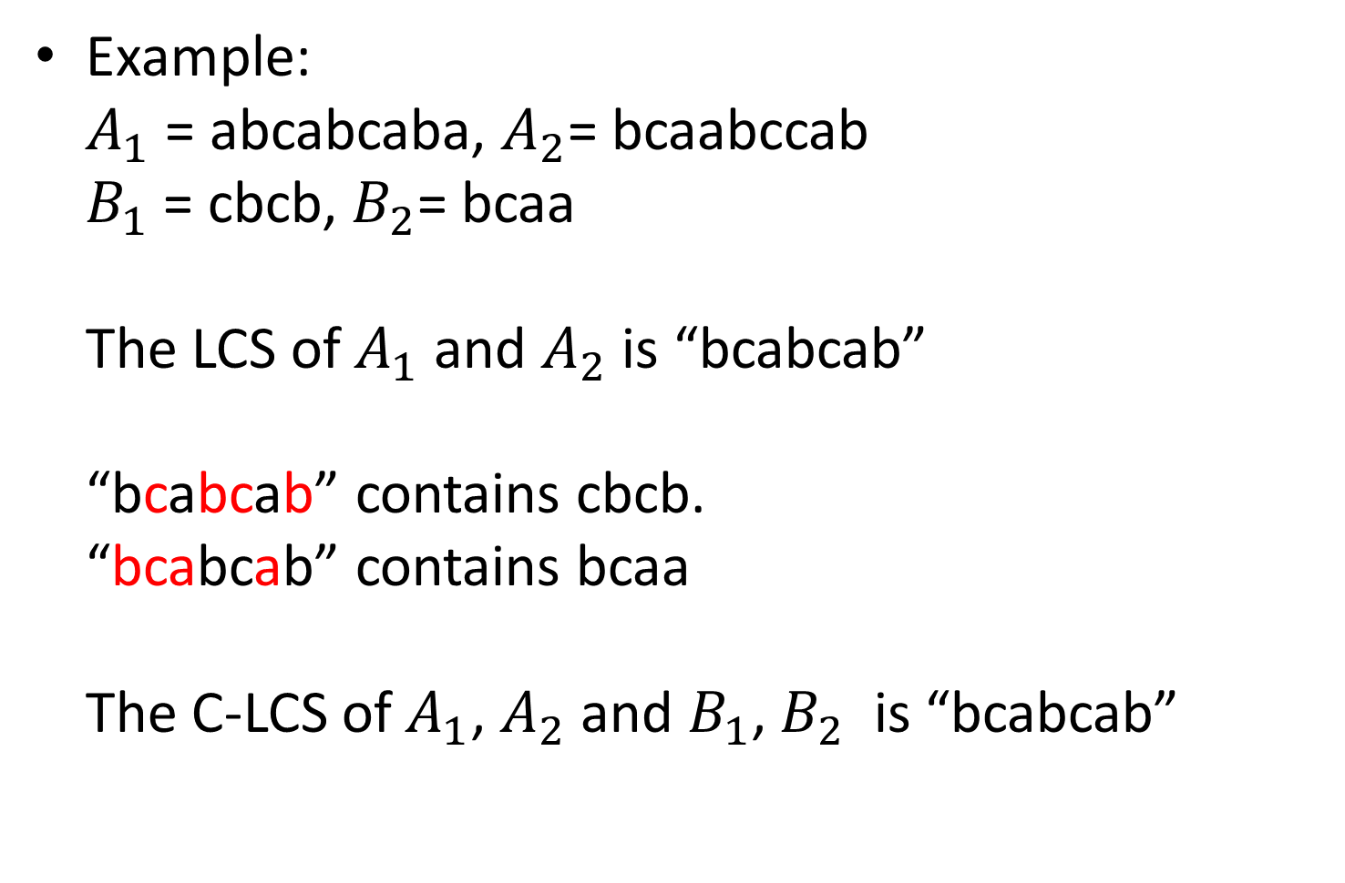
Constrained LCS
Example: $A_{1}$ = abcabcaba, $A_{2}$= bcaabccab $B_{1}$ = cbcb, $B_{2}$= bcaa The LCS of $A_{1}$ and $A_{2}$ is “bcabcab” “bcabcab” contains cbcb. “bcabcab” contains bcaa The C-LCS of $A_{1}$, $A_{2}$ and $B_{1}$, $B_{2}$ is “bcabcab”

Slide 5
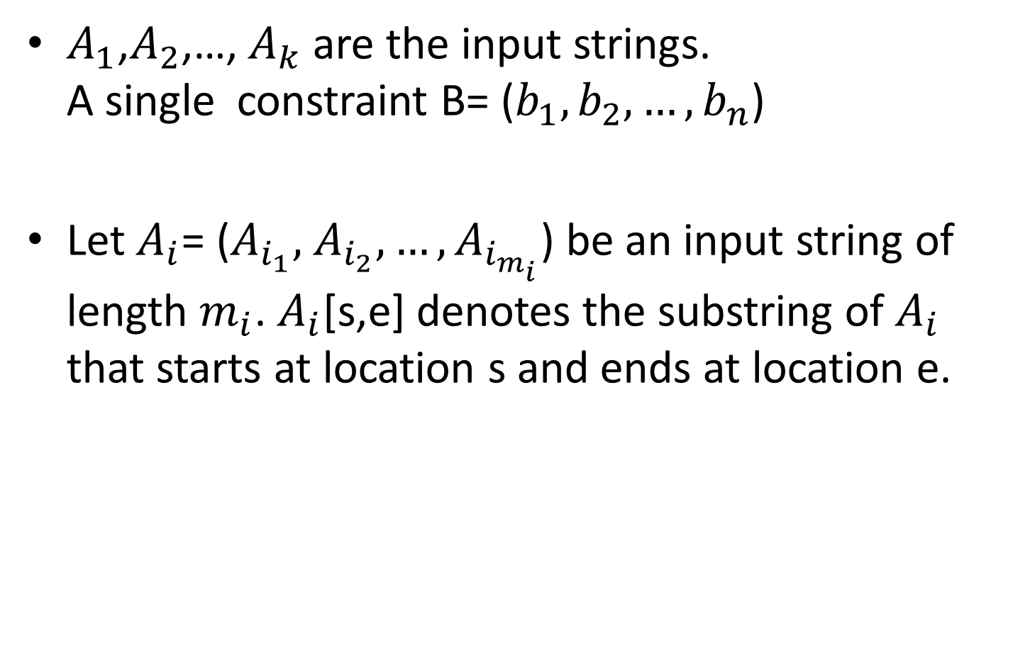
Constrained LCS – Single Constraint
$A_{1}$,$A_{2}$,…, $A_{k}$ are the input strings. A single constraint B= ($b_{1},b_{2},…,b_{n}$)
Let $A_{i}$= ($A_{i_{1}},$ $A_{i_{2}},…,A_{i_{m_{i}}}$) be an input string of length $m_{i}$. $A_{i}$[s,e] denotes the substring of $A_{i}$ that starts at location s and ends at location e.

Slide 6
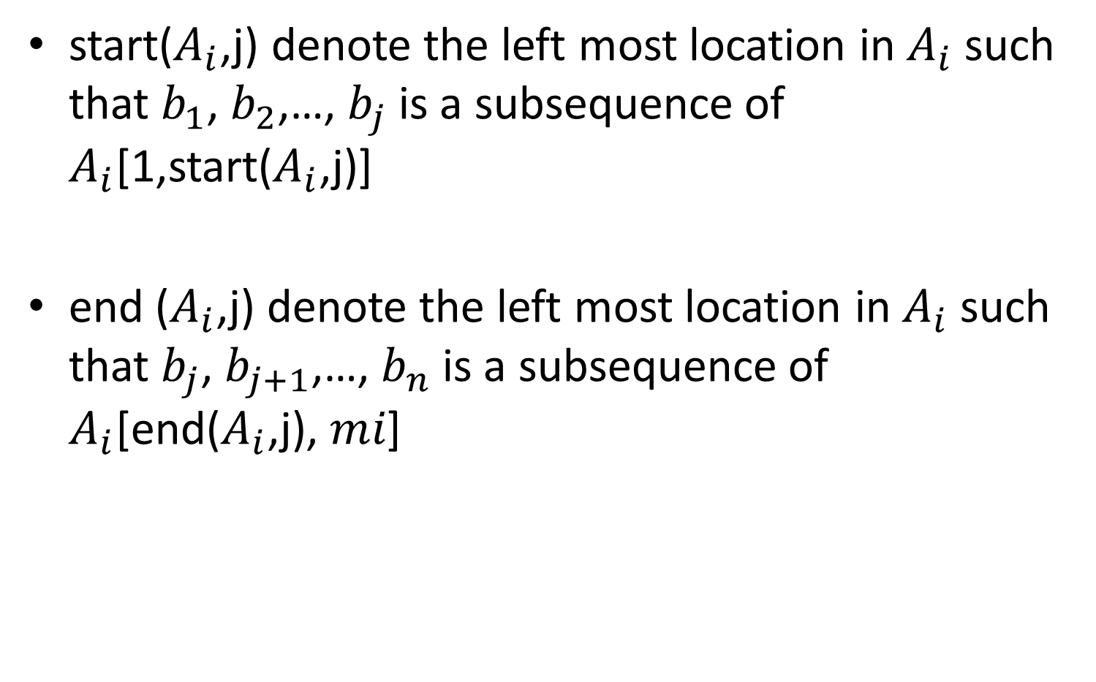
Constrained LCS – Single Constraint
start($A_{i}$,j) denote the left most location in $A_{i}$ such that $b_{1}$, $b_{2}$,…, $b_{j}$ is a subsequence of $A_{i}$[1,start($A_{i}$,j)]
end ($A_{i}$,j) denote the left most location in $A_{i}$ such that $b_{j}$, $b_{j+1}$,…, $b_{n}$ is a subsequence of $A_{i}$[end($A_{i}$,j), $m﷮i$]

Slide 7














Constrained LCS – Single Constraint
Example:
end ($A_{1}$,1)
end ($A_{1}$,2)
end ($A_{1}$,3)
start($A_{1}$,1)
start($A_{1}$,2)
start($A_{1}$,3)
$$A_{1}$$
c | a | b | d | b | c | a | d | d | b | c | a
$$A_{2}$$
c | b | b | a | d | d | c | a | b | b | d | a
start($A_{2}$,1)
start($A_{2}$,2)
start($A_{2}$,3)
end ($A_{2}$,1)
end ($A_{2}$,2)
end ($A_{2}$,3)
B
c | b | a

Slide 8
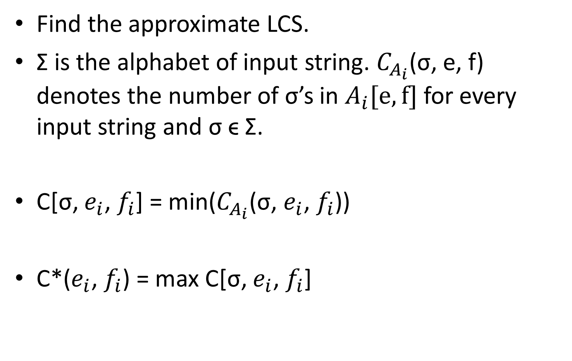
An Approximation Algorithm
Find the approximate LCS.
Σ is the alphabet of input string. $C_{A_{i}}$(σ, e, f) denotes the number of σ’s in $A_{i}[e,f]$ for every input string and σ ϵ Σ.
C[σ, $e_{i}$, $f_{i}$] = min($C_{A_{i}}$(σ, $e_{i}$, $f_{i}$))
C*($e_{i}$, $f_{i}$) = max C[σ, $e_{i}$, $f_{i}$]

Slide 9
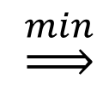




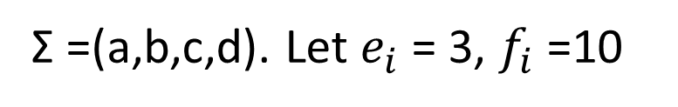
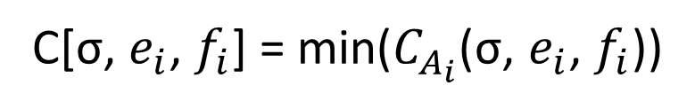
An Approximation Algorithm
C[σ, $e_{i}$, $f_{i}$] = min($C_{A_{i}}$(σ, $e_{i}$, $f_{i}$))
$$A_{1}$$
c | a | b | d | b | c | a | d | d | b | c | a
$$A_{2}$$
c | b | b | a | d | d | c | a | b | b | d | a
Σ =(a,b,c,d). Let $e_{i}$ = 3, $f_{i}$ =10
$$A_{1}$$
a | b | c | d
1 | 3 | 1 | 3
a | b | c | d
1 | 3 | 1 | 2
$\underset{⇒}{min}$
a | b | c | d
2 | 3 | 1 | 2
$$A_{2}$$

Slide 10
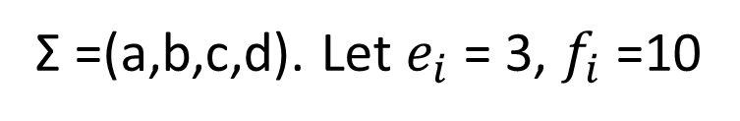
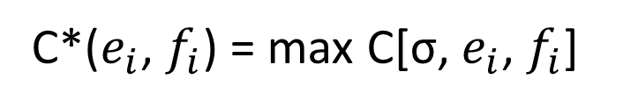
An Approximation Algorithm
C*($e_{i}$, $f_{i}$) = max C[σ, $e_{i}$, $f_{i}$]
$$A_{1}$$
c | a | b | d | b | c | a | d | d | b | c | a
$$A_{2}$$
c | b | b | a | d | d | c | a | b | b | d | a
Σ =(a,b,c,d). Let $e_{i}$ = 3, $f_{i}$ =10
max:
a | b | c | d
1 | 3 | 1 | 2

Slide 11
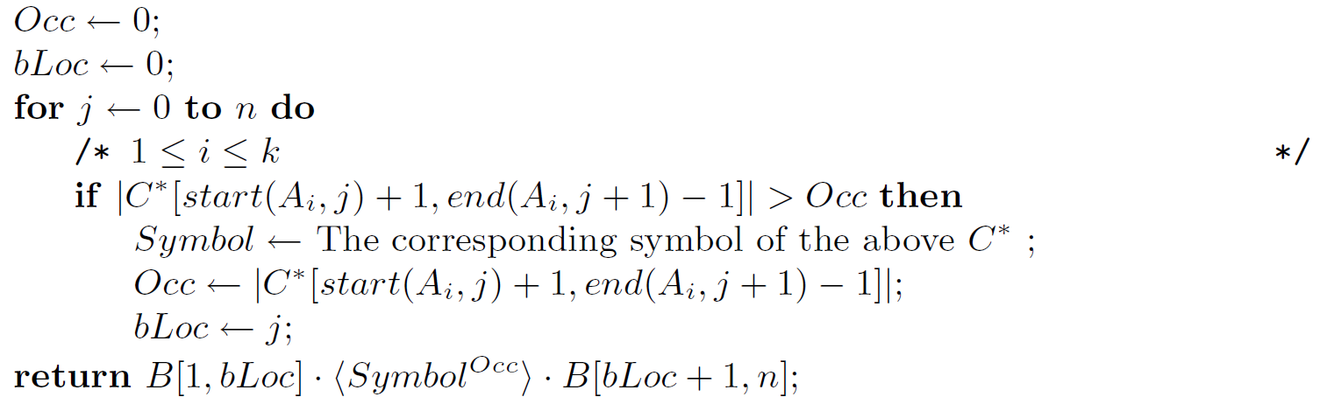
An Approximation Algorithm

Slide 12
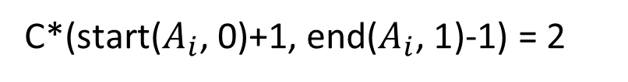

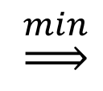



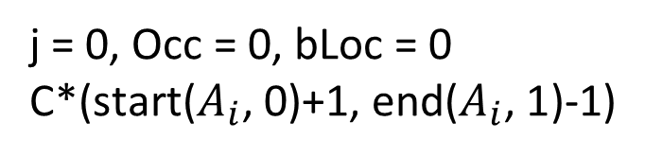
An Approximation Algorithm
Example:
$$A_{1}$$
c | a | b | d | b | c | a | d | d | b | c | a
$$A_{2}$$
c | b | b | a | d | d | c | a | b | b | d | a
B
c | b | a
Σ =(a,b,c,d)
j = 0, Occ = 0, bLoc = 0 C*($\text{start}\text{(}A_{i}\text{,}$0)+1, end($A_{i}\text{, }\text{1}$)-1)
symbol = b, Occ = 2, bLoc = 0
a | b | c | d
1 | 2 | 1 | 1
$$A_{1}$$
a | b | c | d
1 | 2 | 1 | 1
$\underset{⇒}{min}$
a | b | c | d
1 | 2 | 1 | 2
$$A_{2}$$
C*($\text{start}\text{(}A_{i}\text{, }$0)+1, end($A_{i}\text{, 1}$)-1) = 2

Slide 13
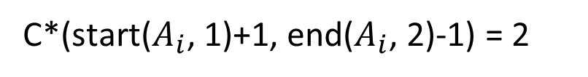
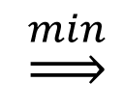


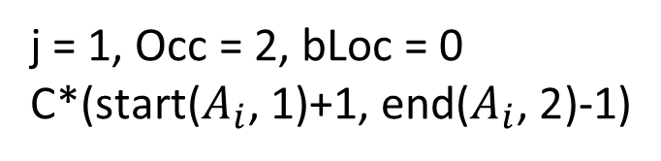
An Approximation Algorithm
Example:
$$A_{1}$$
c | a | b | d | b | c | a | d | d | b | c | a
$$A_{2}$$
c | b | b | a | d | d | c | a | b | b | d | a
B
c | b | a
Σ =(a,b,c,d)
j = 1, Occ = 2, bLoc = 0 C*($\text{start}\text{(}A_{i}\text{,}\text{ 1}$)+1, end($A_{i}\text{, }\text{2}$)-1)
symbol = b, Occ = 2, bLoc = 0
a | b | c | d
2 | 2 | 1 | 3
$$A_{1}$$
a | b | c | d
2 | 2 | 1 | 2
$\underset{⇒}{min}$
a | b | c | d
2 | 3 | 1 | 2
$$A_{2}$$
C*($\text{start}\text{(}A_{i}\text{, }\text{1}$)+1, end($A_{i}\text{,}$2)-1) = 2

Slide 14
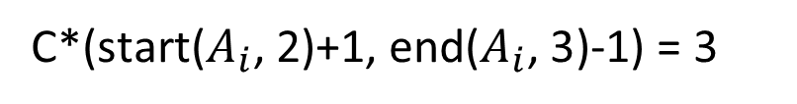
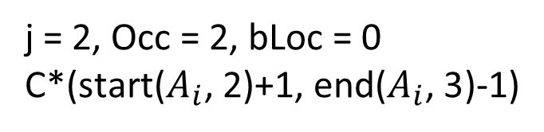
An Approximation Algorithm
Example:
$$A_{1}$$
c | a | b | d | b | c | a | d | d | b | c | a
$$A_{2}$$
c | b | b | a | d | d | c | a | b | b | d | a
B
c | b | a
Σ =(a,b,c,d)
j = 2, Occ = 2, bLoc = 0 C*($\text{start}\text{(}A_{i}\text{,}\text{ 2}$)+1, end($A_{i}\text{, }\text{3}$)-1)
symbol = d, Occ = 3, bLoc = 2
a | b | c | d
1 | 2 | 2 | 3
$$A_{1}$$
a | b | c | d
1 | 2 | 1 | 3
$\underset{⇒}{min}$
a | b | c | d
2 | 3 | 1 | 3
$$A_{2}$$
C*($\text{start}\text{(}A_{i}\text{, }\text{2}$)+1, end($A_{i}\text{, }\text{3}$)-1) = 3

Slide 15
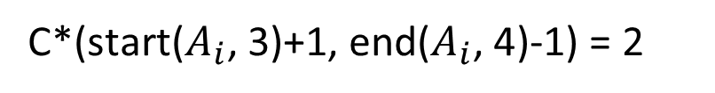
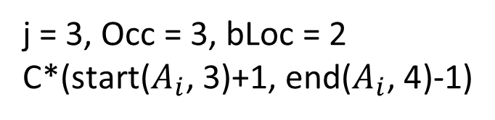
An Approximation Algorithm
Example:
$$A_{1}$$
c | a | b | d | b | c | a | d | d | b | c | a
$$A_{2}$$
c | b | b | a | d | d | c | a | b | b | d | a
B
c | b | a
Σ =(a,b,c,d)
j = 3, Occ = 3, bLoc = 2 C*($\text{start}\text{(}A_{i}\text{,}\text{ 3}$)+1, end($A_{i}\text{, }\text{4}$)-1)
symbol = d, Occ = 3, bLoc = 2
a | b | c | d
1 | 1 | 1 | 2
$$A_{1}$$
a | b | c | d
1 | 1 | 1 | 2
$\underset{⇒}{min}$
a | b | c | d
2 | 2 | 1 | 3
$$A_{2}$$
C*($\text{start}\text{(}A_{i}\text{, }\text{3}$)+1, end($A_{i}\text{, }\text{4}$)-1) = 2

Slide 16
An Approximation Algorithm
Example:
$$A_{1}$$
c | a | b | d | b | c | a | d | d | b | c | a
$$A_{2}$$
c | b | b | a | d | d | c | a | b | b | d | a
B
c | b | a
Σ =(a,b,c,d)
symbol = d, Occ = 3, bLoc = 2
approximate LCS: cb‧ddd‧a C-LCS = cbddda

Slide 17
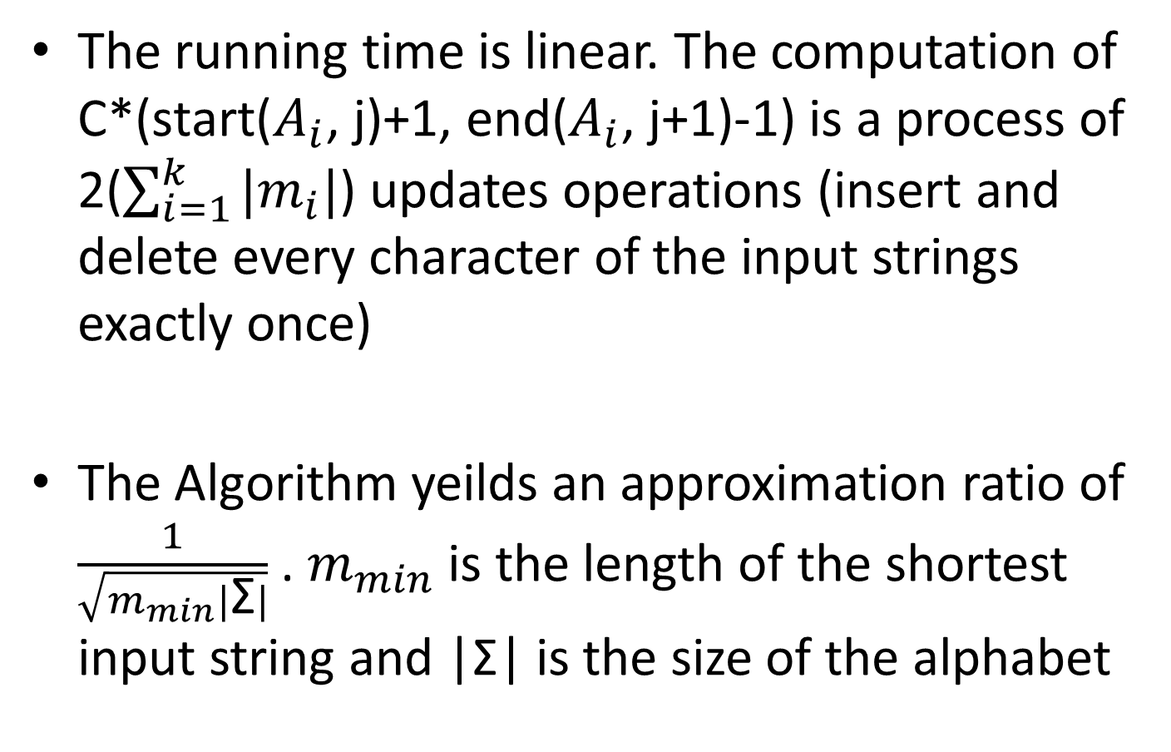
Conclusion
The running time is linear. The computation of C*($\text{start}\text{(}A_{i}\text{, }\text{j}$)+1, end($A_{i}\text{, }\text{j}\text{+1}$)-1) is a process of 2($\sum_{i=1}^{k}{|m_{i}|}$) updates operations (insert and delete every character of the input strings exactly once)
The Algorithm yeilds an approximation ratio of $\frac{1}{\sqrt{m_{min}|\text{Σ}|}}$ . $m_{min}$ is the length of the shortest input string and |Σ| is the size of the alphabet

