Slide 1
An all-substrings common subsequence algorithm
C.E.R. Alves, E.N. Cáceres, S.W. Song
Discrete Applied Mathematics 156 (2008) 1025 – 1035
Presenter: Ding-Yao Huang
Date:2014/10/14

Slide 2
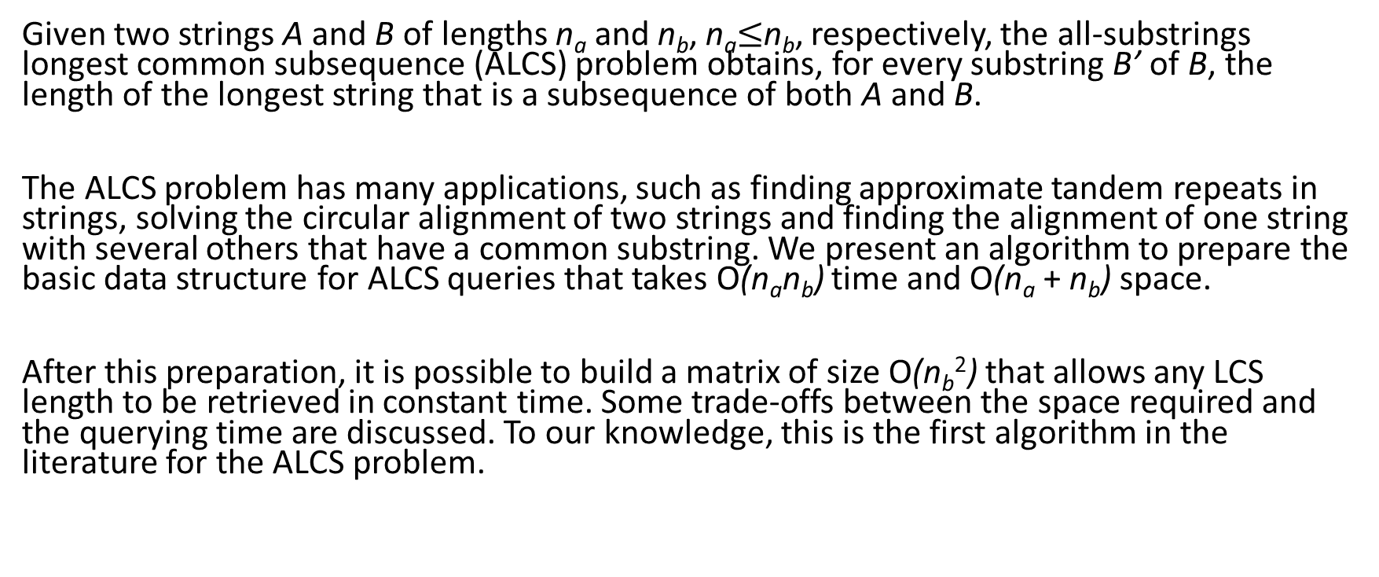
Abstract
Given two strings A and B of lengths n_{a} and n_{b}, n_{a}$≤$n_{b}, respectively, the all-substrings longest common subsequence (ALCS) problem obtains, for every substring B’ of B, the length of the longest string that is a subsequence of both A and B.
The ALCS problem has many applications, such as finding approximate tandem repeats in strings, solving the circular alignment of two strings and finding the alignment of one string with several others that have a common substring. We present an algorithm to prepare the basic data structure for ALCS queries that takes O(n_{a}n_{b}) time and O(n_{a} + n_{b}) space.
After this preparation, it is possible to build a matrix of size O(n_{b}²) that allows any LCS length to be retrieved in constant time. Some trade-offs between the space required and the querying time are discussed. To our knowledge, this is the first algorithm in the literature for the ALCS problem.

Slide 3
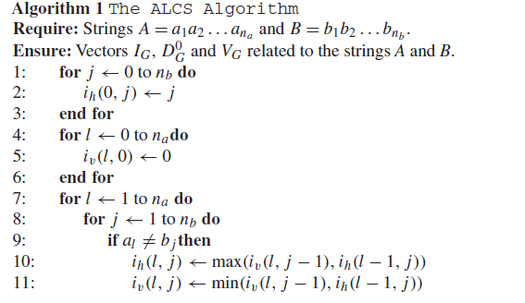
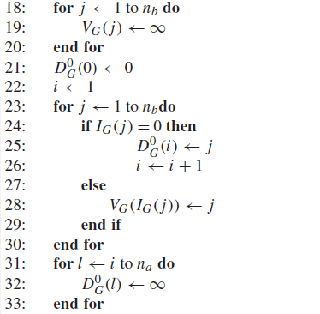
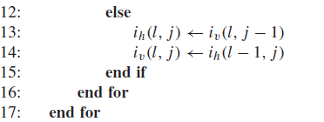
The ALCS algorithm
I_{G}

Slide 4
The ALCS algorithm
D⁰ , V_{G}

Slide 5
流程
I_{G}
D⁰_{G ,} V_{G}
C_{G}

Slide 6
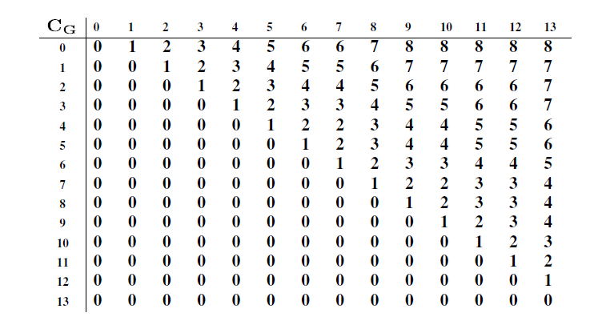
目標推回C_{G}這張表
j
i

Slide 7
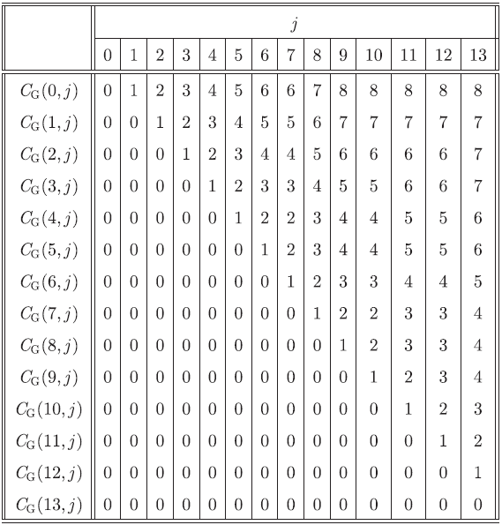
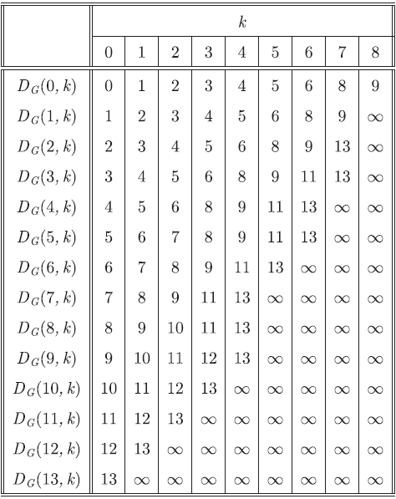
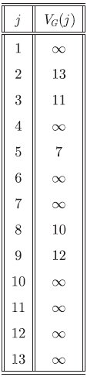

Slide 8
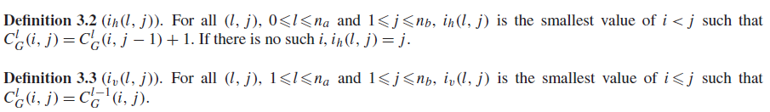
 | 0 | 1 y | 2 x | 3 x | 4 y | 5 z | 6 x | 7 y | 8 z | 9 x | 10 y | 11 x | 12 z | 13 x
0 | - - | - 1 | - 2 | - 3 | - 4 | - 5 | - 6 | - 7 | - 8 | - 9 | - 10 | - 11 | - 12 | - 13
1y | 0 - | 1 0
2x | 0 -
3x | 0 -
4y | 0 -
5z | 0 -
6y | 0 -
7z | 0 -
8x | 0 -
j
i_{v}
1 2 3 4 5 6 7 8 9 10 11 12 13
i_{h}
y
x
x
y
z
x
y
z
x
y
x
z
x
(0,0)
y
x
x
y
z
y
z
x

Slide 9
 | 0 | 1 y | 2 x | 3 x | 4 y | 5 z | 6 x | 7 y | 8 z | 9 x | 10 y | 11 x | 12 z | 13 x
0 | - - | - 1 | - 2 | - 3 | - 4 | - 5 | - 6 | - 7 | - 8 | - 9 | - 10 | - 11 | - 12 | - 13
1y | 0 - | 1 0 | 1
2x | 0 -
3x | 0 -
4y | 0 -
5z | 0 -
6y | 0 -
7z | 0 -
8x | 0 -
j
i_{v}
1 2 3 4 5 6 7 8 9 10 11 12 13
i_{h}
y
x
x
y
z
x
y
z
x
y
x
z
x
(0,0)
y
x
x
y
z
y
z
x

Slide 10
 | 0 | 1 y | 2 x | 3 x | 4 y | 5 z | 6 x | 7 y | 8 z | 9 x | 10 y | 11 x | 12 z | 13 x
0 | - - | - 1 | - 2 | - 3 | - 4 | - 5 | - 6 | - 7 | - 8 | - 9 | - 10 | - 11 | - 12 | - 13
1y | 0 - | 1 0 | 1
2x | 0 -
3x | 0 -
4y | 0 -
5z | 0 -
6y | 0 -
7z | 0 -
8x | 0 -
j
i_{v}
1 2 3 4 5 6 7 8 9 10 11 12 13
i_{h}
y
x
x
y
z
x
y
z
x
y
x
z
x
(0,0)
y
x
x
y
z
y
z
x

Slide 11
 | 0 | 1 y | 2 x | 3 x | 4 y | 5 z | 6 x | 7 y | 8 z | 9 x | 10 y | 11 x | 12 z | 13 x
0 | - - | - 1 | - 2 | - 3 | - 4 | - 5 | - 6 | - 7 | - 8 | - 9 | - 10 | - 11 | - 12 | - 13
1y | 0 - | 1 0 | 1 2
2x | 0 -
3x | 0 -
4y | 0 -
5z | 0 -
6y | 0 -
7z | 0 -
8x | 0 -
j
i_{v}
1 2 3 4 5 6 7 8 9 10 11 12 13
i_{h}
y
x
x
y
z
x
y
z
x
y
x
z
x
(0,0)
y
x
x
y
z
y
z
x

Slide 12
找i_{v} , i_{h} 分別代表可以找到分界線
i_{v}
i_{h}

Slide 13
找i_{v} , i_{h} 分別代表可以找到分界線
i_{v}
i_{h}

Slide 14
找i_{v} , i_{h} 分別代表可以找到分界線
i_{v}
i_{h}

Slide 15

The ALCS algorithm
a_{l} ≠ b_{j}
i_{v}
i_{h}
(l-1,j)
(l,j)
(l,j-1)

Slide 16
The ALCS algorithm
a_{l} ≠ b_{j}
i_{v}
i_{h}
(l-1,j)
(l,j)
(l,j-1)

Slide 17
The ALCS algorithm
a_{l} ≠ b_{j}
i_{v}
i_{h}
(l-1,j)
(l,j)
(l,j-1)

Slide 18

The ALCS algorithm
a_{l} ≠ b_{j}
i_{v}
i_{h}
(l-1,j)
(l,j)
(l,j-1)

Slide 19
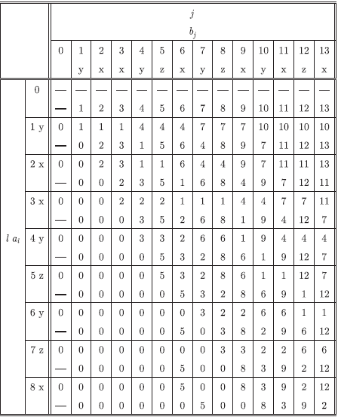
The ALCS algorithm
a_{l} ≠ b_{j}
i_{v}
i_{h}
(l-1,j)
(l,j)
(l,j-1)

Slide 20
The ALCS algorithm
a_{l} ≠ b_{j}
i_{h}
i_{v}
(l-1,j)
(l,j)
(l,j-1)

Slide 21
The ALCS algorithm
a_{l} ≠ b_{j}
i_{h}
i_{v}
(l-1,j)
(l,j)
(l,j-1)

Slide 22
The ALCS algorithm
a_{l} ≠ b_{j}
i_{h}
i_{v}
(l-1,j)
(l,j)
(l,j-1)

Slide 23
The ALCS algorithm
a_{l} ≠ b_{j}
i_{h}
i_{v}
(l-1,j)
(l,j)
(l,j-1)

Slide 24
The ALCS algorithm
a_{l} ≠ b_{j}
i_{h}
i_{v}
(l-1,j)
(l,j)
(l,j-1)

Slide 25
The ALCS algorithm
3. a_{l} = b_{j}
i_{h}
i_{v}
(l-1,j)
(l,j)
(l,j-1)

Slide 26
The ALCS algorithm
3. a_{l} = b_{j}
i_{v}
i_{h}
(l-1,j)
(l,j)
(l,j-1)

Slide 27
The ALCS algorithm
3. a_{l} = b_{j}
i_{h}
i_{v}
(l-1,j)
(l,j)
(l,j-1)

Slide 28
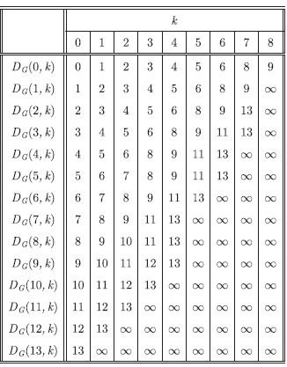
因為i_{h}紀錄的位置 就是
幾分的關係
j
1 2 3 4 5 6 7 8 9 10 11 12 13
y
x
x
y
z
x
y
z
x
y
x
z
x
(0,0)
y
x
x
y
z
y
I_{G}
z
x

Slide 29

I_{G}
j
1 2 3 4 5 6 7 8 9 10 11 12 13

Slide 30
D_{G}⁰, V_{G}
 | 0 | 1 | 2 | 3 | 4 | 5 | 6 | 7 | 8
0 | 0 | 1 | 2 | 3 | 4 | 5 | 6 | 8 | 9
1
2
3
4
5
6
7
8
9
10
11
12
13

Slide 31
特性2.2(1)(2)
k₁
k₂
i₂
i₁
string X : yxxyzyzx
string Y : yxxyzxyzxyxzx

Slide 32
特性2.2(1)(2)
k₁
k₂
i₂
i₁
string X : yxxyzyzx
string Y : yxxyzxyzxyxzx

Slide 33
特性2.2(3)(4)

Slide 34
D_{G}⁰, V_{G}
 | 0 | 1 | 2 | 3 | 4 | 5 | 6 | 7 | 8
0 | 0 | 1 | 2 | 3 | 4 | 5 | 6 | 8 | 9
1 | 1 | 2
2 | 2
3
4
5
6
7
8
9
10
11
12
13

Slide 35
D_{G}⁰, V_{G}
 | 0 | 1 | 2 | 3 | 4 | 5 | 6 | 7 | 8
0 | 0 | 1 | 2 | 3 | 4 | 5 | 6 | 8 | 9
1 | 1 | 2 | 3 | 4 | 5 | 6 | 8 | 9
2 | 2 | 3 | 4 | 5 | 6 | 8 | 9 | 13
3
4
5
6
7
8
9
10
11
12
13

Slide 36
D_{G}⁰, V_{G}
 | 0 | 1 | 2 | 3 | 4 | 5 | 6 | 7 | 8
0 | 0 | 1 | 2 | 3 | 4 | 5 | 6 | 8 | 9
1 | 1 | 2 | 3 | 4 | 5 | 6 | 8 | 9
2 | 2 | 3 | 4 | 5 | 6 | 8 | 9 | 13
3 | 3 | 4 | 5 | 6 | 8 | 9 | 11 | 13
4 | 4 | 5 | 6 | 8 | 9 | 11 | 13
5 | 5 | 6 | 7 | 8 | 9 | 11 | 13
6 | 6 | 7 | 8 | 9 | 11 | 13
7 | 7 | 8 | 9 | 11 | 13
8
9
10
11
12
13

Slide 37
D_{G}⁰, V_{G}
 | 0 | 1 | 2 | 3 | 4 | 5 | 6 | 7 | 8
0 | 0 | 1 | 2 | 3 | 4 | 5 | 6 | 8 | 9
1 | 1 | 2 | 3 | 4 | 5 | 6 | 8 | 9
2 | 2 | 3 | 4 | 5 | 6 | 8 | 9 | 13
3 | 3 | 4 | 5 | 6 | 8 | 9 | 11 | 13
4 | 4 | 5 | 6 | 8 | 9 | 11 | 13
5 | 5 | 6 | 7 | 8 | 9 | 11 | 13
6 | 6 | 7 | 8 | 9 | 11 | 13
7 | 7 | 8 | 9 | 11 | 13
8 | 8 | 9 | 10 | 11 | 13
9 | 9 | 10 | 11 | 12 | 13
10 | 10 | 11 | 12 | 13
11 | 11 | 12 | 13
12 | 12 | 13
13 | 13

Slide 39
Conclusion
We consider the ALCS (all-substring longest common subsequence) problem for strings A and B, |A| = n_{a} and |B| = n_{b}.
The basic algorithm takes O(n_{a}n_{b}) time and O(n_{a} + n_{b}) space and, depending on the queries that will be necessary, extra O(n_{b}²) time and space are required.
Although the ALCS was the problem under consideration, actually the GDAG, and not the original strings, is used. Other problems may be approached by the techniques presented here. For example, alignments where matches between symbols are given by some non-transitive relation may be used instead of LCS.
The algorithm presented here can be easily adapted to solve the problem incrementally, that is, presenting the solution for a certain prefix A based on the solution for a smaller prefix. Other adaptations, including new data structures more suitable for certain applications, may appear in the future.

