Slide 1
A Learning Algorithm for the Longest Common Subsequence Problem
Eric A. Breimer, Mark K. Goldberg and Darren T. Lim Journal of Experimental Algorithmics, Volume 8, 2003 Article No. 2.1

Slide 2
Abstract (1 / 2)
We present an experimental study of a learning algorithm for the longest common subsequence problem, LCS. Given an arbitrary input domain, the algorithm learns an LCS-procedure tailored to that domain. The learning is done with the help of an oracle, which can be any LCS-algorithm. After solving a limited number of training inputs using an oracle, the learning algorithm outputs a new LCS-procedure. Our experiments demonstrate that, by allowing a slight loss of optimality, learning yields a procedure which is significantly faster than the oracle. The oracle used for the experiments is the np-procedure by Wu et al., a modification of Myers' classical LCS-algorithm. We show how to scale up the results of learning on small inputs to inputs of arbitrary lengths. For the domain of two random 2-symbol inputs of length n, learning yields a program with 0.999 expected accuracy, which runs in O(n^{1.41})-time, in contrast with O(n²/log n) running time of the fastest theoretical algorithm that produces optimal solutions.

Slide 3
Abstract (2 / 2)
For the domain of random 2-symbol inputs of length 100,000, the program runs 10.5 times faster than the np-procedure, producing 0.999- accurate outputs. The scaled version of the evolved algorithm applied to random inputs of length 1 million runs approximately 30 times faster than the np-procedure while constructing 0.999- accurate solutions. We apply the evolved algorithm to DNA sequences of various lengths by training on random 4-symbol sequences of up to length 10,000. The evolved algorithm, scaled up to the lengths of up to 1.8 million, produces solutions with the 0.998-accuracy in a fraction of the time used by the np.

Slide 4
Learning Algorithm
Stage 1: Training inputs to LCS are generated.
Stage 2: The inputs are solved by an oracle-algorithm.
Stage 3: The database of solution traces is processed, yielding a search area.
Stage 4: A procedure for a restricted search through the search area is developed.

Slide 5
Training Inputs
可利用機率分布隨機產生訓練資料
或者現成的資料庫
在這篇論文中，訓練用的sample數是300

Slide 6
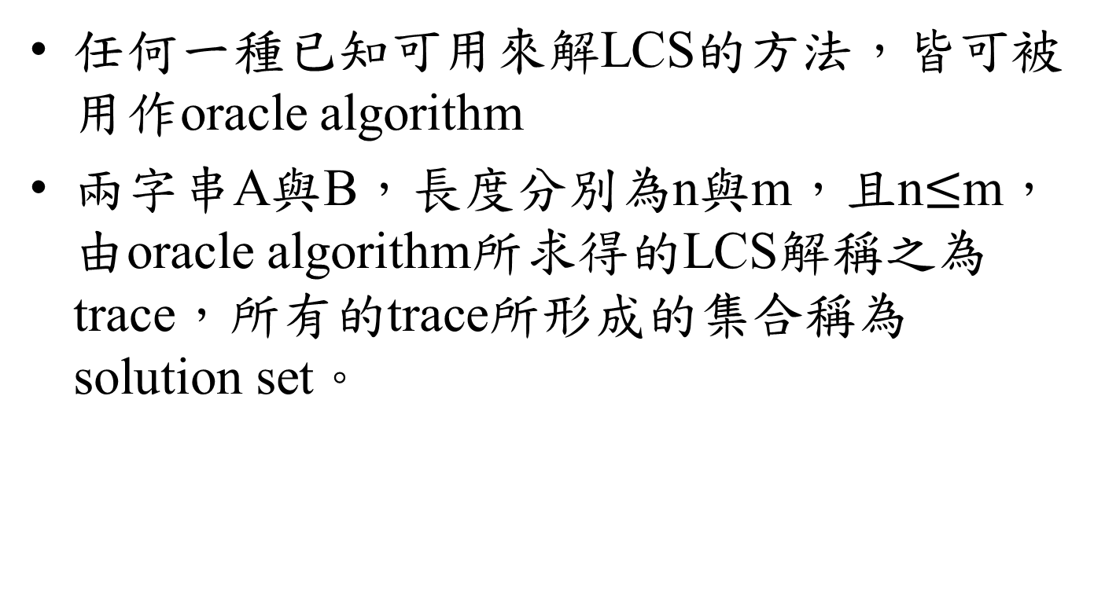
Oracle Algorithm
任何一種已知可用來解LCS的方法，皆可被用作oracle algorithm
兩字串A與B，長度分別為n與m，且n$≤$m，由oracle algorithm所求得的LCS解稱之為trace，所有的trace所形成的集合稱為solution set。

Slide 7
Yielding a Search Area
將上述的solution set處理後，圈出LCS元素可能出現的範圍
Clustering
Refining
Scaling

Slide 8
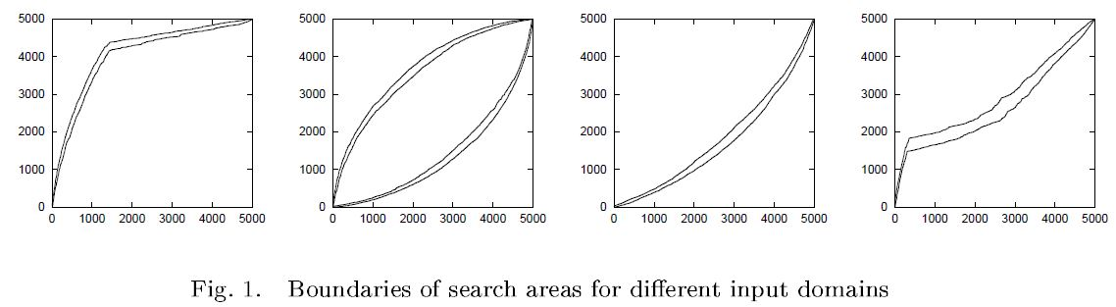
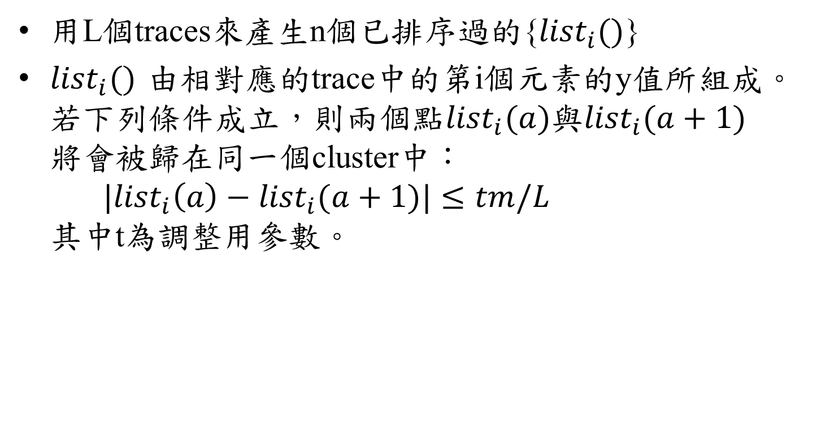
Clustering
用L個traces來產生n個已排序過的{${list}_{i}()$}
${list}_{i}()$由相對應的trace中的第i個元素的y值所組成。若下列條件成立，則兩個點${list}_{i}(a)$與${list}_{i}(a+1)$將會被歸在同一個cluster中： $|{list}_{i}\left(a\right)−{list}_{i}(a+1)|≤tm/L$ 其中t為調整用參數。

Slide 9
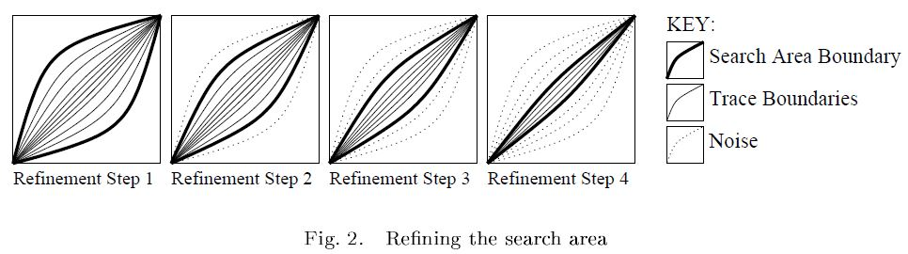
Refining
縮小search area，維持一定的準確率(99.9%)，將預設的 search area 邊界去除，利用剩下的範圍驗證，檢查準確率是否有維持，重複此步驟。

Slide 10
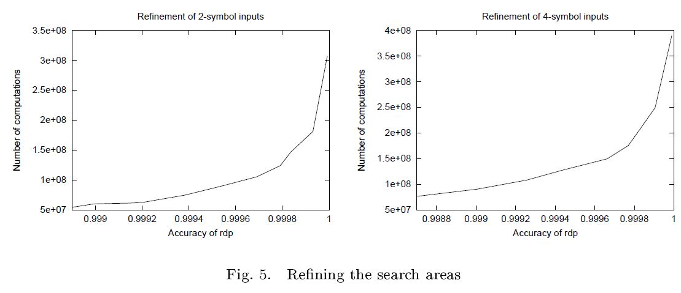
Refining

Slide 11
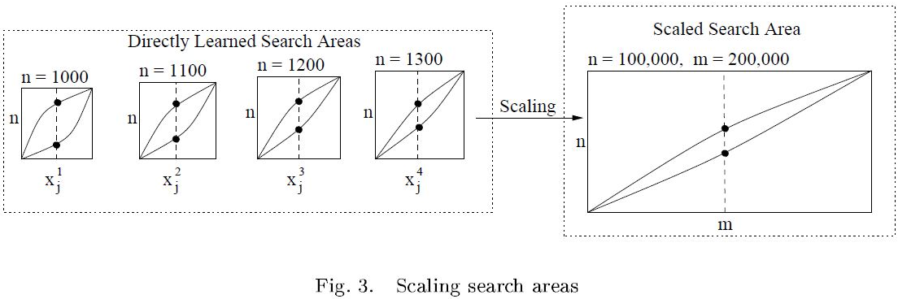
Scaling
以輸入資料長度較小的訓練資料找出search area，再利用least square method計算當輸入資料長度較長時的search area。

Slide 12

Restricted Dynamic Programming
設 search area 為 S，S 為所有元素數量m * n 的 DP matrix 的子集合。
Restricted dynamic programming 就是將一般的 DP 範圍限制在 S 中，如此DP的計算量為$O(|S|)$

Slide 13
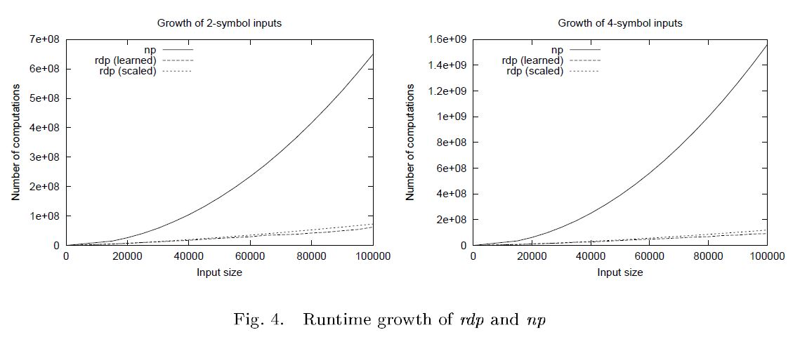
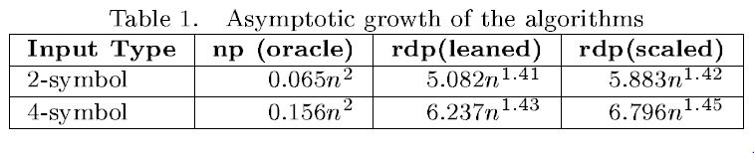
Experimental Results

