Slide 1
Derivative Dynamic Time Warping
Eamonn J. Keogh , Michael J. Pazzani
First SIAM International Conference on Data Mining (2001)
Presenter：Guan-Cheng Guo Date：2014/11/4

Slide 2
Abstract
In this paper we introduce a modification of DTW. The crucial difference is in the features we consider when attempting to find the correct warping. Rather than use the raw data, we consider only the (estimated) local derivatives of the data.

Slide 3




Dynamic Time Warping
$$DTW\left(i−1, j−1\right)$$
$$DTW\left(i−1, j\right)$$
$$DTW\left(i, j−1\right)$$
$$DTW\left(i, j\right)$$

Slide 4
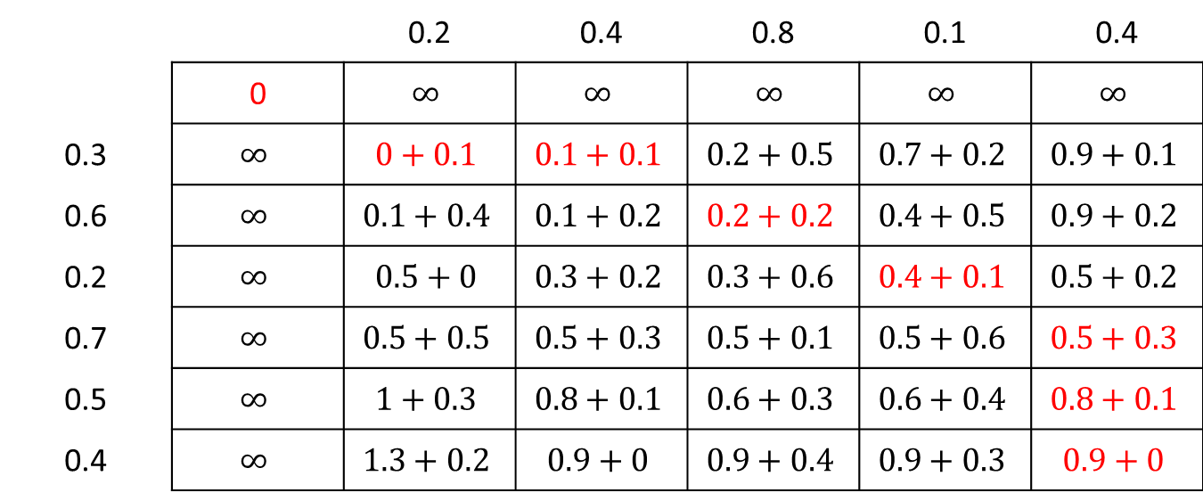

Dynamic Time Warping
$X = \{0.3, 0.6, 0.2, 0.7, 0.5, 0.4\}$, $Y = \{0.2, 0.4, 0.8, 0.1, 0.4\}$, $d\left(x_{i}, y_{j}\right)=\left|x_{i}−y_{j}\right|$
 |  | 0.2 | 0.4 | 0.8 | 0.1 | 0.4
 | 0 | $$∞$$ | $$∞$$ | $$∞$$ | $$∞$$ | $$∞$$
0.3 | $$∞$$ | $$0+0.1$$ | $$0.1+0.1$$ | $$0.2+0.5$$ | $$0.7+0.2$$ | $$0.9+0.1$$
0.6 | $$∞$$ | $$0.1+0.4$$ | $$0.1+0.2$$ | $$0.2+0.2$$ | $$0.4+0.5$$ | $$0.9+0.2$$
0.2 | $$∞$$ | $$0.5+0$$ | $$0.3+0.2$$ | $$0.3+0.6$$ | $$0.4+0.1$$ | $$0.5+0.2$$
0.7 | $$∞$$ | $$0.5+0.5$$ | $$0.5+0.3$$ | $$0.5+0.1$$ | $$0.5+0.6$$ | $$0.5+0.3$$
0.5 | $$∞$$ | $$1+0.3$$ | $$0.8+0.1$$ | $$0.6+0.3$$ | $$0.6+0.4$$ | $$0.8+0.1$$
0.4 | $$∞$$ | $$1.3+0.2$$ | $$0.9+0$$ | $$0.9+0.4$$ | $$0.9+0.3$$ | $$0.9+0$$

Slide 5
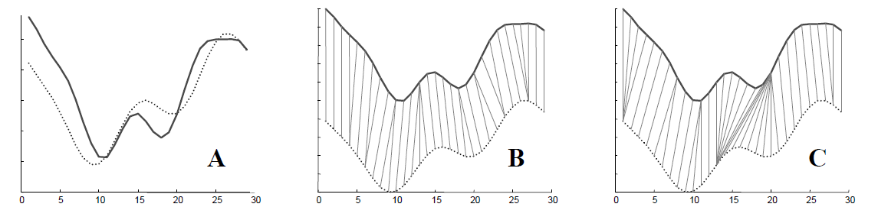
Dynamic Time Warping
A) Two synthetic signals (with the same mean and variance). B) The natural "feature to feature" alignment. C) The alignment produced by dynamic time warping. Note that DTW failed to align the two central peaks because they are slightly separated in the Y-axis

Slide 6
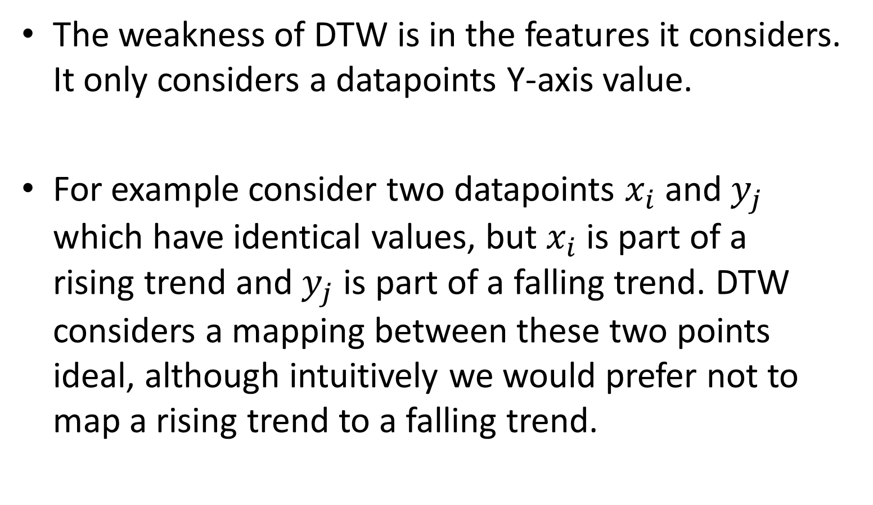
Derivative Dynamic Time Warping
The weakness of DTW is in the features it considers. It only considers a datapoints Y-axis value.
For example consider two datapoints$x_{i}$ and $y_{j}$ which have identical values, but $x_{i}$ is part of a rising trend and $y_{j}$ is part of a falling trend. DTW considers a mapping between these two points ideal, although intuitively we would prefer not to map a rising trend to a falling trend.

Slide 7
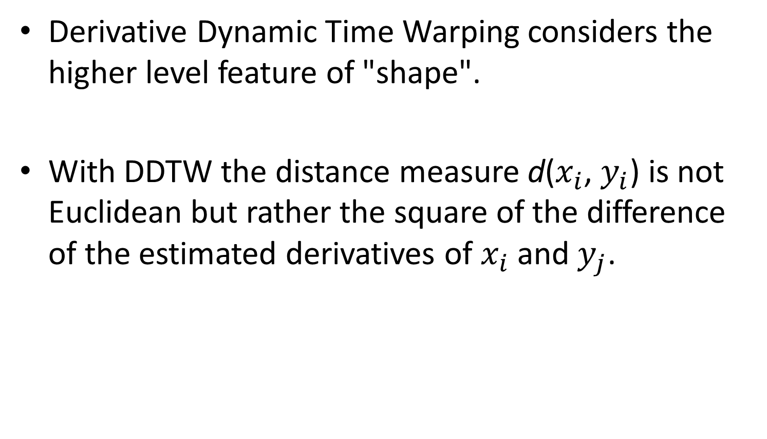
Derivative Dynamic Time Warping
Derivative Dynamic Time Warping considers the higher level feature of "shape".
With DDTW the distance measure d($x_{i}$,$y_{i}$) is not Euclidean but rather the square of the difference of the estimated derivatives of $x_{i}$ and $y_{j}$.

Slide 8
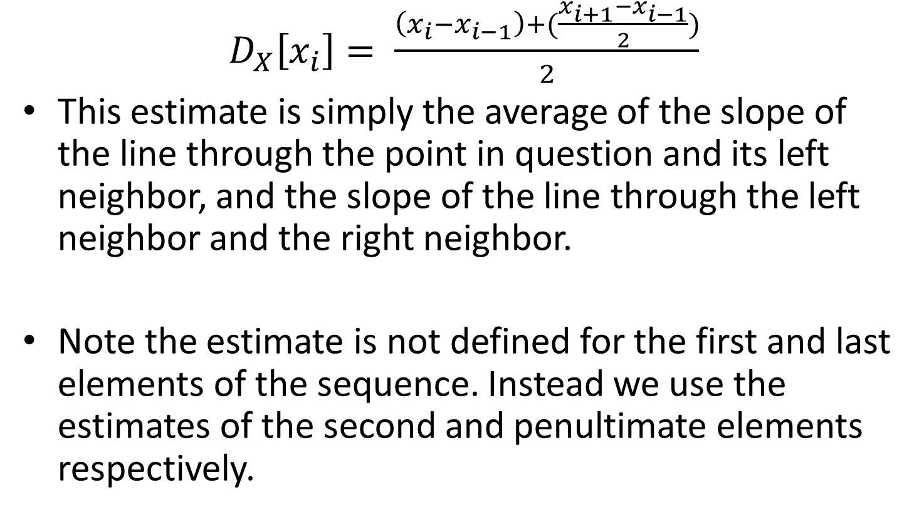
Derivative Dynamic Time Warping
$D_{X}\left[x_{i}\right]= \frac{\left(x_{i}−x_{i−1}\right)+(\frac{x_{i+1}−x_{i−1}}{2})}{2}$
This estimate is simply the average of the slope of the line through the point in question and its left neighbor, and the slope of the line through the left neighbor and the right neighbor.
Note the estimate is not defined for the first and last elements of the sequence. Instead we use the estimates of the second and penultimate elements respectively.

Slide 9
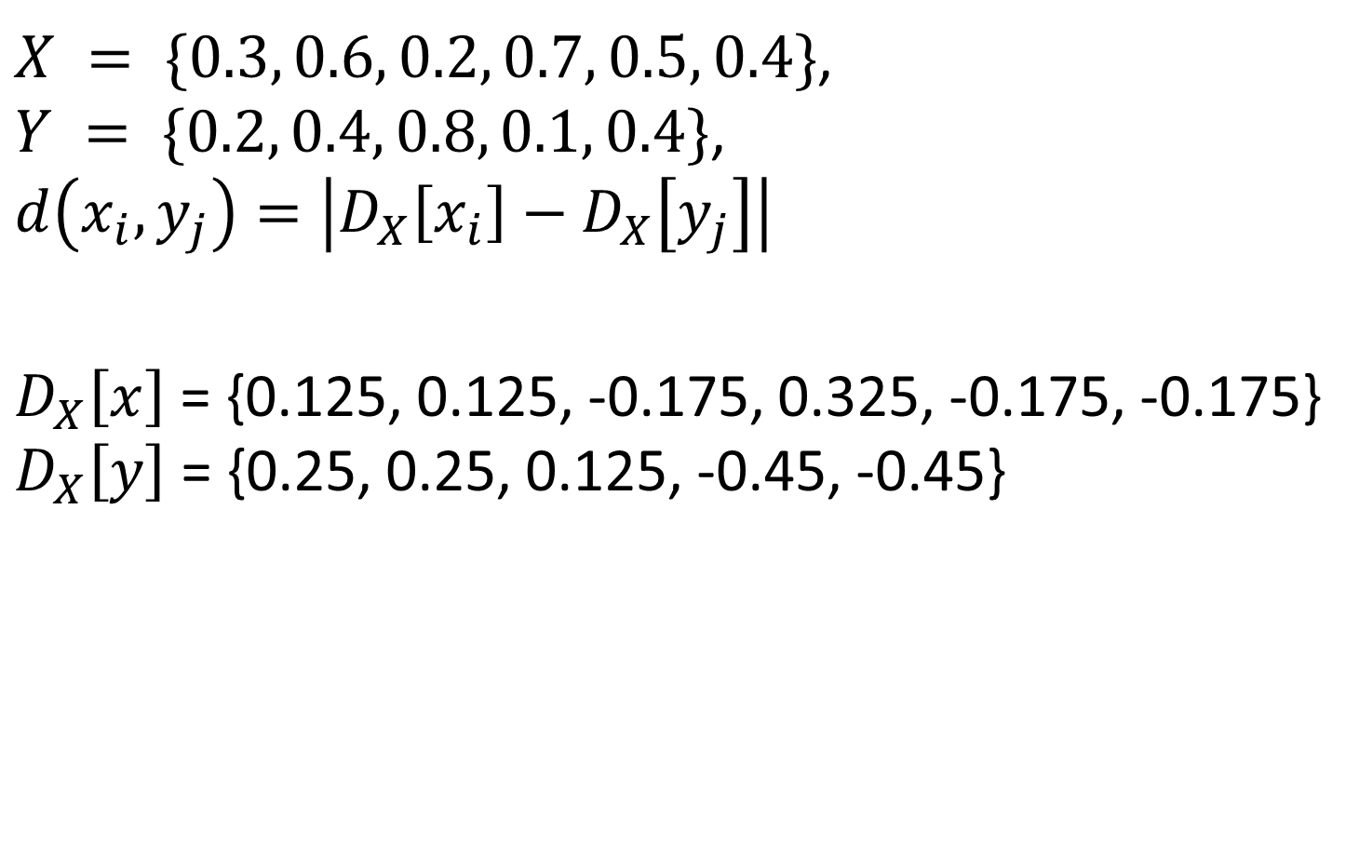
Derivative Dynamic Time Warping
$X = \{0.3, 0.6, 0.2, 0.7, 0.5, 0.4\}$, $Y = \{0.2, 0.4, 0.8, 0.1, 0.4\}$, $d\left(x_{i}, y_{j}\right)=\left|D_{X}\left[x_{i}\right]−D_{X}\left[y_{j}\right]\right|$
$D_{X}\left[x\right]$= {0.125, 0.125, -0.175, 0.325, -0.175, -0.175} $D_{X}\left[y\right]$= {0.25, 0.25, 0.125, -0.45, -0.45}

Slide 10


Derivative Dynamic Time Warping
$D_{X}\left[x\right]$= {0.125, 0.125, -0.175, 0.325, -0.175, -0.175} $D_{X}\left[y\right]$= {0.25, 0.25, 0.125, -0.45, -0.45}
 |  | 0.25 | 0.25 | 0.125 | -0.45 | -0.45
 | 0 | $$∞$$ | $$∞$$ | $$∞$$ | $$∞$$ | $$∞$$
0.125 | $$∞$$ | $$0+0.125$$ | $$0.125+0.125$$ | $$0.25+0$$ | $$0.25+0.575$$ | $$0.825+0.575$$
0.125 | $$∞$$ | $$0.125+0.125$$ | $$0.125+0.125$$ | $$0.25+0$$ | $$0.25+0.575$$ | $$0.825+0.575$$
-0.175 | $$∞$$ | $$0.25+0.425$$ | $$0.25+0.425$$ | $$0.25+0.3$$ | $$0.25+0.275$$ | $$0.525+0.275$$
0.325 | $$∞$$ | $$0.675+0.075$$ | $$0.675+0.075$$ | $$0.55+0.2$$ | $$0.525+0.775$$ | $$0.525+0.775$$
-0.175 | $$∞$$ | $$0.75+0.425$$ | $$0.75+0.425$$ | $$0.75+0.3$$ | $$0.75+0.275$$ | $$1.025+0.275$$
-0.175 | $$∞$$ | $$1.175+0.425$$ | $$1.175+0.425$$ | $$1.05+0.3$$ | $$1.025+0.275$$ | $$1.025+0.275$$

Slide 11

Derivative Dynamic Time Warping
$D_{X}\left[x\right]$= {0.125, 0.125, -0.175, 0.325, -0.175, -0.175} $D_{X}\left[y\right]$= {0.25, 0.25, 0.125, -0.45, -0.45}
 |  | 0.25 | 0.25 | 0.125 | -0.45 | -0.45
 | 0 | $$∞$$ | $$∞$$ | $$∞$$ | $$∞$$ | $$∞$$
0.125 | $$∞$$ | $$0+0.125$$ | $$0.125+0.125$$ | $$0.25+0$$ | $$0.25+0.575$$ | $$0.825+0.575$$
0.125 | $$∞$$ | $$0.125+0.125$$ | $$0.125+0.125$$ | $$0.25+0$$ | $$0.25+0.575$$ | $$0.825+0.575$$
-0.175 | $$∞$$ | $$0.25+0.425$$ | $$0.25+0.425$$ | $$0.25+0.3$$ | $$0.25+0.275$$ | $$0.525+0.275$$
0.325 | $$∞$$ | $$0.675+0.075$$ | $$0.675+0.075$$ | $$0.55+0.2$$ | $$0.525+0.775$$ | $$0.525+0.775$$
-0.175 | $$∞$$ | $$0.75+0.425$$ | $$0.75+0.425$$ | $$0.75+0.3$$ | $$0.75+0.275$$ | $$1.025+0.275$$
-0.175 | $$∞$$ | $$1.175+0.425$$ | $$1.175+0.425$$ | $$1.05+0.3$$ | $$1.025+0.275$$ | $$1.025+0.275$$

Slide 12
DTW Alignment

Slide 13
DDTW Alignment

Slide 14
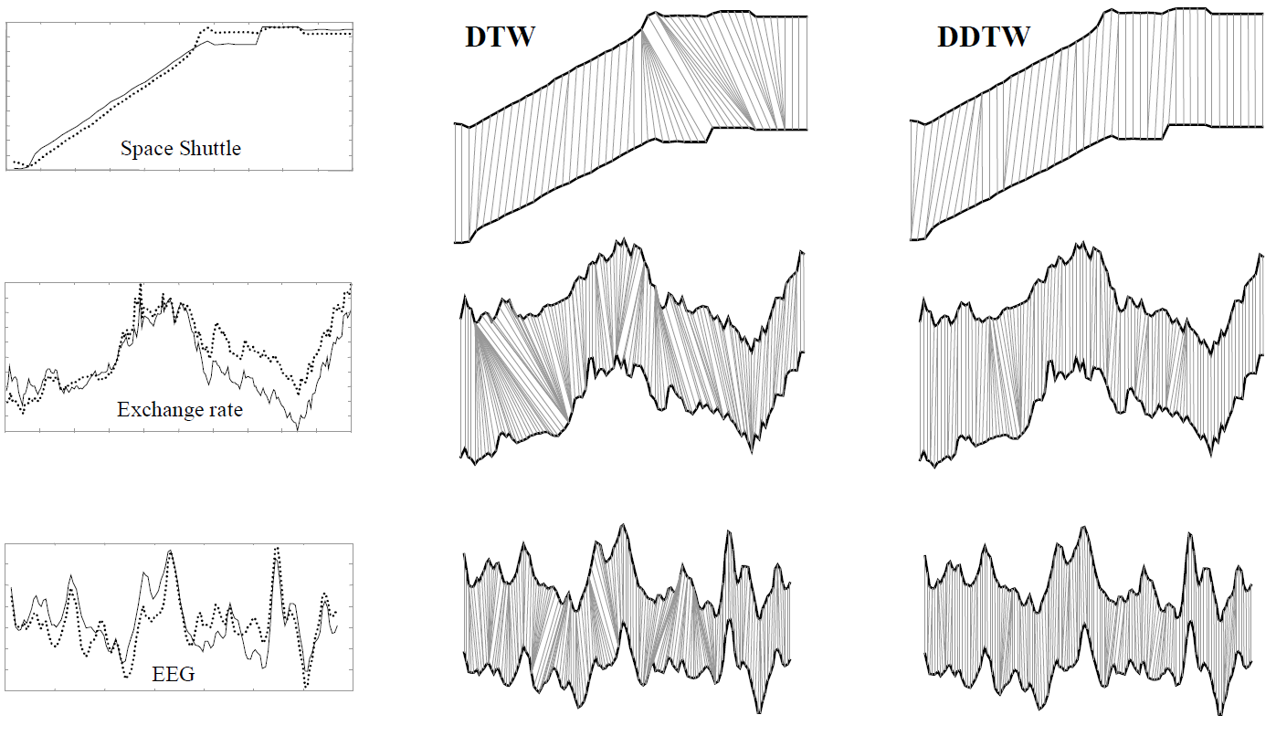
Result

Slide 15
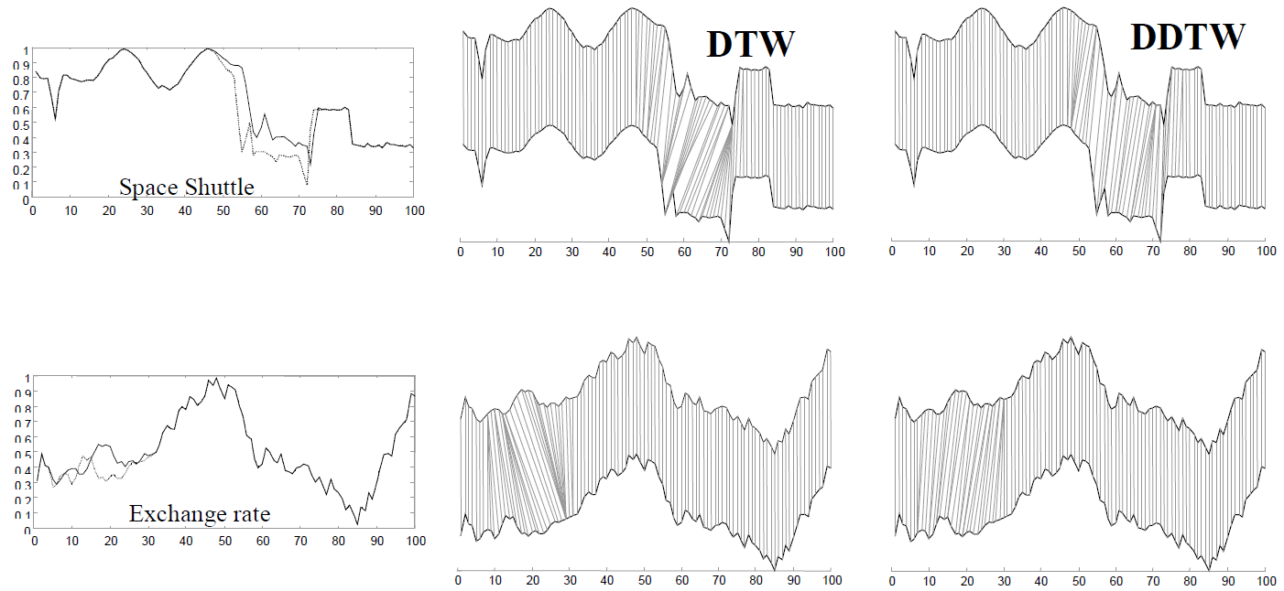
Result

