Slide 1
A New Practical Linear Space Algorithm for the Longest Common Subsequence Problem
Goeman.Heiko,Clausen.Michael
Kybernetika,vol. 38 (2002), issue 1, pp. 45-66

Slide 2
Abstract
This paper deals with a new practical method for solving the longest
common subsequence (LCS) problem.
Given two strings of lengths m and n, n ≥ m, on an alphabet of size s, we first present an algorithm which determines the length p of an LCS in O(ns + min{ mp , p(n - p)}) time and O(ns) space.
This result has been achieved before [Ric94, Ric95], but our algorithm is significantly faster than previous methods.
We also provide a second algorithm which generates an LCS in
O(ns + min{mp , mlogm+ p(n - p)}) time while preserving the linear space bound, thus solving the problem posed in [Ric94, Ric95].
Experimental results confirm the efficiency of our method.

Slide 3
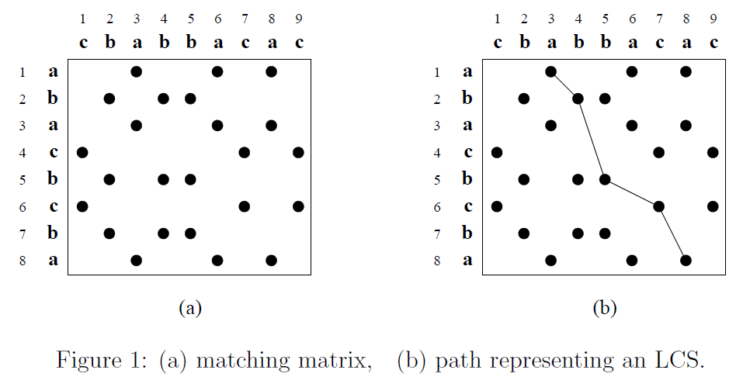
Introduction
For example, x = abacbcba and y = cbabbacac
Define a partial order ≪ on N × N by establishing ( k , l ) ≪ ( k’ , l’) both k < k’ and l < l’.
a match
A chain C ⊆ M is a set of points which are pairwise comparable

Slide 4
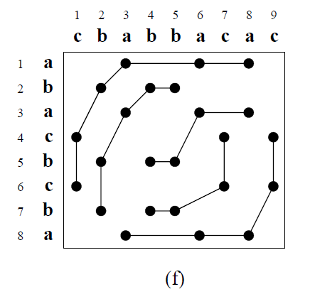
Introduction
The LCS problem is equivalent to finding a
chain of maximum cardinality in M.
chain of maximum cardinality in M
=the minimum number of disjoint antichains in M
(by Dilworth's fundamental theorem )

Slide 5
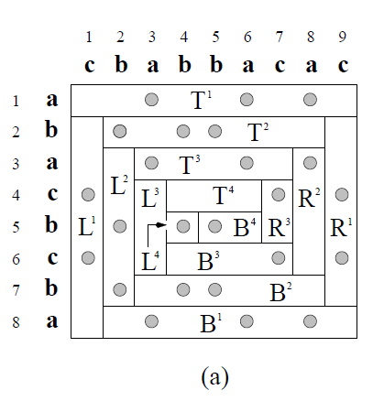
A New Approach to the LCS Problem
split [1 : m] × [1 : n] into subsets denoted by Ti, Li, Bi, and Ri, where
Ti := {i} × [i : n + 1 - i]
Li := [i + 1 : m + 1 - i] × {i}
Bi := {m + 1 – i} × [i + 1 : n + 1 - i]
Ri := [i + 1 : m - i] × {n + 1 – i}

Slide 6
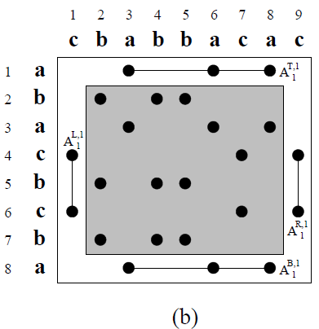
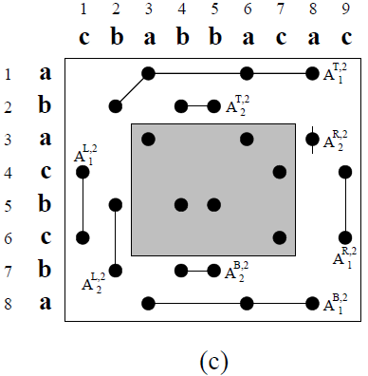

A New Approach to the LCS Problem
We use A_{u}^{T,i}to denote an antichainin A^{T,i}, where u is an index between 1 and the size e^{T,i}:= |A^{T,i}|of A^{T,i}.(i = 1, 2 ,. . . . $┌$m/2$┐$)
For A^{L,i}, A^{B,i}, and A^{R,i}, we introduce analogous notations.
remaining part of M which has not been processed
i = 1
e^{T,1}:= |A^{T,1}|=1
.
.
.
i = 2
e^{T,2}:= |A^{T,2}|=2
.
.
.

Slide 7
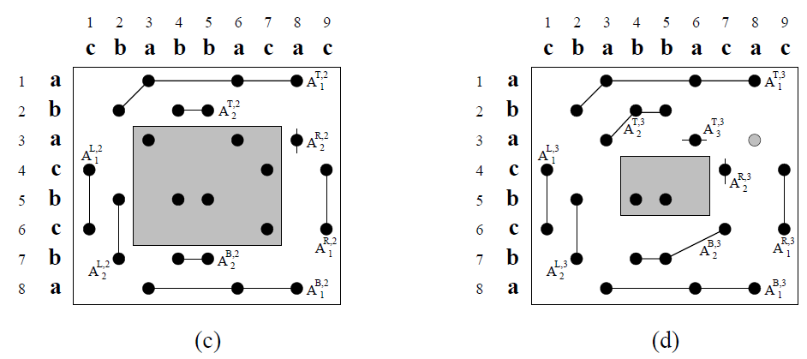
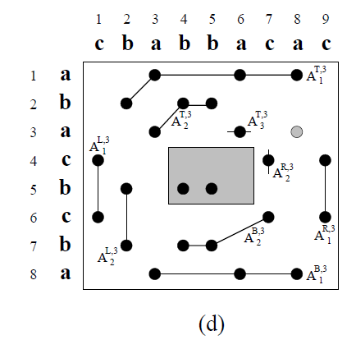
A New Approach to the LCS Problem
there are two start indices s^{TL,i} and s^{BR,i}.
s^{TL,i} : used to split both A^{T,i} and A^{L,i} into two parts. And Only the latter part will be used for the updating process ,whereas the former one will be copied to A^{T,i+1}
( s^{BR,i} similarly splits A^{B,i} and A^{R,i})
For example:
s^{TL,2}=2;
For any A_{k}^{T,3}(k<2)
A_{k}^{T,3} = A_{k}^{T,2}

Slide 8
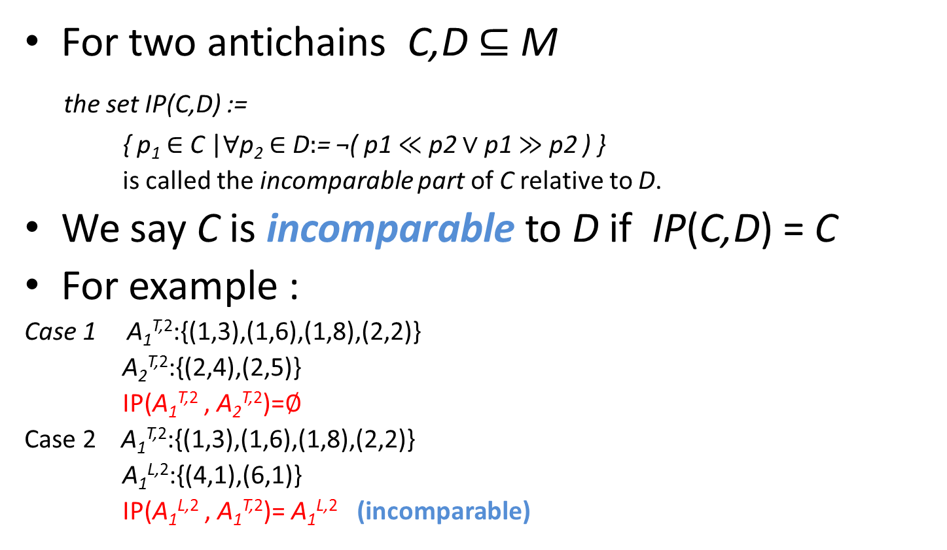
A New Approach to the LCS Problem
For two antichainsC,D ⊆ M
the set IP(C,D) :=
{ p₁∈ C |∀p₂∈ D$\text{:}$=¬( p1 $≪$ p2 ∨ p1 $≫$ p2 ) }
is called the incomparable part of C relative to D.
We say C is incomparableto D if IP(C,D) = C
For example :
Case 1 A₁^{T,2}:{(1,3),(1,6),(1,8),(2,2)}
A₂^{T,2}:{(2,4),(2,5)}
IP(A₁^{T,2} , A₂^{T,2})=$∅$
Case 2 A₁^{T,2}:{(1,3),(1,6),(1,8),(2,2)}
A₁^{L,2}:{(4,1),(6,1)}
IP(A₁^{L,2} , A₁^{T,2})=A₁^{L,2} (incomparable)

Slide 9
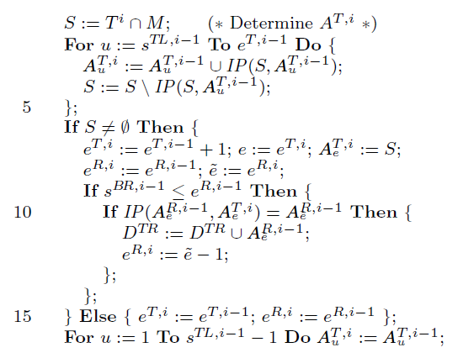
Determine A^{T,i}
determine A^{T,i} from A^{T,i-1}.
合併incomparable的部分
確定R的最後一條chain(A_{e}^{R,i-1})
和T的最後一條chain(A_{e}^{T,i})
能不能合併，若可以則刪除A_{e}^{R,i-1}
The frst s - 1 antichains remain unchanged

Slide 10
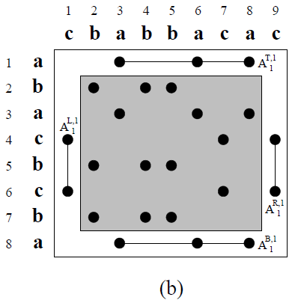
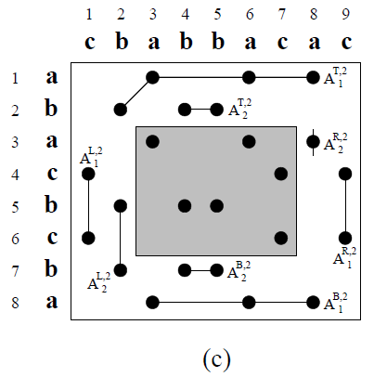
Determine A^{T,i}
For example, when processing T²
in Fig. 2 (b), IP(T²∩ M;A₁^{T,1}) = {(2,2)}
the match (2,2)combined with A₁^{T,1} makes up A₁^{T,2} as shown in Fig. 2 (c).

Slide 11
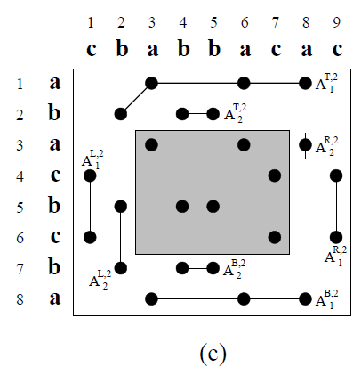
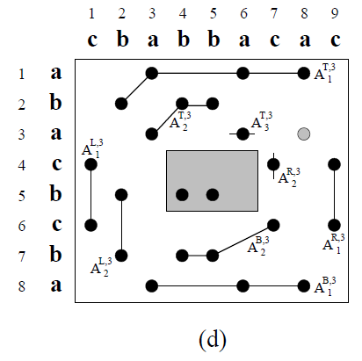
Determine A^{T,i}
For example, when processing T3
The match (3,3) cannot be put intoA₁^{T,3}, but into A₂^{T,3}, and the other match (3, 6) makes up the new antichain A₃^{T,3}.
This time (3, 6) inactivates (3, 8), and thus A₂^{R,2} is removed.
(all matches located in deleted antichains)

Slide 12
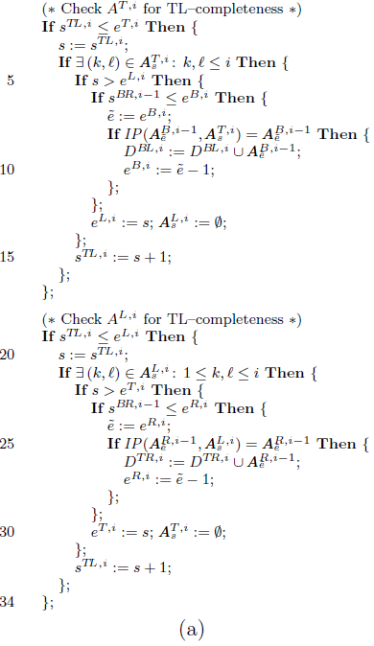
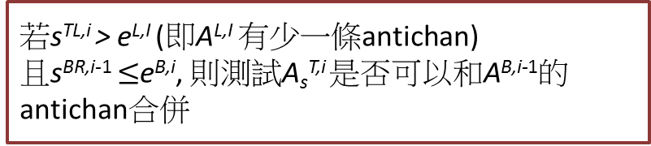
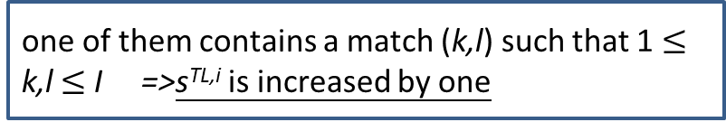
Check A^{T,i} and A^{L,i} for TL-completeness
TL-completeness:
所有 A_{s}^{T,i} & A_{s}^{L,i} (s<= s^{TL,i})不會再改變
one of them contains a match (k,l) such that 1 $≤$k,l$≤$ I =>s^{TL,i}is increased by one
若s^{TL,i}>e^{L,I}(即A^{L,I} 有少一條antichan)
且s^{BR,i-1}$≤$e^{B,i}, 則測試A_{s}^{T,i}是否可以和A^{B,i-1}的antichan合併

Slide 13
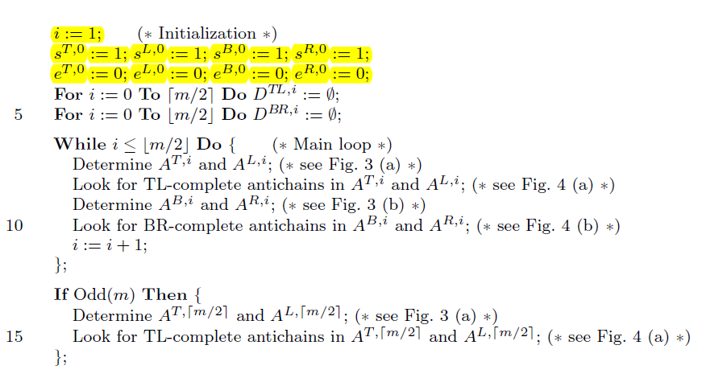
The main program for decomposing M

Slide 14
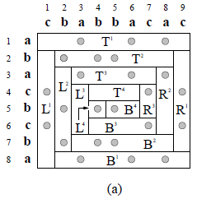
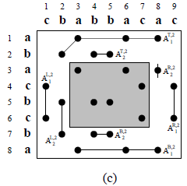
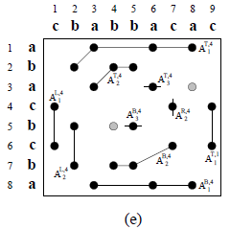
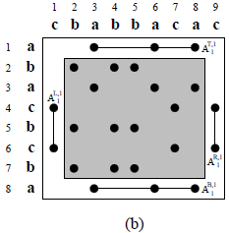
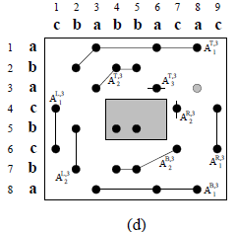
A New Approach to the LCS Problem
i=2(in main loop)
i=4(in main loop)
i=1(in main loop)
i=3(in main loop)

Slide 15
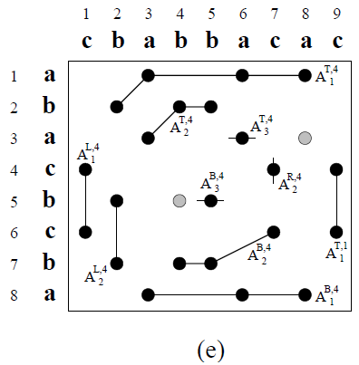
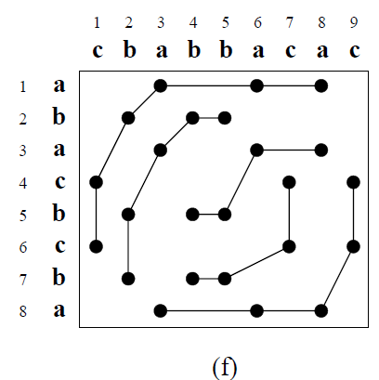
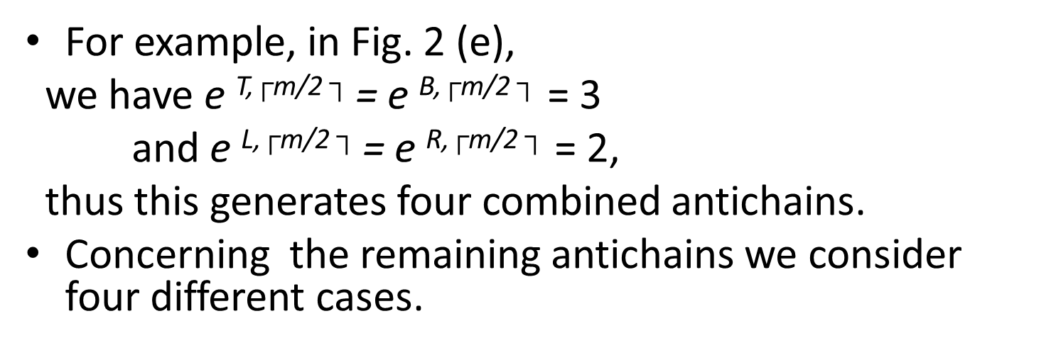
Determine length p of an LCS
For example, in Fig. 2 (e),
we have e ^{T,}$┌$^{m/2}$┐$= e ^{B,}$┌$^{m/2}$┐$= 3
and e ^{L,}$┌$^{m/2}$┐$= e ^{R,}$┌$^{m/2}$┐$= 2,
thus this generates four combined antichains.
Concerningthe remaining antichains we consider four different cases.
Ans:P=5

Slide 16
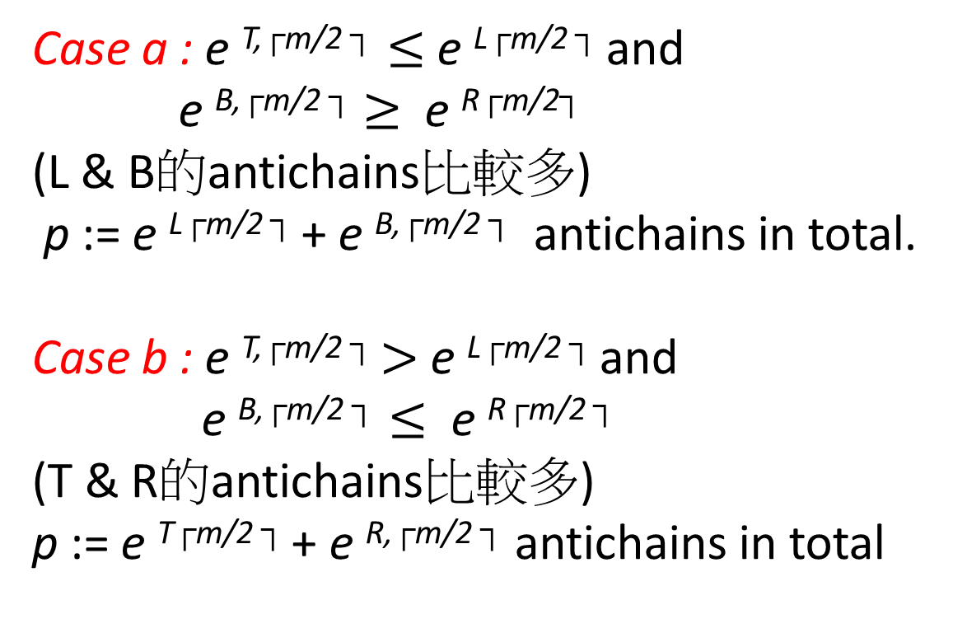
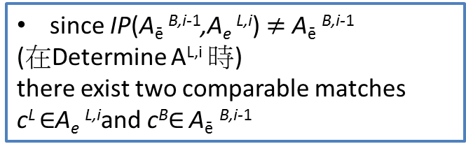
Case a& Case b
Case a : e ^{T,}$┌$^{m/2}$┐≤$ e ^{L}$┌$^{m/2}$┐$and
e ^{B,}$┌$^{m/2}$┐$$≥$ e ^{R}$┌$^{m/2}$┐$
(L&B的antichains比較多)
p := e ^{L}$┌$^{m/2}$┐$+e ^{B,}$┌$^{m/2}$┐$antichains in total.
Case b : e ^{T,}$┌$^{m/2}$┐$$>$e ^{L}$┌$^{m/2}$┐$and
e ^{B,}$┌$^{m/2}$┐≤$ e ^{R}$┌$^{m/2}$┐$
(T&R的antichains比較多)
p := e ^{T}$┌$^{m/2}$┐$+ e ^{R,}$┌$^{m/2}$┐$antichains in total
since IP(A_{ē}^{B,i-1},A_{e}^{L,i}) $≠$A_{ē}^{B,i-1}
(在Determine A^{L,i} 時)
there exist two comparable matches
c^{L}$∈$A_{e}^{L,i}andc^{B}$∈$A_{ē}^{B,i-1}
Notes:
123

Slide 17
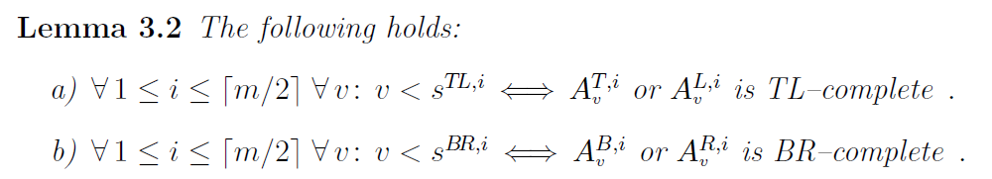
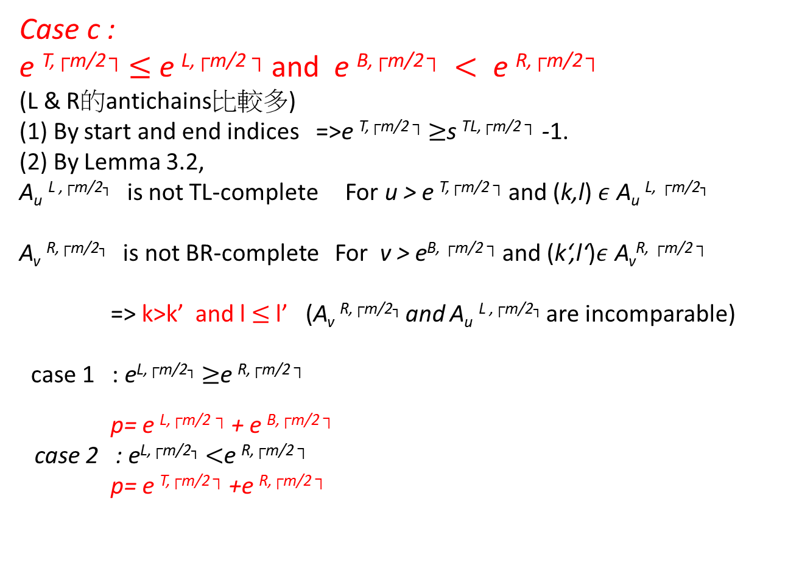
Case c
K’,l’
Case c :
e ^{T,}$┌$^{m/2}$┐$$≤$e ^{L,}$┌$^{m/2}$┐$and e ^{B,}$┌$^{m/2}$┐ <$e ^{R,}$┌$^{m/2}$┐$
(L&R的antichains比較多)
(1) By start and end indices =>e ^{T,}$┌$^{m/2}$┐$$≥$s ^{TL,}$┌$^{m/2}$┐$-1.
(2)By Lemma 3.2,
A_{u}^{L ,}$┌$^{m/2┐} is not TL-complete For u > e ^{T,}$┌$^{m/2}$┐$and(k,l) $ε$ A_{u}^{L,}$┌$^{m/2┐}
A_{v}^{R,}$┌$^{m/2┐} is not BR-complete For v >e^{B,}$┌$^{m/2}$┐$and (k‘,l‘)$ε$A_{v}^{R,}$┌$^{m/2}$┐$
=> k>k’ and l$≤$ l’ (A_{v}^{R,}$┌$^{m/2┐} and A_{u}^{L ,}$┌$^{m/2┐} are incomparable)
case 1 : e^{L,}$┌$^{m/2┐}$≥$e ^{R,}$┌$^{m/2}$┐$
p= e ^{L,}$┌$^{m/2}$┐$+ e ^{B,}$┌$^{m/2}$┐$
case 2 : e^{L,}$┌$^{m/2┐}$<$e ^{R,}$┌$^{m/2}$┐$
p= e ^{T,}$┌$^{m/2}$┐$+e ^{R,}$┌$^{m/2}$┐$
K,l
Notes:
This implies k >$┌$m/2$┐$and l $≤$$┌$m/2$┐$(by check TL-completeness)
k’ $≤┌$m/2$┐$and l’ > n - $└$m/2$┘≥┌$m/2$┐$(by check BR-completeness)

Slide 18
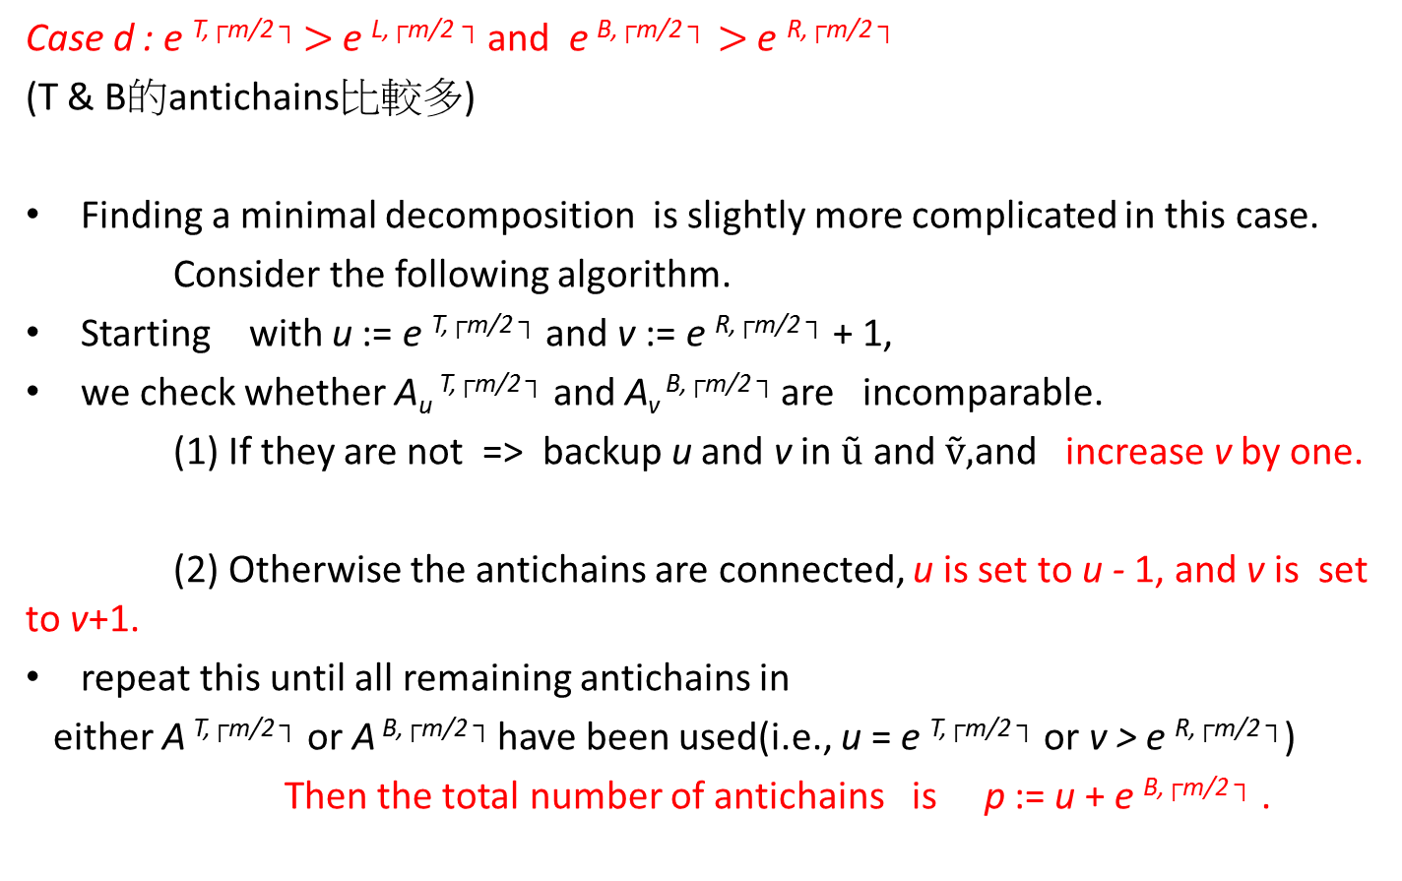
Case d
u
Case d : e ^{T,}$┌$^{m/2}$┐$$>$e ^{L,}$┌$^{m/2}$┐$and e ^{B,}$┌$^{m/2}$┐>$e ^{R,}$┌$^{m/2}$┐$
(T &B的antichains比較多)
Finding a minimal decomposition is slightly more complicated in this case.
Consider the following algorithm.
Startingwith u := e ^{T,}$┌$^{m/2}$┐$and v := e ^{R,}$┌$^{m/2}$┐$+ 1,
we check whether A_{u} ^{T,}$┌$^{m/2}$┐$and A_{v} ^{B,}$┌$^{m/2}$┐$areincomparable.
(1) If they are not =>backup u and v in $ũ$and $ṽ,$andincrease v by one.
(2) Otherwise the antichains are connected, u is set to u - 1, and v is set to v+1.
repeat this until all remaining antichains in
either A^{T,}$┌$^{m/2}$┐$or A^{B,}$┌$^{m/2}$┐$have been used(i.e., u = e ^{T,}$┌$^{m/2}$┐$or v > e ^{R,}$┌$^{m/2}$┐$)
Then the total number of antichains is p := u + e ^{B,}$┌$^{m/2}$┐$.
e
Notes:
Thus, if u = e T,┌m/2 ┐ , we have p = e T,┌m/2 ┐ + e R,┌m/2 ┐ , and the decomposition is optimal.
Now assume u > e T,┌m/2 ┐ .
If ũ and ṽ are unused, then all remaining antichains in A B,┌m/2 ┐ have been connected to corresponding antichains in
A T,┌m/2 ┐, and we have p = e T,┌m/2 ┐ + e R,┌m/2 ┐.
Hence, in this case the decomposition is also a minimal one.
Finally assume that ũ and ṽ have been used for saving u and v at
least once. Then for j = ṽ + 1,…., e B,┌m/2 ┐, A B,┌m/2 ┐ has been connected to A ũ+ṽ−𝑗 𝑇,┌m/2 ┐
and we have u = ũ "-" (e B,┌m/2 ┐- ṽ). Thus p = ũ "−" (e B,┌m/2 ┐- ṽ)+ e B,┌m/2 ┐ = ~u + ~v.
But from the properties of ũ and ṽ,
it can be shown (similar to the proof of Lemma 3.5) that there is a chain of length ũ and ṽ which contains two matches p1∈ Aũ T,┌m/2 ┐
and p2 ∈A ṽ B,┌m/2 ┐ . Hence, the constructed decomposition is optimal.

Slide 19


Case d
u := e ^{T,}$┌$^{m/2}$┐$
v := e ^{R,}$┌$^{m/2}$┐$+ 1

Slide 20
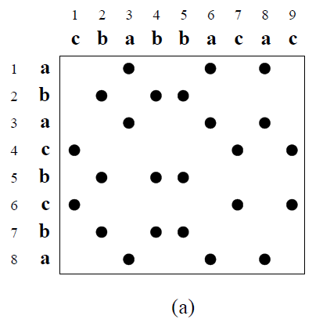
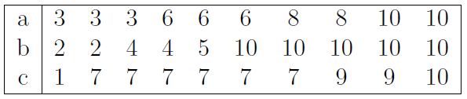
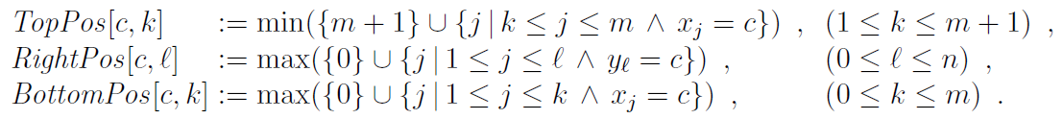
Implementation
LeftPos[a_{i},l] equals the column number of the leftmost occurence of a match in row i located right to column l , and equals n + 1 if there is no such match.

Slide 21
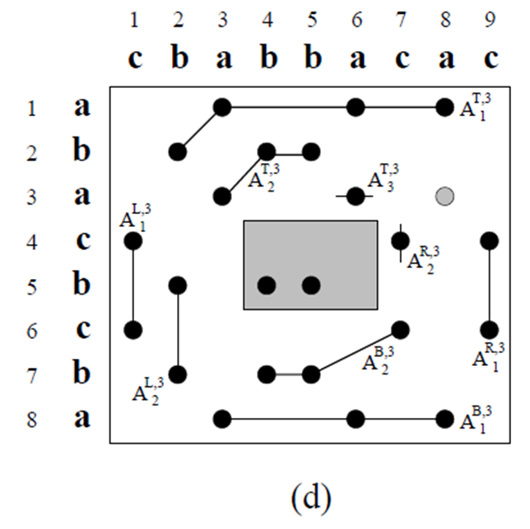
Implementation
We define ThreshT [u] as the leftmost column used by some match in A_{u}^{T,i}

Slide 22
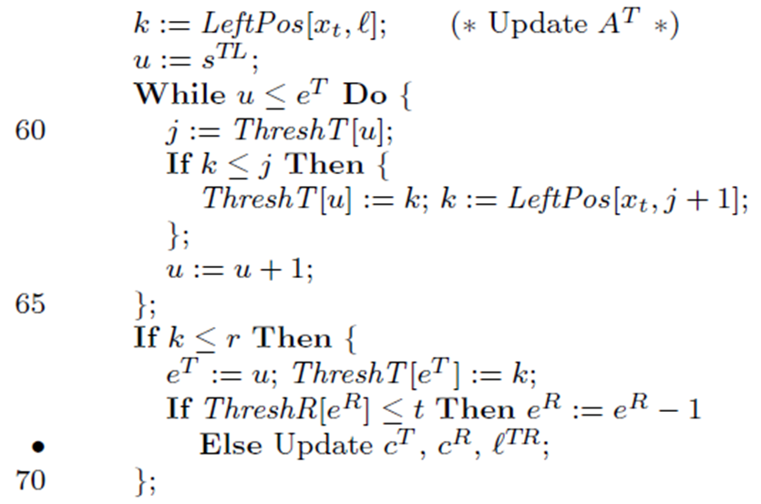
Implementation
updates ThreshT by LeftPos[x_{t},l]

Slide 23
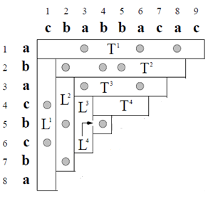
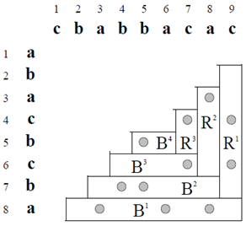
Construction of an LCS in Linear Space
The idea is to apply the divide-and-conquer scheme which first identifies at least one point
of an LCS such that this LCS is splitted into two parts of roughly the same size.
Then the remainder is computed by recursive calls.
The method presented here usually determines two LCS-neighbouring matches c^{TL} and c^{BR}
c^{BR}
c^{TL}

Slide 24
Construction of an LCS in Linear Space
p^{TL}
is the match which caused As A^{T,i} or As A^{L,i} to become TL-complete, s = s^{TL,i}-1.
For example, in Fig. 2 (c), p^{TL} = (2, 2), and in Fig. 2 (d) and (e), p^{TL} = (3, 3).
p^{BR}
has a corresponding meaning for the last BR-complete antichain in A^{B,i}and A^{R,i}, e.g., in Fig. 2 (d), p^{BR} = (6, 7).

Slide 25
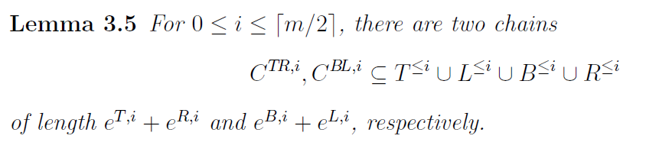
Construction of an LCS in Linear Space
c^{T} and c^{R}
They both lie in C^{TR,i} and are neighbours in this chain. Furthermore, c^{T} and c^{R} are always located in the first i topmost rows and i rightmost columns of M
c^{B} and c^{L}
c^{B} and c^{L} have analogous properties for C^{BL,i}.
l^{TR} and l^{BL}
is the position of c^{T} in C^{TR,i} and of c^{L} in C^{BL,i}
c^{T}
c^{R}
c^{TR}
l^{TR}

Slide 26
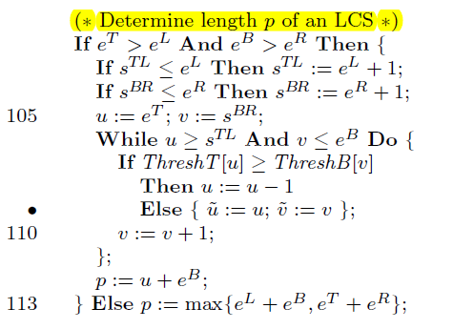
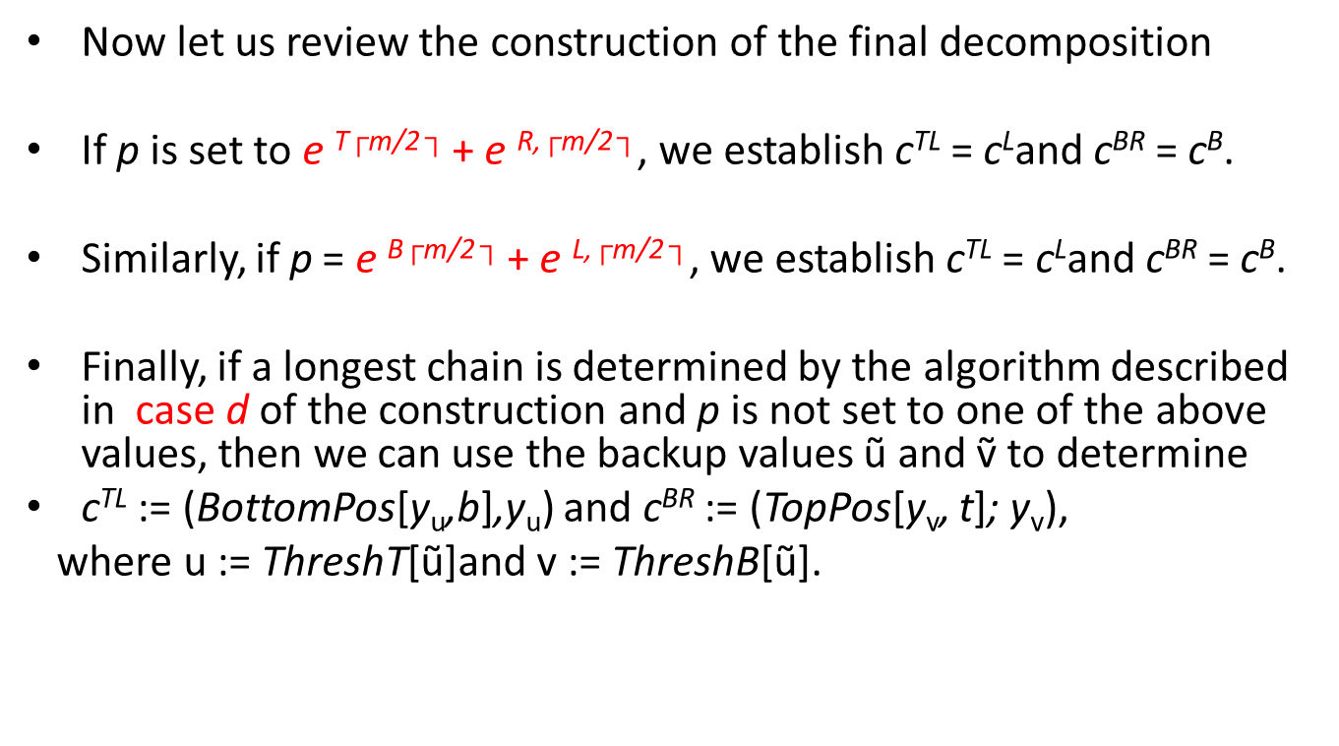
Construction of an LCS in Linear Space
Now let us review the construction of the final decomposition
If p is set to e ^{T}$┌$^{m/2}$┐$+ e ^{R,}$┌$^{m/2}$┐$, we establish c^{TL}= c^{L}andc^{BR}= c^{B}.
Similarly, if p = e ^{B}$┌$^{m/2}$┐$+ e ^{L,}$┌$^{m/2}$┐$, we establish c^{TL}= c^{L}andc^{BR}= c^{B}.
Finally, if a longest chain is determined by the algorithm described in case d of the construction and p is not set to one of the above values, then we can use the backup values ũ and ṽ to determine
c^{TL}:= (BottomPos[y_{u},b],y_{u}) and c^{BR}:= (TopPos[y_{v},t]; y_{v}),
where u:= ThreshT[ũ]and v:= ThreshB[ũ].

Slide 27
Complexity of the algorithm
space :O(ns)
(1)LefttPos,TopPos, RightPos and BottomPos : O(ns)
(2)ThreshT , ThreshL , ThreshB and ThreshR : O(n)
(3)c^{T}, c^{L}, c^{B} and c^{R} : O(n)
Example: lefttPos

Slide 28
Complexity of the algorithm
Time(determining the length p of an LCS) :
O(ns + min{ mp, p(n - p) } )
(1)preprocessed : O(ns)
(2)the main loop: O(┌m/2 ┐) =O(𝑚)
(3)inner While-loops takes more than O(p) time
by(1),(2),(3) : O(ns+mp)
(4)考慮在A^{T}中的每條antichan：
第j條 antichain(在第i次被加入,i>=j)必定包含一個match(k,l)
=> l<=n-(p-j)
=>第n-(p-j)次之後,此antichan才會TL-complete
=>此antichan被運算的次數=n-(p-j)-i<=n-p
=>O(n-p)
(5)在A^{T}中有O(p)條antichain
by(1),(4),(5) : O(ns+p(n-p))

Slide 29
Complexity of the algorithm
Time(Construction of an LCS) :
O(ns + min{ mp, mlogm + p(n - p) } )

Slide 30
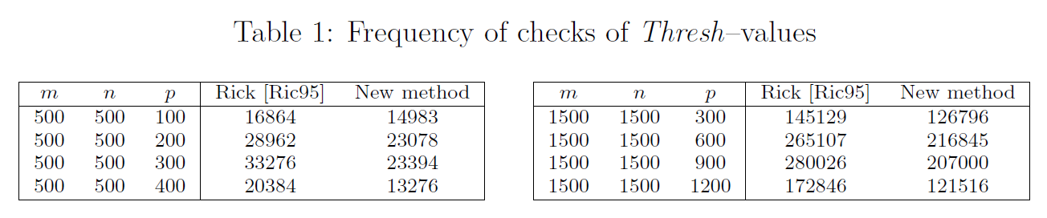
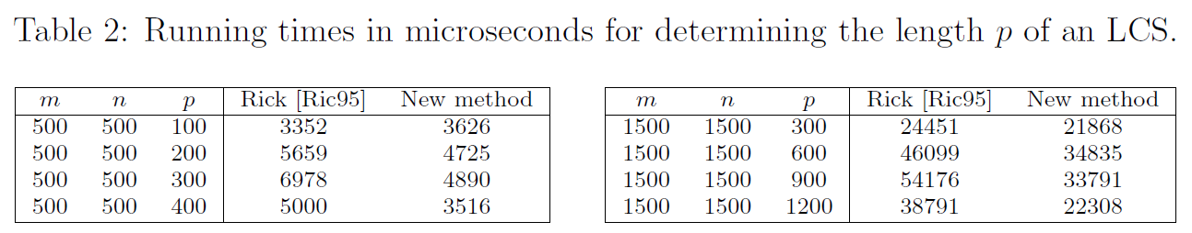
Experimental Results

Slide 31
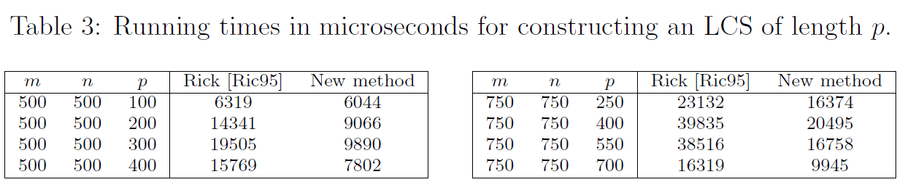
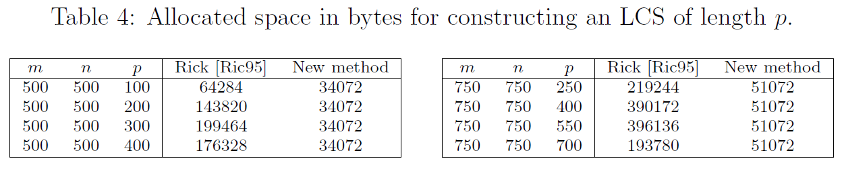
Experimental Results

Slide 32


Slide 33
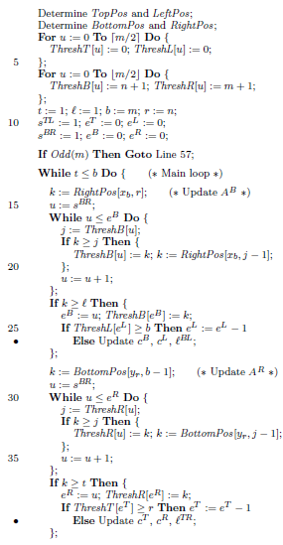
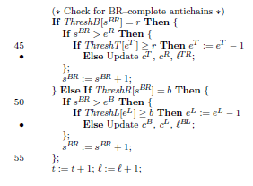
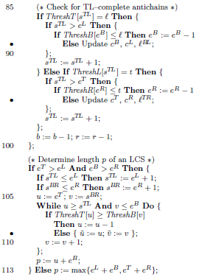
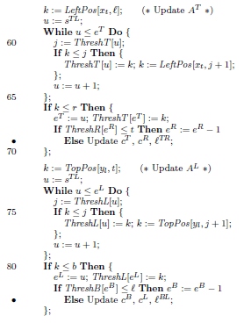
Implementation
Figure 6: The O(ns + min{ mp, p(n - p)})
algorithm for
determining the length p of an LCS.
Notes:
pTL and pBR can be easily updated. For example, consider lines 85{98 in Fig. 6 where
new TL{complete antichains are handled. Let pTL = (u; v). If the condition in line
86 is satis¯ed, then we know pTL has to be set to the bottommost match located in
the ¯rst t rows and column `. Therefore two additional statements can be inserted
between lines 86 and 87 such that u is set to BottomPos[y`; t] and v is set to `. Similar
statements apply for the situation in lines 92{98, and this completes the description
of the management for pTL. pBR can be handled in a similar way.
cT , cR, and `TR must be updated whenever the length of CTR;i increases. These
situations are indicated in lines 40, 46, 69, and 95 in Fig. 6, and here we only sketch
how to manage them. By arguments analogous to the ones given in the proof of
Lemma 3.4, we have to distinguish two cases when updating cT . If sTL;i > eT;i, then
cT is set to pTL, otherwise cT can be determined by some additional statements which
are similar to the ones used for updating pTL. In either case, we set `TR to eT;i because
eT;i is the position of cT in CTR;i, as seen in the proof of Lemma 3.5. The management
of cB, cL, and `BL is similar.

