Slide 1
A branch-and-cut approach to the repetition-free longest common subsequence problem
International Symposium on Combinatorial Optimization
Carlos E. Ferreira and Christian Tjandraatmadja
Presenter : Yao-Chou Tsai
Date:2014/11/4

Slide 2
Abstract
We present a branch-and-cut approach to solve the following problem. Given two sequences x and y over a finite alphabet, find a repetition-free longest common subsequence of x and y. Implementation details of an efficient separation routine and several heuristics are described. We can solve medium size instances of the problem to optimality.

Slide 3
RFLCS
Definition:
A repetition-free longest common subsequence, or RFLCS, is a repetition-free common subsequence of maximum length.
Example:
X = caadbd
Y = abacdad
Ans: cad
NP-hard

Slide 4
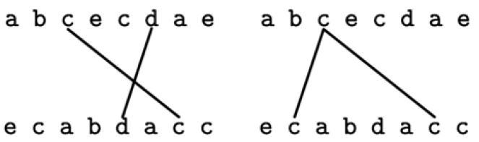
Cross
Two matchs (i, j) and (k, l) cross(or crossing):
i ≤ k and j ≥ l
Have an extreme point in common

Slide 5
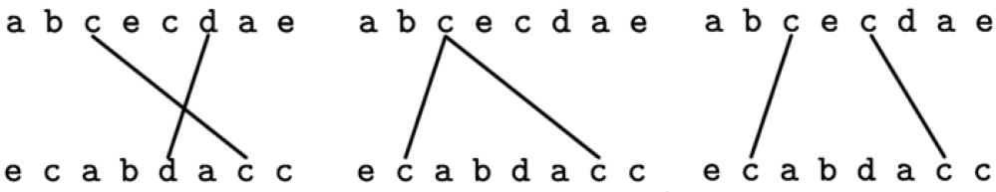
Conflicting
Conflicting:
Two matches (i, j) and (k, l) cross or same symbol.

Slide 6
Defines
X = caadbd
Y = abacdad
A is a set of pairwise non-crossing matches.
A = {(1, 4), (2, 6), (6, 7)}
s is a common subsequence of X and Y
s = cad
A defines s
A set of pairwise non-conflicting matches defines a repetition-free common subsequence.

Slide 7
Non-conflicting matches
The RFLCS problem can be translated into finding a set of pairwise non-conflicting matches of maximum cardinality.
Example:
Phase 1
c a a d b d
a b a c d a d
Phase 2
c a a d b d
a b a c d a d
Phase 3
c a a d b d
a b a c d a d

Slide 8
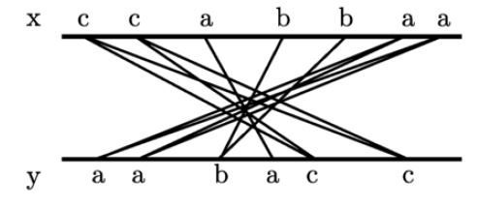
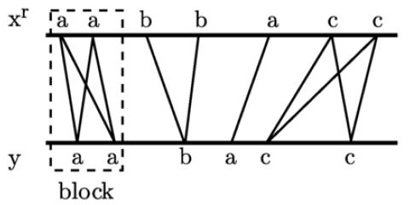
Extended star and Extended planar matching
Extended star definition
A set of pairwise conflicting matches.
Extended planar matching definition
Revert on of the sequences, the extended star turns into a set of matches that two matches with different symbols are not conflicting.
New position of match (i, j) will be at (|x|+1−i, j).
Block definition
A set of matches of a same symbol σ that is formed by a start match (a, b), an end match (i, j) with i ≥ a and j ≥ b, and every match (k, l) of symbol σ such that a ≤ k ≤ i and b ≤ l ≤ j.

Slide 9
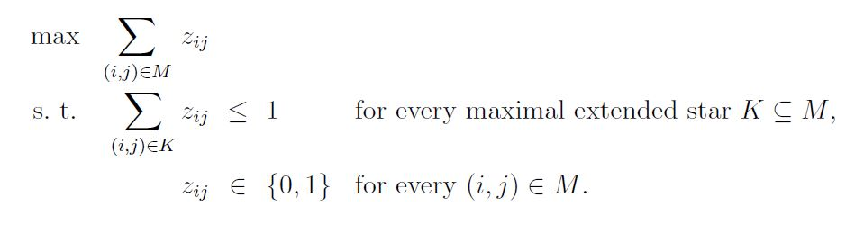
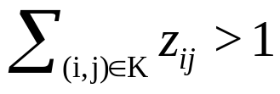
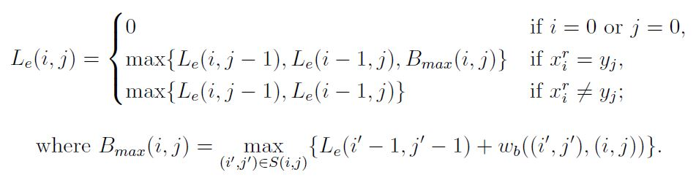
Find maximum extended star(1/2)
Find a maximal extended star K such that
The problem is equivalent to finding a maximum extended planar matching.

Slide 10
Find maximum extended star(2/2)
 | 0 | a | a | b | b | a | c | c
0 | 0 | 0 | 0 | 0 | 0 | 0 | 0 | 0
a | 0 | 1 | 1 | 1 | 1 | 1 | 1 | 1
a | 0 | 1 | 1 | 1 | 1 | 1 | 1 | 1
b | 0 | 1 | 1 | 2 | 2 | 2 | 2 | 2
a | 0 | 1 | 1 | 2 | 2 | 2 | 2 | 2
c | 0 | 1 | 1 | 2 | 2 | 2 | 3 | 3
c | 0 | 1 | 1 | 2 | 2 | 2 | 3 | 3
x = a a b b a c c
y = a a b a c c

Slide 11

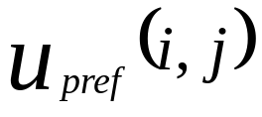
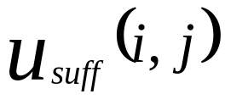
Match upper bound(1/2)
Definition
(i, j) is a match in x and y
u(i, j) is a match upper bound for (i, j)
If there is a repetition-free common subsequence of x and y of length greater than u(i, j), then (i, j) is not in a set defines an RFLCS of x and y.
= length of an RFLCS x[ 1…i-1 ] and y[ 1…j-1 ]
= length of an RFLCS x[ i+1…|x| ] and y[ j+1…|y| ]

Slide 12
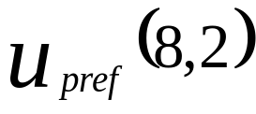
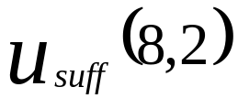
Match upper bound(1/2)
x = a a b b a c c a d
y = a a b a c c b
|x| = 9 , |y| = 7
Let A = abc, |A| = 3
u(8, 2) = + + 1 = 1 + 0 + 1 = 2
|A| > u(8, 2)

Slide 13
Heuristic concept
Weighted LCS and remove repetitions
Simple greedy
Match upper bound greedy
Divide-and-conquer heuristic
Phase1:
a a b b a b c
a a b a c c
Phase2:
a a b a b c
a a a c c

Slide 14
Conclusion
This paper presents a simple technique for removing variables we know that cannot be in an optimal solution to obtain good feasible solutions more quickly.

