Slide 1
Optimal Correspondence of String Subsequences
Wang, Y.P. and Pavlidis, T.
Pattern Analysis and Machine Intelligence, IEEE Transactions on
Volume:12 , Issue: 11 Page(s): 1080 – 1087 Nov 1990
Presenter: Huang-Ting Chan
Date:2014/12/21

Slide 2
Abstract
The problem of substring matching when the strings are from a finite alphabet has been investigated thoroughly in the literature. The corresponding problem when the alphabet is infinite (for example strings of numbers) bas received less attention. We present definitions of string distance, an effective way of computing them, and matching algorithms minimizing such distances.

Slide 3
Our analysis also includes the matching of strings to regular expressions. We include two diverse applications: the stereo epipolar line matching and the bar code recognition.

Slide 4
Introduction
The partial matching problem
Image analysis
contour matching problem
correspondence problem in stereo
occluding object matching (recognition) problem
Speech recognition
syllable recognition in speech

Slide 5
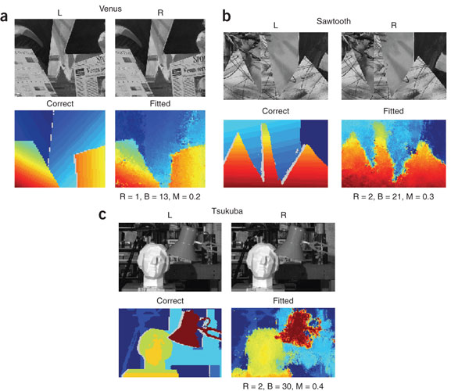
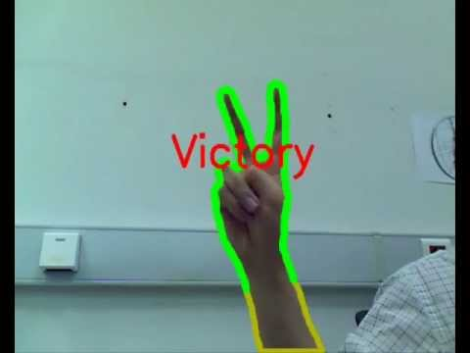
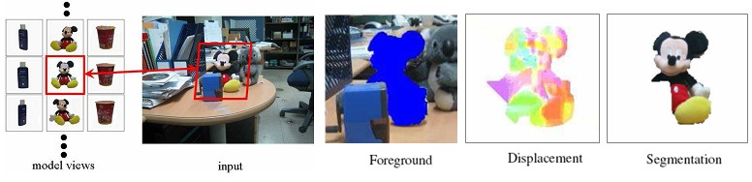
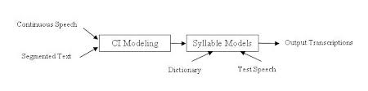

Slide 6
The general algorithm
Correlation
Relaxation
Time-warping
Elastic matching

Slide 7

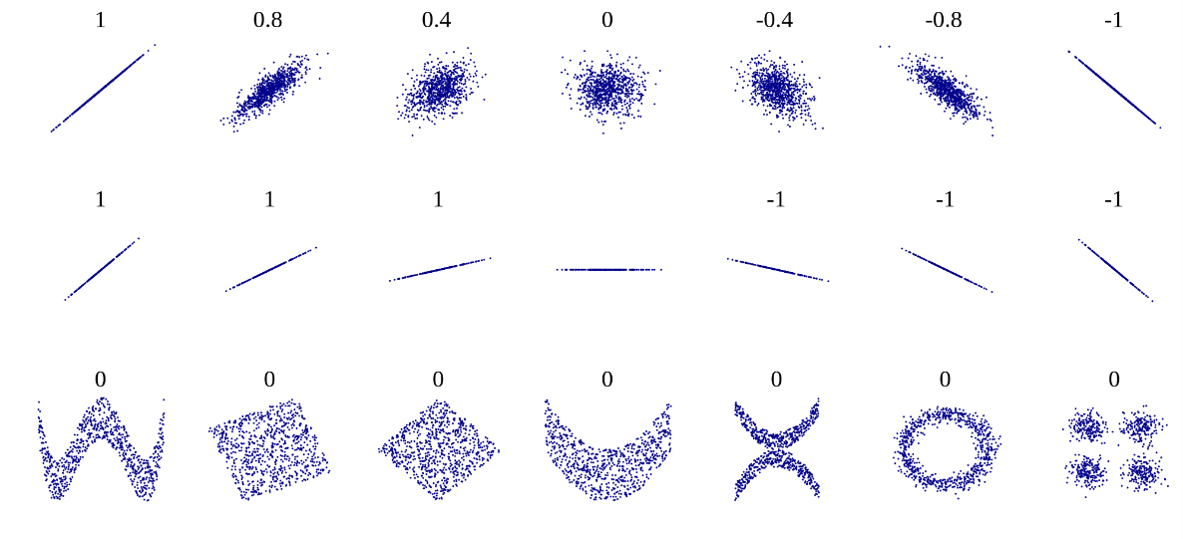
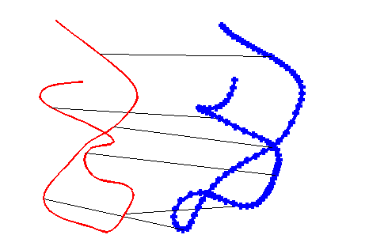
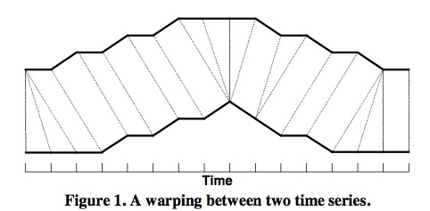
Correlation
Relaxation
Time-warping
Elastic matching

Slide 8
Compare with LCS
LCS :
The matching is defined as a notion of exact match or of compatible relation on a finite alphabet
OCS :
Extends the finite alphabet editing error minimization matching to the infinite alphabet penalty minimization matching.

Slide 9
Example
a noisy system the sampling data can always be
digitized into numbers with quantization unit above
the inherent noise level and represented by a finite
alphabet.
Moreover, if the size of an alphabet is too
large, to maintain a huge lookup table to keep track
of the interpretation of each symbol is infeasible.

Slide 10
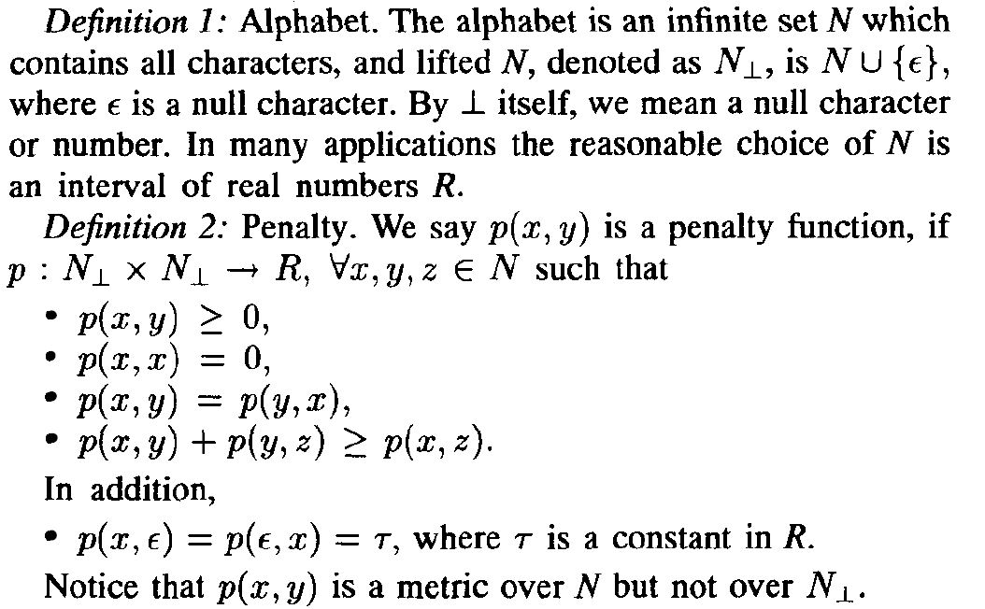
Optimal Correspondent Subsequence(OCS) Problem
as an infinite alphabet penalty minimization problem

Slide 11
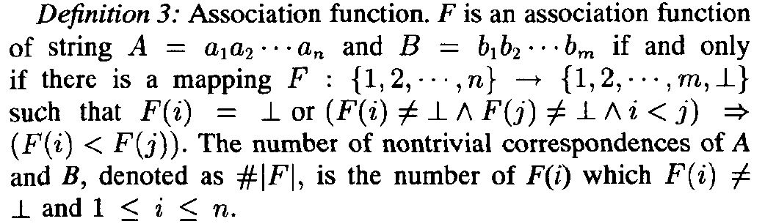
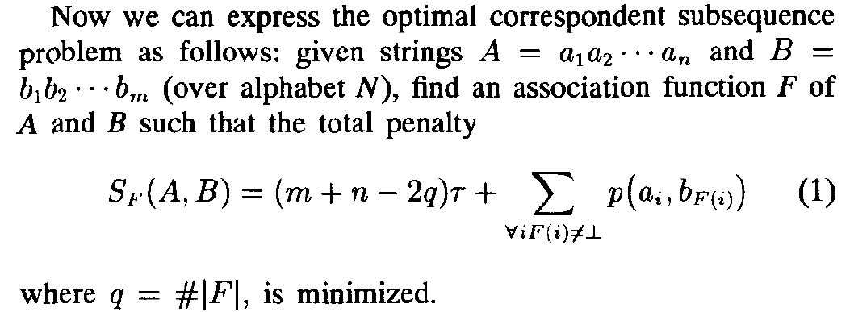
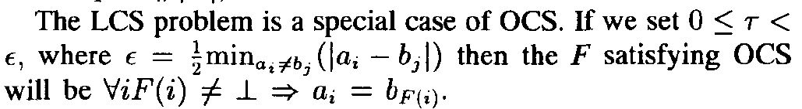

Slide 12
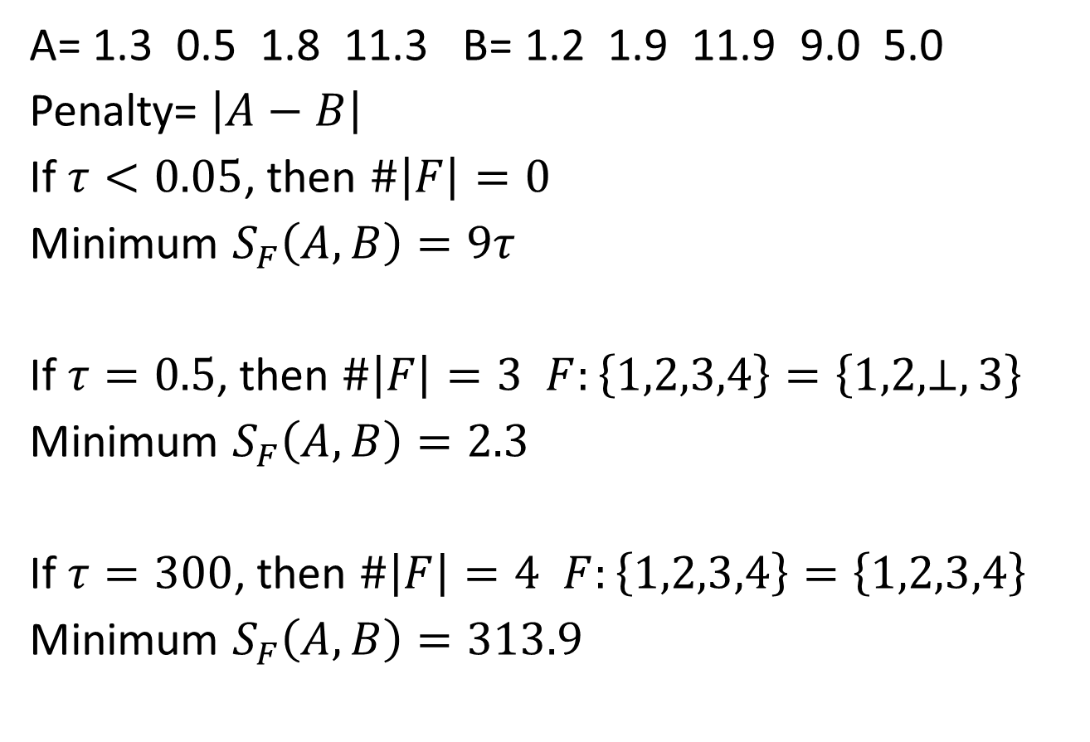
Example
A= 1.3 0.5 1.8 11.3 B= 1.2 1.9 11.9 9.0 5.0
Penalty= $\left|A−B\right|$
If $τ<0.05$, then $\#\left|F\right|=0$
Minimum $S_{F}\left(A,B\right)=9τ$
If$τ=0.5$, then $\#\left|F\right|=3$ $F:\left\{1,2,3,4\right\}=\left\{1,2\text{,}\text{⊥},3\right\}$
Minimum $S_{F}\left(A,B\right)=2.3$
If$τ=300$, then $\#\left|F\right|=4$ $F:\left\{1,2,3,4\right\}=\left\{1,2\text{,}3,4\right\}$
Minimum $S_{F}\left(A,B\right)=313.9$

Slide 13
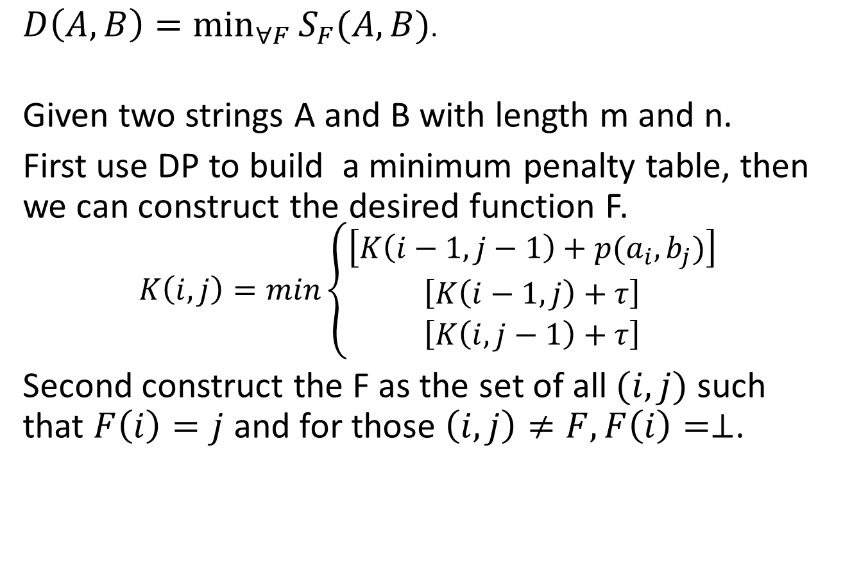
String Distance
$D\left(A,B\right)=\min_{∀F}{S_{F}(A,B)}$.
Given two strings A and B with length m and n.
First use DP to build a minimum penalty table, then we can construct the desired function F.
$$K\left(i,j\right)=min\left\{\begin{aligned}\left[K\left(i−1,j−1\right)+p(a_{i},b_{j})\right] \\ \left[K\left(i−1,j\right)+τ\right] \\ \left[K\left(i,j−1\right)+τ\right]\end{aligned}\right.$$
Second construct the F as the set of all $(i,j)$ such that $F\left(i\right)=j$ and for those $\left(i,j\right)≠F, F\left(i\right)=⊥$.

Slide 14
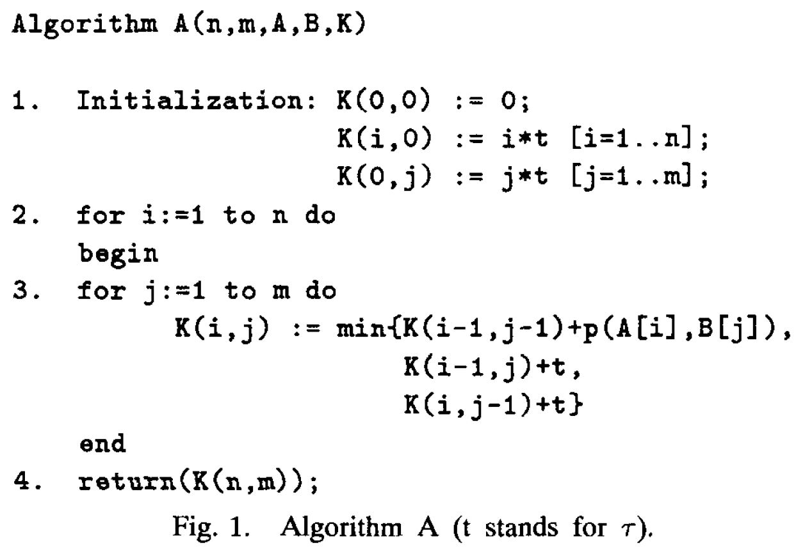
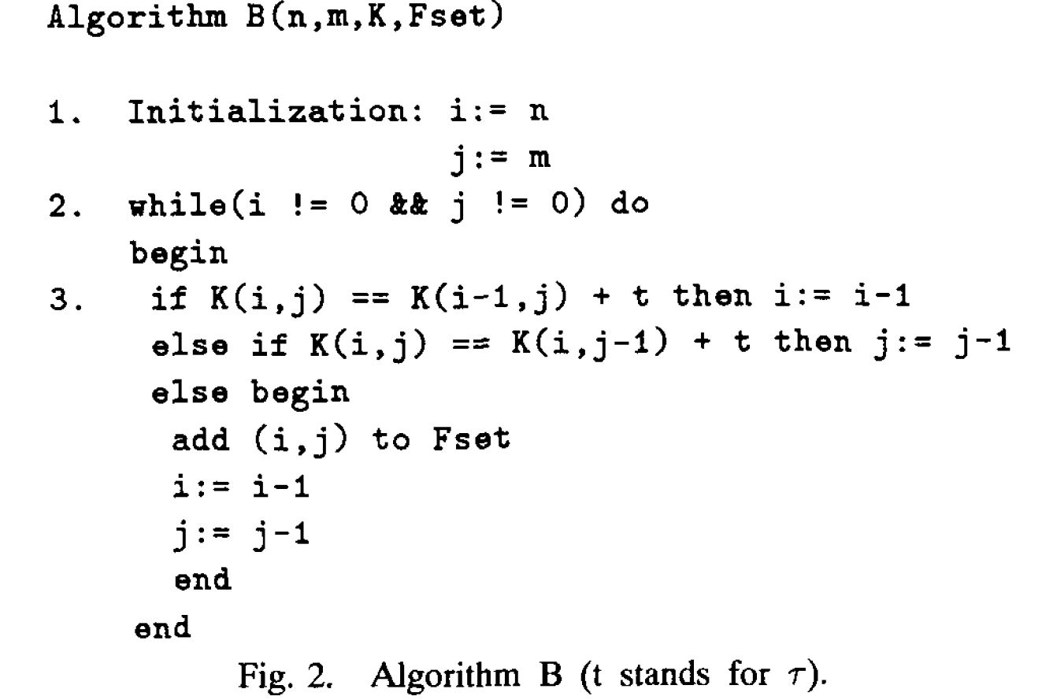

Slide 15
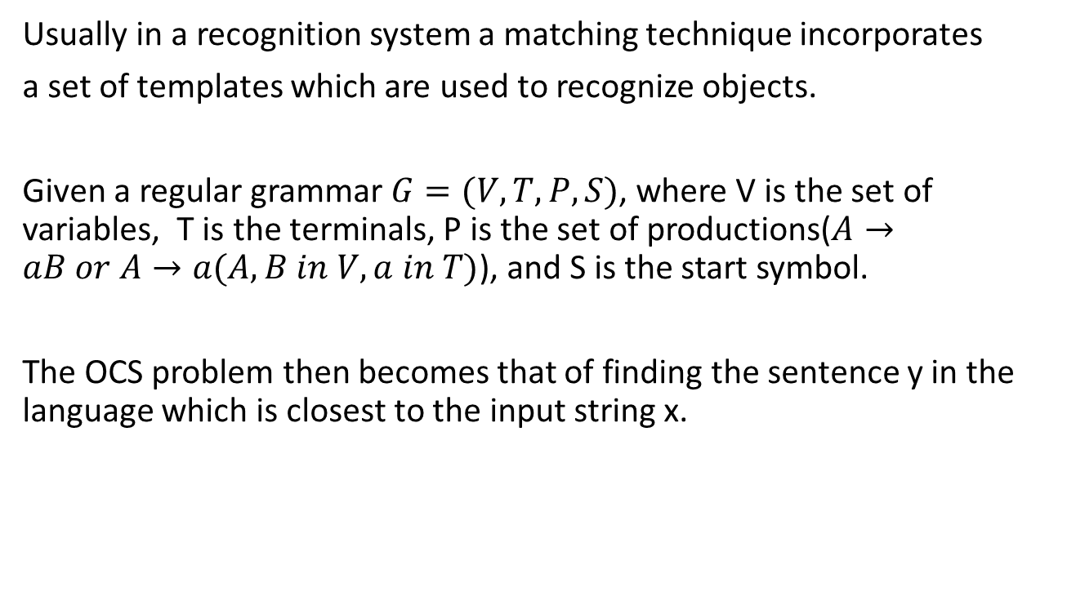
Template Matching
Usually in a recognition system a matching technique incorporates
a set of templates which are used to recognize objects.
Given a regular grammar $G=(V, T, P, S)$, where V is the set of variables, T is the terminals, P is the set of productions($A→aB or A→a(A,B in V, a in T)$), and S is the start symbol.
The OCS problem then becomes that of finding the sentence y in the language which is closest to the input string x.

Slide 16
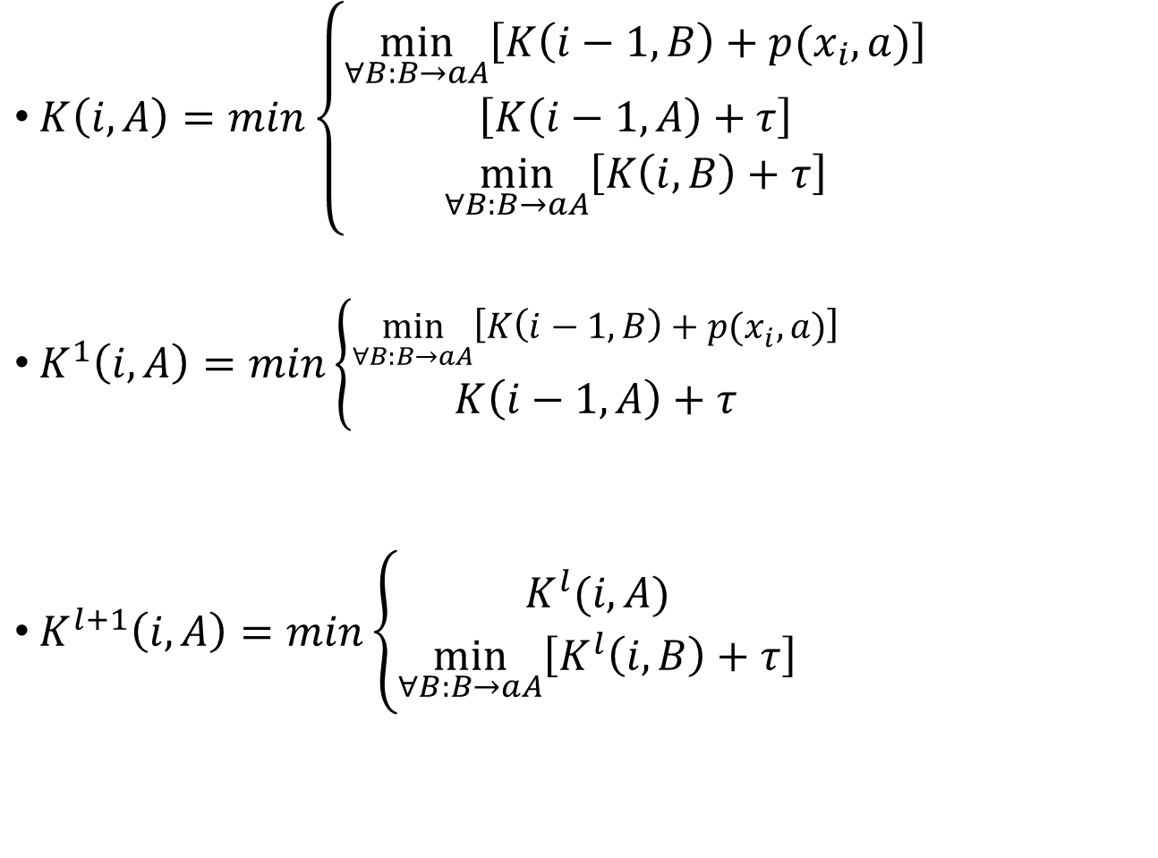
$K\left(i,A\right)=min\left\{\begin{aligned}\min_{∀B:B→aA}\left[K\left(i−1,B\right)+p(x_{i},a)\right] \\ \left[K\left(i−1,A\right)+τ\right] \\ \min_{∀B:B→aA}\left[K\left(i,B\right)+τ\right]\end{aligned}\right.$
$K^{1}\left(i,A\right)=min\left\{\begin{aligned}\min_{∀B:B→aA}\left[K\left(i−1,B\right)+p(x_{i},a)\right] \\ K\left(i−1,A\right)+τ\end{aligned}\right.$
$K^{l+1}\left(i,A\right)=min\left\{\begin{aligned}K^{l}(i,A) \\ \min_{∀B:B→aA}\left[K^{l}\left(i,B\right)+τ\right]\end{aligned}\right.$

Slide 17

Example
Given a regular grammar G = (V, T, P, S) where $V=\left\{A,B\right\},$ $T=\left\{1,2,3\right\}$ and $P=\left\{S→1A,A→2B,S→3B, B→1\#, B→1S\right\}$.
An input string is 1.9 0.8 3 1. If $τ=0.5$ , and $K\left(0,S\right)=0, K\left(0,A\right)=τ, K\left(0,B\right)=τ, K\left(0,\#\right)=2τ$

Slide 18
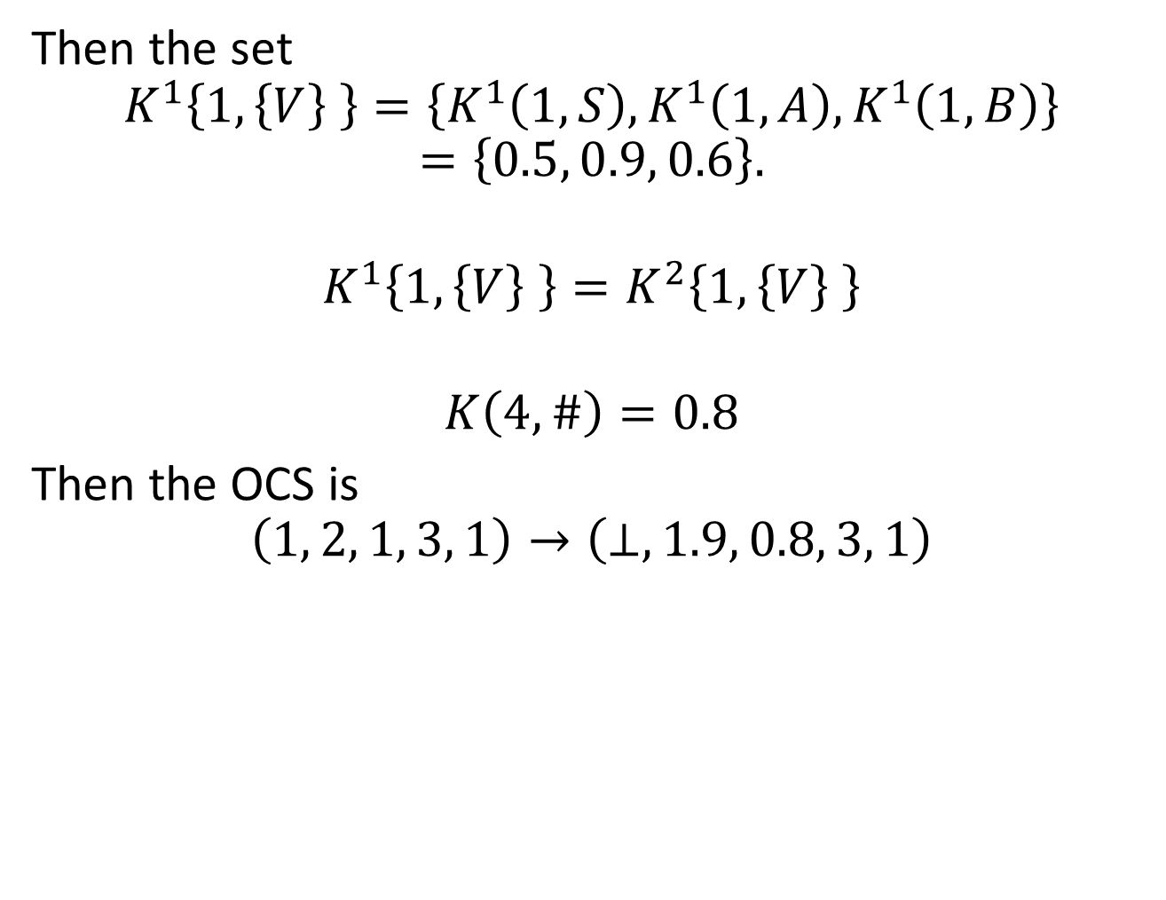
Then the set
$$K^{1}\left\{1,\left\{V\right\} \right\}=\left\{K^{1}\left(1,S\right),K^{1}\left(1,A\right),K^{1}\left(1,B\right)\right\}$$
$$=\left\{0.5, 0.9, 0.6\right\}.$$
$$K^{1}\left\{1,\left\{V\right\} \right\}=K^{2}\left\{1,\left\{V\right\} \right\}$$
$$K\left(4,\#\right)=0.8$$
Then the OCS is
$$\left(1, 2, 1, 3, 1\right)→\left(⊥,1.9, 0.8, 3, 1\right)$$

Slide 19

Penalty Fuction
Pointwise
$$p\left(x,y\right)=\left|x−y\right|$$
Piecewise
$$p\left(x_{i},y_{j}\right)=\sum_{k=−b}^{b−1}{\left|\left(x_{i+k+1}−x_{i+k}\right)−\left(y_{j+k+1}−y_{j+k}\right)\right|}$$

Slide 20
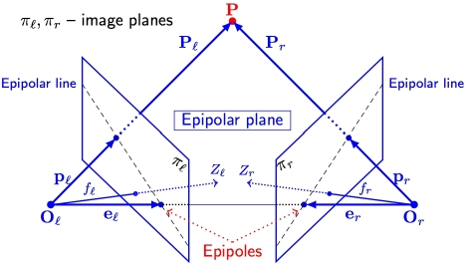
The Epipolar Line

Slide 21
The algorithm for finding the conjugate points of left and right images can be described in two stages.
Epipolar Line Registration
Finding Conjugate Points

Slide 22
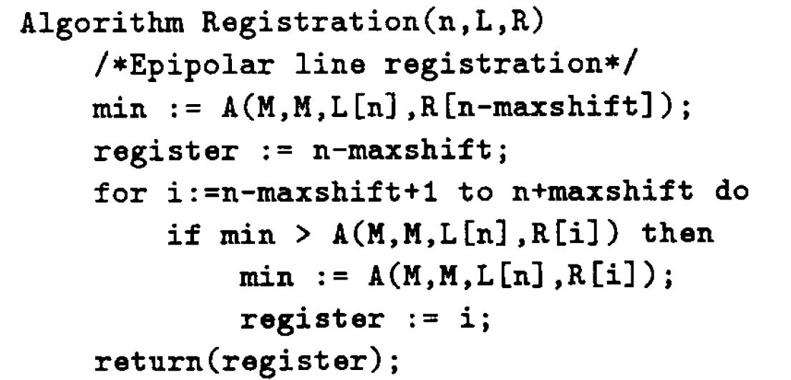
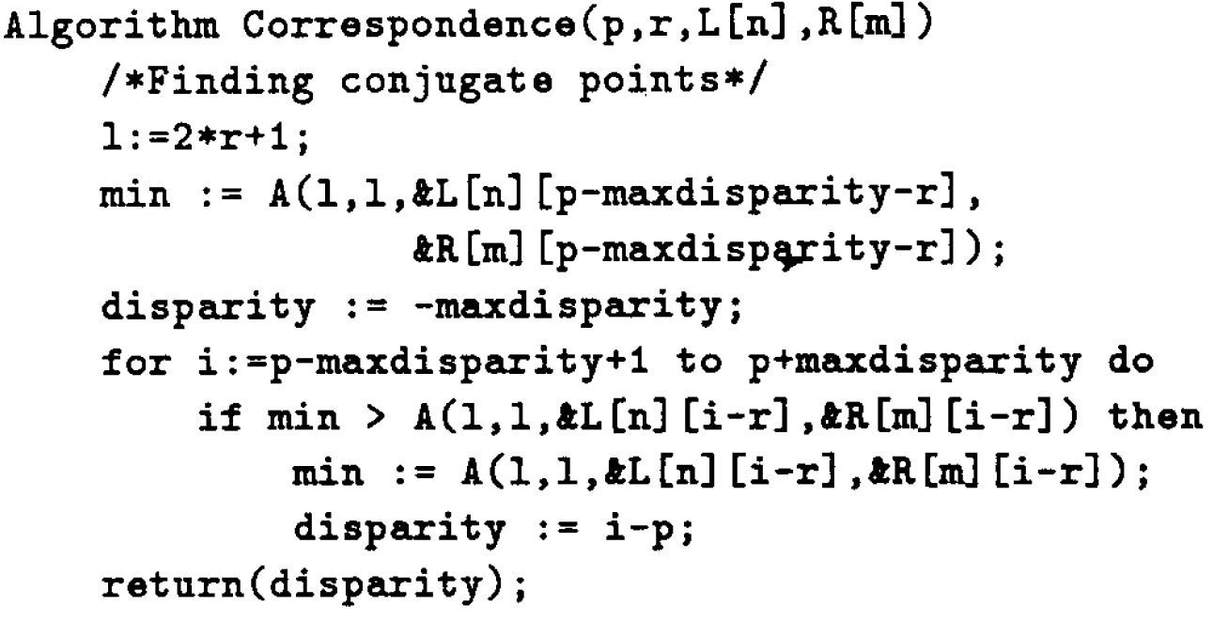

Slide 23
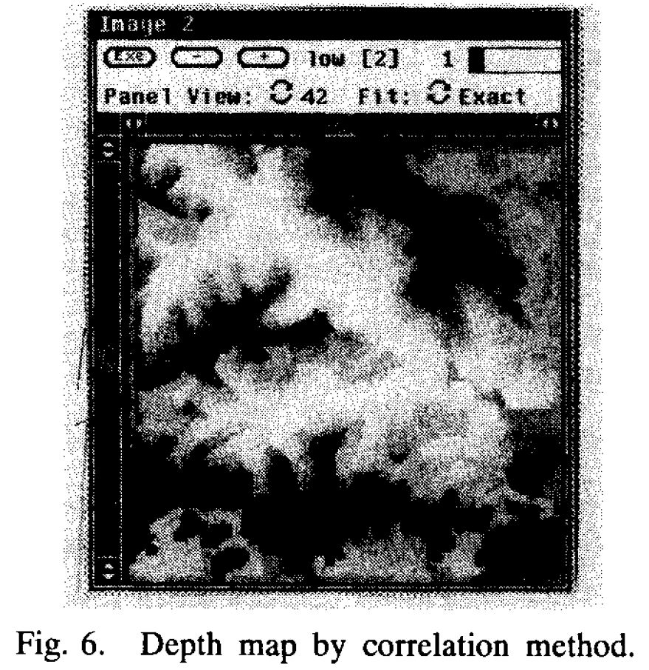
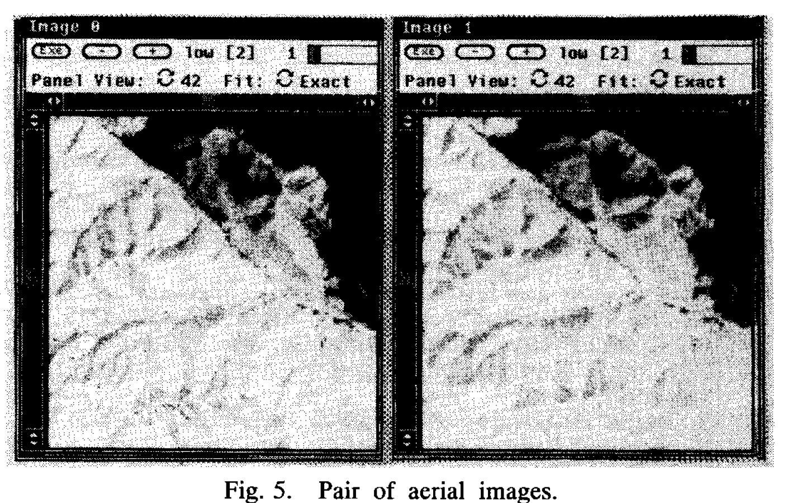
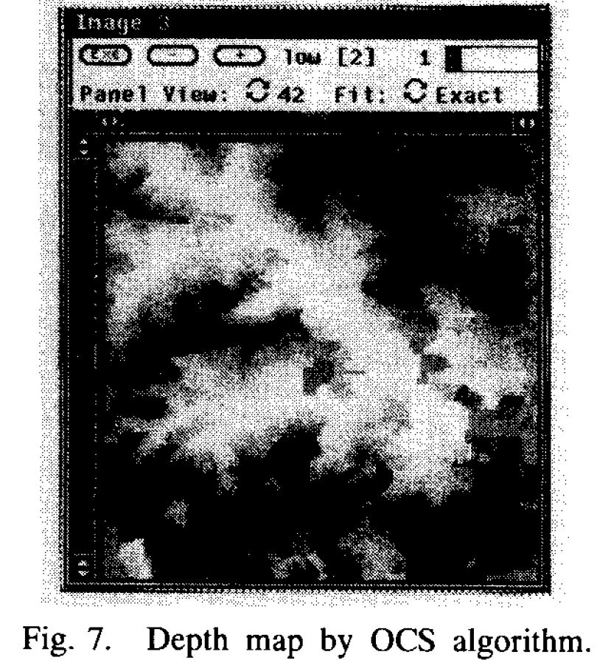
Experiment

Slide 24

UPC bar Decoding

Slide 25
Conclusion
The classical LCS problem is well understood. It seems that the OCS problem has not been explored as much as LCS.
This paper gives the definition of the optimal correspondent subsequence (OCS) problem and the algorithms.
The complexity of OCS is quadratic. It is superior to relaxation and elastic matching of which complexity are cubic.
In comparison to relaxation and elastic matching techniques, the OCS also shows its elegance in combining syntactic information and doing matching incrementally.
The diversity of the OCS algorithm is shown in the last two applications. It can tackle either the string-to-string or string-to-regular-grammar approximate matching problem in the infinite alphabet domain.

