Slide 1
A fast algorithm for computing a longest common increasing subsequence
I-Hsuan Yang , Chien-Pin Huang Kun-Mao Chao
Information Processing Letters 93 (2005) pp. 249–253
Presenter:林憲良
Date:2014/12/22

Slide 2
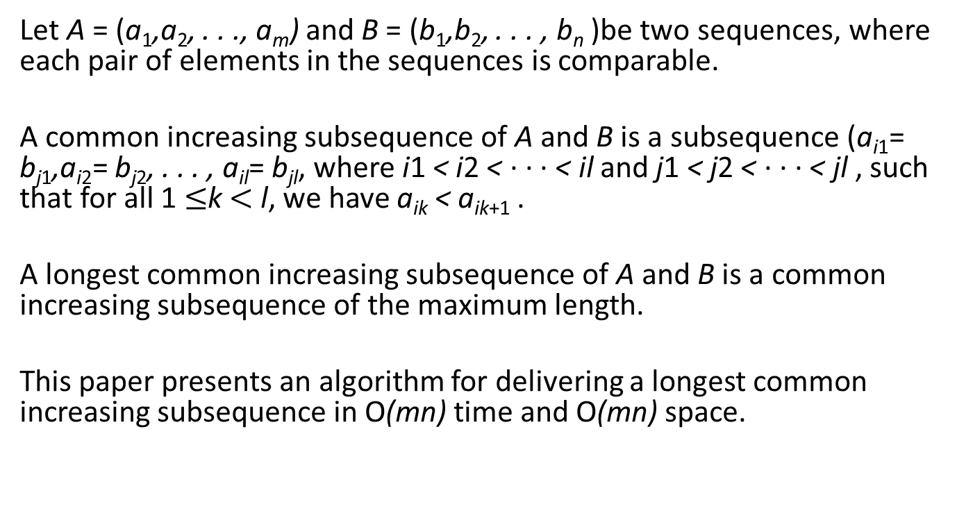
Abstract
Let A = (a₁,a₂, . . ., a_{m}) and B = (b₁,b₂, . . . , b_{n} )be two sequences, where each pair of elements in the sequences is comparable.
A common increasing subsequence of A and B is a subsequence (a_{i1}= b_{j1},a_{i2}= b_{j2}, . . . , a_{il}= b_{jl}, where i1 < i2 < · · · < il and j1 < j2 < · · · < jl , such that for all 1 $≤$k $<$ l, we have a_{ik} < a_{ik+1} .
A longest common increasing subsequence of A and B is a common increasing subsequence of the maximum length.
This paper presents an algorithm for delivering a longest common increasing subsequence in O(mn) time and O(mn) space.

Slide 3
LCS&LIS
A:1 2 4 3 5 7 6 A’LIS: 1 2 3 5 6
B:1 3 4 3 5 7 6 2 B’LIS: 1 3 4 5 6
LCS: 1 4 3 5 7 6
_{B} ^{A} | 1 | 2 | 4 | 3 | 5 | 7 | 6
1 | 1 | 1 | 1 | 1 | 1 | 1 | 1
3 | 1 | 1 | 1 | 2 | 2 | 2 | 2
4 | 1 | 1 | 2 | 2 | 2 | 2 | 2
3 | 1 | 1 | 2 | 3 | 3 | 3 | 3
5 | 1 | 1 | 2 | 3 | 4 | 4 | 4
7 | 1 | 1 | 2 | 3 | 4 | 5 | 5
6 | 1 | 1 | 2 | 3 | 4 | 5 | 6
2 | 1 | 2 | 2 | 3 | 4 | 5 | 6

Slide 4
LCIS
A straightforward O(mn²)-time algorithm for this problem is to sort the shorter sequence, and then find a longest common subsequence among the two sequences and the sorted sequence
Here we give an algorithm that solves the longest common increasing subsequence problem in O(mn) time and O(mn) space
Example:
A:1 2 4 3 5 7 6 B:1 3 4 3 5 7 6 2
LCIS:1 3 5 6

Slide 5
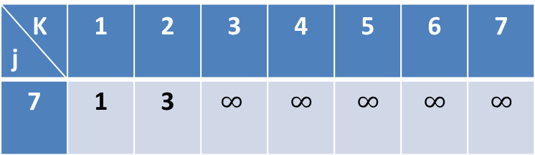

Introduction(1/2)
A:1 2 4 3 5 7 6
B:1 3 4 3 5 7 6 2
L^{i}_{j}[k]: be the smallest ending number of a
longest common increasing subsequence of length k between the sequences A(a₁, a₂, . . . ,a_{i}) and B(b₁, b₂, . . . ,b_{j} ), where 1$≤$ i $≤$m and 1 $≤$ j, k $≤$ n.(n$≤$m)
A(j) B(i) |  | 1 | 2 | 3 | 4 | 5 | 6 | 7
 |  | 1 | 2 | 4 | 3 | 5 | 7 | 6
1 | 1
2 | 3
3 | 4
4 | 3
5 | 5
6 | 7
7 | 6
8 | 2
For L^{i}_{j} (i=3,j=7)
K j | 1 | 2 | 3 | 4 | 5 | 6 | 7
7 | 1 | 3 | $$∞$$ | $$∞$$ | $$∞$$ | $$∞$$ | $$∞$$

Slide 6
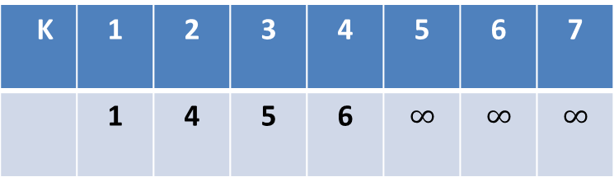
Introduction(2/2)
A:1 2 4 3 5 7 6
B:1 3 4 3 5 7 6 2
L_index^{i}_{j}[k]:record the index pair (x, y) such that L^{i}_{j}[k] is the element a_{x} and b_{y}
Prev[i, j ]:record the index pair (x, y)such that there is a link from (i, j ) to (x, y).
A(j) B(i) |  | 1 | 2 | 3 | 4 | 5 | 6 | 7
 |  | 1 | 2 | 4 | 3 | 5 | 7 | 6
1 | 1
2 | 3
3 | 4
4 | 3
5 | 5
6 | 7
7 | 6
8 | 2
K | 1 | 2 | 3 | 4 | 5 | 6 | 7
 | 1 | 4 | 5 | 6 | $$∞$$ | $$∞$$ | $$∞$$
L_index[4]=(7,7)
Prev[7,7]=(5,5)
Prev[5,5]=(2,4)
Prev[2,4]=(1,1)
LCIS:1 3 5 6

Slide 7
Algorithm(1/13)
In the match case
L^{i}_{j}= Insert a_{i} into L^{i−1}_{j} ,
In the mismatch case
L^{i}_{j}= merge(L^{i}_{j−1} ,L^{i−1}_{j})
=> L^{i}_{j}:=L^{i-1}_{j}
L^{i}_{j}[X^{i}_{j-1}]:=min{L^{i}_{j}[X^{i}_{j-1}], L^{i}_{j-1}[X^{i}_{j-1}]}

Slide 8
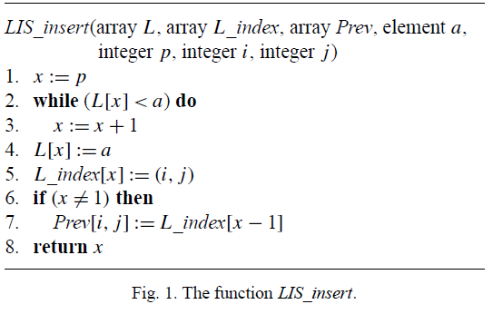
Algorithm(2/13)
L_{J}[X]
K J | 1 | 2 | 3 | 4 | 5 | 6 | 7
1 | 1
2
3
4
5
6
7
8
A(j) B(i) |  | 1 | 2 | 3 | 4 | 5 | 6 | 7
 |  | 1 | 2 | 4 | 3 | 5 | 7 | 6
1 | 1
2 | 3
3 | 4
4 | 3
5 | 5
6 | 7
7 | 6
8 | 2
Match case
 | 1 | 2 | 3 | 4 | 5 | 6 | 7 | 8
A(j) | 1 | 2 | 4 | 3 | 5 | 7 | 6
B(i) | 1 | 3 | 4 | 3 | 5 | 7 | 6 | 2

Slide 9
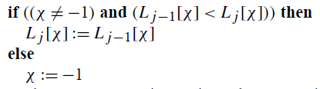
Algorithm(3/13)
L_{J}[X]
K J | 1 | 2 | 3 | 4 | 5 | 6 | 7
1 | 1
2 | 1
3
4
5
6
7
8
A(j) B(i) |  | 1 | 2 | 3 | 4 | 5 | 6 | 7
 |  | 1 | 2 | 4 | 3 | 5 | 7 | 6
1 | 1
2 | 3
3 | 4
4 | 3
5 | 5
6 | 7
7 | 6
8 | 2
 | 1 | 2 | 3 | 4 | 5 | 6 | 7 | 8
A(j) | 1 | 2 | 4 | 3 | 5 | 7 | 6
B(i) | 1 | 3 | 4 | 3 | 5 | 7 | 6 | 2
Mismatch case

Slide 10
Algorithm(4/13)
L_{J}[X]
K J | 1 | 2 | 3 | 4 | 5 | 6 | 7
1 | 1
2 | 1
3 | 1
4 | 1
5 | 1
6 | 1
7 | 1
A(j) B(i) |  | 1 | 2 | 3 | 4 | 5 | 6 | 7
 |  | 1 | 2 | 4 | 3 | 5 | 7 | 6
1 | 1
2 | 3
3 | 4
4 | 3
5 | 5
6 | 7
7 | 6
8 | 2
 | 1 | 2 | 3 | 4 | 5 | 6 | 7 | 8
A(j) | 1 | 2 | 4 | 3 | 5 | 7 | 6
B(i) | 1 | 3 | 4 | 3 | 5 | 7 | 6 | 2
Mismatch case

Slide 11
Algorithm(5/13)
L_{J}[X]
K J | 1 | 2 | 3 | 4 | 5 | 6 | 7
1 | 1
2 | 1
3 | 1
4 | 1
5 | 1
6 | 1
7 | 1
A(j) B(i) |  | 1 | 2 | 3 | 4 | 5 | 6 | 7
 |  | 1 | 2 | 4 | 3 | 5 | 7 | 6
1 | 1
2 | 3
3 | 4
4 | 3
5 | 5
6 | 7
7 | 6
8 | 2
 | 1 | 2 | 3 | 4 | 5 | 6 | 7 | 8
A(j) | 1 | 2 | 4 | 3 | 5 | 7 | 6
B(i) | 1 | 3 | 4 | 3 | 5 | 7 | 6 | 2
Mismatch case

Slide 12
Algorithm(6/13)
L_{J}[X]
K J | 1 | 2 | 3 | 4 | 5 | 6 | 7
1 | 1
2 | 1
3 | 1
4 | 1 | 3
5 | 1
6 | 1
7 | 1
A(j) B(i) |  | 1 | 2 | 3 | 4 | 5 | 6 | 7
 |  | 1 | 2 | 4 | 3 | 5 | 7 | 6
1 | 1
2 | 3
3 | 4
4 | 3
5 | 5
6 | 7
7 | 6
8 | 2
Match case
 | 1 | 2 | 3 | 4 | 5 | 6 | 7 | 8
A(j) | 1 | 2 | 4 | 3 | 5 | 7 | 6
B(i) | 1 | 3 | 4 | 3 | 5 | 7 | 6 | 2

Slide 13
Algorithm(7/13)
L_{J}[X]
K J | 1 | 2 | 3 | 4 | 5 | 6 | 7
1 | 1
2 | 1
3 | 1
4 | 1 | 3
5 | 1 | 3
6 | 1 | 3
7 | 1 | 3
A(j) B(i) |  | 1 | 2 | 3 | 4 | 5 | 6 | 7
 |  | 1 | 2 | 4 | 3 | 5 | 7 | 6
1 | 1
2 | 3
3 | 4
4 | 3
5 | 5
6 | 7
7 | 6
8 | 2
 | 1 | 2 | 3 | 4 | 5 | 6 | 7 | 8
A(j) | 1 | 2 | 4 | 3 | 5 | 7 | 6
B(i) | 1 | 3 | 4 | 3 | 5 | 7 | 6 | 2
Mismatch case

Slide 14
Algorithm(8/13)
L_{J}[k]
K J | 1 | 2 | 3 | 4 | 5 | 6 | 7
1 | 1
2 | 1
3 | 1
4 | 1 | 3
5 | 1 | 3
6 | 1 | 3
7 | 1 | 3
A(j) B(i) |  | 1 | 2 | 3 | 4 | 5 | 6 | 7
 |  | 1 | 2 | 4 | 3 | 5 | 7 | 6
1 | 1
2 | 3
3 | 4
4 | 3
5 | 5
6 | 7
7 | 6
8 | 2
 | 1 | 2 | 3 | 4 | 5 | 6 | 7 | 8
A(j) | 1 | 2 | 4 | 3 | 5 | 7 | 6
B(i) | 1 | 3 | 4 | 3 | 5 | 7 | 6 | 2
Mismatch case

Slide 15
Algorithm(9/13)
L_{J}[X]
K J | 1 | 2 | 3 | 4 | 5 | 6 | 7
1 | 1
2 | 1
3 | 1 | 4
4 | 1 | 3
5 | 1 | 3
6 | 1 | 3
7 | 1 | 3
A(j) B(i) |  | 1 | 2 | 3 | 4 | 5 | 6 | 7
 |  | 1 | 2 | 4 | 3 | 5 | 7 | 6
1 | 1
2 | 3
3 | 4
4 | 3
5 | 5
6 | 7
7 | 6
8 | 2
Match case
 | 1 | 2 | 3 | 4 | 5 | 6 | 7 | 8
A(j) | 1 | 2 | 4 | 3 | 5 | 7 | 6
B(i) | 1 | 3 | 4 | 3 | 5 | 7 | 6 | 2

Slide 16
Algorithm(10/13)
L_{J}[X]
K J | 1 | 2 | 3 | 4 | 5 | 6 | 7
1 | 1
2 | 1
3 | 1 | 4
4 | 1 | 3
5 | 1 | 3
6 | 1 | 3
7 | 1 | 3
A(j) B(i) |  | 1 | 2 | 3 | 4 | 5 | 6 | 7
 |  | 1 | 2 | 4 | 3 | 5 | 7 | 6
1 | 1
2 | 3
3 | 4
4 | 3
5 | 5
6 | 7
7 | 6
8 | 2
 | 1 | 2 | 3 | 4 | 5 | 6 | 7 | 8
A(j) | 1 | 2 | 4 | 3 | 5 | 7 | 6
B(i) | 1 | 3 | 4 | 3 | 5 | 7 | 6 | 2
Mismatch case

Slide 17
Algorithm(11/13)
L_{J}[X]
K J | 1 | 2 | 3 | 4 | 5 | 6 | 7
1 | 1
2 | 1 | 2
3 | 1 | 4
4 | 1 | 3 | 5
5 | 1 | 3 | 5
6 | 1 | 3 | 5 | 7
7 | 1 | 3 | 5 | 6
A(j) B(i) |  | 1 | 2 | 3 | 4 | 5 | 6 | 7
 |  | 1 | 2 | 4 | 3 | 5 | 7 | 6
1 | 1
2 | 3
3 | 4
4 | 3
5 | 5
6 | 7
7 | 6
8 | 2
 | 1 | 2 | 3 | 4 | 5 | 6 | 7 | 8
A(j) | 1 | 2 | 4 | 3 | 5 | 7 | 6
B(i) | 1 | 3 | 4 | 3 | 5 | 7 | 6 | 2

Slide 18
Algorithm(12/13)
L_{J}[X]
K J | 1 | 2 | 3 | 4 | 5 | 6 | 7
1 | 1
2 | 1 | 2
3 | 1 | 4
4 | 1 | 3 | 5
5 | 1 | 3 | 5
6 | 1 | 3 | 5 | 7
7 | 1 | 3 | 5 | 6
L_index_{J}[X]
K J | 1 | 2 | 3 | 4 | 5 | 6 | 7
1 | (1,1)
2 | (1,1) | (8,2)
3 | (1,1) | (3,3)
4 | (1,1) | (2,4) | (5,5)
5 | (1,1) | (2,4) | (5,5)
6 | (1,1) | (2,4) | (5,5) | (6,6)
7 | (1,1) | (2,4) | (5,5) | (7,7)
Prev[i,j]
i J | 1 | 2 | 3 | 4 | 5 | 6 | 7 | 8
1
2 |  |  |  |  |  |  |  | (1,1)
3 |  |  | (1,1)
4 |  | (1,1)
5 |  |  |  |  | (2,4)
6 |  |  |  |  |  | (5,5)
7 |  |  |  |  |  |  | (5,5)
Largest x in L_{n}[X]
 | 1 | 2 | 3 | 4 | 5 | 6 | 7 | 8
A(j) | 1 | 2 | 4 | 3 | 5 | 7 | 6
B(i) | 1 | 3 | 4 | 3 | 5 | 7 | 6 | 2

Slide 19
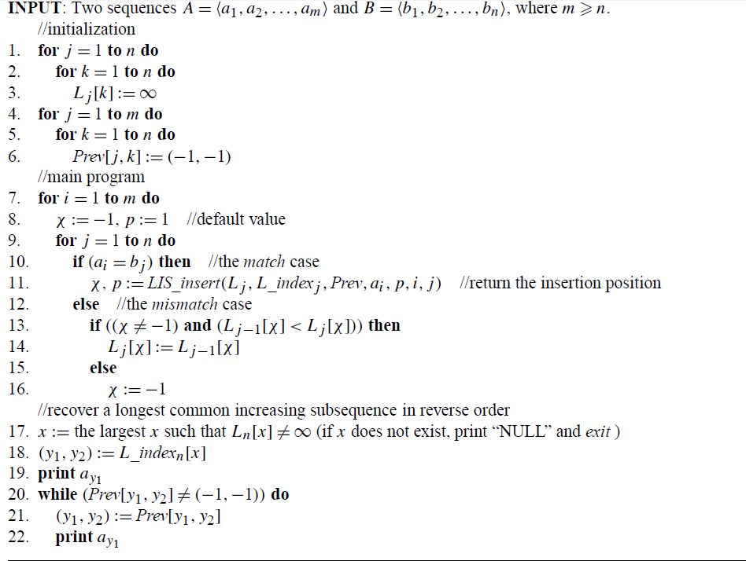
Algorithm(13/13)

Slide 20
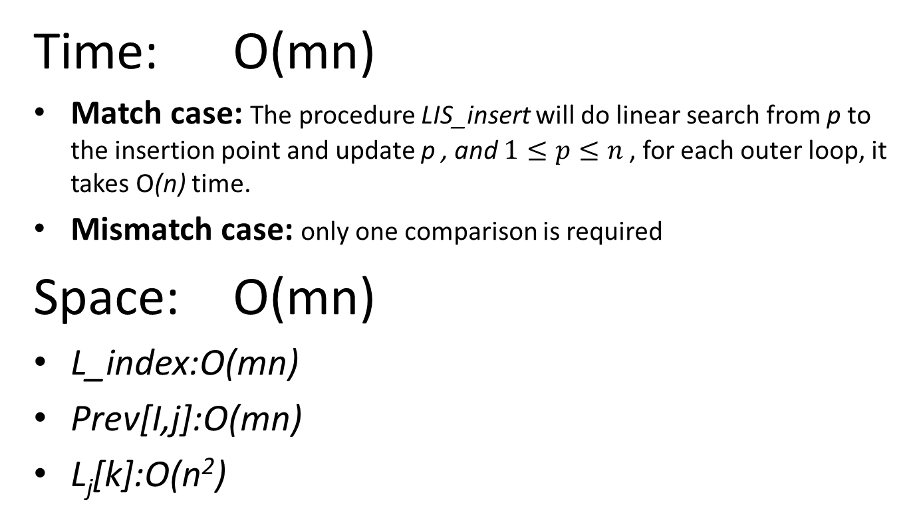
Time and space complexity
Time: O(mn)
Match case: The procedure LIS_insert will do linear search from p to the insertion point and update p , and $1≤p≤n$, for each outer loop, it takes O(n) time.
Mismatch case: only one comparison is required
Space: O(mn)
L_index:O(mn)
Prev[I,j]:O(mn)
L_{j}[k]:O(n²)

Slide 21
thank for your listening

