Slide 1
Performing Feature Selection
With Multilayer Perceptrons
Enrique Romero and Josep María Sopena
IEEE Transaction on Neural Networks,
Vol. 19, No. 3, March 2008

Slide 2
Abstract
An experimental study on two decision issues for wrapper feature selection (FS) with multilayer perceptrons and the sequential backward selection (SBS) procedure is presented. The decision issues studied are the stopping criterion and the network retraining before computing the saliency.

Slide 3
Abstract
Experimental results indicate that the increase in the computational cost associated with retraining the network with every feature temporarily removed before computing the saliency[顯著;突出;跳躍;要點](the saliency is the measure of importance of a feature) is rewarded with a significant performance improvement.

Slide 4
Abstract
Despite being quite intuitive, this idea has been hardly used in practice. A somehow nonintuitive conclusion can be drawn by looking at the stopping criterion, suggesting that forcing overtraining may be as useful as early stopping. A significant improvement in the overall results with respect to learning with the whole set of variables is observed.

Slide 5
Approach to Classification
Feature
  Feature extraction
  Feature selection
Classification algorithm
  Decision tree, Neural network, Support vector machine
  Ensemble classifiers

Slide 6
Feature selection & selection
The dimensionality reduction techniques can be classified in two categories: feature selection and feature extraction.
Feature selection: only a subset from the original feature vector is preserved.
Feature extraction: the original features are combined or transformed into the new extracted features.(or new ones are created)
Advantages for dimensionality reduction:
  Reducing the storage requirements and the computational cost
  Improving generalization results
  Being helpful for interpretation

Slide 7
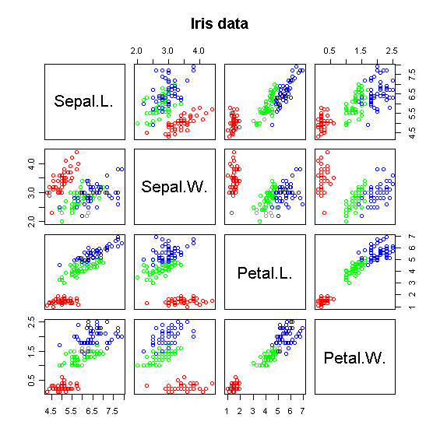
Iris (鳶尾屬植物) data
四個特徵中，Petal.L及Petal.W可大致把三類植物分開，因此最具有鑑別力。如果再觀察Petal.L及Petal.W所對應特徵分佈，可以發現此二特徵資料分佈約呈45度，這表示此二特徵值呈正相關(即Petal.L可以一正的常數乘上Petal.W而獲得)，且具資訊冗餘。
Notes:
LD1 LD2
Sepal.L. -0.8293776 0.02410215
Sepal.W. -1.5344731 2.16452123
Petal.L. 2.2012117 -0.93192121
Petal.W. 2.8104603 2.83918785

Slide 8
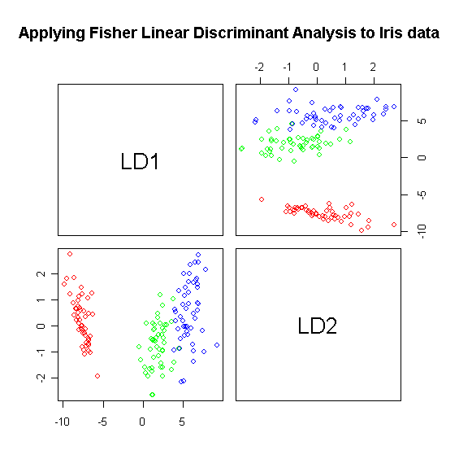
Iris (鳶尾屬植物) data
LDA (FLD)feature extraction:
  LD1為擷取出相當有鑑別力的特徵
其他像是PCA、QDA
Notes:
LD1 LD2
Sepal.L. -0.8293776 0.02410215
Sepal.W. -1.5344731 2.16452123
Petal.L. 2.2012117 -0.93192121
Petal.W. 2.8104603 2.83918785

Slide 9
Using Classifiers to Extract Features
Data
Classifier1
在一般的情況下，Classifier2會比Classifier1對Validation資料有更好的預測能力。
1.訓練
2.分類
Prediction
Classifier2
Prediction
4.訓練
3.疊加
Data
Newly extracted features

Slide 10
Using Classifiers to Extract Features
在一般的情況下，Classifier2會比Classifier1對Validation資料有更好的預測能力(見以下範例)
以104特徵先進行參數調整，一半資料當訓練，一半資料當驗證分四類(C1, C2, C3, C4)，SVM正確率82.5%(for驗證)
之後把剛得到之SVM分別預測訓練與驗證資料，各獲得6組decision values(C1/C2, C1/C3, C1/C4, C2/C3, C2/C4, C3/C4)，把decision values當成新特徵，這時已經有110特徵，再重複訓練過程，正確率可達84% ► 84.3%(116特徵) ► 84.6%(122特徵) ► 84.6%(128特徵)，之後不再提高

Slide 11
Feature selection, Why
An MLP with irrelevant variables is more flexible than the same model without them, leading to better approximations in the training set. However, an MLP that uses irrelevant variables will have poor generalization.

Slide 12
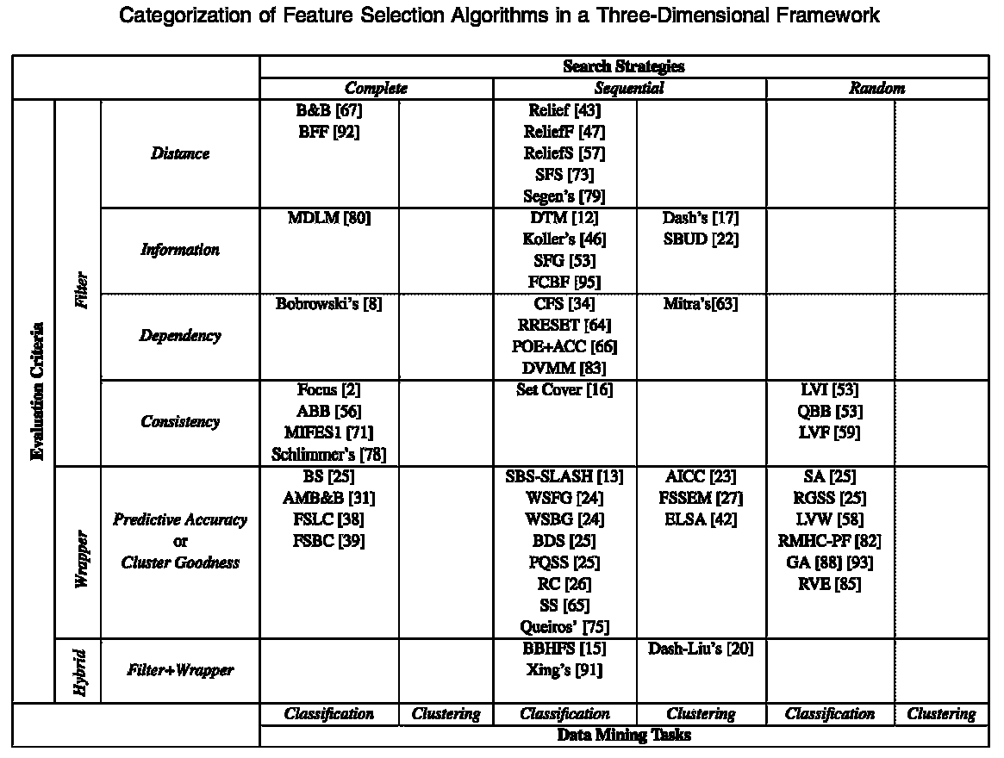
IEEE TRANSACTIONS ON KNOWLEDGE AND DATA ENGINEERING, VOL. 17, NO. 4, APRIL 2005

Slide 13
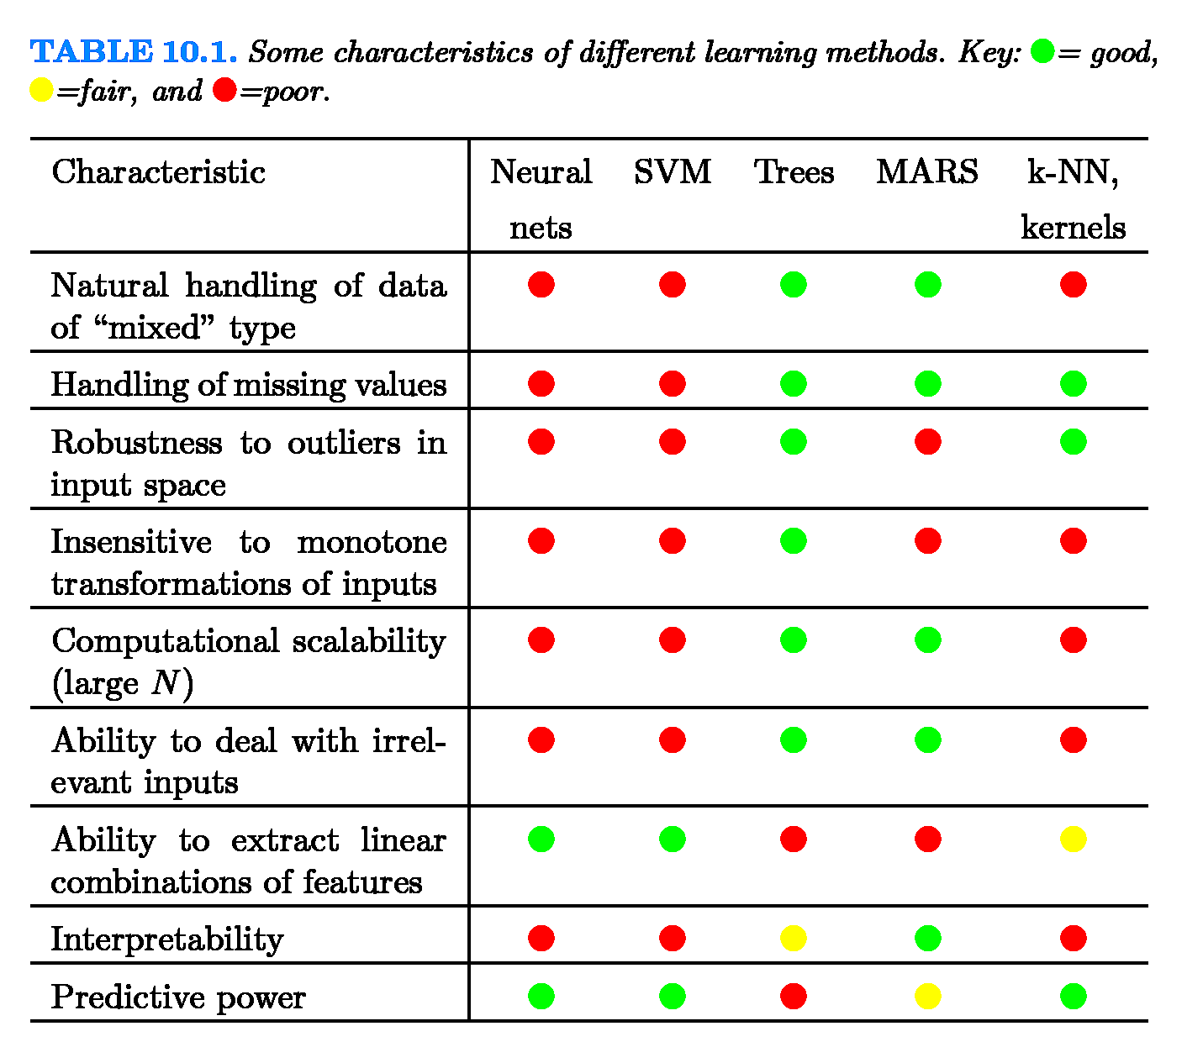
Learning Methods
Jerome Friedman,Trevor Hastie, and Robert Tibshirani , “The Elements of Statistical Learning”, 2001

Slide 14
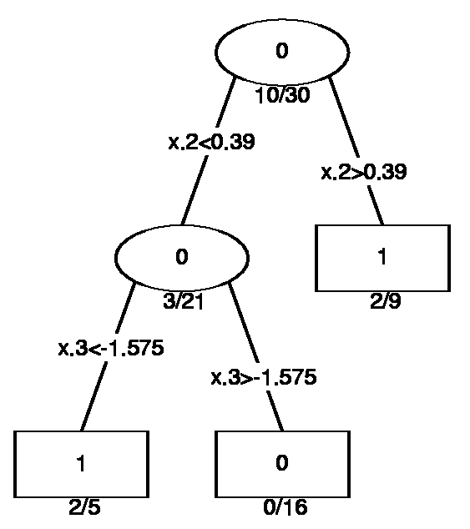
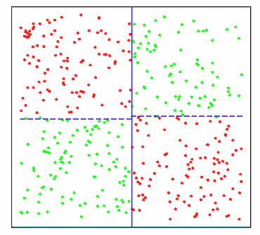
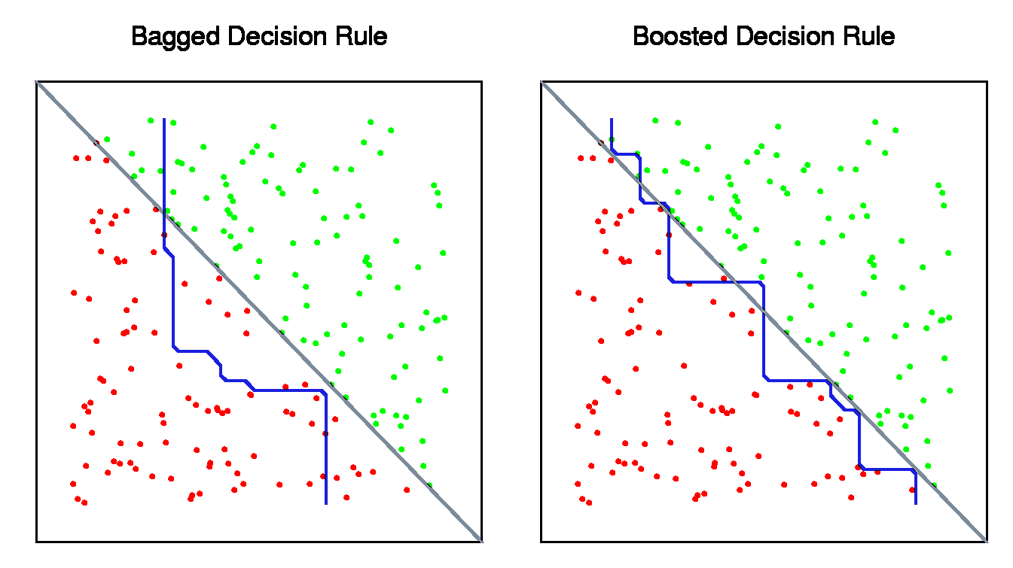
Decision Tree: XOR problem
But
What DT fails to handle.
There should be variable like x1x2 to break the tie.

Slide 15
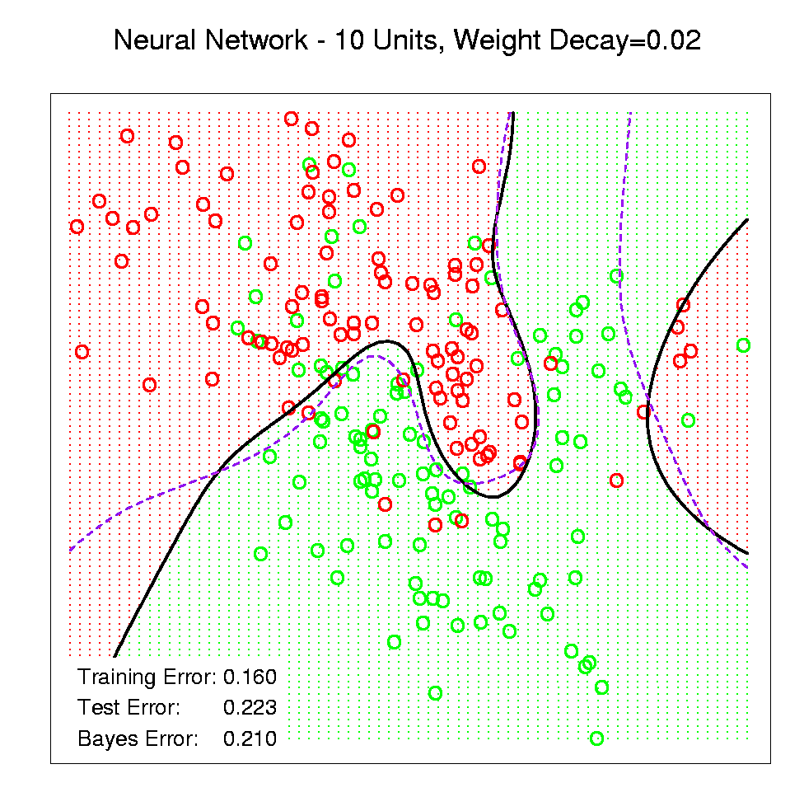
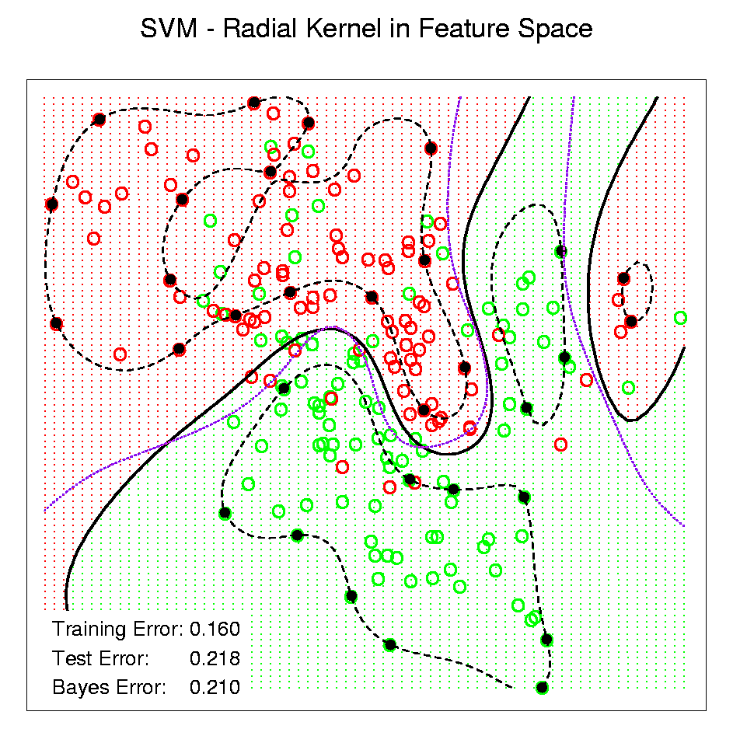
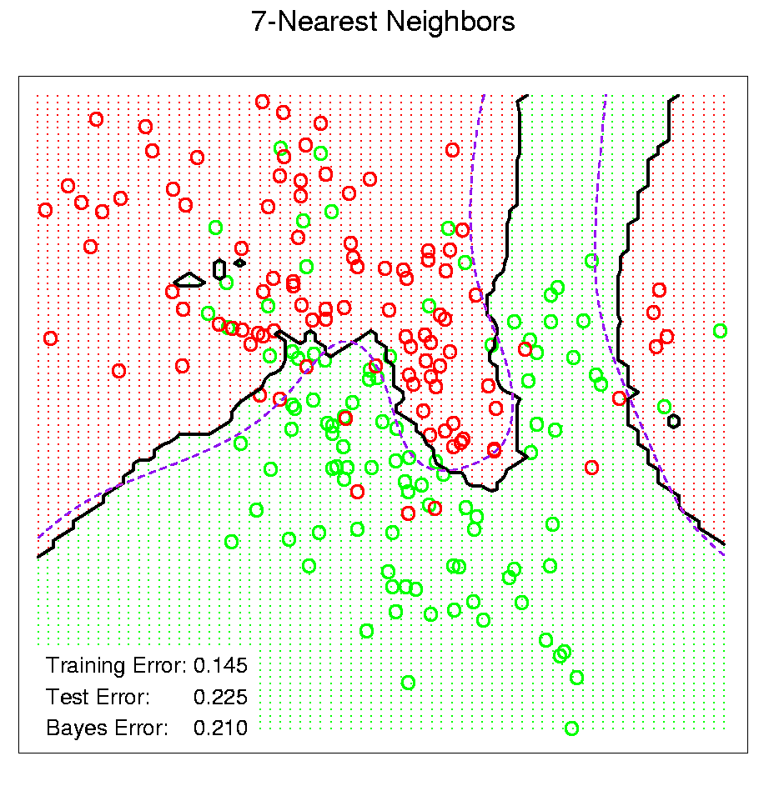
Other Kinds of Classifiers

Slide 16
SVM
A SVM model (from LibSVM):
svm_type c_svc
kernel_type rbf
gamma 0.25
nr_class 3
total_sv 58
rho -0.0620413 0.0160067 0.105572
label 1 2 3
nr_sv 7 28 23
SV
0 0.66 1:-0.22 2:1.00 3:-0.83 4:-0.75
1 0.76 1:-0.56 2:0.08 3:-0.76 4:-0.67
1 0 1:-0.61 2:-0.17 3:-0.80 4:-0.92
0.03 0 1:-0.39 2:0.17 3:-0.83 4:-0.75
…
Support vectors:基本上是把需要的點(不一定全部)記下來

Slide 17
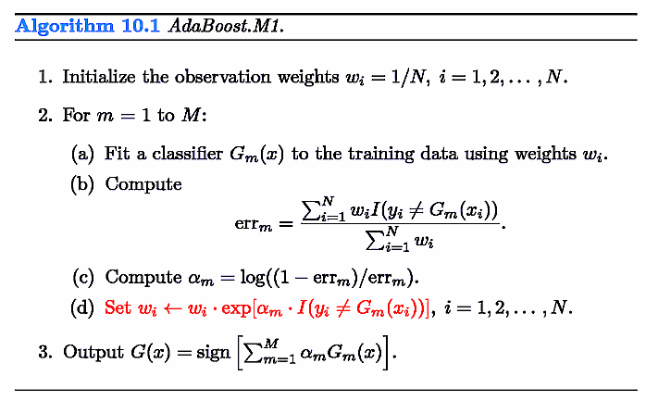
Adaboost
觀察某一訓練資料在adaboost訓練時出現狀況
第一輪0個，第一輪錯
第二輪2個，第二輪錯
第三輪6個，第三輪錯
第四輪11個，第四輪對
第五輪4個，第五輪錯
第六輪6個，第六輪錯
第七輪10個，第七輪對
第八輪8個，第八輪對
第九輪3個，第九輪錯

Slide 18
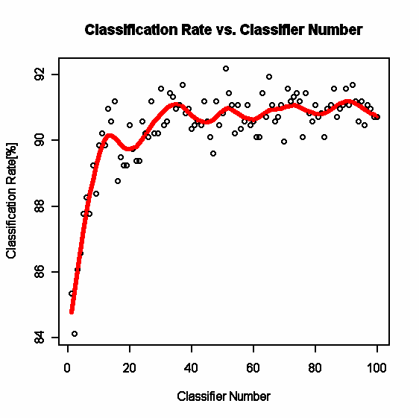
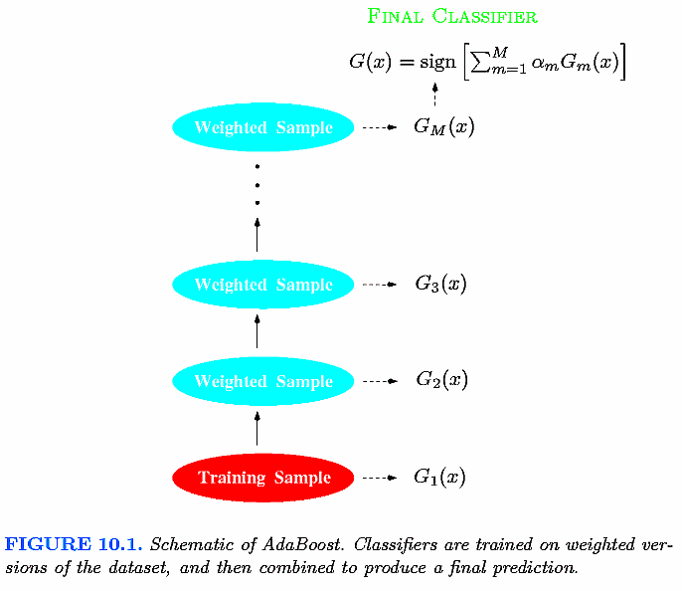
Adaboost

Slide 19
Feature Selection
Filter feature selection
  Evaluating the goodness of the feature subset by using the intrinsic characteristic of the data
  Being relatively computationally cheap since they do not involve the induction (learning) algorithm
  Taking the risk of selecting subsets of features that may not match the chosen induction algorithm

Slide 20
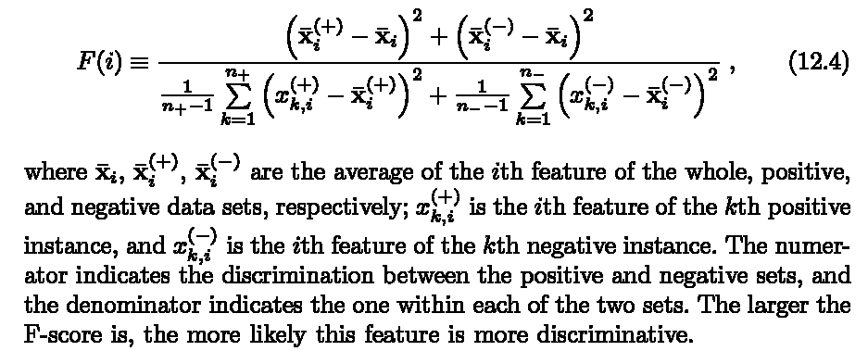
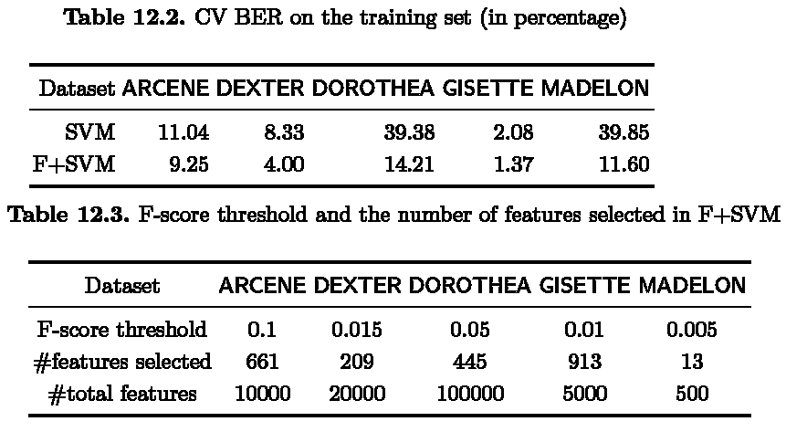
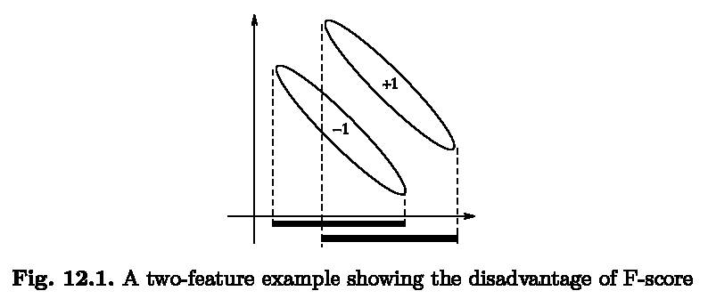
Filter Feature Selection Example
Yi-Wei Chen and Chih-Jen Lin, “Combining SVMs with Various Feature Selection Strategies”, 2006

Slide 21
Feature Selection
Wrapper feature selection
  Using directly the induction algorithm to evaluate the feature subsets
  Wrapping around predictors providing them feature subset & receiving feedback
  Generally outperforming filter methods in terms of prediction accuracy
  Being generally computationally more intensive

Slide 22
Sequential Backward Selection (SBS)
Helping to detect irrelevant variables in the first steps, trying to maintain the interactions among the variables
Starting from the complete set of available features, one feature is deleted at every step of the algorithm until a subset of features remains for which the elimination of further variables results in performance degradation

Slide 23
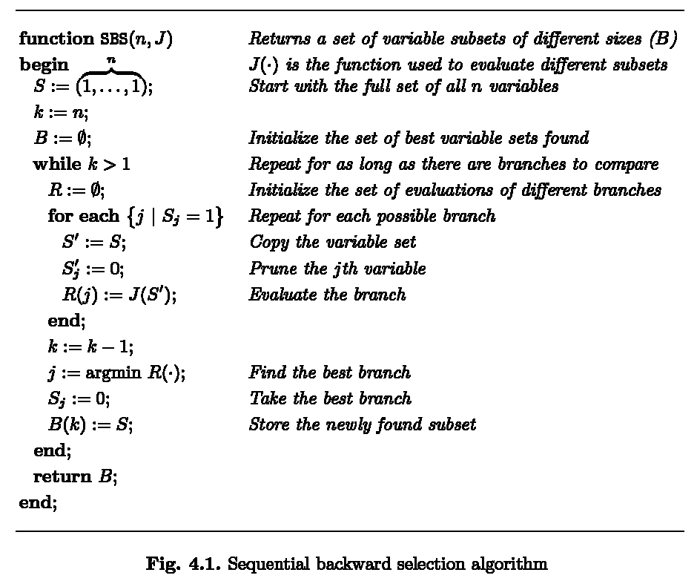
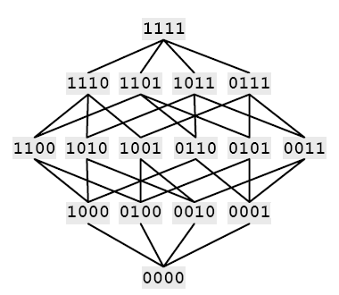
SBS Algorithm

Slide 24
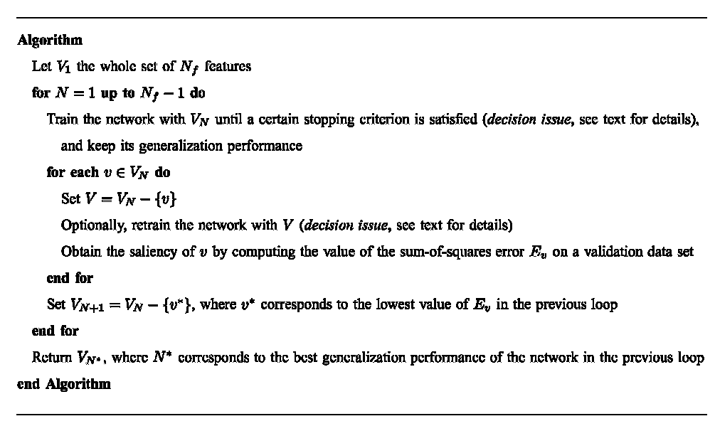
SBS Algorithm of This Paper

Slide 25
Training Issues
There is no reason to think that the relative saliencies of every feature remain unchanged with respect to those obtained in the original network without retraining it.
A more reliable estimation of the saliency should be obtained by retraining the network with every feature temporarily removed.
The good results obtained (in general) by models that retrain the network before computing the saliency seem to validate this intuition.

Slide 26
Two Stopping Criteria
To train until a minimum of the SSE for the training set is achieved
To stop where a minimum for a validation set is obtained
Two Training Schemes
Calculating saliency with/without retraining the networks
There are totally 4 configurations.

Slide 27
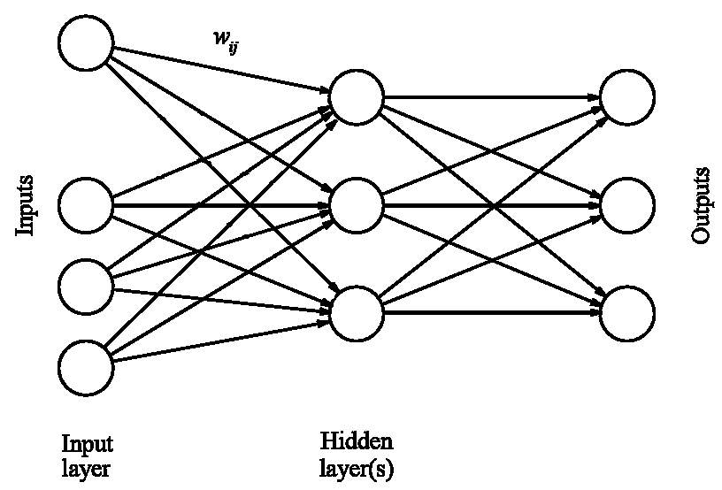
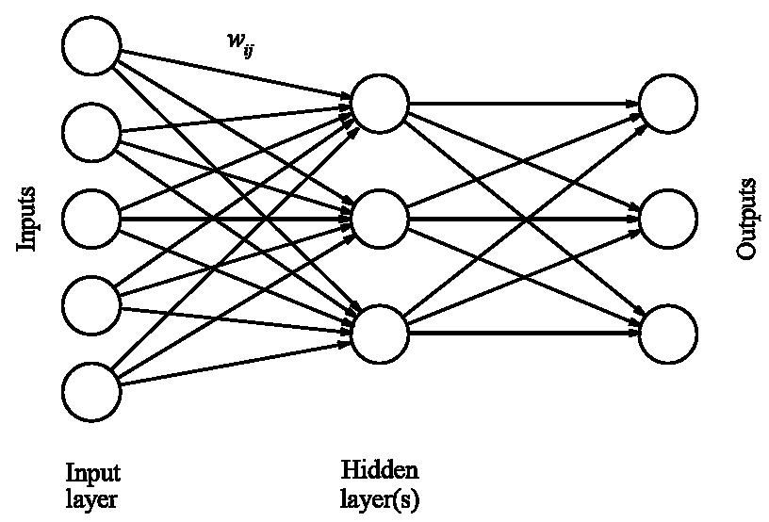
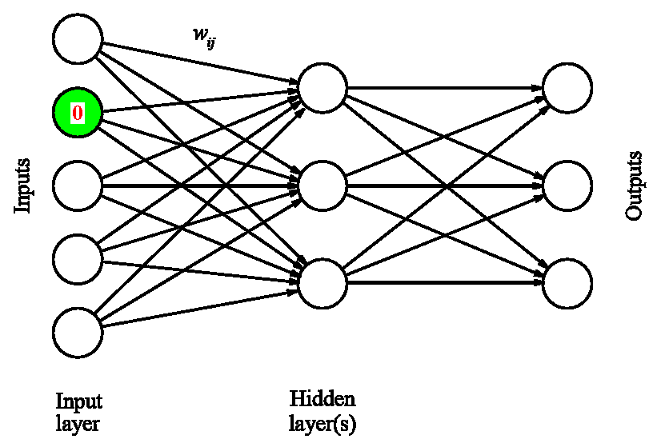
Two Training Schemes
Calculating saliency with/without retraining the networks

Slide 28
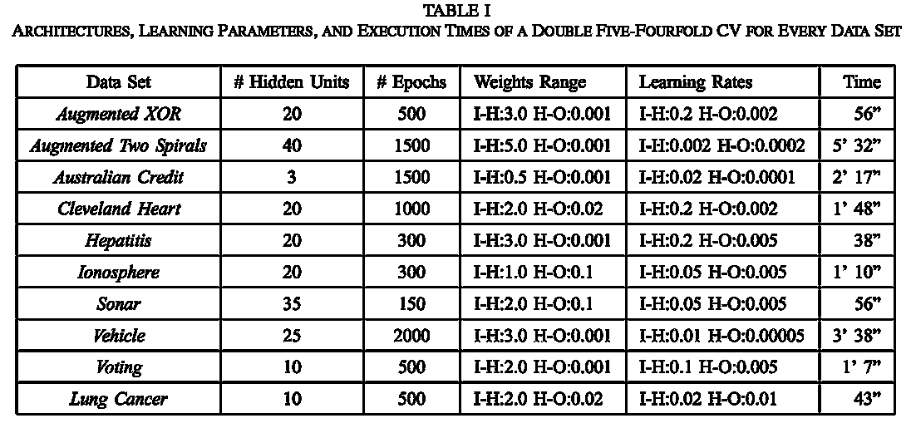
Experiment Settings

Slide 29
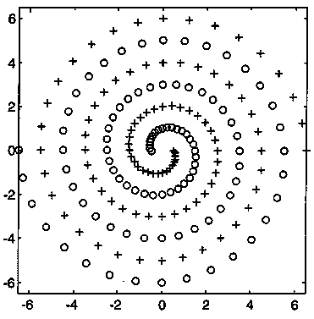
Artificial Data Experiments

Slide 30
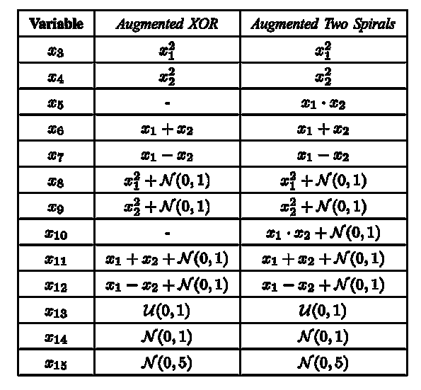
Artificial Data Experiments
理論上，x1~x7為無雜訊資料，應該會最重要 ，x8~x12次之，x13~x15根本不應該被挑選
Irrevalent features，用來干擾學習

Slide 31
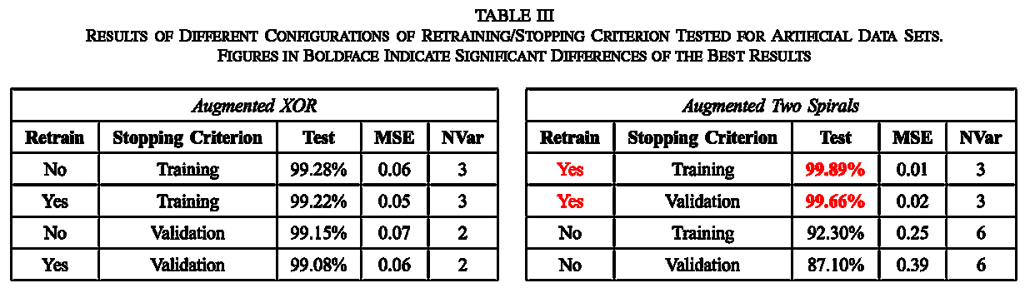
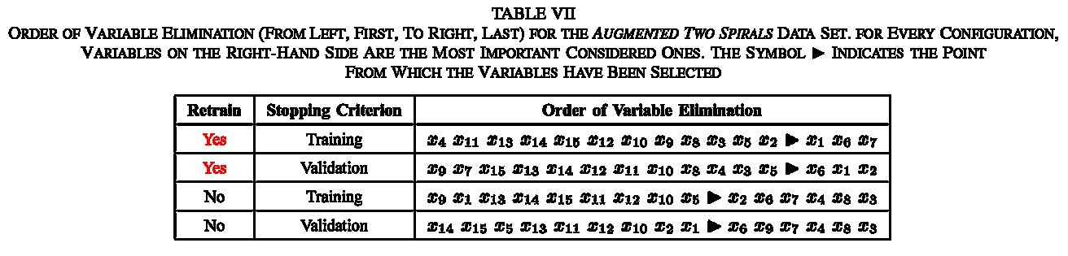
Artificial Data Experiments
由以上結果顯示，以SBS+retrain演算法篩特徵時，不但有正確率提升效果，且不因stopping criteria(validation or training)不同而導致選出的特徵有變異

Slide 32
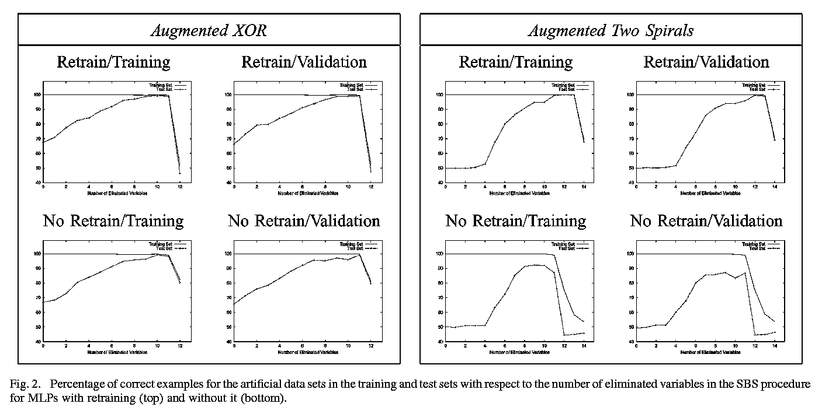
Artificial Data Experiments
由以上結果顯示，以SBS+retrain演算法篩特徵時，有正確率提升效果

Slide 33
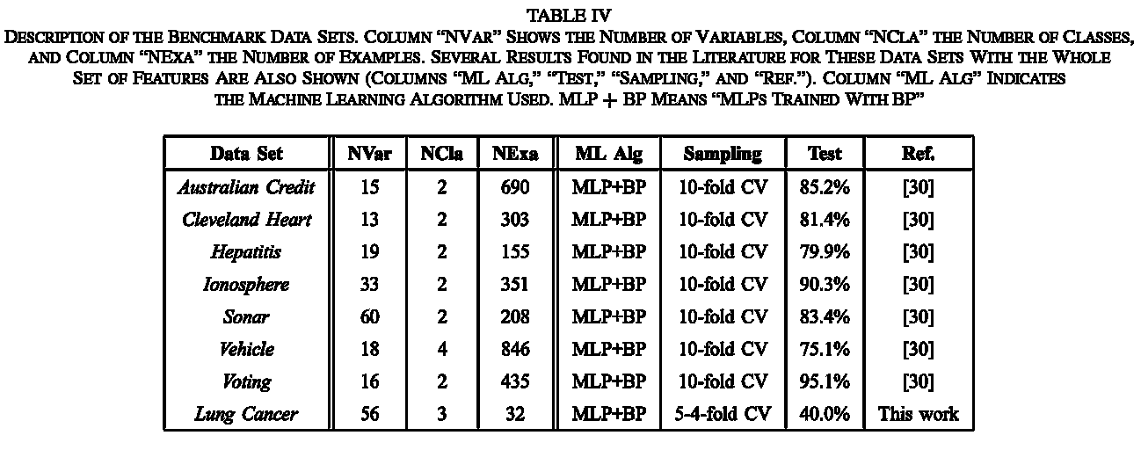
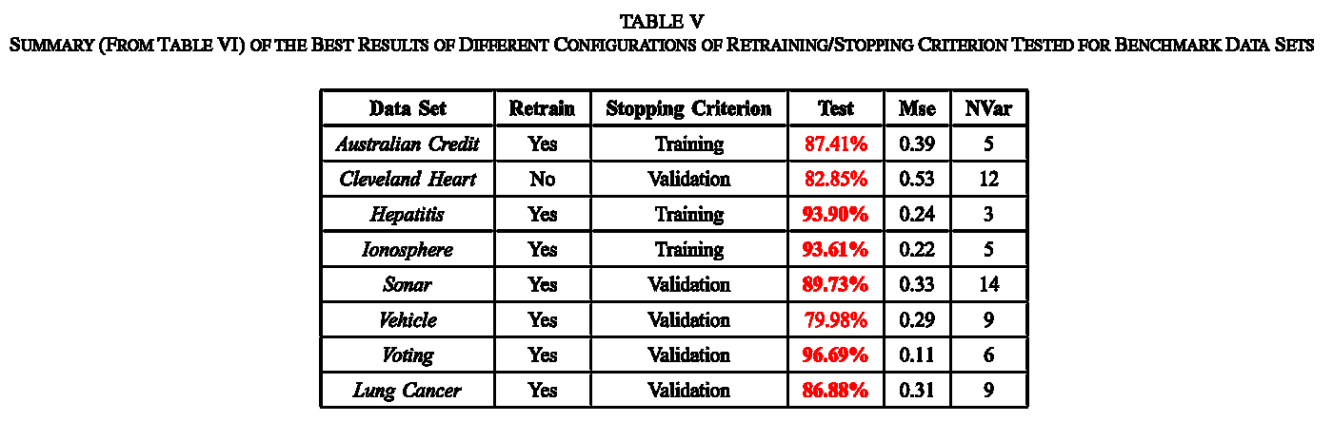
Benchmark Data Experiments

