Slide 1
Biometric Personal Identification Based on Handwriting
Yong Zhu, Tieniu Tan and Yunhong Wang
Proceedings of
15th International Conference on
Pattern Recognition
Barcelona, Spain
September 3 -7, 2000
Presenter : Bo-Xian Chen
Date : 2016/11/29

Slide 2
Abstract(1/2)
In this paper, we describe a new method to identify the
writer of Chinese handwriting documents. There are
many methods for signature verification or writer
identification, but most of them require segmentation or
connected component analysis. They are the kinds of
content dependent identification methods as signature
verification requires the writer to write the same text (e.g.
his name). In our new method, we take the handwriting as
an image containing some special texture, and writer
identification is regarded as texture identification.

Slide 3
Abstract(2/2)
This is a content independent method. We apply the
well established 2-D Gabor filtering technique to extract
features of such textures and a Weighted Euclidean
Distance classifier to fulfill the identification task.
Experiments are made using Chinese handwritings from
17 different people and very promising results were
achieved.

Slide 4
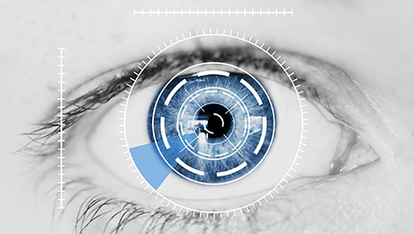
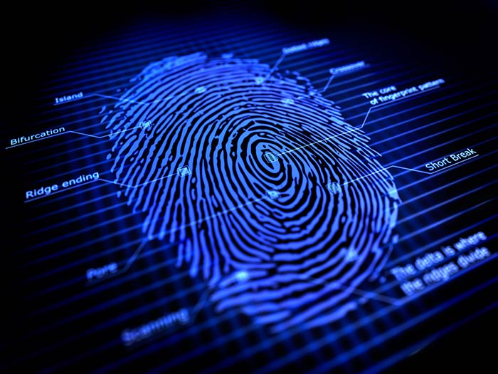
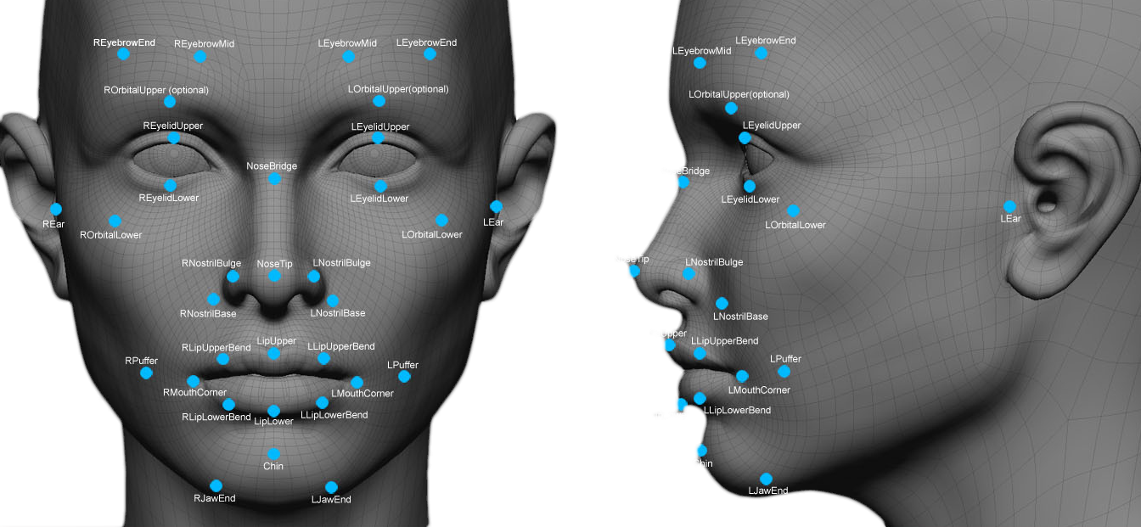
Biometric personal identification
Physiological

Slide 5
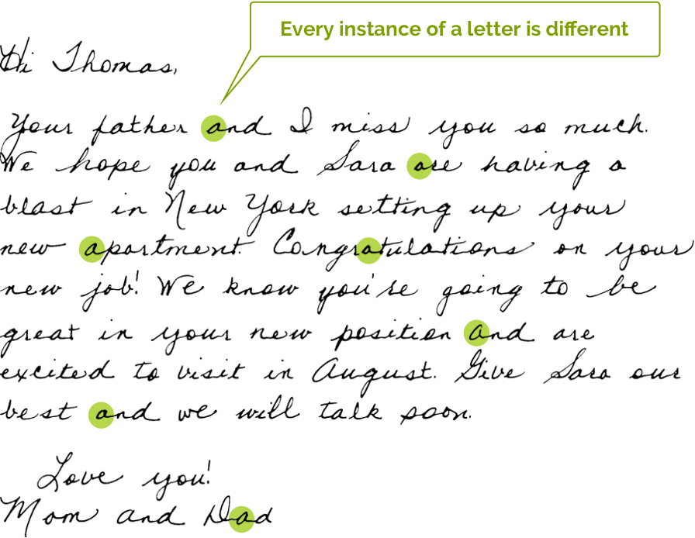

Biometric personal identification
Behavioral

Slide 6
HBPI system
automatic handwriting based personal identification (HBPI)
writing speed
direction
duration
height
width
slant angle
black pixel
…etc

Slide 7
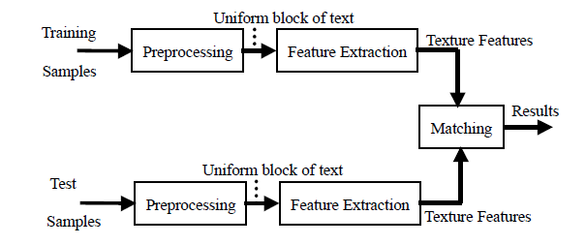
The flow chart of the HBPI system

Slide 8
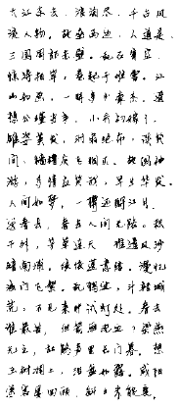
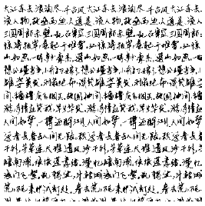
The preprocessing of the HBPI system
create a uniform block of text
Notes:
大江東去，浪淘盡，千古風流人物。 故壘西邊，人道是，三國周郎赤壁。 亂石崩雲，驚濤裂岸，捲起千堆雪。 江山如畫，一時多少豪傑。
遙想公瑾當年，小喬出嫁了，雄姿英發。 羽扇綸巾，談笑間，強虜飛灰湮滅。 故國神遊，多情應笑我，早生華髮。 人間如夢，一尊還酹江月。

Slide 9
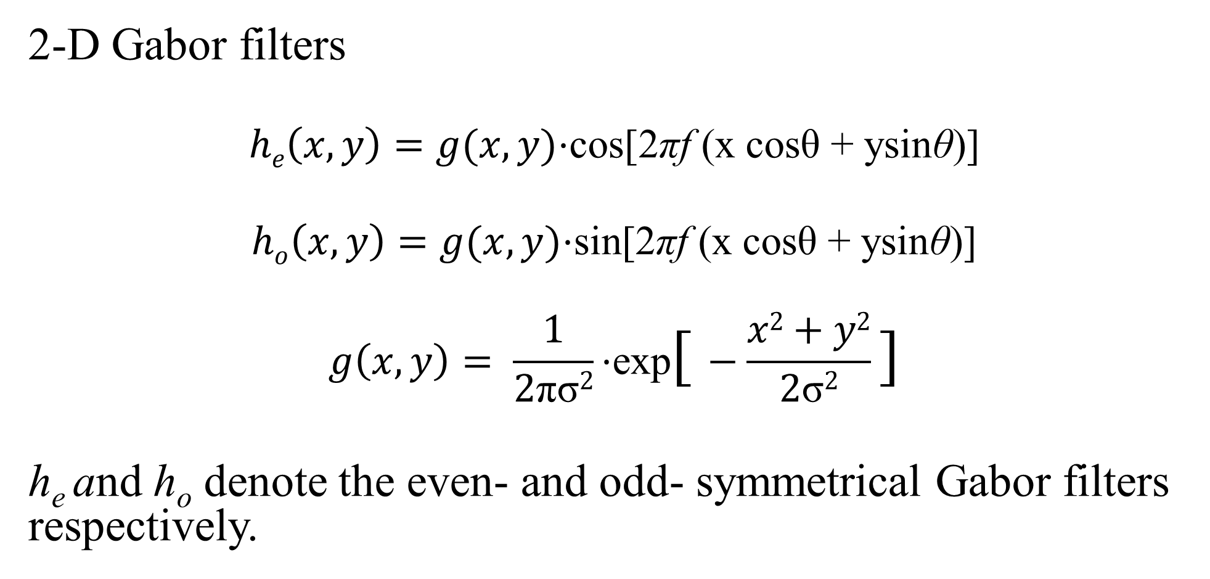
Feature extraction
2-D Gabor filters
$$he\left(x,y\right)=g(x, y)\text{⋅}\text{cos}\text{[2}\text{π}\text{f} \text{(}\text{x} \text{cos}\text{θ}\text{ + }\text{ysin}\text{θ}\text{)]}$$
$$ho\left(x,y\right)=g(x, y)\text{⋅}\text{sin}\text{[2}\text{π}\text{f} \text{(}\text{x} \text{cos}\text{θ}\text{ + }\text{ysin}\text{θ}\text{)]}$$
$$g\left(x, y\right)= \frac{1}{2\text{πσ}2}\text{⋅}\text{exp}\text{[}−\frac{x2+y2}{2\text{σ}2}\text{]}$$
h_{e} and h_{o} denote the even- and odd- symmetrical Gabor filters respectively.

Slide 10
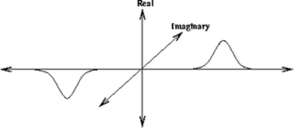
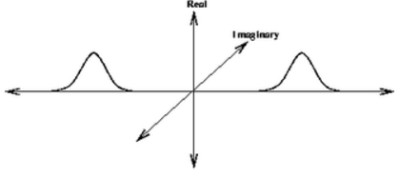
Feature extraction
odd-symmetrical Gabor filters even-symmetrical Gabor filters

Slide 11
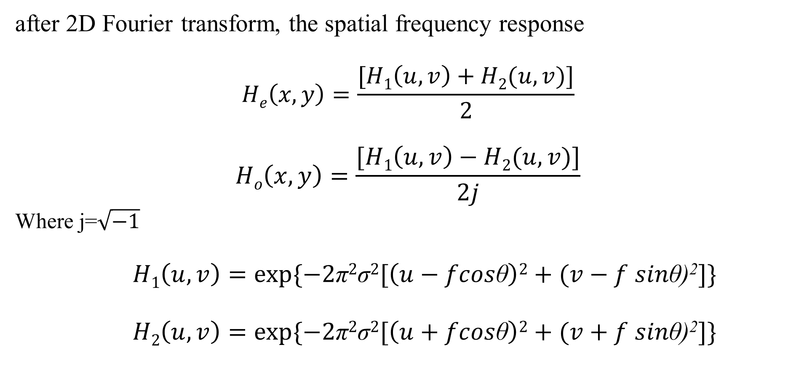
Feature extraction
after 2D Fourier transform, the spatial frequency response
$$He\left(x,y\right)=\frac{[H1\left(u,v\right)+H2(u,v)]}{2}$$
$$Ho\left(x,y\right)=\frac{[H1\left(u,v\right)−H2(u,v)]}{2j}$$
Where j=$\sqrt{−1}$
$$H1\left(u,v\right)=exp⁡\{−2\text{π}2\text{σ}2[\left(u−fcos\text{θ}\right)2+(v−f sin\text{θ}\text{)}\text{2}]\}$$
$$H2\left(u,v\right)=exp⁡\{−2\text{π}2\text{σ}2[\left(u+fcos\text{θ}\right)2+(v+f sin\text{θ}\text{)}\text{2}]\}$$

Slide 12
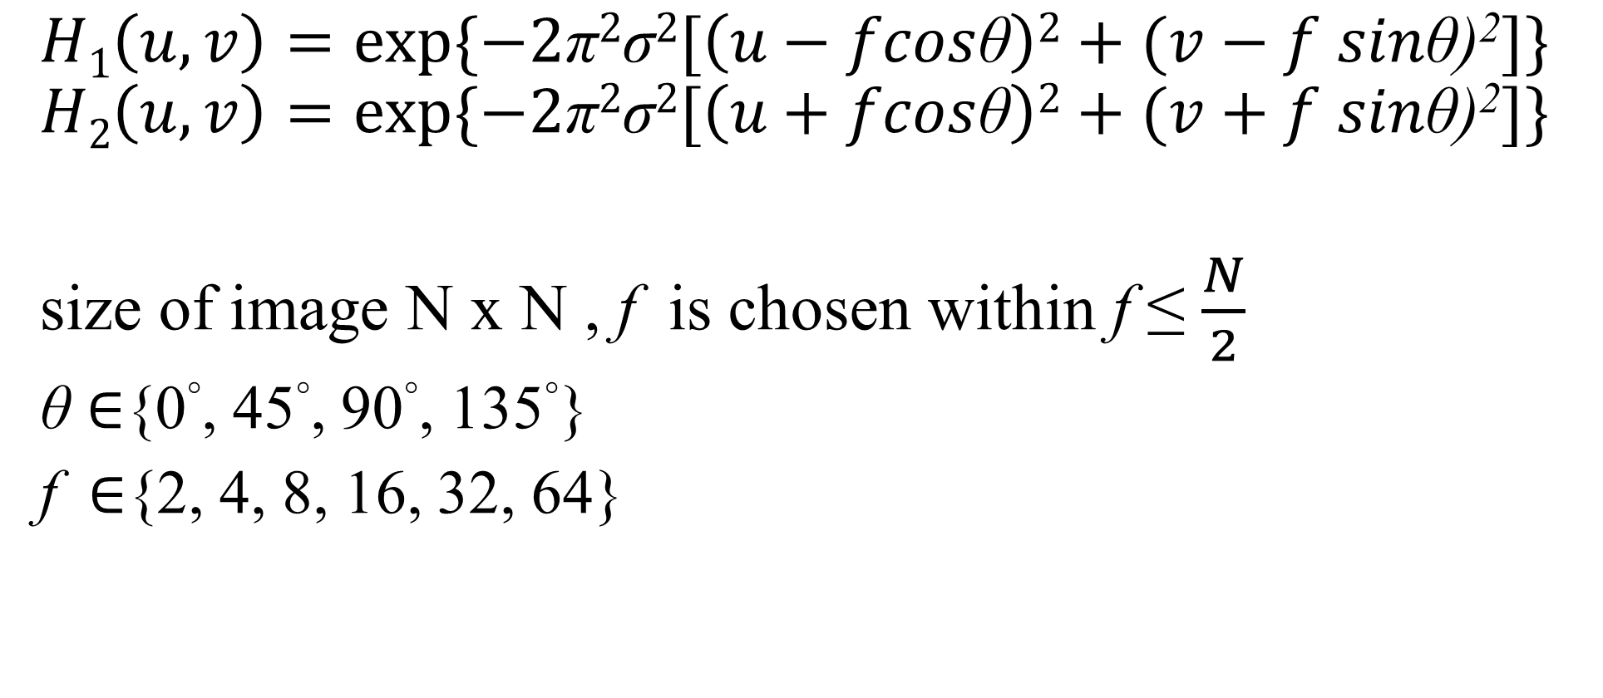
Feature extraction
$$H1\left(u,v\right)=exp⁡\{−2\text{π}2\text{σ}2[\left(u−fcos\text{θ}\right)2+(v−f sin\text{θ}\text{)}\text{2}]\}$$
$$H2\left(u,v\right)=exp⁡\{−2\text{π}2\text{σ}2[\left(u+fcos\text{θ}\right)2+(v+f sin\text{θ}\text{)}\text{2}]\}$$
size of image N x N , f is chosen within f ≤ $\frac{N}{2}$
$\text{θ}$ ∈{0°, 45°, 90°, 135°}
f ∈{2, 4, 8, 16, 32, 64}
24 Gabor channels

Slide 13
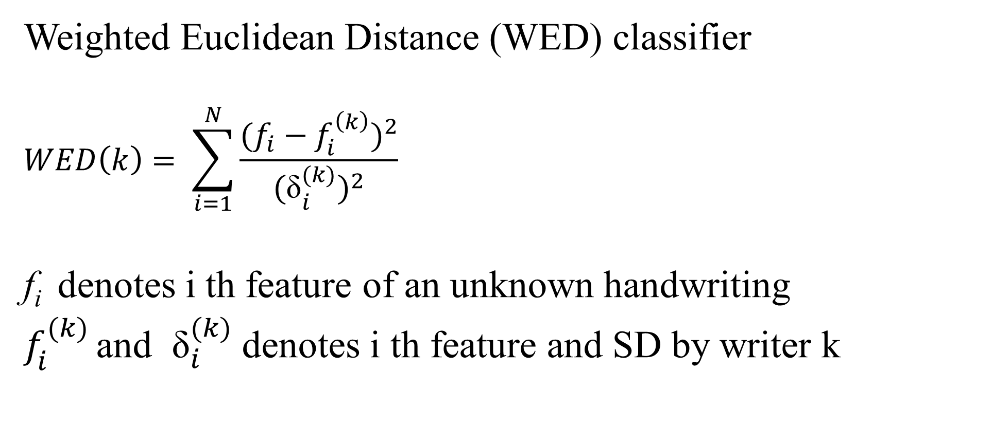
Classifier
Weighted Euclidean Distance (WED) classifier
$$WED\left(k\right)= \sum_{i=1}^{N}{\frac{{(f_{i}−f_{i}^{\left(k\right)})}^{2}}{{{(\text{δ}}_{i}^{(k)})}^{2}}}$$
f_{i} denotes i th feature of an unknown handwriting
$f_{i}^{(k)}$ and ${ \text{δ}}_{i}^{(k)}$ denotes i th feature and SD by writer k

Slide 14
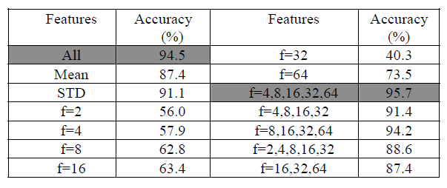
Result

Slide 15
Conclusions
The content of training handwriting samples is not required to be the same as testing samples.
Because of preprocessing, the new method can function well even if the input image contains a small amount of text.

Slide 19

Feature extraction
multi-channel Gabor filtering
$$He\left(u, v\right)=\frac{[H1\left(u, v\right)+H2\left(u, v\right)]}{2}$$
$$Ho\left(u, v\right)=\frac{[H1\left(u, v\right)−H2\left(u, v\right)]}{2j}, where j=\sqrt{−1}$$

