Slide 1
A Fast Algorithm for Computing Longest Common Subsequences
James W. Hunt, Thomas G. Szymanski
Communications of the ACM
Pages 350-353
May 1977
Presenter : Shie-Yan Lee
Date : 2016/11/29

Slide 2
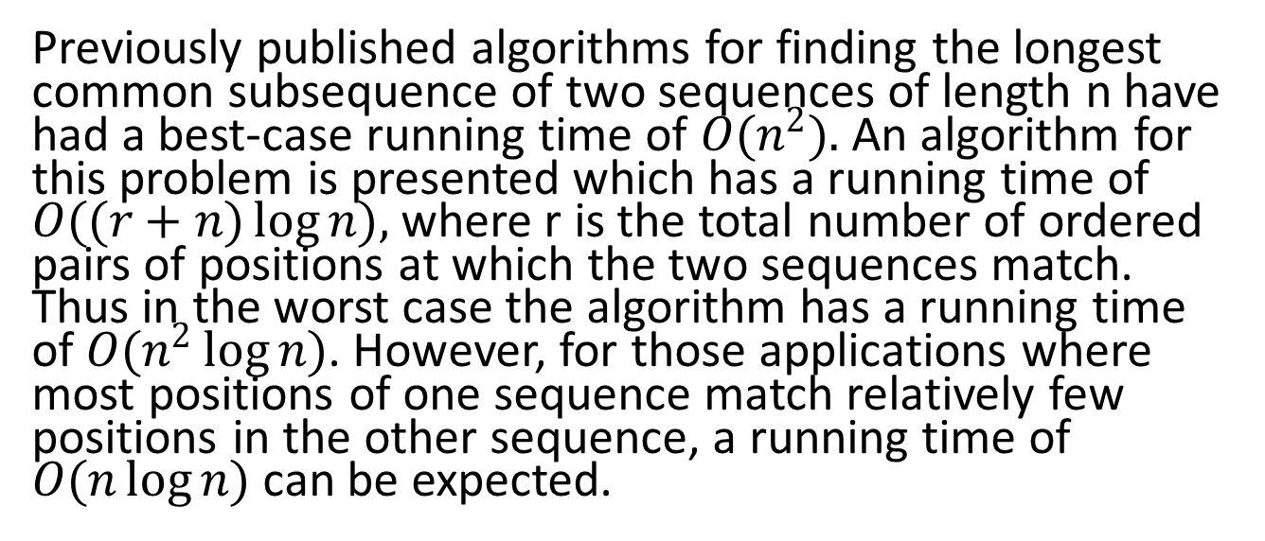
Abstract
Previously published algorithms for finding the longest common subsequence of two sequences of length n have had a best-case running time of $O(n^{2}).$An algorithm for this problem is presented which has a running time of $O((r+n)\log{n}),$where r is the total number of ordered pairs of positions at which the two sequences match. Thus in the worst case the algorithm has a running time of $O(n^{2}\log{n})$. However, for those applications where most positions of one sequence match relatively few positions in the other sequence, a running time of $O(n\log{n})$can be expected.

Slide 3
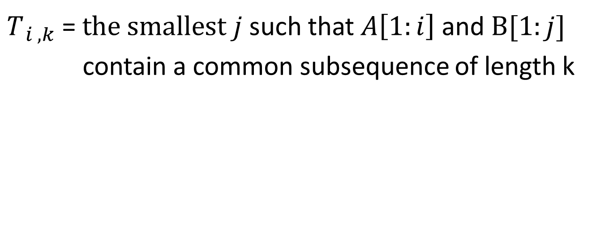
Threshhold Value
$T_{ i , k}$ = $the smallest j$ such that $A\left[1:i\right]$ and $B[1:j]$
contain a common subsequence of length k
String A : a b c b d d a
String B : b a d b a b d

Slide 4

Threshhold Value
$T_{ i , k}$ = $the smallest j$ such that $A\left[1:i\right]$ and $B[1:j]$
contain a common subsequence of length k
String A : a b c b d d a
String B : b a d b a b d
$$T_{ 5 , 1}=1$$

Slide 5

Threshhold Value
$T_{ i , k}$ = $the smallest j$ such that $A\left[1:i\right]$ and $B[1:j]$
contain a common subsequence of length k
String A : a b c b d d a
String B : b a d b a b d
$$T_{ 5 , 2}=3$$

Slide 6

Threshhold Value
$T_{ i , k}$ = $the smallest j$ such that $A\left[1:i\right]$ and $B[1:j]$
contain a common subsequence of length k
String A : a b c b d d a
String B : b a d b a b d
$$T_{ 5 , 4}=7$$

Slide 7
Algorithm 1
String A : a b c b d d a
String B : b a d b a b d
$T_{ i , k}$ = $the smallest j$ such that $A\left[1:i\right]$ and $B[1:j]$
contain a common subsequence of length k

Slide 8
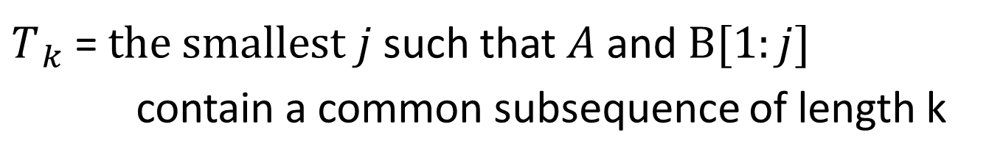
Algorithm 1
String A : a b c b d d a
String B : b a d b a b d
$T_{ k}$ = $the smallest j$ such that $A$ and $B[1:j]$
contain a common subsequence of length k

Slide 9
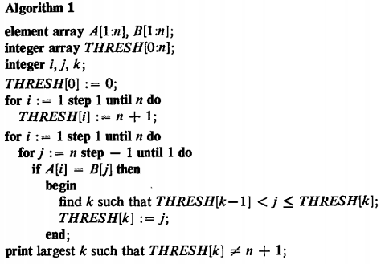
Algorithm 1
String A : a b c b d d a
String B : b a d b a b d
i | 0 | 1 | 2 | 3 | 4 | 5 | 6 | 7
THRESH[i] | 0 | 8 | 8 | 8 | 8 | 8 | 8 | 8

Slide 10
Algorithm 1
B
A
 | b | a | d | b | a | b | d
a
b
c
b
d
d
a
i | 0 | 1 | 2 | 3 | 4 | 5 | 6 | 7
THRESH[i] | 0 | 8 | 8 | 8 | 8 | 8 | 8 | 8

Slide 11
Algorithm 1
B
A
 | b | a | d | b | a | b | d
a
b
c
b
d
d
a
i | 0 | 1 | 2 | 3 | 4 | 5 | 6 | 7
THRESH[i] | 0 | 5 | 8 | 8 | 8 | 8 | 8 | 8

Slide 12
Algorithm 1
B
A
 | b | a | d | b | a | b | d
a
b
c
b
d
d
a
i | 0 | 1 | 2 | 3 | 4 | 5 | 6 | 7
THRESH[i] | 0 | 2 | 8 | 8 | 8 | 8 | 8 | 8

Slide 13
Algorithm 1
B
A
 | b | a | d | b | a | b | d
a
b
c
b
d
d
a
i | 0 | 1 | 2 | 3 | 4 | 5 | 6 | 7
THRESH[i] | 0 | 1 | 2 | 5 | 7 | 8 | 8 | 8

Slide 14

Algorithm 1
Time complexity :
$$O(n^{2}\log{n )}$$
i | 0 | 1 | 2 | 3 | 4 | 5 | 6 | 7
THRESH[i] | 0 | 1 | 2 | 5 | 7 | 8 | 8 | 8

Slide 15
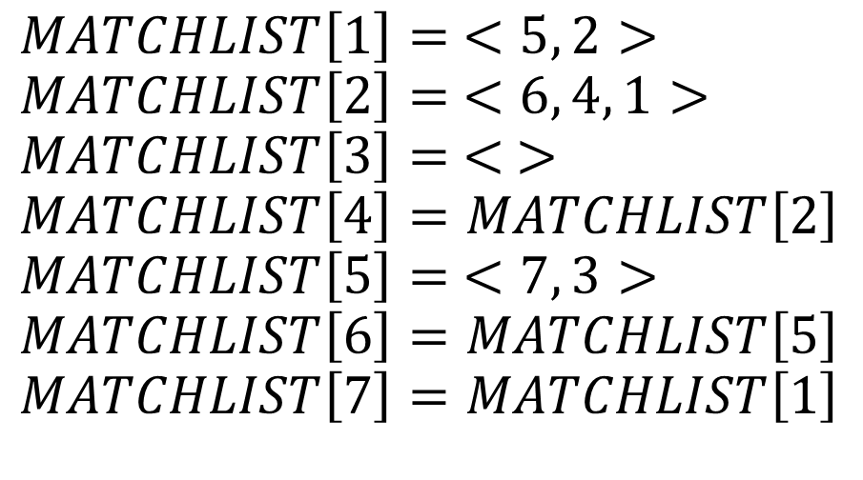

Algorithm 2
String A : a b c b d d a
String B : b a d b a b d
$$MATCHLIST$$
$$MATCHLIST\left[1\right]= <5, 2>$$
$$MATCHLIST\left[2\right]= <6, 4, 1>$$
$$MATCHLIST\left[3\right]= < >$$
$$MATCHLIST\left[4\right]=MATCHLIST\left[2\right]$$
$$MATCHLIST\left[5\right]= <7, 3>$$
$$MATCHLIST\left[6\right]=MATCHLIST\left[5\right]$$
$$MATCHLIST\left[7\right]=MATCHLIST\left[1\right]$$

Slide 16
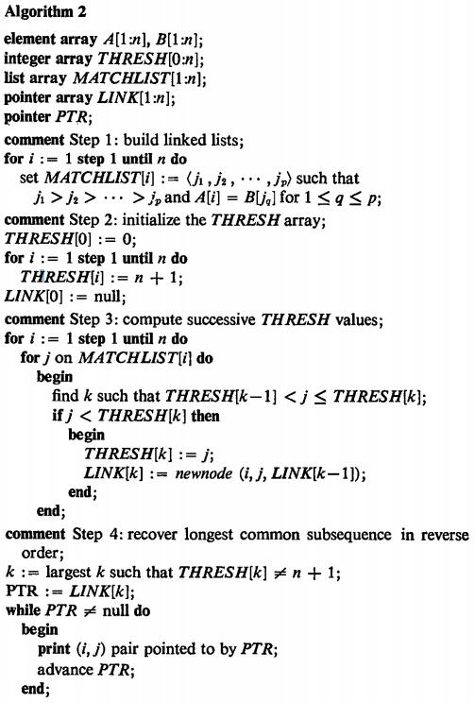
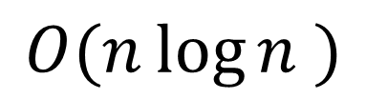
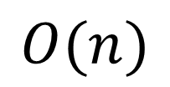
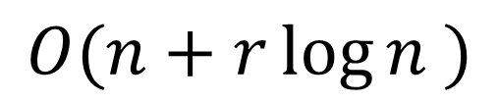
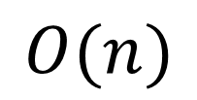
Algorithm 2
$$O(n\log{n )}$$
$$O(n)$$
$$O(n+r\log{n )}$$
$$O(n)$$

Slide 17
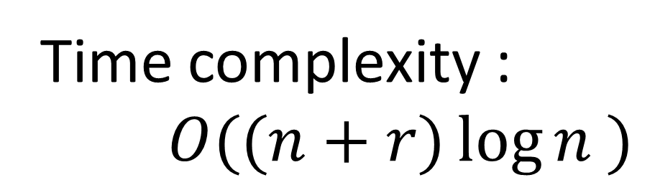
Algorithm 2
Time complexity :
$$O((n+r)\log{n )}$$

Slide 18
Algorithm 2
String A : a b c b d d a
String B : b a d b a b d
i | 0 | 1 | 2 | 3 | 4 | 5 | 6 | 7
THRESH[i] | 0 | 1 | 2 | 5 | 7 | 8 | 8 | 8
5 , 7
4 , 6
2 , 4
1 , 2
LCS
a
b
b
d

