Slide 1
Prototype selection for dissimilarity-based classifiers
Elzbieta PeRkalska,
Robert P.W. Duin,
Pavel Paclik,
Pattern Recognition 39 (2006) 189 – 208
Presenter: Shu-Kai Hung
Date:2016/12/15

Slide 2
Abstract(1/2)
A conventional way to discriminate between objects represented by dissimilarities is the nearest neighbor method. A more efficient and sometimes a more accurate solution is offered by other dissimilarity-based classifiers. They construct a decision rule based on the entire training set, but they need just a small set of prototypes, the so-called representation set, as a reference for classifying new objects. Such alternative approaches may be especially advantageous for non-Euclidean or even non-metric dissimilarities.
The choice of a proper representation set for dissimilarity-based classifiers is not yet fully investigated. It appears that a random selection may work well. In this paper, a number of experiments has been conducted on various metric and non-metric dissimilarity representations and prototype selection methods.

Slide 3
Abstract(2/2)
Several procedures, like traditional feature selection methods (here effectively searching for prototypes), mode seeking and linear programming are compared to the random selection. In general, we find out that systematic approaches lead to better results than the random selection, especially for a small number of prototypes. Although there is no single winner as it depends on data characteristics, the k-centres works well, in general. For two-class problems, an important observation is that our dissimilarity-based discrimination functions relying on significantly reduced prototype sets (3–10% of the training objects) offer a similar or much better
classification accuracy than the best k-NN rule on the entire training set. This may be reached for multi-class data as well, however such problems are more difficult.

Slide 4
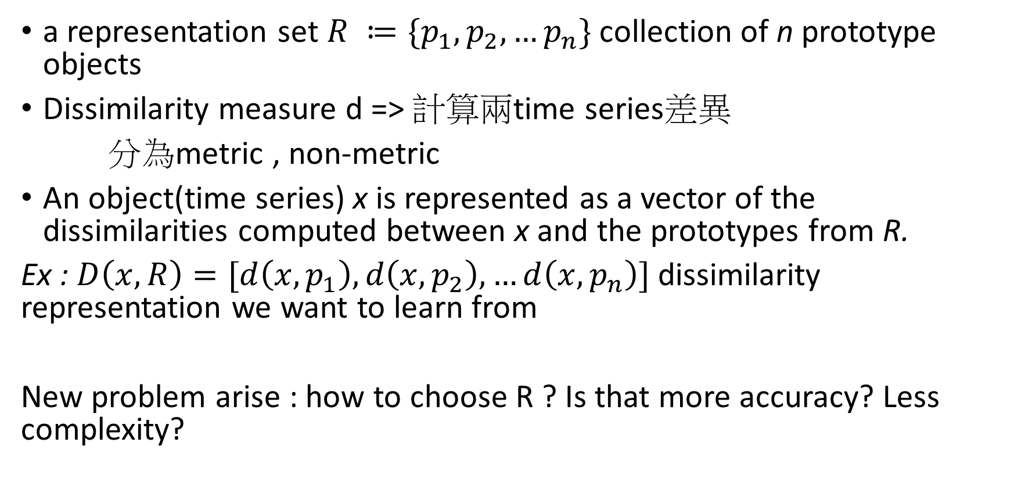
Dissimilarity-based classification
a representation set $R ≔\{p_{1},p_{2},…p_{n}\}$ collection of n prototype objects
Dissimilarity measure d => 計算兩time series差異
分為metric , non-metric
An object(time series) x is represented as a vector of the dissimilarities computed between x and the prototypes from R.
Ex : $D\left(x,R\right)=[d\left(x,p_{1}\right),d\left(x,p_{2}\right),…d\left(x,p_{n}\right)]$ dissimilarity representation we want to learn from
New problem arise : how to choose R ? Is that more accuracy? Less complexity?

Slide 5
Dissimilarity measure
Metric measure :
Euclidean distance, DTW
Non-Metric measure :
modified Hausdorff measure : 測量兩子集差距(圖形)
Mahalanobis distance : 兩群體差距

Slide 6

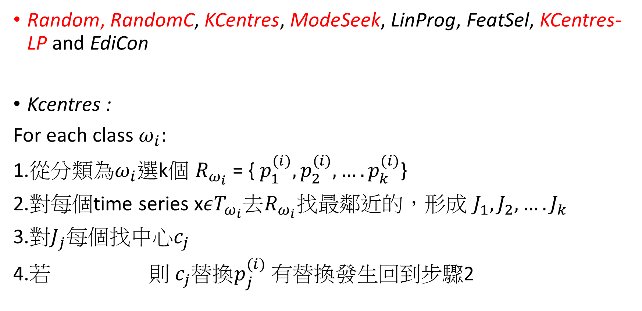
Prototype selection and the representation set
Random, RandomC, KCentres, ModeSeek, LinProg, FeatSel, KCentres-LP and EdiCon
Kcentres :
For each class $ω_{i}$:
1.從分類為$ω_{i}$選k個 $R_{ω_{i}}$ = { $p_{1}^{(i)},p_{2}^{(i)},….p_{k}^{(i)}$}
2.對每個time series x$εT_{ω_{i}}去R_{ω_{i}}$找最鄰近的，形成 $J_{1},J_{2},….J_{k}$
3.對$J_{j}每個$找中心$c_{j}$
4.若 則 $c_{j}替換p_{j}^{(i)} 有替換$發生回到步驟2

Slide 7
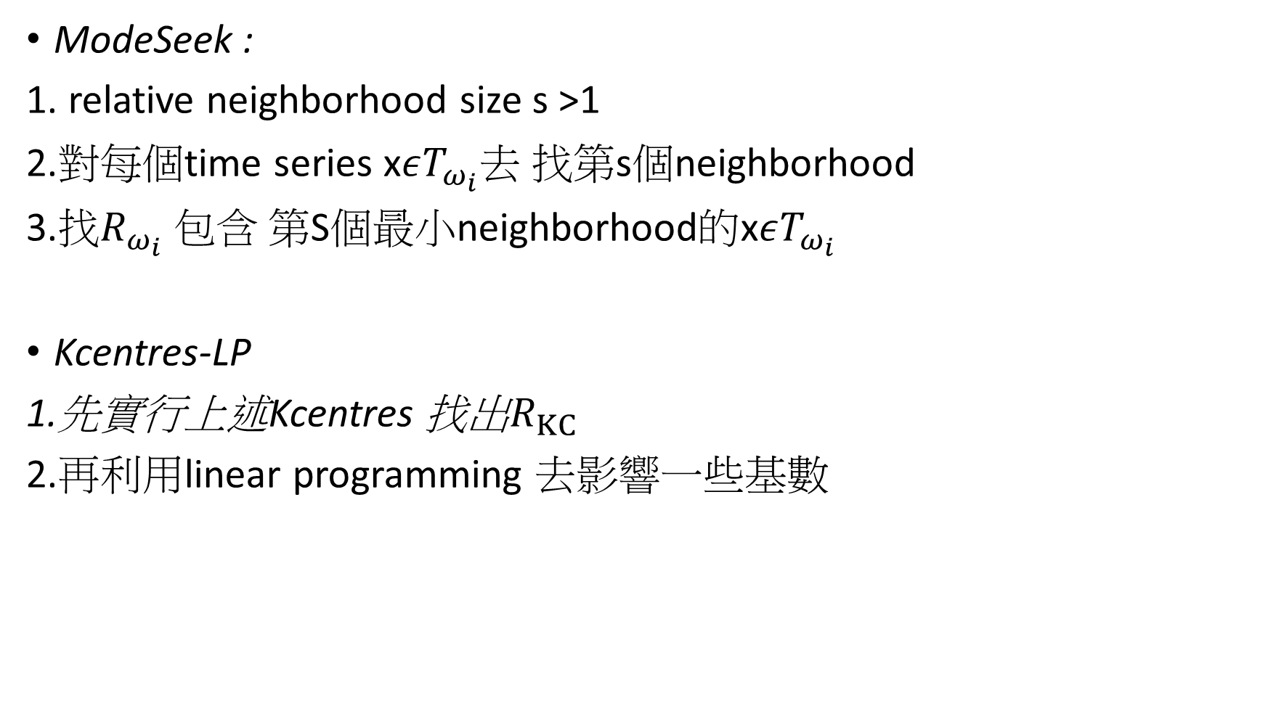
ModeSeek :
1. relative neighborhood size s >1
2.對每個time series x$εT_{ω_{i}}去$ 找第s個neighborhood
3.找$R_{ω_{i}}$ 包含 第S個最小neighborhood的x$εT_{ω_{i}}$
Kcentres-LP
1.先實行上述Kcentres 找出$R_{KC}$
2.再利用linear programming 去影響一些基數

Slide 8
Classifiers in dissimilarity spaces
K-NN rule : 在R中 尋找K個離 x (time series) 最近的，哪一類比較多x即標記為此類
K-means : 在R中 尋找K個群集的中心點，x 離哪一個最近 x即標記為此類
x

Slide 9
Naive Bayesian Classifier
把每個特徵化成機率，去計算x所要分去的那一類
Play-tennis example:
P(p) = 9/14
P(n) = 5/14
Training set:

Slide 10
An unseen sample X = <rain, hot, high, false>
P(X|p)·P(p) = P(rain|p)·P(hot|p)·P(high|p)·P(false|p)·P(p) = 3/9·2/9·3/9·6/9·9/14 = 0.010582
P(X|n)·P(n) = P(rain|n)·P(hot|n)·P(high|n)·P(false|n)·P(n) = 2/5·2/5·4/5·2/5·5/14 = 0.018286
Sample X is classified in class n (don’t play)

Slide 11
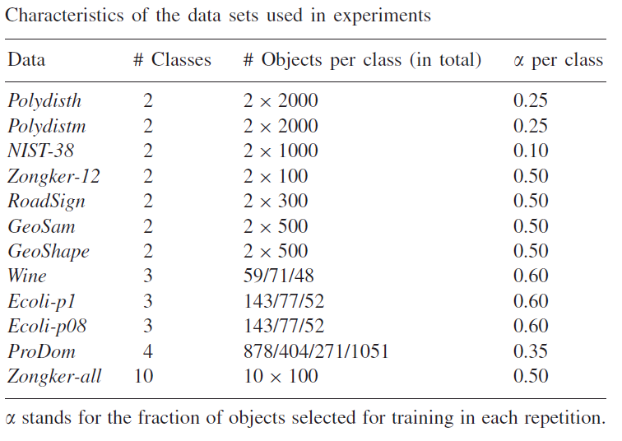

Slide 12
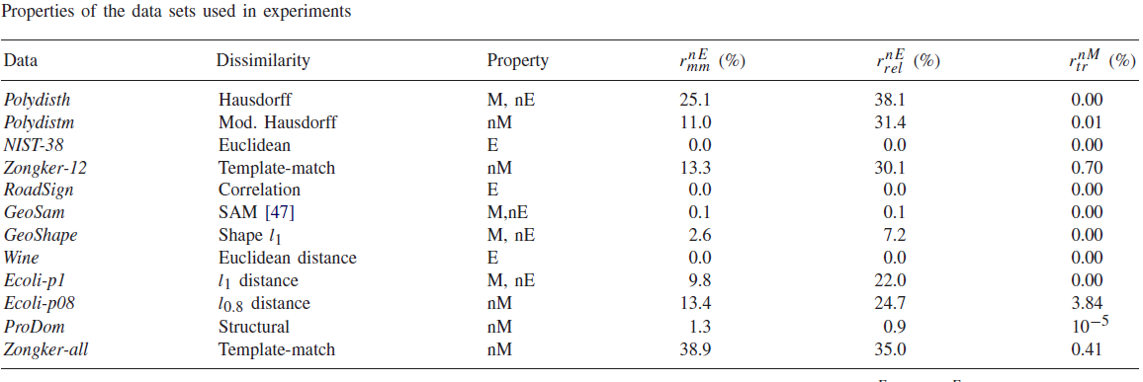

Slide 13
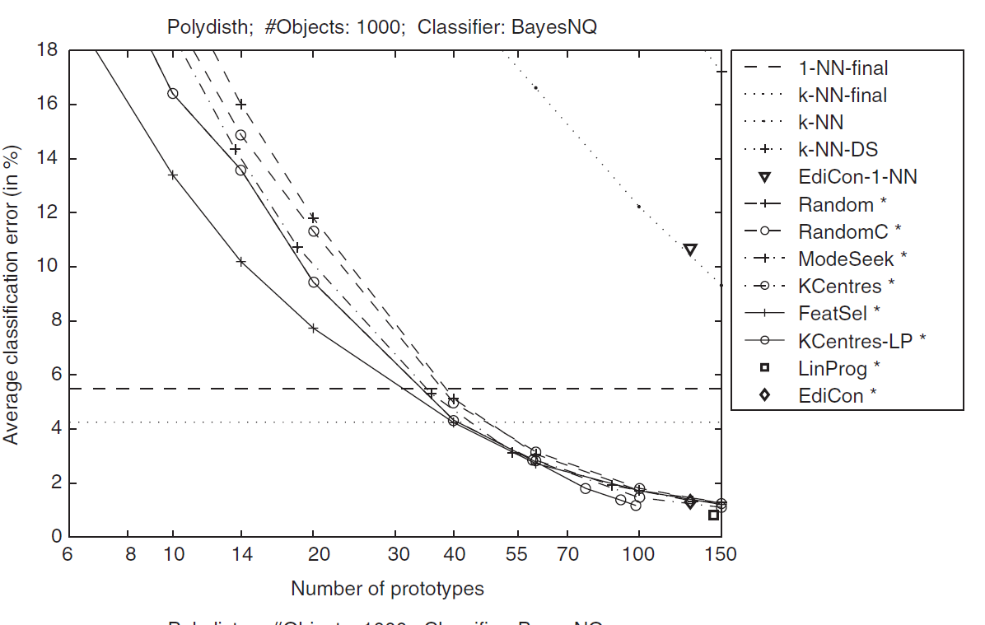

Slide 14
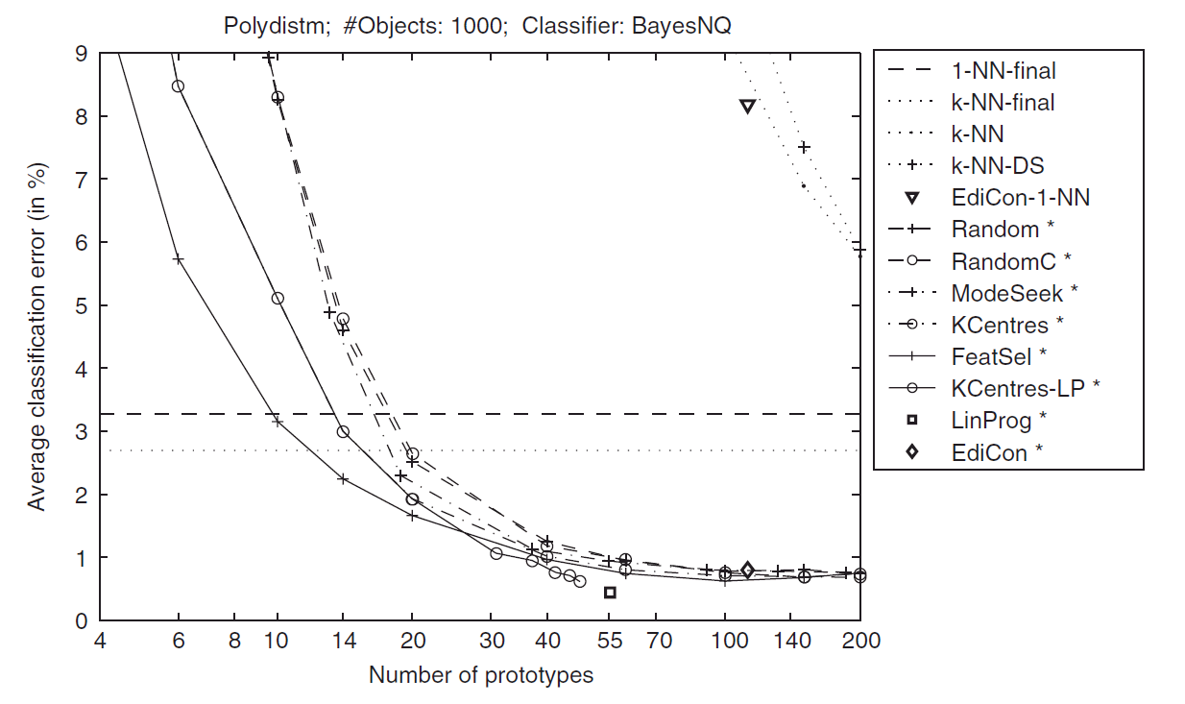

Slide 15
