Slide 1
Sequence alignment using FastLSA
Kevin Charter, Jonathan Schaeffer, Duane Szafron
Proceedings of the 2000 International Conference on Mathematics and Engineering Techniques in Medicine and Biological Sciences, Las Vegas, Nevada, 2000, pp.239-245
Presenter: Bi-Shiang Lin
Date:2016/12/15

Slide 2
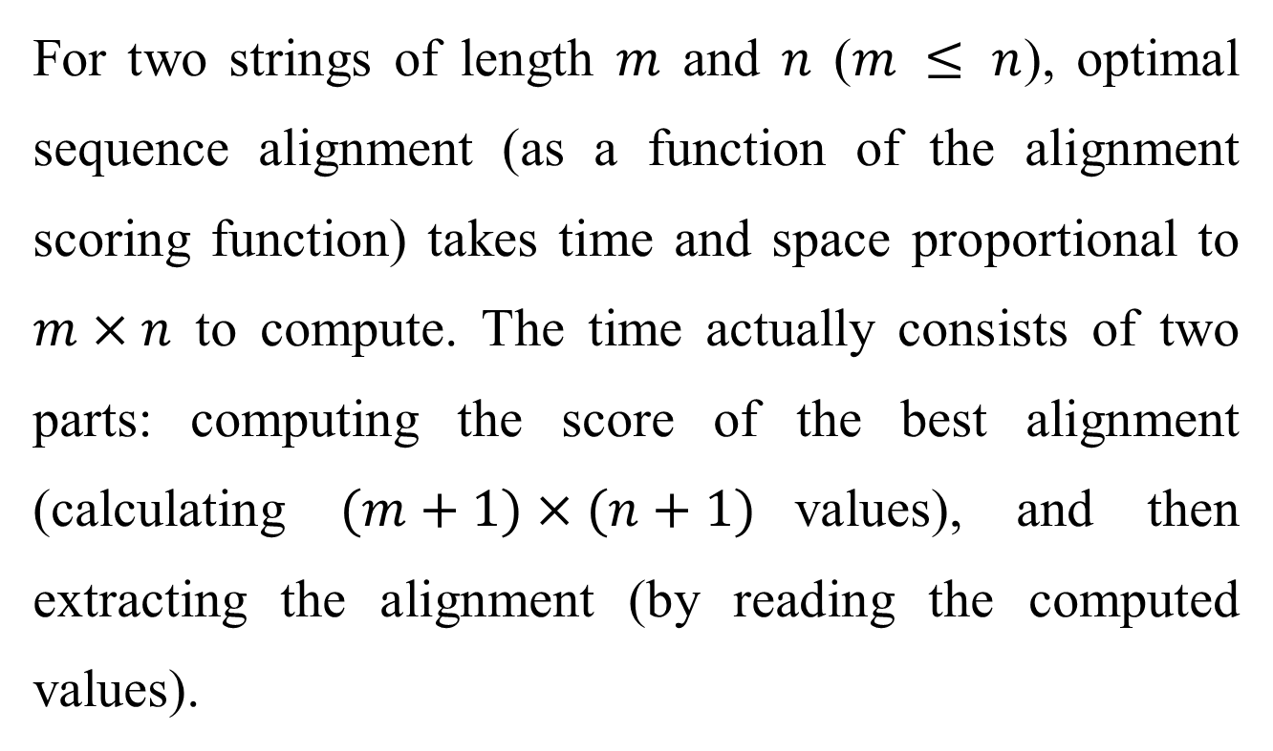
Abstract(1/3)
For two strings of length $m$ and $n$ ($m ≤ n$), optimal sequence alignment (as a function of the alignment scoring function) takes time and space proportional to $m×n$ to compute. The time actually consists of two parts: computing the score of the best alignment (calculating $(m+1)×(n+1)$values), and then extracting the alignment (by reading the computed values).

Slide 3
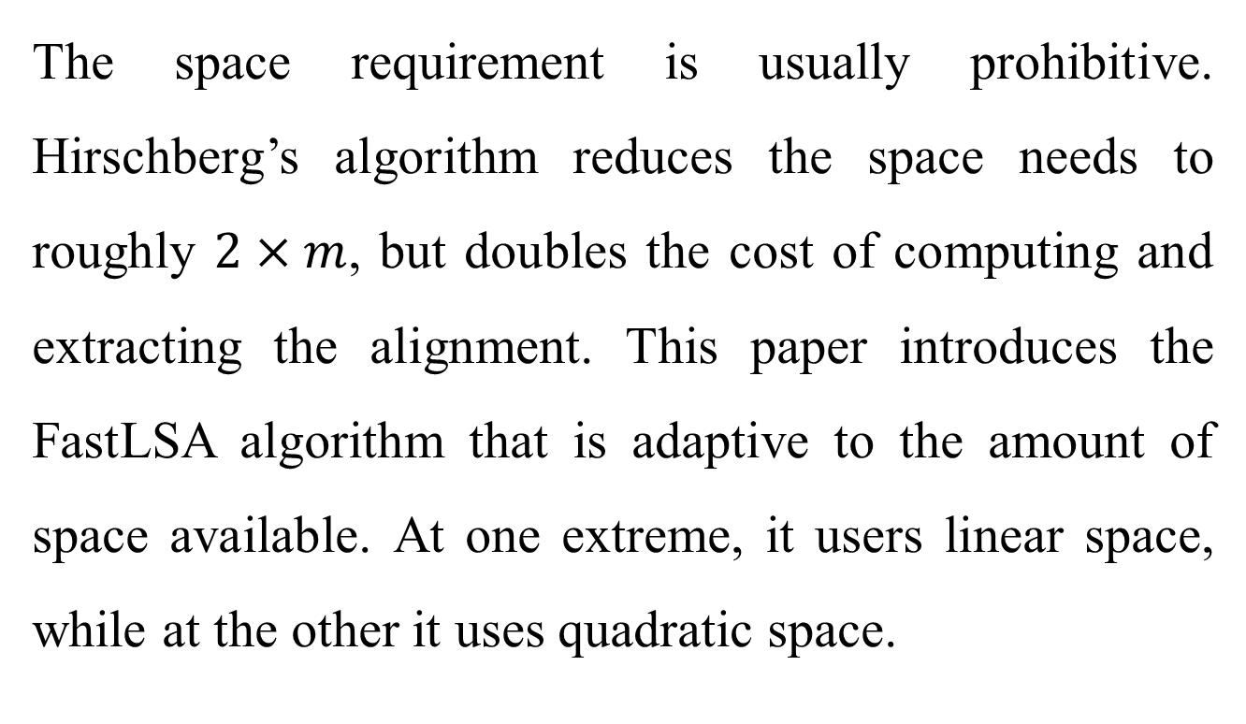
Abstract(2/3)
The space requirement is usually prohibitive. Hirschberg’s algorithm reduces the space needs to roughly $2×m$, but doubles the cost of computing and extracting the alignment. This paper introduces the FastLSA algorithm that is adaptive to the amount of space available. At one extreme, it users linear space, while at the other it uses quadratic space.

Slide 4
Abstract(3/3)
Based on the memory resources available, the algorithm saves the maximum amount of information to achieve the lowest extraction cost. The algorithm is shown to be analytically and experimentally superior to Hirschberg’s algorithm.

Slide 5
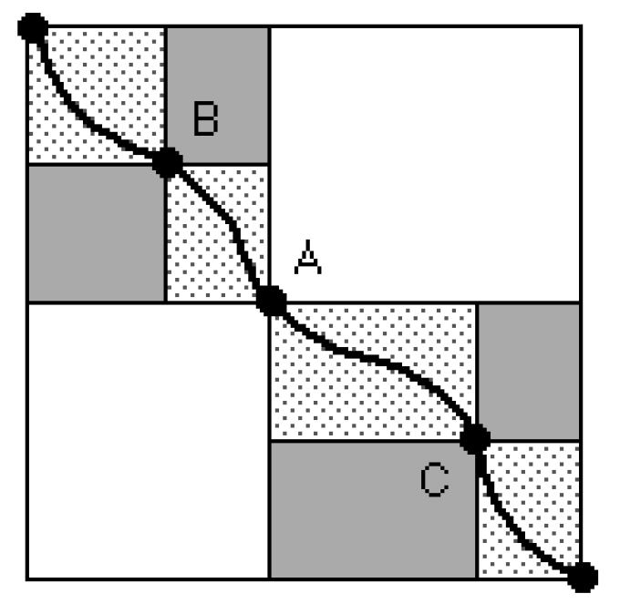

Hirschberg’s algorithm
Time complexity : $O\left(n^{2}\right)$
Approximately $m× n$ re-computations need to be done.
Space complexity : $O\left(n\right)$

Slide 6

Changes
Divide both sequences.
Divide each sequence into $k$ parts.
Store some specific rows and columns to reduce the re-computations.

Slide 7
Fast Linear-Space Alignment(1/8)
k = 4

Slide 8
FastLSA(2/8)

Slide 9
FastLSA(3/8)

Slide 10
FastLSA(4/8)

Slide 11
FastLSA(5/8)

Slide 12
FastLSA(6/8)

Slide 13
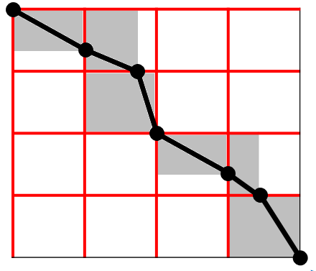
FastLSA(7/8)

Slide 14
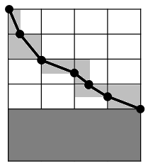
FastLSA(8/8)

Slide 15

FastLSA Conclusion
Space : $2kn$
Expected number of values recomputed : $\frac{m×n}{k}$

Slide 16
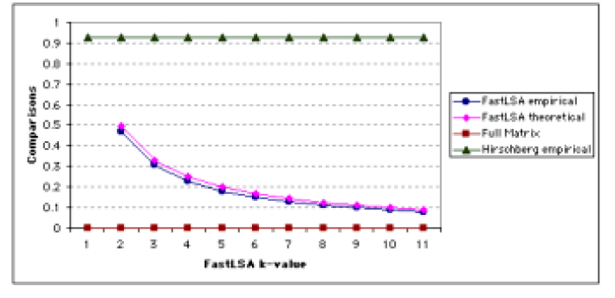
Experimental Results
Number of Recomputations

Slide 17
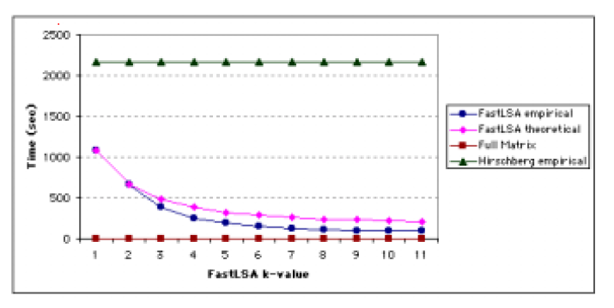
Experimental Results
Execution Time

