Slide 1
Machine learning for high-speed corner detection
Edward Rosten and Tom Drummond
9th European Conference on Computer Vision
Graz, Austria
May 7 - 13, 2006
Presenter：Jia-Hong Liu
Date：2016/ 12/ 15
Presenter：Jia-Hong Liu
Date：2016/ 10/ 25
Presenter：Jia-Hong Liu
Date：2016/ 10/ 25

Slide 2
Abstract(1/2)
Where feature points are used in real-time frame-rate applications, a high-speed feature detector is necessary. Feature detectors such as SIFT (DoG), Harris and SUSAN are good methods which yield high quality features, however they are too computationally intensive for use in real-time applications of any complexity. Here we show that machine learning can be used to derive a feature detector which can fully process live PAL video using less than 7% of the available processing time. By comparison neither the Harris detector (120%) nor the detection stage of SIFT (300%) can operate at full frame rate.

Slide 3
Abstract(2/2)
Clearly a high-speed detector is of limited use if the features produced are unsuitable for downstream processing. In particular, the same scene viewed from two different positions should yield features which correspond to the same real-world 3D locations[1]. Hence the second contribution of this paper is a comparison corner detectors based on this criterion applied to 3D scenes. This comparison supports a number of claims made elsewhere concerning existing corner detectors. Further, contrary to our initial expectations, we show that despite being principally constructed for speed, our detector significantly outperforms existing feature detectors according to this criterion.

Slide 4
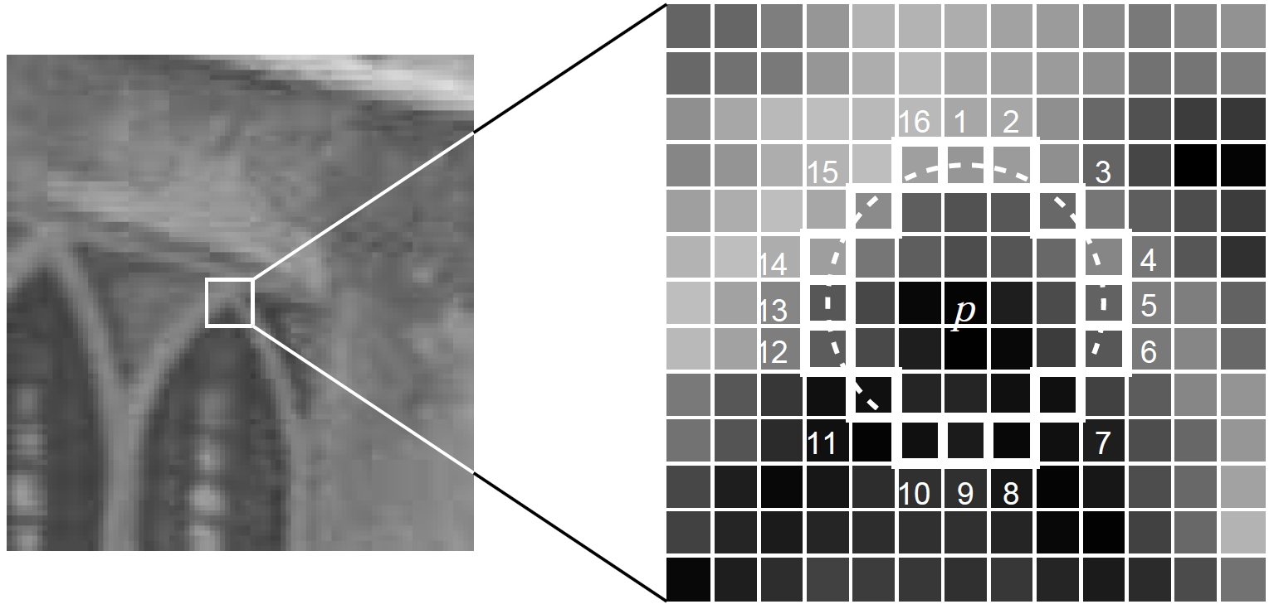
Feature Detection using FAST

Slide 5
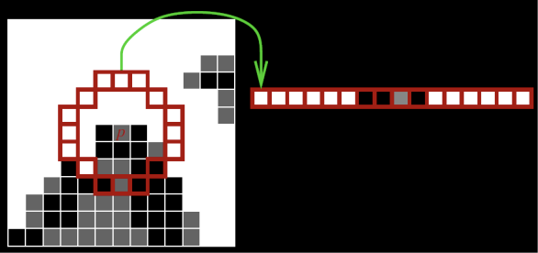
Machine Learning Approach

Slide 6
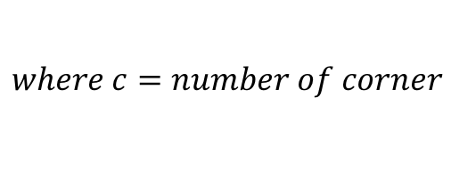
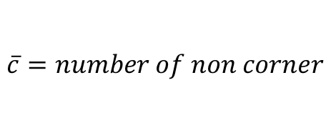
Machine Learning Approach
1 2 3
$$H\left(P\right)=\left(c+\overline{c}\right)\log_{2}\left(c+\overline{c}\right)−c\log_{2}{c}−\overline{c}\log_{2}{\overline{c}}$$
1
$$where c=number of corner$$
No
$$\overline{c}=number of non corner$$
Yes
Yes
$$entropy=H\left(P_{b}\right)+H\left(P_{s}\right)+H(P_{d})$$
Yes
Yes
3
Yes
3
No
Yes
No
Yes
No
No
Yes
Yes
Yes
No
Yes
ID3 algorithm
1.Calculate the entropy of every attribute using the data set S
2.Split the set S into subsets using the attribute for which entropy is minimum
3.Make a decision tree node containing that attribute
4.Recurse on subsets using remaining attributes
Yes
Yes
Yes
No

Slide 7



Machine Learning Approach
1 2 3
No
1
2
Yes
Yes
Yes
Yes
Yes=3
No=2
Yes=4
No=0
Yes=3
No=2
Yes=4
No=1
Yes=4
No=2
Yes=2
No=1
No
Yes
$$entropy=9.7$$
$$entropy=11.87$$
No
3
Yes
Yes
Yes
Yes
Yes=5
No=1
Yes=2
No=1
Yes=3
No=2
Yes
No
$$entropy=11.5$$

Slide 8
Machine Learning Approach
1 2 3
No
1
Yes
Yes
Yes
Yes
Yes=3
No=2
Yes=4
No=0
Yes=3
No=2
No
Yes
No
Yes
Yes
Yes
Yes
Yes
No

Slide 9


Machine Learning Approach
1 2 3
No
2
3
Yes
No
Yes
Yes
Yes=1
No=1
Yes=1
No=1
Yes=1
No=0
Yes=0
No=1
Yes=0
No=1
Yes=3
No=0
$$entropy=4$$
$$entropy=0$$

Slide 10
Machine Learning Approach
1 2 3
1
No
Yes
Yes
Yes
Yes
3
Yes=4
No=0
Yes=3
No=2
No
Yes
No
Yes
Yes=0
No=1
Yes=0
No=1
Yes=3
No=0
Yes
Yes
Yes
Yes
No

Slide 11

Machine Learning Approach
1 2 3
Yes
2
3
Yes
No
Yes
No
Yes=1
No=0
Yes=2
No=1
Yes=0
No=1
Yes=2
No=0
Yes=1
No=0
Yes=0
No=2
$$entropy=2.75$$
$$entropy=0$$

Slide 12
Machine Learning Approach
1 2 3
1
No
Yes
Yes
Yes
Yes
3
Yes=4
No=0
3
No
Yes
No
Yes
Yes=0
No=1
Yes=0
No=1
Yes=3
No=0
Yes=2
No=0
Yes=1
No=0
Yes=0
No=2
Yes
Yes
Yes
Yes
No

Slide 13
Machine Learning Approach
1 2 3
1
No
Yes
Yes
Yes
Yes
3
Yes
3
No
Yes
No
Yes
No
No
Yes
Yes
Yes
No
Yes
Yes
Yes
Yes
No

Slide 14
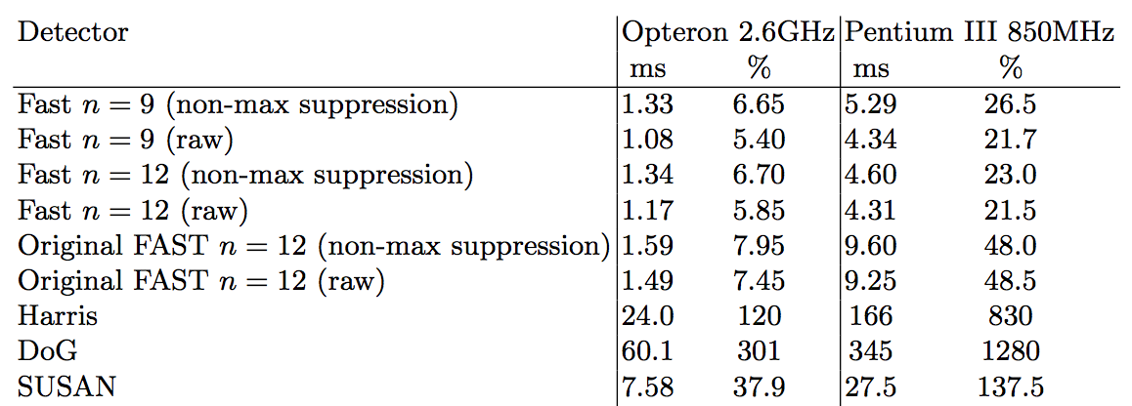
Timing results

Slide 15
Machine Learning Approach
1 2 3
No
2
3
Yes
Yes
Yes
Yes
Yes=1
No=1
Yes=4
No=0
Yes=3
No=2
Yes=2
No=0
Yes=1
No=0
Yes=0
No=2
No
Yes
Information gain=2.3
Information gain=4.85
No
Yes
Yes
H ( P ) = ( c + c ̄ ) l o g 2 ( c + c ̄ ) − c l o g 2 c − c ̄ l o g 2 c ̄
where c = number of corners
and c ̄ = number of non corners
Yes
Yes
Yes
No
Information gain=H(P)−H(Pd)−H(Ps)−H(Pb)

Slide 16
Machine Learning Approach
1 2 3
No
2
3
Yes
Yes
Yes
Yes
Yes=1
No=1
Yes=4
No=0
Yes=3
No=2
Yes=2
No=0
Yes=1
No=0
Yes=0
No=2
No
Yes
Information gain=2.3
Information gain=4.85
No
Yes
Yes
H ( P ) = ( c + c ̄ ) l o g 2 ( c + c ̄ ) − c l o g 2 c − c ̄ l o g 2 c ̄
where c = number of corners
and c ̄ = number of non corners
Yes
Yes
Yes
No
Information gain=H(P)−H(Pd)−H(Ps)−H(Pb)

Slide 17
Machine Learning Approach
Non-Corner
Non-Corner
Corner
Corner
Corner
Non-Corner
Corner
Non-Corner
Corner
Corner
Corner
Corner
Corner
Non-Corner

