Slide 1
A Better Balance in Metaheuristic Algorithms: Does It Exist?
Bernardo Morales-Castañeda, Daniel Zaldīvar, Erik Cuevas, Fernando Fausto and Alma Rodrīguez.
Swarm and Evolutionary Computation, 2020,
Vol. 54, 100671.
Presenter : Tzu-Hsu Lee
Date : Apr. 20, 2021.
Notes:
journal

Slide 2
Abstract(1/2)
The constant development of new metaheuristic algorithms has led to a saturation in the field of stochastic search. There are now hundreds of different algorithms that can be used to solve any problem. To produce a good performance, every metaheuristic method needs to address a satisfactory equilibrium between exploration and exploitation of the search space. Although exploration and exploitation represent two fundamental concepts in metaheuristics, the main questions about their combination and balance have not been yet completely understood. Most of the existent analyzes conducted on metaheuristic techniques consider only the comparison of their final results which cannot evaluate the nature of a good or bad balance.

Slide 3
Abstract(2/2)
This paper presents an experimental analysis that quantitatively evaluates the balance between exploration and exploitation of several of the most important and better-known metaheuristic algorithms. In the study, a dimension-wise diversity measurement is used to assess the balance of each scheme considering a representative set of 42 benchmark problems that involve multimodal, unimodal, composite and shifted functions. As a result, the analysis provides several observations that allow understanding how this balance affects the results in each type of functions, and which balance is producing better solutions.

Slide 4
Exploration and Exploitation
Exploration : The ability of a search algorithm to discover a diverse assortment of solutions, spread within different regions of the search space.
ex : biotic pollens (FPA) and w < 0.8 (PSO).
Exploitation : Emphasizes the idea of intensifying the search process over- promising regions of the solution space with the aim of finding better solutions or improving the existing ones.
ex : abiotic pollens (FPA) and w > 1.2 (PSO).
Notes:
儘管利用開發策略可以提高收斂速度，朝著全局最優方向發展，但同時也可以提高捕獲策略陷入局部最優狀態的可能性。

Slide 5
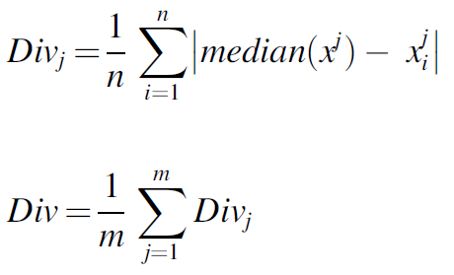

Evaluation of the Balance (1/5)
Dimension-wise diversity measurement :
, where median($x^{j}$) represents the median of dimension j in the whole population.
$x_{i}^{j}$ is the dimension j of search agent i. n corresponds to the number of search
agents in the population while m symbolizes the number of design variables of the
optimization problem.
Notes:
the distance among search agents decreases while the effect of exploitation increases. On the other hand, when the distance among search agents increases, the effect of the exploration process is more evident.
Both values are computed in every iteration.

Slide 6
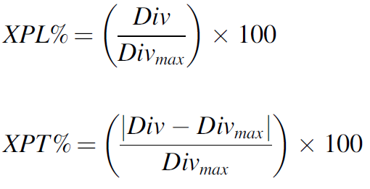
Evaluation of the Balance (2/5)
The percentage of exploration and exploitation :
, where Divmax represents the maximum diversity value found in the entire
optimization process.
Notes:
探索百分比XPL％將探索級別表示為每次迭代的多樣性與達到的最大多樣性之間的關係。 開發百分比XPT％與開發水平相對應。 它被計算為XPL％的補正百分比，因為最大多樣性與當前迭代多樣性之間的差異是搜索代理濃度的結果而產生的。 可以看出，元素XPL％和XPT％是相互衝突和互補的。
缺點:部分很小的多樣性突然變化被忽略了。

Slide 7
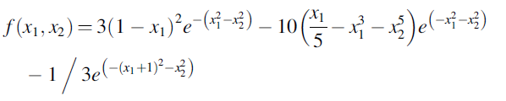
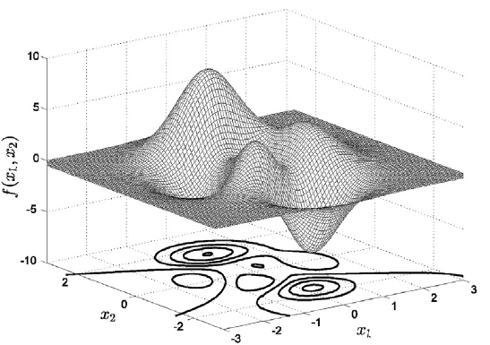
Evaluation of the Balance (3/5)
Ex :

Slide 8
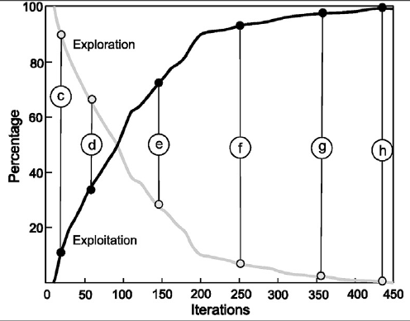
Evaluation of the Balance (4/5)
Notes:
Point (c) represents an early stage of the algorithm (about the 20 iteration) where the balance evaluation has as values XPL% = 90 and XPT% = 10.
Point (d) corresponds to the 60 iterations. In this position, the balance evaluation maintains a value of XPL% = 70 along with XPT% = 30.
Points (e) and (f) correspond to the 150 and 250 iterations, respectively, where the balance evaluations have as values % = 25 , XPT% = 75 and XPL% = 08 , XPT% = 92

Slide 9
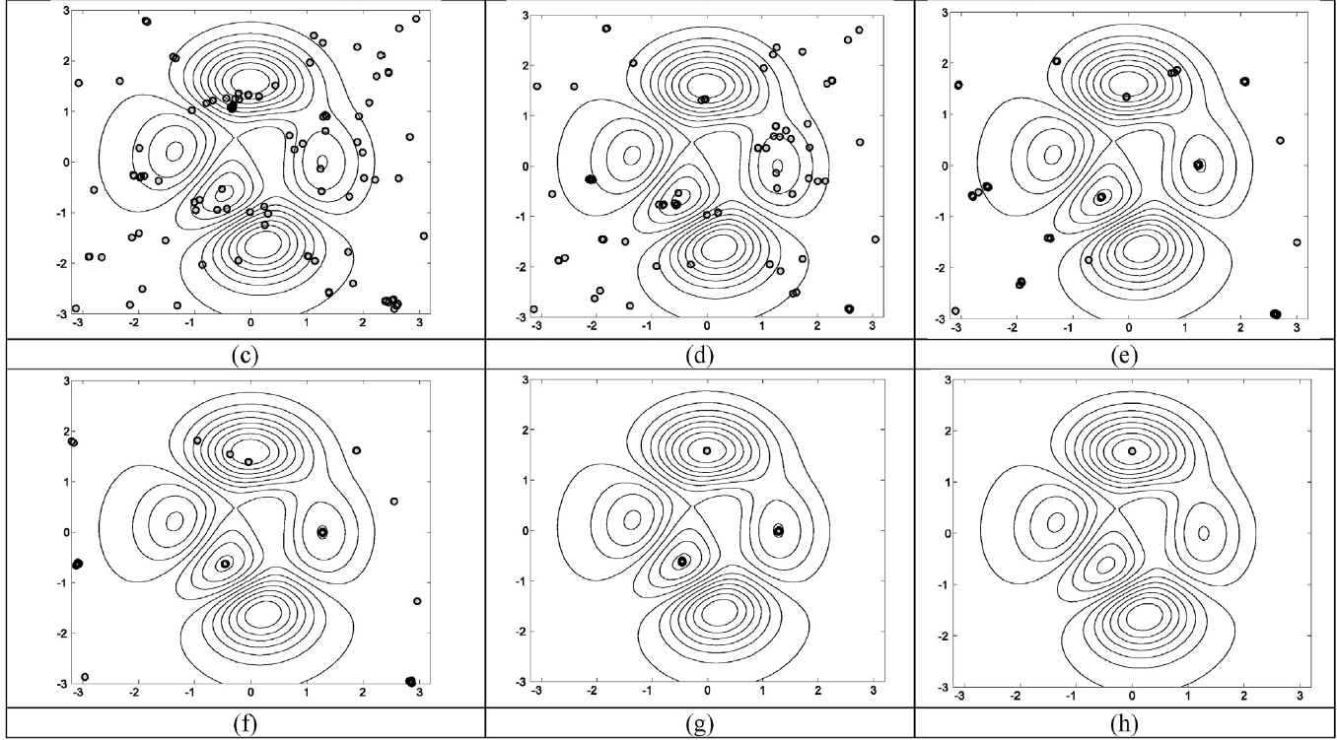
Evaluation of the Balance (5/5)
Notes:
Point (c) represents an early stage of the algorithm (about the 20 iteration) where the balance evaluation has as values XPL% = 90 and XPT% = 10.
Point (d) corresponds to the 60 iterations. In this position, the balance evaluation maintains a value of XPL% = 70 along with XPT% = 30.
Points (e) and (f) correspond to the 150 and 250 iterations, respectively, where the balance evaluations have as values % = 25 , XPT% = 75 and XPL% = 08 , XPT% = 92

Slide 10
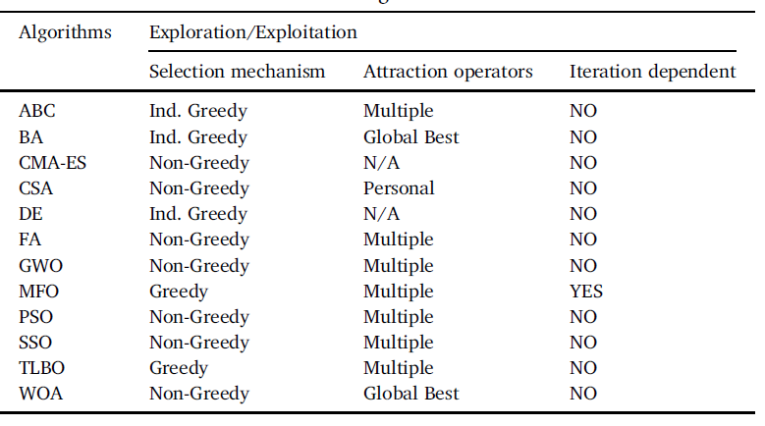
Experiments and Results (1/5)
Notes:
the maximum function evaluations were 50,000 and unless otherwise stated, the population was 50
The average, median and standard deviation of the best-found solutions from 30 individual runs (AB, MD, SD)

Slide 11
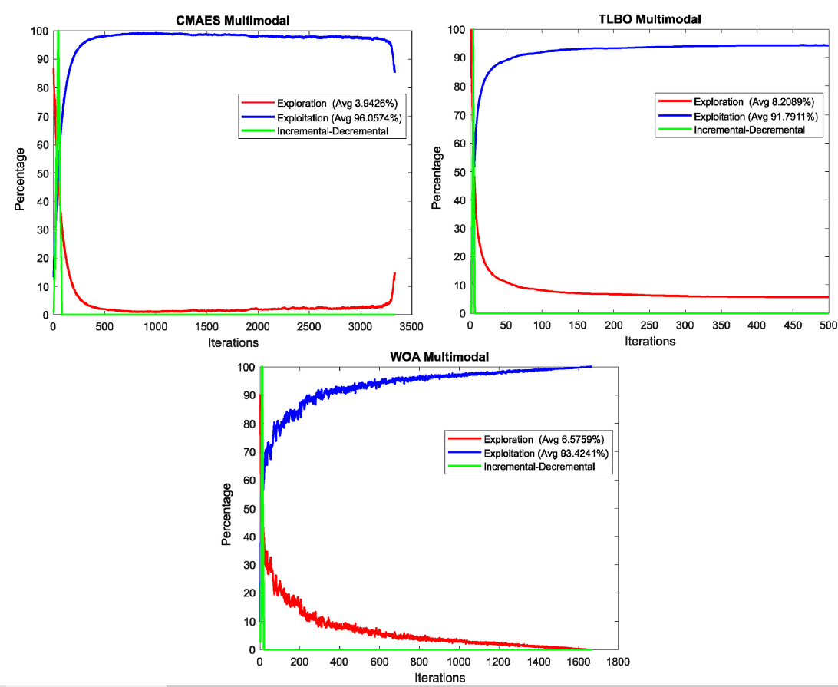
Experiments and Results (2/5)
Results of multimodal test functions
Notes:
having multiple local optima

Slide 12
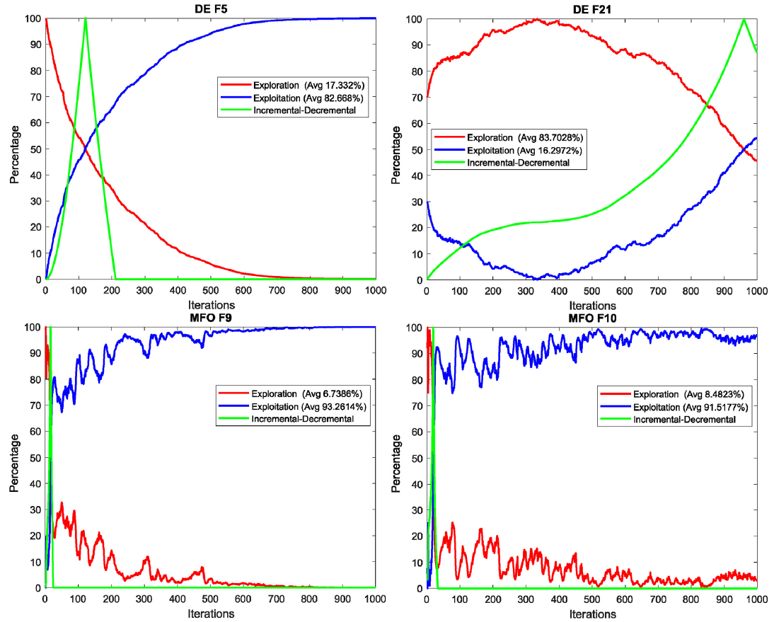
Experiments and Results (3/5)
Notes:
having multiple local optima

Slide 13
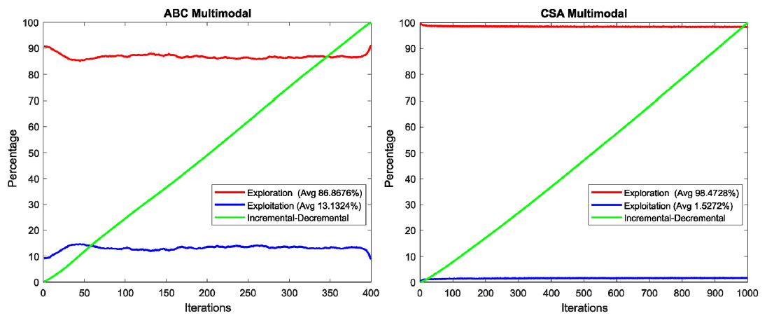
Experiments and Results (4/5)
Notes:
having multiple local optima

Slide 14
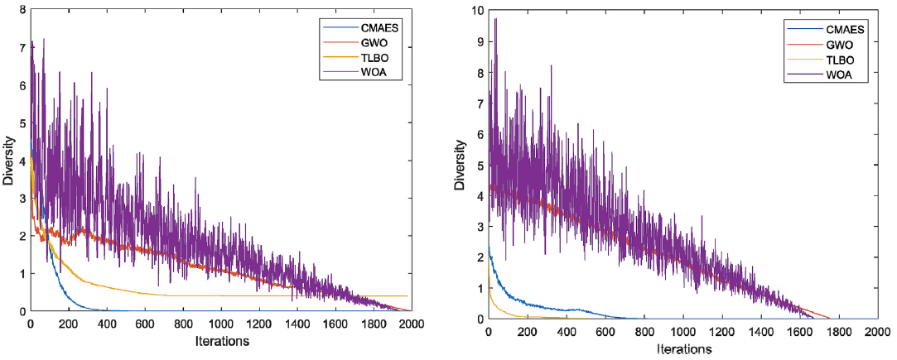
Experiments and Results (5/5)
Diversity analysis
Notes:
he functions f 6 and f 37 are considered.

Slide 15
Result Analysis
The best results have been obtained by WOA, CMA-ES, GWO and TLBO through an exploitation rate of over 90% (XPL% = 10, XPT% = 90).
In order to produce this behavior, the exploration process should last only the first iterations, specifically from 100 to 300 iterations. Then, the rest of the search strategy is mainly guided by the exploitation process.
It is also necessary to have operators for the generation of promising solutions so that they take advantage of the adequate diversity conditions observed in the balance response.

