Slide 1
ProbPFP: A Multiple Sequence Alignment Algorithm Combining Hidden Markov Model Optimized by Particle Swarm Optimization with Partition Function
Qing Zhan, Nan Wang, Shuilin Jin,
Renjie Tan, Qinghua Jiang, Yadong Wang
BMC Bioinformatics, 2019
Volume 20, Supplement 18, Article number: 573
Presenter: Tsung-Lin Lu
Date: Apr. 20, 2021

Slide 2
Abstract (1/2)
During procedures for conducting multiple sequence alignment, that is so essential to use the substitution score of pairwise alignment. To compute adaptive scores for alignment, researchers usually use Hidden Markov Model or probabilistic consistency methods such as partition function. Recent studies show that optimizing the parameters for hidden Markov model, as well as integrating hidden Markov model with partition function can raise the accuracy of alignment. The combination of partition function and optimized HMM, which could further improve the alignment’s accuracy, however, was ignored by these researches.

Slide 3
Abstract (2/2)
A novel algorithm for MSA called ProbPFP is presented in this paper. It intergrate optimized HMM by particle swarm with partition function. The algorithm of PSO was applied to optimize HMM’s parameters. After that, the posterior probability obtained by the HMM was combined with the one obtained by partition function, and thus to calculate an integrated substitution score for alignment.
We propose a new multiple sequence alignment method combining optimized HMM and partition function in this paper. The performance validates this method could make a great improvement of the alignment’s accuracy.

Slide 4
Outline
Posterior probability
Partition function
Particle swarm optimization
Pair-hidden Markov model
Progressive alignment

Slide 5
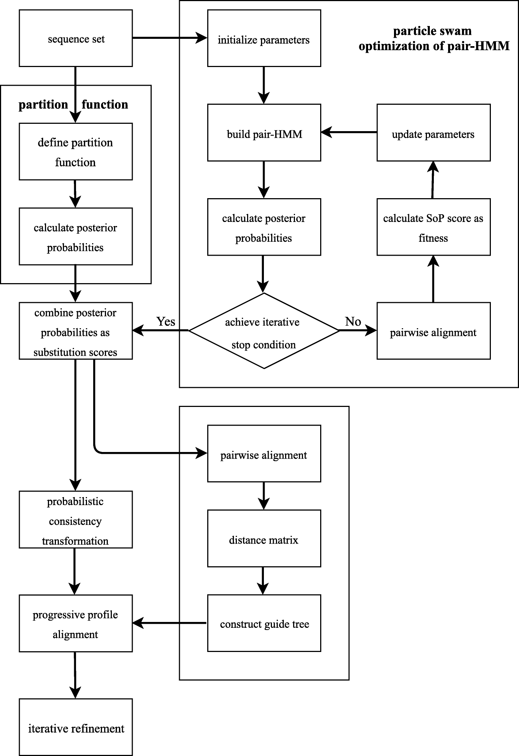
Framework of ProbPFP
(a) Rebuilt substitution scores
(b) Multiple Sequence Alignment

Slide 6

Posterior probability
事後機率 ∝ 事前機率 × 可能性
如：看到穿褲子，為女性的機率？
$\frac{0.5 × 0.4}{0.8}=0.2$5
 | 穿褲子 | 穿裙子
男(0.6) | 1 (0.6*1=0.6) | 0 (0.6*0=0)
女(0.4) | 0.5 (0.4*0.5=0.2) | 0.5 (0.4*0.5=0.2)

Slide 7
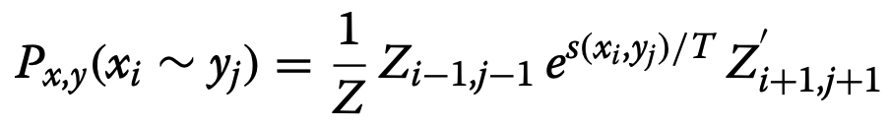
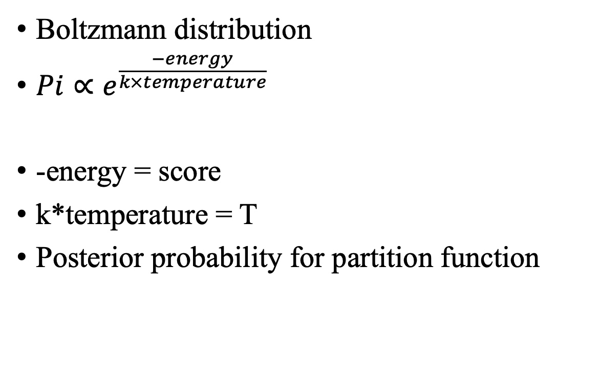
Partition function
Boltzmann distribution
$Pi∝e^{\frac{−energy}{k×temperature}}$
-energy = score
k*temperature = T
Posterior probability for partition function
事後機率 ∝ 事前機率 × 可能性
x_{i} aligns y_{i}

Slide 8
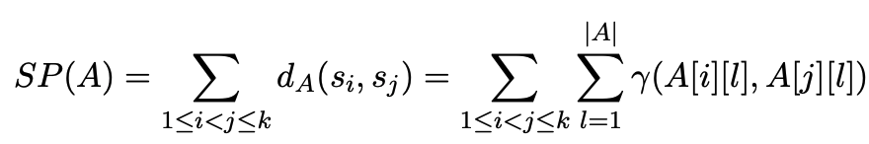
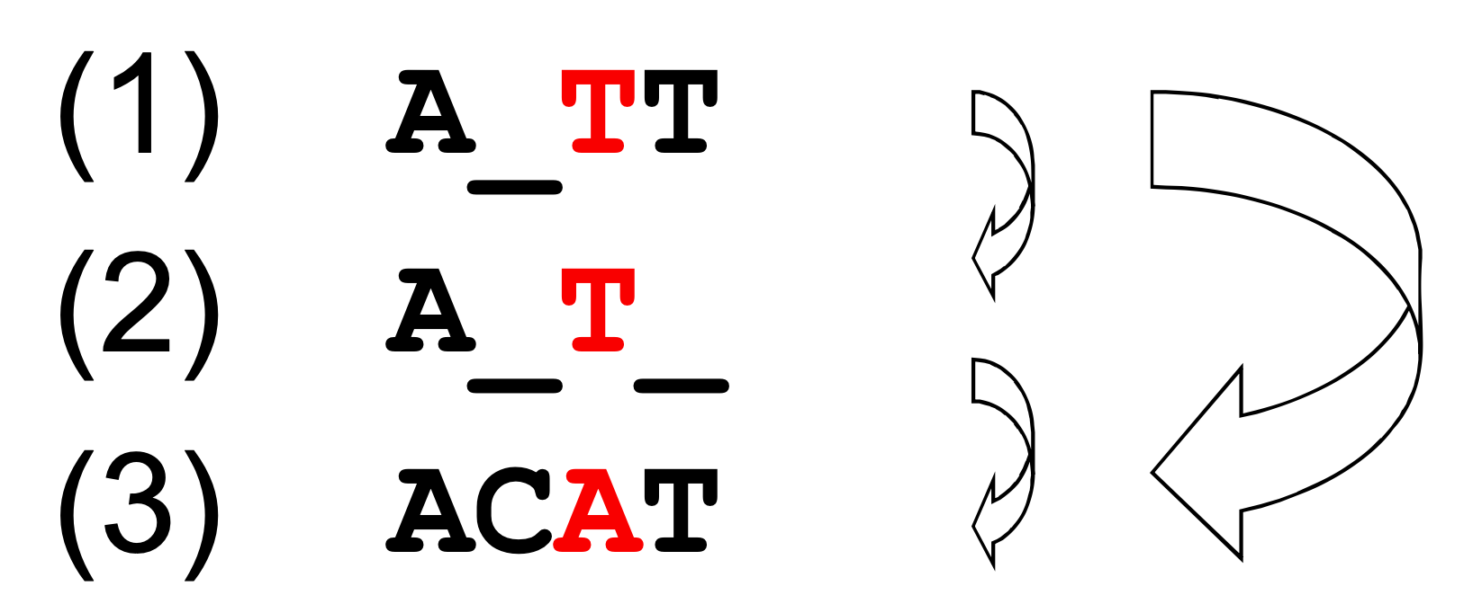
Particle swarm optimization
Sum-of-pairs score (SP score)
score = 𝛾(S_{1,3}, S_{2,3}) +
𝛾(S_{2,3}, S_{3,3}) +
𝛾(S_{1,3}, S_{3,3})

Slide 9
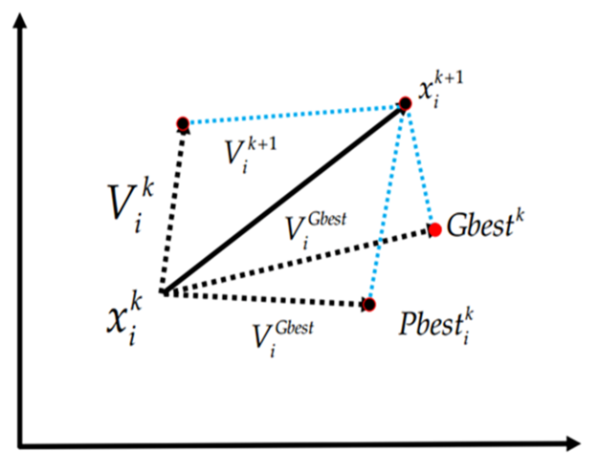
Particle swarm optimization
Sum-of-pairs score (SP score)
Update X_{i}
V_{i} = original + personal best +Global best

Slide 10
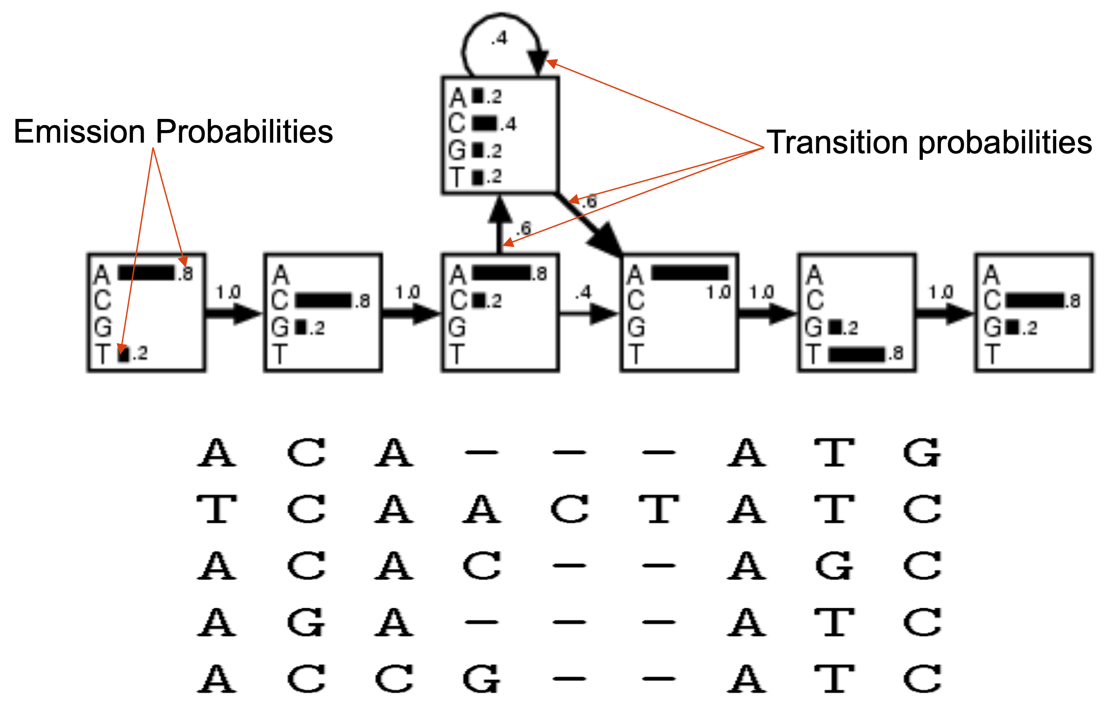
Pair-hidden Markov model
無gap
有gap
無gap

Slide 11
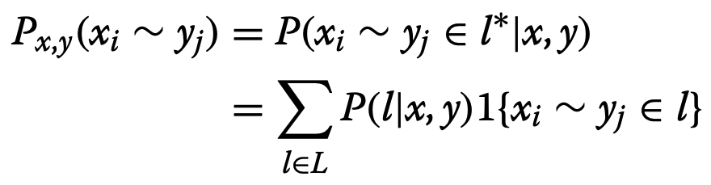
Pair-hidden Markov model
Posterior probability for pair-HMM
The probability that x_{i} is aligned to y_{j} in the true alignment l∗

Slide 12
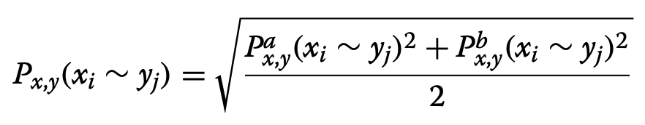
Combination
Combine posterior probability as substitution scores
a is hidden Markov model
b is partition function

Slide 13
Progressive alignment
Distance matrix : Similarity of this two sequences.
Guide tree : Guide the subsequent alignment.
Probabilistic consistency transformation : Re-estimate the probabilities.
Progressive alignment : Choosing the closest pair of profiles in the set and aligning them to generate a new profile to replace them in the set.

Slide 14
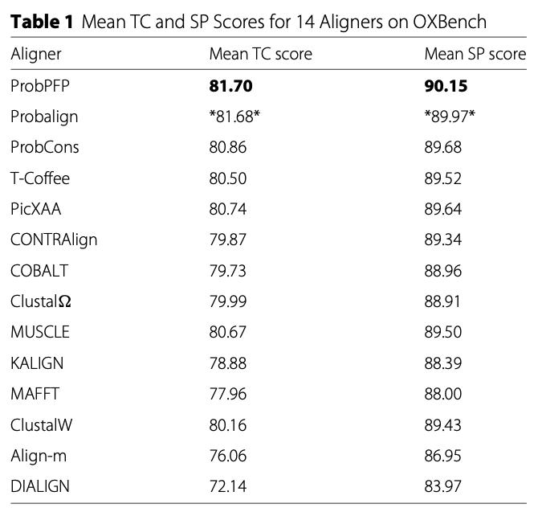
Results
Particle size : 10
Generation of PSO : 30
SP (Sum-of-pairs score )
TC (total column) score :
A similarity metric
ProbPFP : partition + opmized HMM
Probalign : partition function

Slide 15
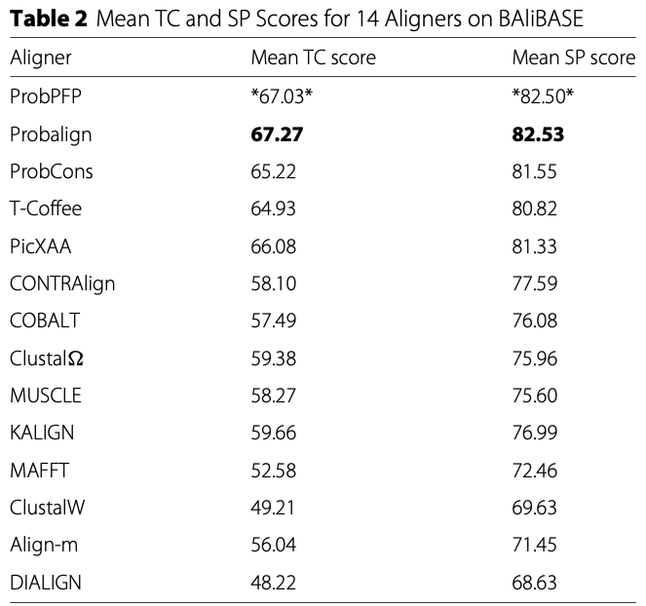
Results
Particle size : 10
Generation of PSO : 30
SP (Sum-of-pairs score )
TC (total column) score :
A similarity metric
ProbPFP : partition + opmized HMM
Probalign : partition function
BAliBASE is heavily biased toward
globally related protein families.

Slide 16
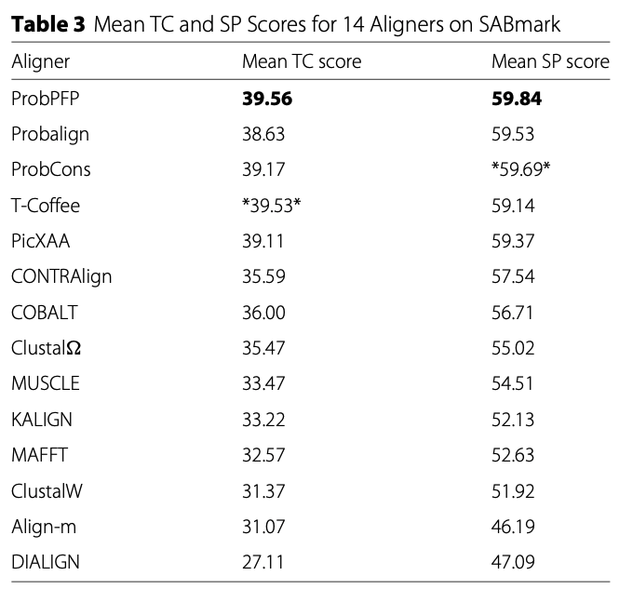
Results
Particle size : 10
Generation of PSO : 30
SP (Sum-of-pairs score )
TC (total column) score :
A similarity metric
ProbPFP : partition + opmized HMM
Probalign : partition function
SABmark is divergent

Slide 17
Thank you for listening

