Slide 1
Automatic Bridge Bidding Using Deep Reinforcement Learning
Chih-Kuan Yeh, Cheng-Yu Hsieh , and Hsuan-Tien Lin
IEEE TRANSACTIONS ON GAMES,
VOL. 10, NO. 4, DECEMBER 2018 P365~P377
Presenter: Jing-Ping Jan
Date: April 27, 2021

Slide 2
Abstract
Bridge is among the zero-sum games for which artificial intelligence has not yet outperformed expert human players. The main difficulty lies in the bidding phase of bridge, which requires cooperative decision making with partial information. Existing artificial intelligence systems for bridge bidding rely on, and are thus restricted by, human-designed bidding systems or features. In this work, we propose a flexible and pioneering bridge-bidding system, which can learn either with or without the aid of human domain knowledge. The system is based on a novel deep reinforcement learning model, which extracts sophisticated features and learns to bid automatically based on raw card data.

Slide 3
Abstract
The model includes an upper-confidence-bound algorithm and additional techniques to achieve a balance between exploration and exploitation. We further study how different pieces of human knowledge can be exploited to assist the model. Our experiments demonstrate the promising performance of our proposed model. In particular, the model can advance from having no knowledge on bidding to achieving a superior performance compared with a champion-winning computer bridge program that implements a human-designed bidding system. In addition, further synergies can be extracted by incorporating expert knowledge into the proposed model.

Slide 4
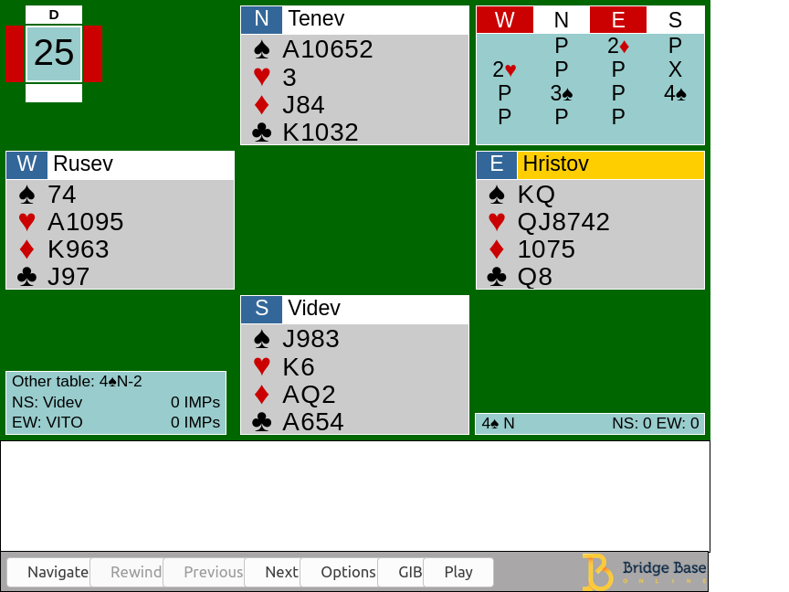
Introduction
Bidding stage Find the most profitable contract for the playing stage
Playing stage 13 rounds of a card-strength competition

Slide 5
Bidding stage
Asserting By making this bid, I assert that my hand has these properties
Denying By making this bid, I deny that my hand has these properties
Asking and Answering Questions If your hand is of type 1, make bid 1; if it is of type 2, make bid 2, etc.
Interrupting The primary purpose of this bid is to stop the opponents communicating

Slide 6
Problem
Goal : learn a bidding strategy Q for predicting bid B

Slide 7
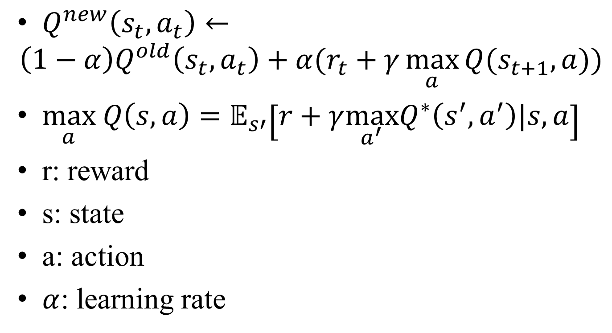
Q Learning
$Q^{new}\left(s_{t},a_{t}\right)←$
$$\left(1−α\right)Q^{old}\left(s_{t},a_{t}\right)+α(r_{t}+γ\max_{a}{Q(s_{t+1},a)})$$
$\max_{a} Q\left(s,a\right)=𝔼_{s′}\left[r+γ\max_{a^{′}}Q^{∗}\left(s^{′},a^{′}\right)|s,a\right]$
r: reward
s: state
a: action
$α$: learning rate

Slide 8
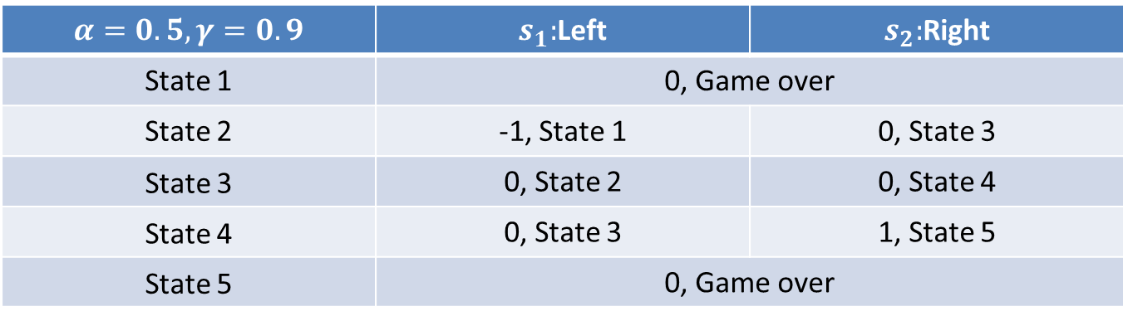
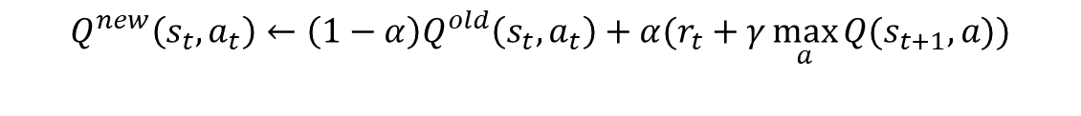
Q Learning
$$\max_{a} Q\left(s,a\right)=𝔼_{s′}\left[r+γ\max_{a^{′}}Q^{∗}\left(s^{′},a^{′}\right)|s,a\right]$$
$$α=0.5, γ=0.9$$ | $s_{1}:$Left | $s_{2}:$Right
State 1 | 0, Game over | 0
State 2 | -1, State 1 | 0, State 3
State 3 | 0, State 2 | 0, State 4
State 4 | 0, State 3 | 1, State 5
State 5 | 0, Game over | Game over
$$Q^{new}\left(s_{t},a_{t}\right)←\left(1−α\right)Q^{old}\left(s_{t},a_{t}\right)+α(r_{t}+γ\max_{a}{Q(s_{t+1},a)})$$
1 | 2 | 3 | 4 | 5
-1
1
3
1
2
4
5

Slide 9
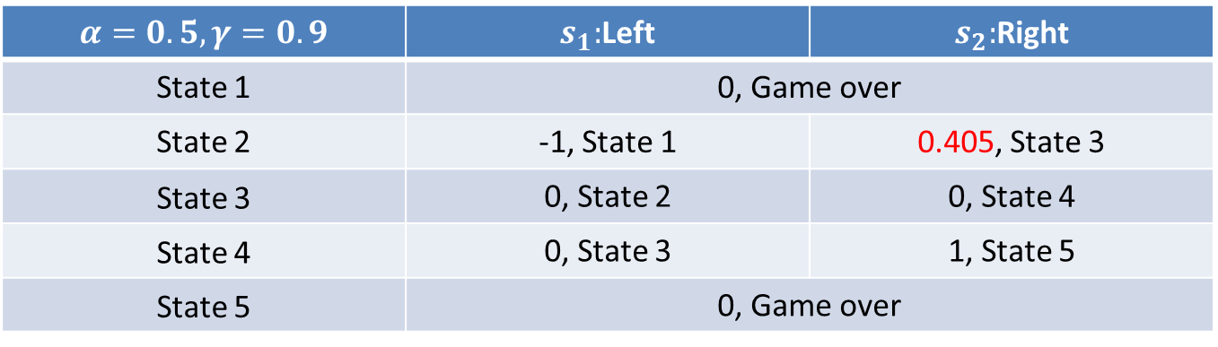
Q Learning
$$\max_{a} Q\left(s,a\right)=𝔼_{s′}\left[r+γ\max_{a^{′}}Q^{∗}\left(s^{′},a^{′}\right)|s,a\right]$$
$$α=0.5, γ=0.9$$ | $s_{1}:$Left | $s_{2}:$Right
State 1 | 0, Game over | 0
State 2 | -1, State 1 | 0.405, State 3
State 3 | 0, State 2 | 0, State 4
State 4 | 0, State 3 | 1, State 5
State 5 | 0, Game over | Game over
$$Q^{new}\left(s_{2},a_{2}\right)←\left(1−0.5\right)×0+0.5(0+0.9(0+0.9×1))$$
1 | 2 | 3 | 4 | 5
-1
1
3
1
2
4
5
0.405

Slide 10
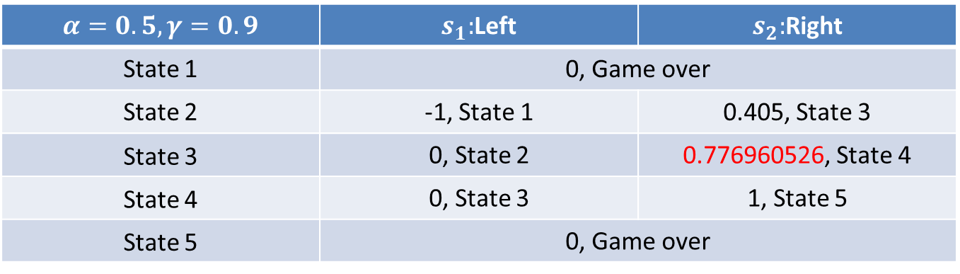
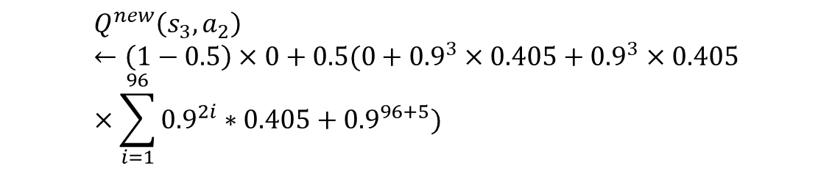
Q Learning
$$\max_{a} Q\left(s,a\right)=𝔼_{s′}\left[r+γ\max_{a^{′}}Q^{∗}\left(s^{′},a^{′}\right)|s,a\right]$$
$$α=0.5, γ=0.9$$ | $s_{1}:$Left | $s_{2}:$Right
State 1 | 0, Game over | 0
State 2 | -1, State 1 | 0.405, State 3
State 3 | 0, State 2 | 0.776960526, State 4
State 4 | 0, State 3 | 1, State 5
State 5 | 0, Game over | Game over
$$Q^{new}\left(s_{3},a_{2}\right)←\left(1−0.5\right)×0+0.5(0+{0.9}^{3}×0.405+{0.9}^{3}×0.405×\sum_{i=1}^{96}{{0.9}^{2i}∗0.405}+{0.9}^{96+5})$$
1 | 2 | 3 | 4 | 5
-1
1
3
1
2
0.7769
4
5
0.405

Slide 11
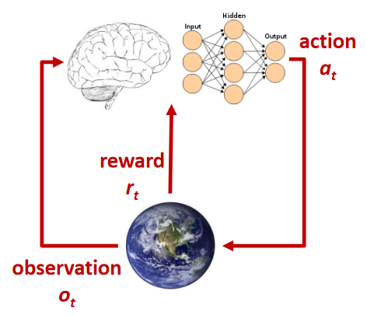
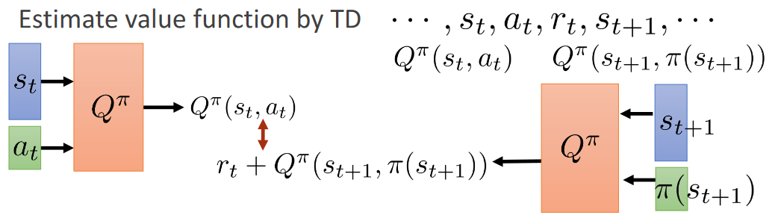

Deep Q Network
State $s_{t}=(x^{(t)},b^{(t)})$
Action $a_{t}$= the possible bids
$L\left(θ\right)={\left(Q\left(s,a;θ\right)−[r+γ\max_{a^{′}}Q(s^{′},a^{′};θ)|s,a]\right)}^{2}$

Slide 12
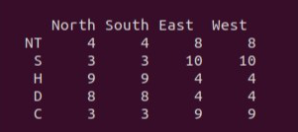
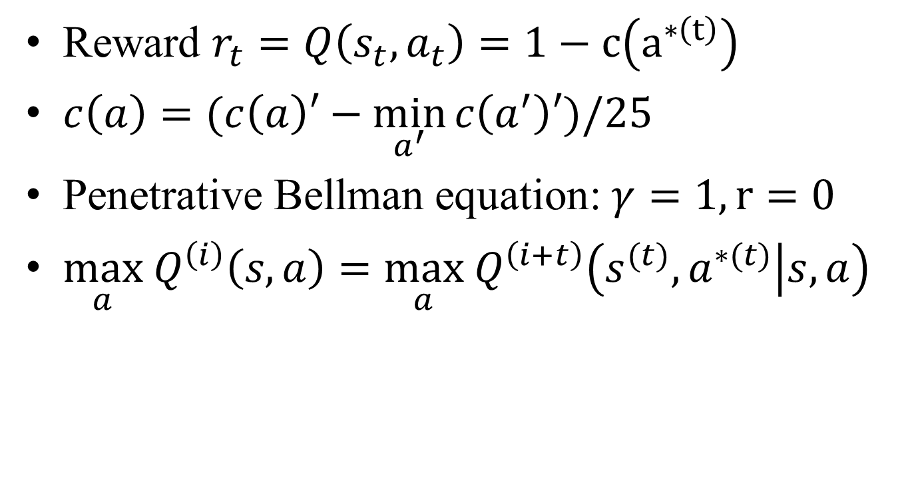
Proposed Framework
Reward $r_{t}=Q\left(s_{t},a_{t}\right)=1−c\left(a^{∗\left(t\right)}\right)$
$c\left(a\right)=(c\left(a\right)′−\min_{a^{′}}{c\left(a^{′}\right)′})/25$
Penetrative Bellman equation: $γ=1,r=0$
$\max_{a} Q^{\left(i\right)}\left(s,a\right)=\max_{a} Q^{\left(i+t\right)}\left(s^{(t)},a^{∗(t)} | s,a\right)$

Slide 13
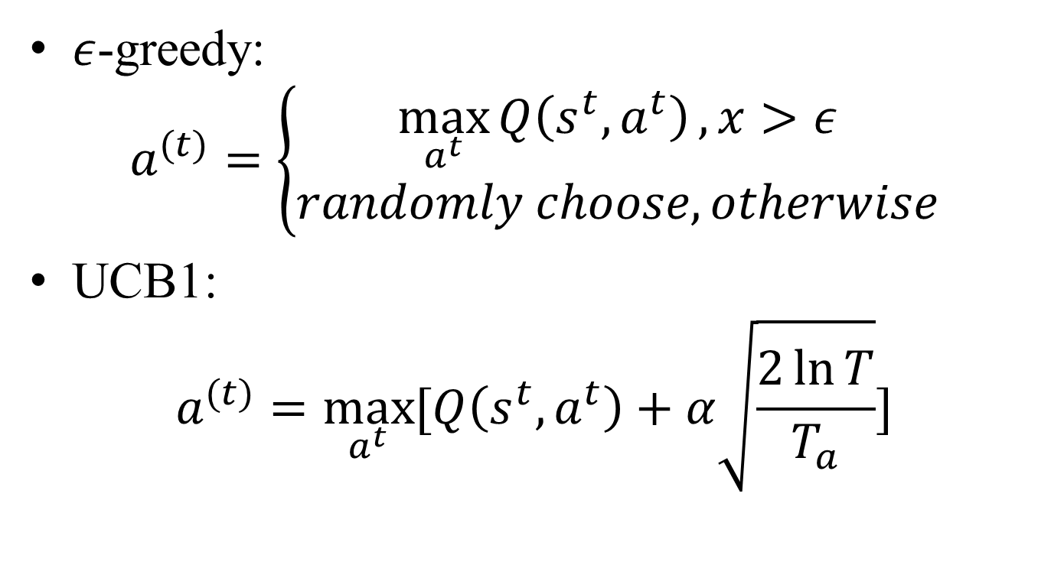
Exploration
$ε$-greedy: $a^{(t)}=\left\{\begin{aligned}\max_{a^{t}}{Q\left(s^{t},a^{t}\right)}, x>ε \\ randomly choose, otherwise\end{aligned}\right.$
UCB1: $a^{(t)}=\max_{a^{t}}{[Q\left(s^{t},a^{t}\right)+α\sqrt{\frac{2\ln{T}}{T_{a}}}]}$

Slide 14
Proposed Framework
Input
Hand of player1
52d
128d
128d
128d
Predict Cost 1
36d
Bid = UCB1(a)
Bid history
36d
Bid Layer

Slide 15

Proposed Framework
Stochastic gradient descent
$$L(θ)$$
Input
Hand 52d
Bid
Layer 1
Bid
Layer 2
Bid
Layer N
Target
Cost
36d
Predict Cost
36d
. . .
Bid history
36d
N = 2,3,4,5,6

Slide 16
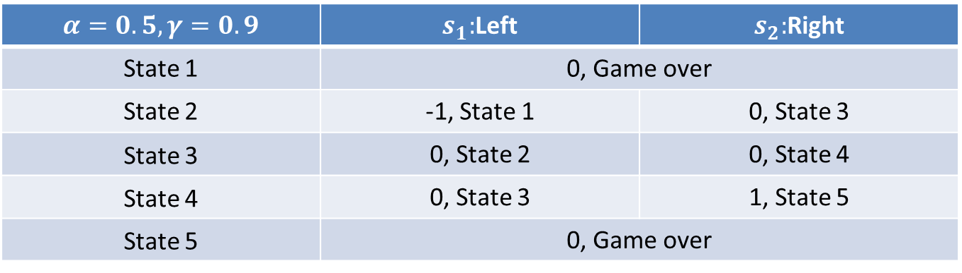
Penetrative Bellman equation
$$α=0.5, γ=0.9$$ | $s_{1}:$Left | $s_{2}:$Right
State 1 | 0, Game over | 0
State 2 | -1, State 1 | 0, State 3
State 3 | 0, State 2 | 0, State 4
State 4 | 0, State 3 | 1, State 5
State 5 | 0, Game over | Game over
$$Q^{new}\left(s_{t},a_{t}\right)←\left(1−α\right)Q^{old}\left(s_{t},a_{t}\right)+α(r_{t}+γ\max_{a}{Q(s_{t+1},a)})$$
1 | 2 | 3 | 4 | 5
$$\max_{a} Q^{\left(i\right)}\left(s,a\right)=\max_{a} Q^{\left(i+t\right)}\left(s^{(t)},a^{∗(t)} | s,a\right)$$
-1
1
3
1
2
4
5

Slide 17
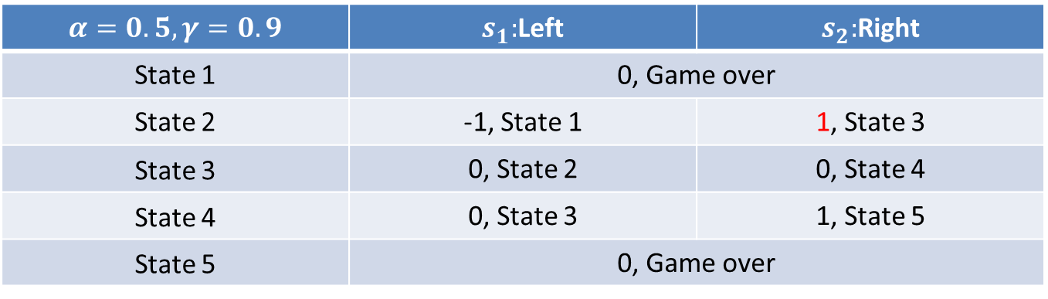
Penetrative Bellman equation
$$α=0.5, γ=0.9$$ | $s_{1}:$Left | $s_{2}:$Right
State 1 | 0, Game over | 0
State 2 | -1, State 1 | 1, State 3
State 3 | 0, State 2 | 0, State 4
State 4 | 0, State 3 | 1, State 5
State 5 | 0, Game over | Game over
$$Q^{new}\left(s_{2},a_{2}\right)←0×0+1(0+1(0+1×1))$$
1 | 2 | 3 | 4 | 5
$$\max_{a} Q^{\left(i\right)}\left(s,a\right)=\max_{a} Q^{\left(i+t\right)}\left(s^{(t)},a^{∗(t)} | s,a\right)$$
-1
1
3
2
5
1
1
4

Slide 18

Penetrative Bellman equation
$$α=0.5, γ=0.9$$ | $s_{1}:$Left | $s_{2}:$Right
State 1 | 0, Game over | 0
State 2 | -1, State 1 | 1, State 3
State 3 | 0, State 2 | 1, State 4
State 4 | 0, State 3 | 1, State 5
State 5 | 0, Game over | Game over
$$Q^{new}\left(s_{3},a_{2}\right)←0×0+1(0+1×1)$$
1 | 2 | 3 | 4 | 5
$$\max_{a} Q^{\left(i\right)}\left(s,a\right)=\max_{a} Q^{\left(i+t\right)}\left(s^{(t)},a^{∗(t)} | s,a\right)$$
-1
1
3
1
2
5
1
1
4

Slide 19
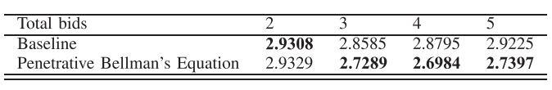
Penetrative Bellman equation
Exploration: UCB1

Slide 20
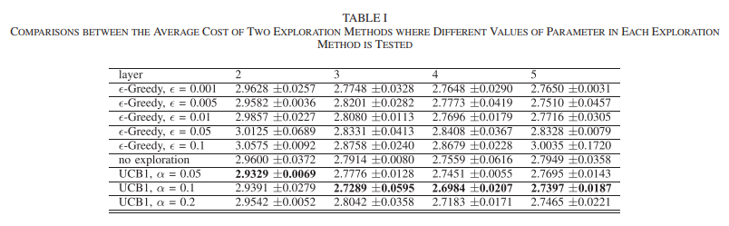
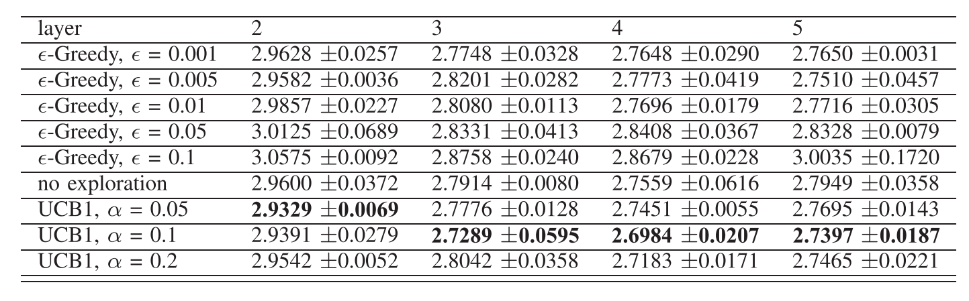
Exploration

Slide 21
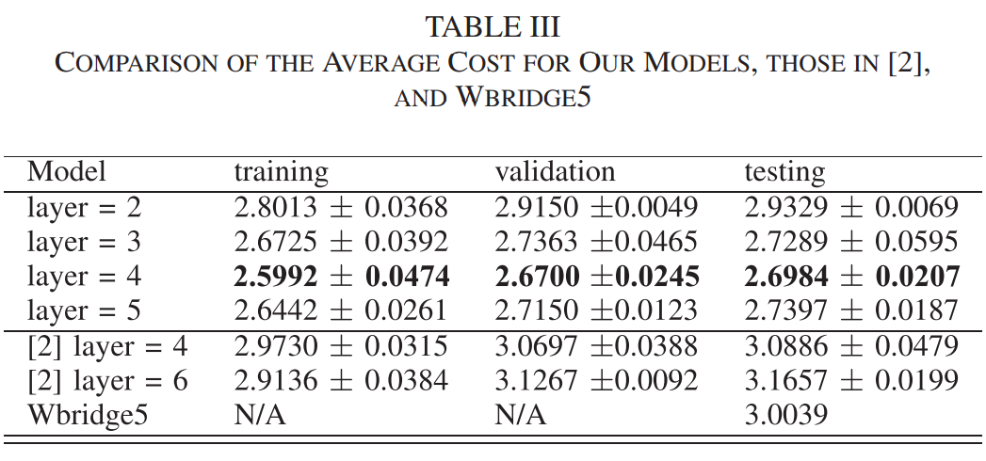
Comparison With the State of the Art

