Slide 1
Improvised Divide and Conquer Approach for the LIS Problem
Seema Rani and Dr. Dharmveer Singh Rajpoot
Journal of Discrete Algorithms
Volume 48, January 2018, Pages 17-26
Presenter: Shin-Cheng Lin
Date: Apr. 27, 2021

Slide 2
Abstract
There exist many optimal (using single and multiple processors) and approximate solutions to the longest increasing subsequence (LIS) problem. Through this paper, we present the enhancement to the divide-and-conquer approach presented in paper[6]. An improved D&C algorithmic solution is proposed which outputs optimal solution in all cases. The proposed algorithm takes O(n log n) time in best and average cases and o(n log²n) time in worst case. The portion of the proposed solution can run in parallel using multiprocessors.

Slide 3
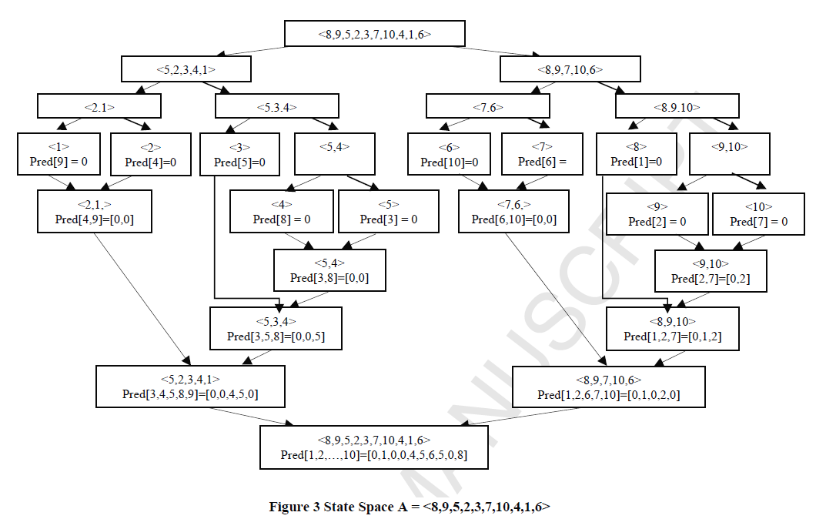

Slide 4
Divide
Pair<value, index>
X=<4, 2, 5, 1, 3>
X_{sorted}=<1, 2, 3, 4, 5>
X_{sorted}[5/2]= X_{sorted}[2]= 2
X₁=<(2,2), (1,4)>
X₂=<(4,1), (5,3), (3,5)>

Slide 5
Divide
Pair<value, index>
X=<4, 2, 2, 1, 3, 2>
X_{sorted}=<1, 2, 2, 2, 3, 4>
X_{sorted}[6/2]= X_{sorted}[3]= 2
X₁=<(2,2), (2,3), (1,4)>
X₂=<(4,1), (3,5), (2,6)>

Slide 6
Merge
Pair<value, index>
<(2,4), (1,9)> and <(5,3), (3,5), (4,8)>
Pred[4,9]=[0,0] and Pred[3,5,8]=[0,0,5]
Pred[3,4,5,8,9]=[0,0,0,5,0]
<(5,3), (2,4), (3,5), (4,8), (1,9)>
1.<(5,3)>
2.<(2,4)>
3.<(2,4), (3,5)>, pred[5]=4
4.<(2,4), (3,5), (4,8)>
5.<(1,9), (3,5), (4,8)>
Pred[3,4,5,8,9]=[0,0,4,5,0]

Slide 7
Merge
Pair<value, index>
<(7,6), (6,10)> and <(8,1), (9,2), (10,7)>
Pred[6,10]=[0,0] and Pred[1,2,7]=[0,1,2]
Pred[1,2,6,7,10]=[0,1,0,2,0]
<(8,1), (9,2), (7,6), (10,7), (6,10)>
1.<(8,1)>
2.<(8,1), (9,2)>
3.<(7,6), (9,2)>
4.<(7,6), (9,2), (10,7)>
5.<(6,10), (9,2), (10,7)>
Pred[1,2,6,7,10]=[0,1,0,2,0]

Slide 8
Time complexity
T(n)=2T(n/2)+O(n logn)
O(n log²n)

