Slide 1
Neural Networks and the Estimation of Hands’ Strength in Contract Bridge
Krzysztof Mossakowski and Jacek Ma´ndziuk
Intelligence and Soft Computing - ICAISC 2006, 8th International Conference, Zakopane, Poland, June 25-29, 2006
Presenter: Jing-Ping Jan
Date: July 6, 2021

Slide 2
Abstract
This paper is focused on a Double Dummy Bridge Problem (DDBP) which consists in answering the question of how many tricks are to be taken by a pair of players assuming perfect play of all four sides with all cards being revealed. Several experiments are also presented in a variant of DDBP in which the information about to whom of the two players in a given pair a particular card belongs to is hidden. In contrast to our previous works, which were devoted to no trump contracts, here we concentrate on suit contracts. Several interesting conclusions are drawn from comparison of weight patterns of networks trained on no trump contracts only vs. those trained exclusively on suit contracts.

Slide 3
Abstract
The ultimate goal of this research is to construct a computer program playing the game of contract bridge using neural networks and other CI techniques with the basic assumption of using zero-human-knowledge approach and to learn purely on examples.

Slide 4
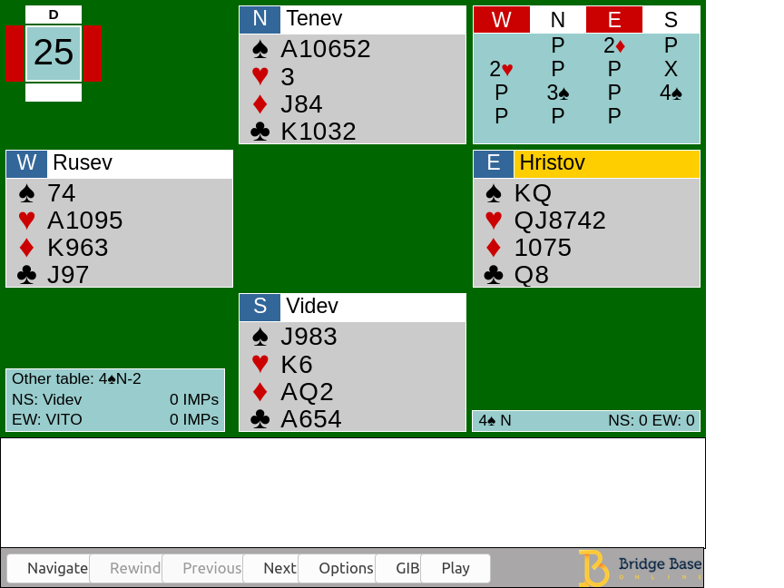
Introduction
Bidding stage Find the most profitable contract for the playing stage
Playing stage 13 rounds of a card-strength competition

Slide 5
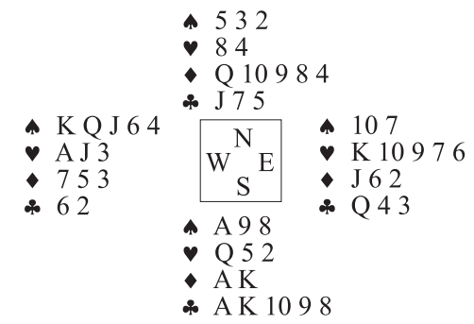
Double Dummy Bridge problem

Slide 6
Neural Network
52-1
52-25-1

Slide 7
No Trump Contracts
Data: 100,000 deals with revealed all hands from GIB Library
Network Input: (1)N1, S0.8, E-0.8, W-1 and (2)NS1, WE-1
 | <= 2 tricks | <= 1 tricks | Perfectly right
52-1(1) | 94.15 | 76.15 | 31.29
52-25-1(1) | 95.81 | 79.95 | 34.02
52-25-1(2) | 96.07 | 80.88 | 34.66
104-1(2) | 94.76 | 77.52 | 32.19
104-30-4-1(2) | 95.64 | 79.63 | 33.74
HCP*13/40 | 86.19 | 61.32 | 22.52

Slide 8
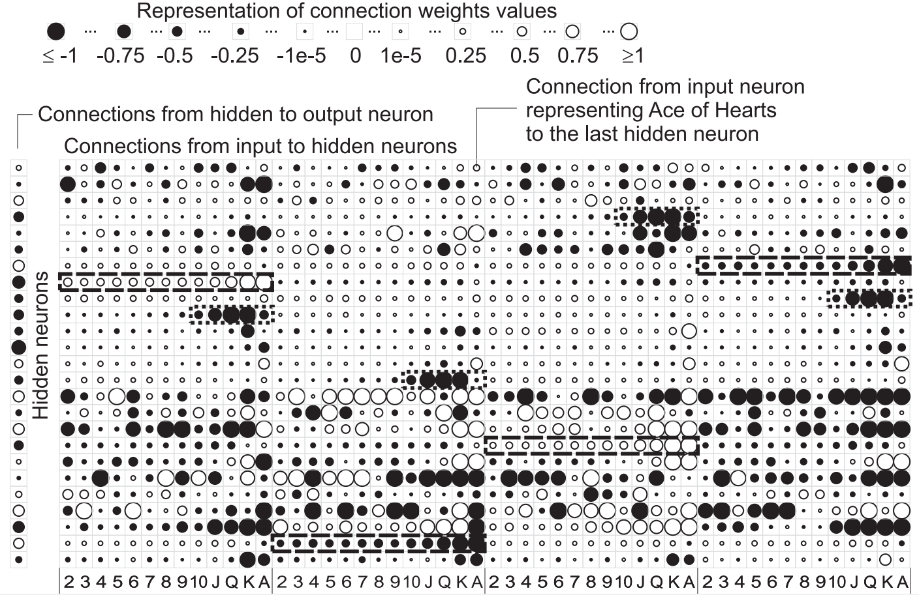
No Trump Contracts

Slide 9
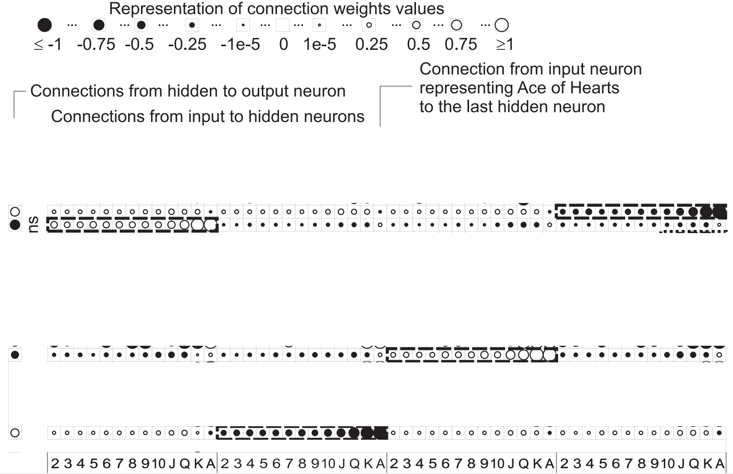
No Trump Contracts

Slide 10
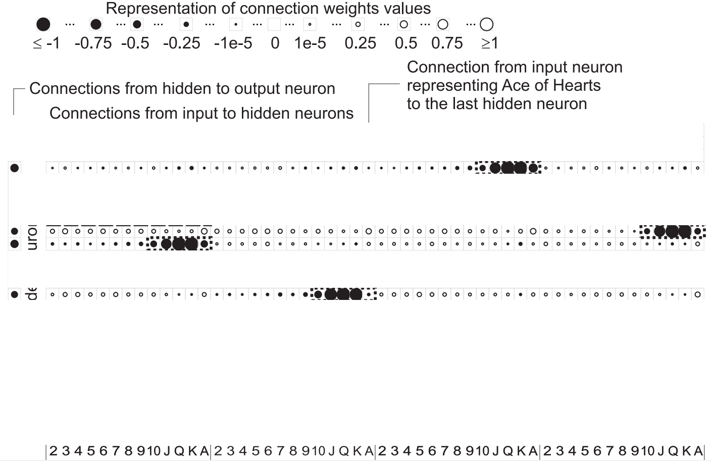
No Trump Contracts

Slide 11
Suit Contracts
Data: 100,000 deals with revealed all hands from GIB Library
Network Input: Cards of the trump suit had input values equal to 1.0 for players N, S or −1.0 for players W, E. Cards of other suits: 0.5 for N, S and −0.5 for W, E.

Slide 12
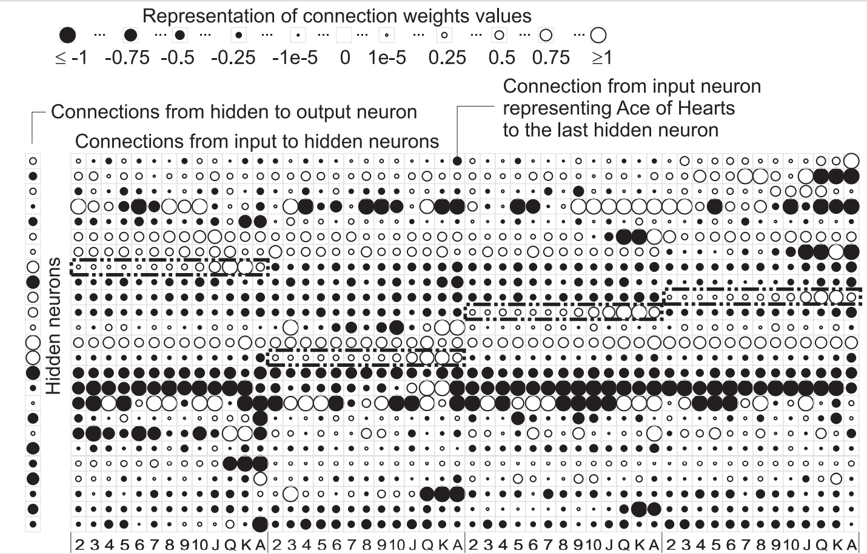
Suit Contracts

Slide 13
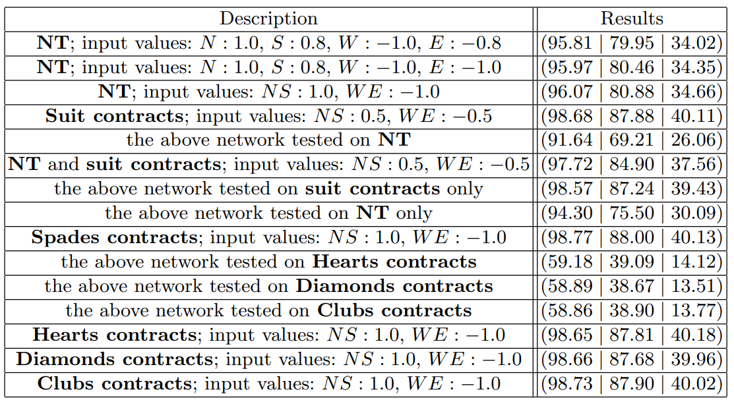
Results

Slide 14
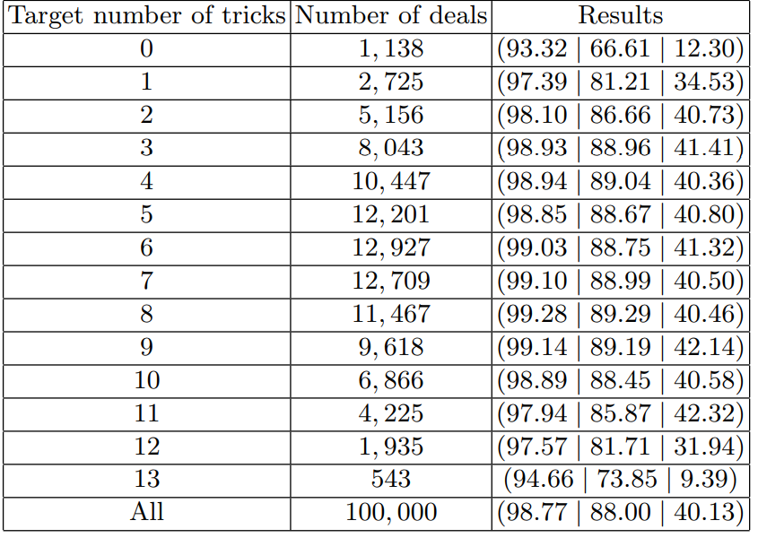
Results

